Slide 1

UNIT 8:IN OUR CLASSROOM
LESSON 1 (4, 5, 6)
Made by: Nguyen Thi Thu Phuong

Slide 2

Let's play
Kim’s game

Slide 3
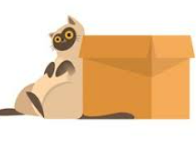
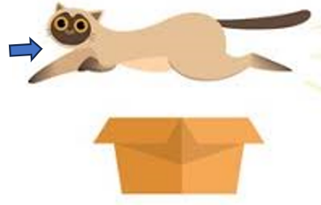
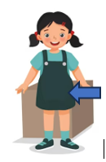
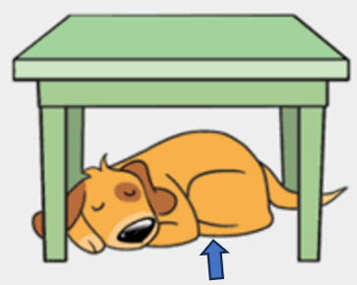
LET’S PLAY: KIM’S GAME
0:0
0:3
0:2
0:5
0:4
0:1
Start
beside
above
under
in front of

Slide 4
Check and read
above
beside
under
in front of

Slide 5
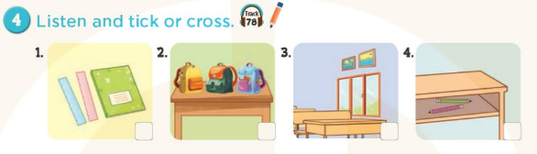




Slide 6
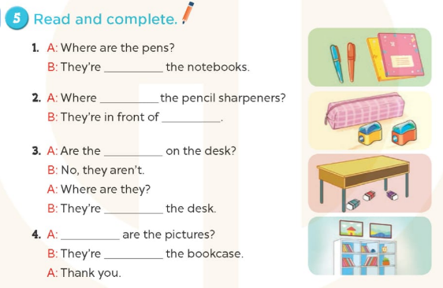

Slide 7
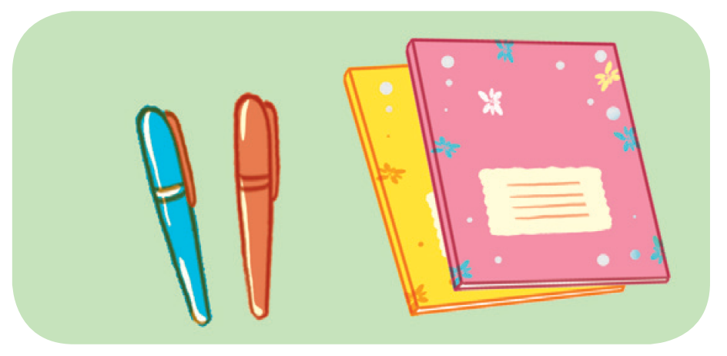
5. Read and complete
A: Where are the pens?
B: They’re _______ the notebook.
beside

Slide 8
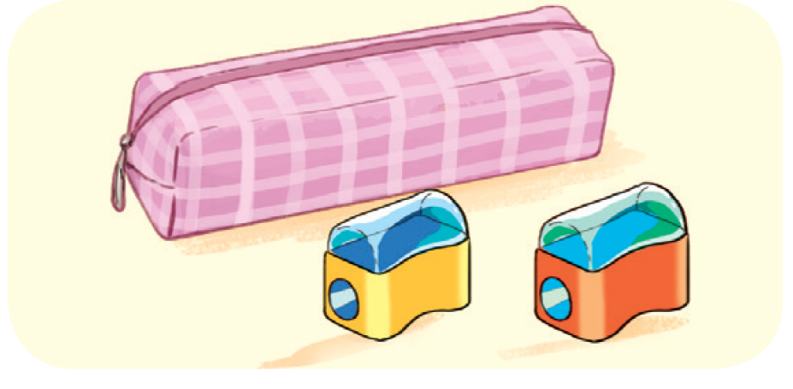
5. Read and complete
2. A: Where ____ the pencil sharpeners?
B: They’re in front of _______________.
are
the pencil case

Slide 9
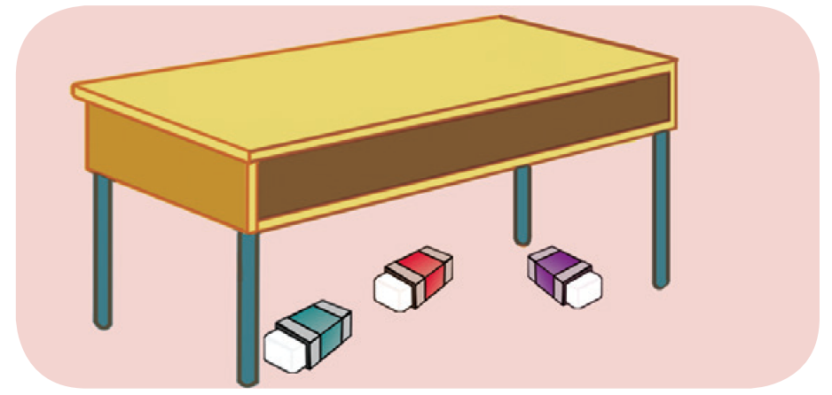
5. Read and complete
3. A: Are the _______ on the desk?
B: No, they aren’t.
A: Where are they?
B: They are ______ the desk.
erasers
under

Slide 10
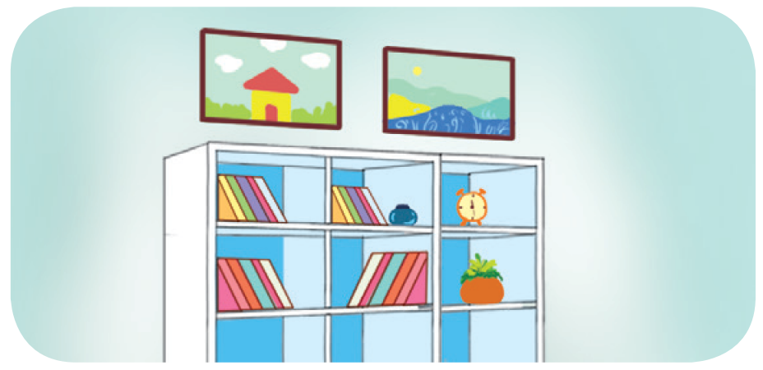
5. Read and complete
4. A: _______ are the pictures?
B: They’re _______ the bookcase.
A: Thank you.
Where
above

Slide 11
beside
are
the pencil case
erasers
under
Where
above

Slide 12
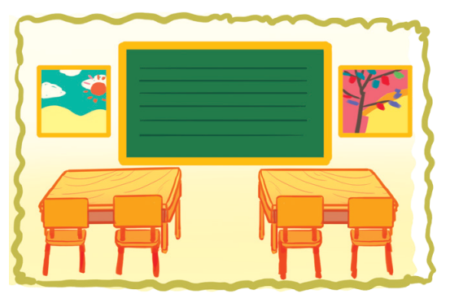
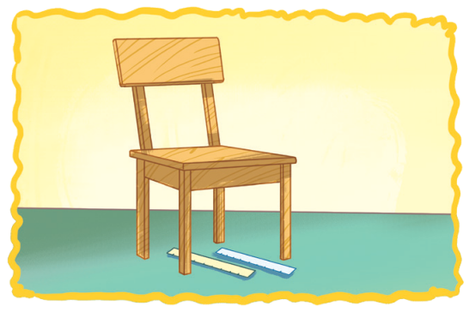
6. Let’s sing
WHERE ARE THEY?
Pictures, pictures, pictures.
Where are the pictures?
Beside the board.
Beside the board.
They’re beside the board.
Rulers, rulers, rulers.
Where are the rulers?
Under the chair.
Under the chair.
They’re under the chair.

Slide 13




PLAY GAME
Choose the best answer
Notes:
Step 2: Have groups put the posters on the desk and practice the presentation. Encourage all members in the group to present. Go around the classroom and offer help where necessary.

Slide 14

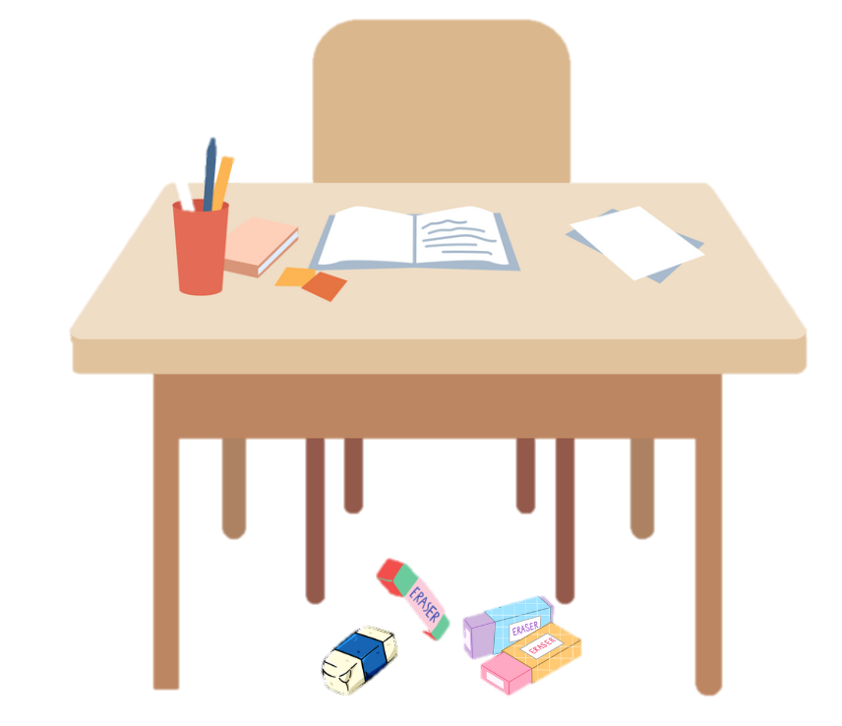

READ and CHOOSE the correct answer.
under
beside
Where are erasers?
above
They’re ______ the desk.

Slide 15
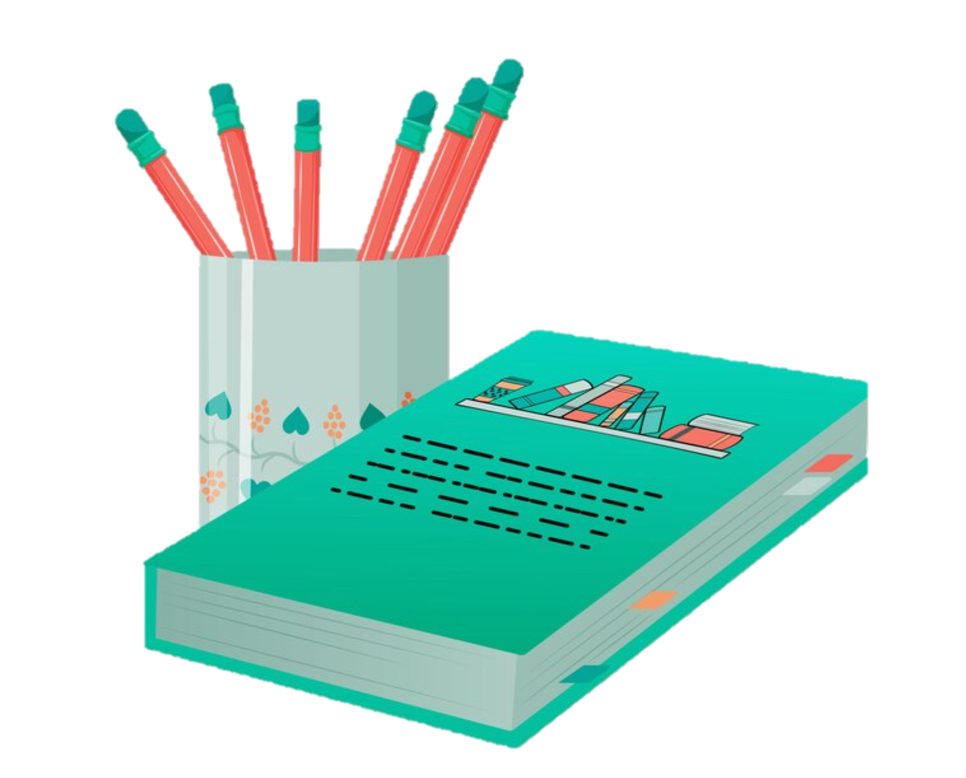
READ and CHOOSE the correct answer.
under
above
Where are the pencils?
beside
They’re _____ the book.

Slide 16
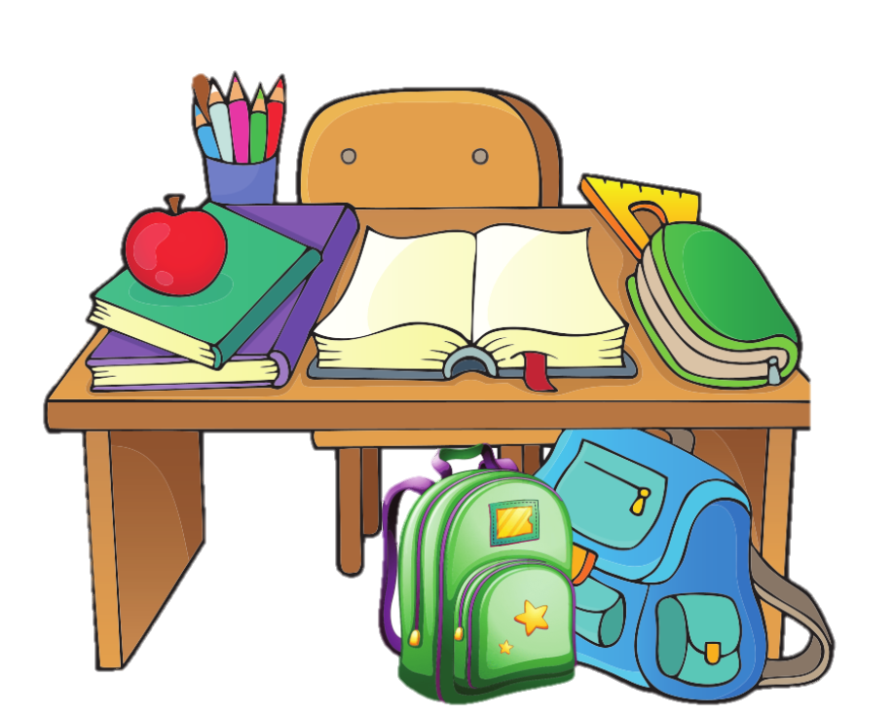
READ and CHOOSE the correct answer.
under
above
Where are school bags?
on
They’re _____ the desk.

Slide 17
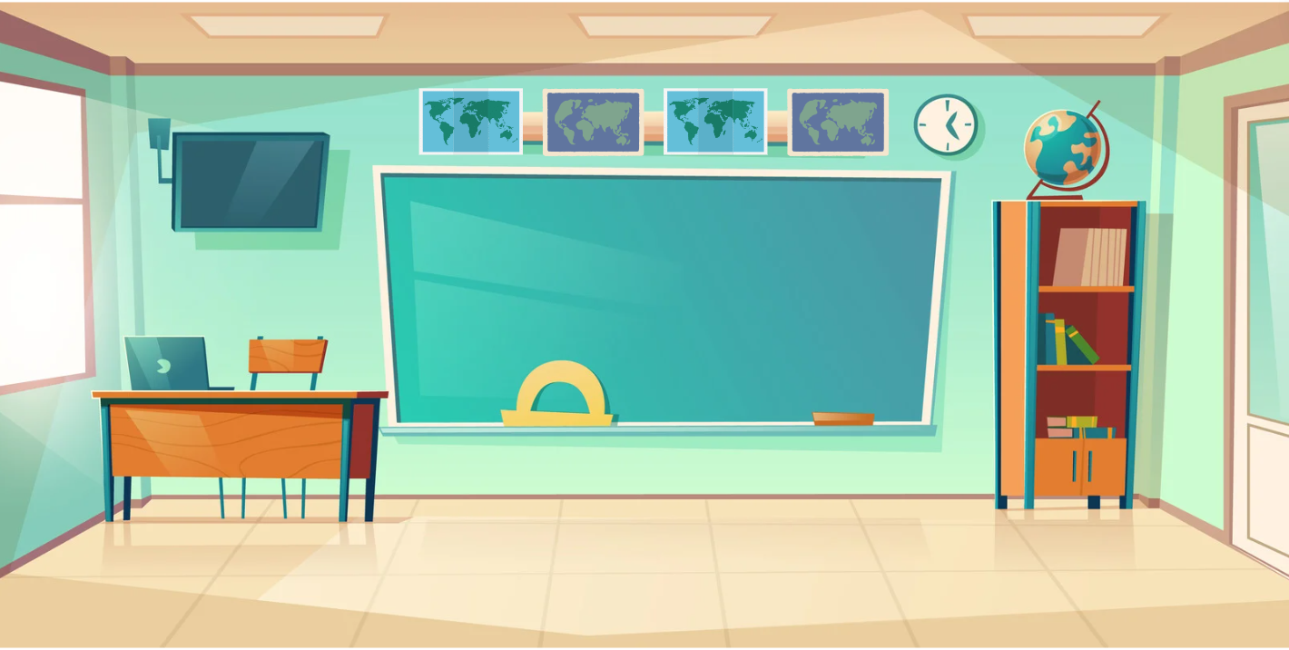
READ and CHOOSE the correct answer.
under
above
Where are maps?
in front of
They’re _____ the board.

Slide 18
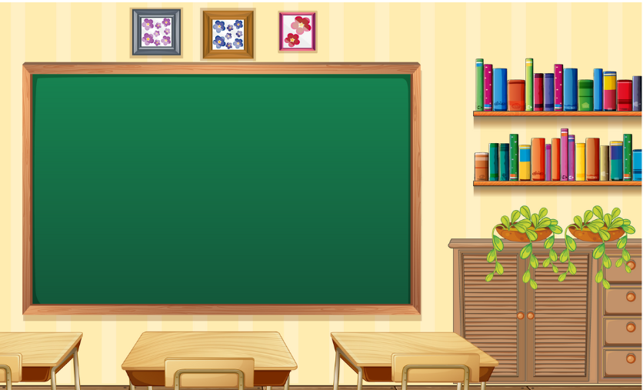
READ and CHOOSE the correct answer.
above
in front of
Where is the bookshelf?
beside
It’s _____ the board.

Slide 19
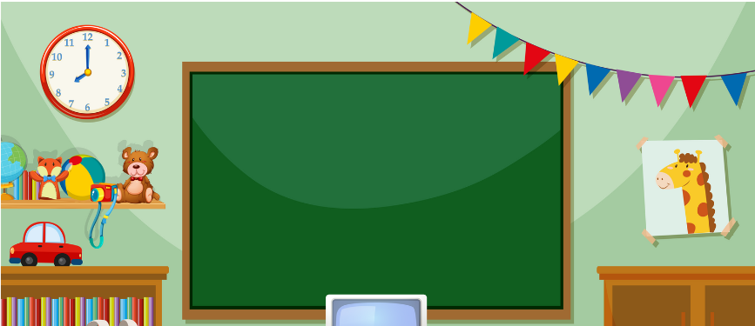
READ and CHOOSE the correct answer.
beside
above
Where is the clock?
on
It’s _____ the shelf.

Slide 20
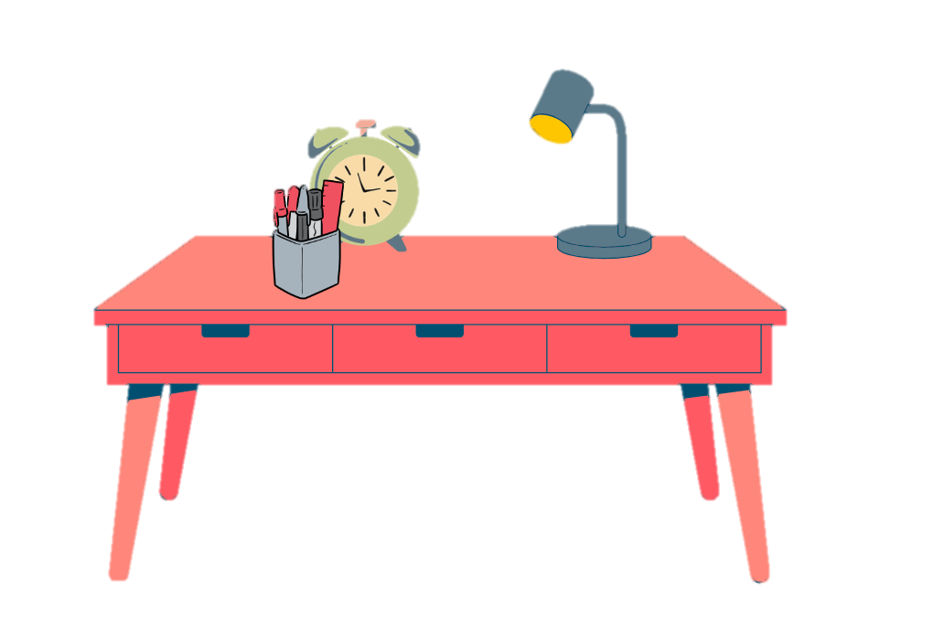
READ and CHOOSE the correct answer.
under
in front of
Where are pens?
beside
They’re _____ the clock.

Slide 21
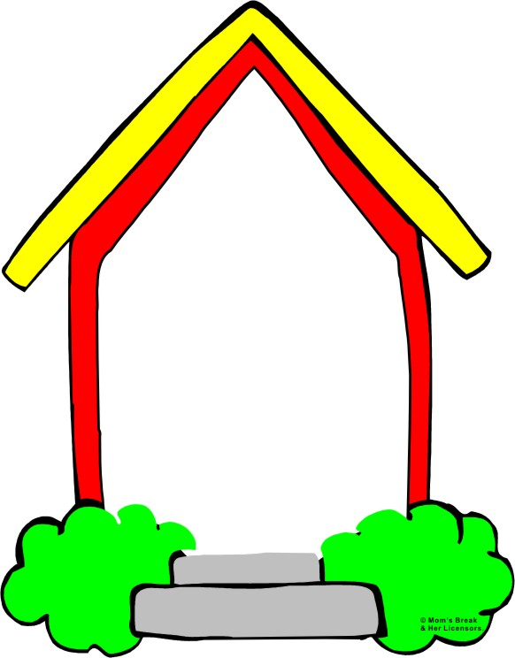

Homework:
- Practice more at home
- Prepare Unit 8- Lesson 2 ( 1, 2, 3)

