Slide 1
Made by: Teacher: Nguyen Thi Thu Phuong
UNIT 8: IN OUR CLASSROOM
LESSON 2 ( 1, 2, 3)

Slide 2





Warm-up

Slide 3

LET’S PLAY
SLAP THE BOARD

Slide 4


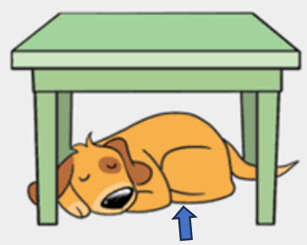

Slap the board

Slide 5
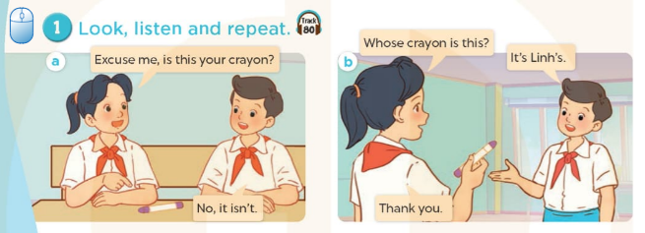


Slide 6
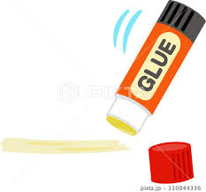
glue stick /ɡluː stɪk/keo dán

Slide 7
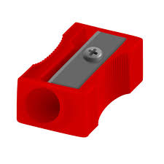
pencil sharpener /ˈpensl ʃɑːpnə(r)/
cái gọt bút chì

Slide 8
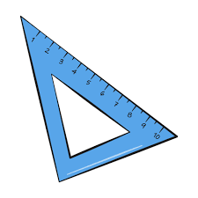
set square /ˈset skweə(r)/
thước ê-ke

Slide 9

crayon/ˈkreɪən/bút sáp màu

Slide 10

VOCABULARY
Glue stick: keo dán
Pencil sharpener: gọt bút chì
Set square: thước ê –ke
Crayon: bút sáp màu

Slide 11
Let's play
WHAT’S MISSING?

Slide 12

Set square
?

Slide 13
Pencil sharpener

Slide 14
crayon
?

Slide 15
?
Glue stick

Slide 16
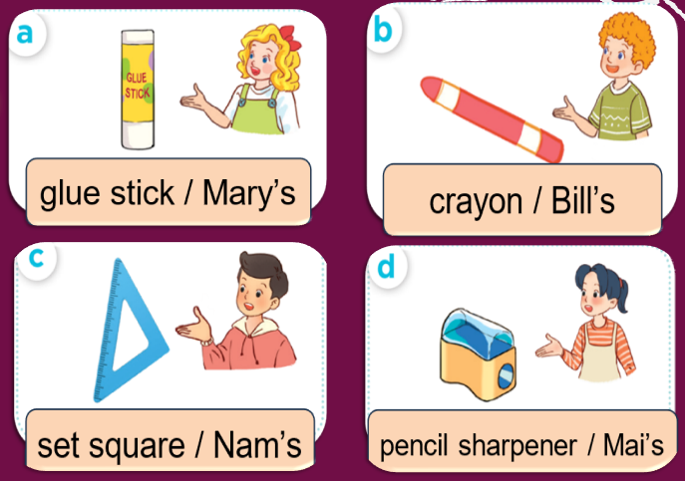
2.Listen, point and say
glue stick
Whose....................... is this?
Mary’s
It’s…..................

Slide 17
Whose glue stick is this?
( Hồ dán này là của ai vậy? )
It’s Mary’s.
(Là của Mary.)

Slide 18
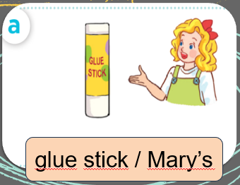
glue stick
Whose....................... is this?
Mary’s
It’s…..................

Slide 19
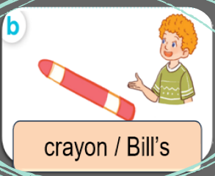
crayon
Whose....................... is this?
Bill’s
It’s…..................

Slide 20
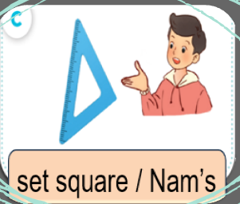
set square
Whose....................... is this?
Nam’s
It’s…..................

Slide 21
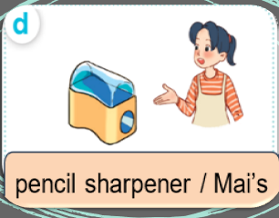
pencil sharpener
Whose.............................. is this?
Mai’s
It’s…..................

Slide 22
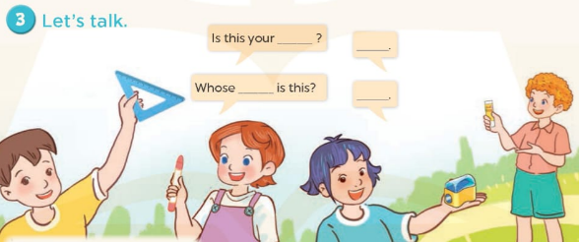

Slide 23


Let's play

Slide 24

LET’S PLAY
50
10
20
30
MAGIC WHEEL
10
20
30
40
Spin
PLAY
LUẬT CHƠI
Nhấn nút để quay.
Trả lời đúng câu hỏi sẽ được cộng số điểm tương ứng vị trí mũi tên dừng.
Kết thúc trò chơi đội cao điểm hơn sẽ chiến thắng.
Spin

Slide 25
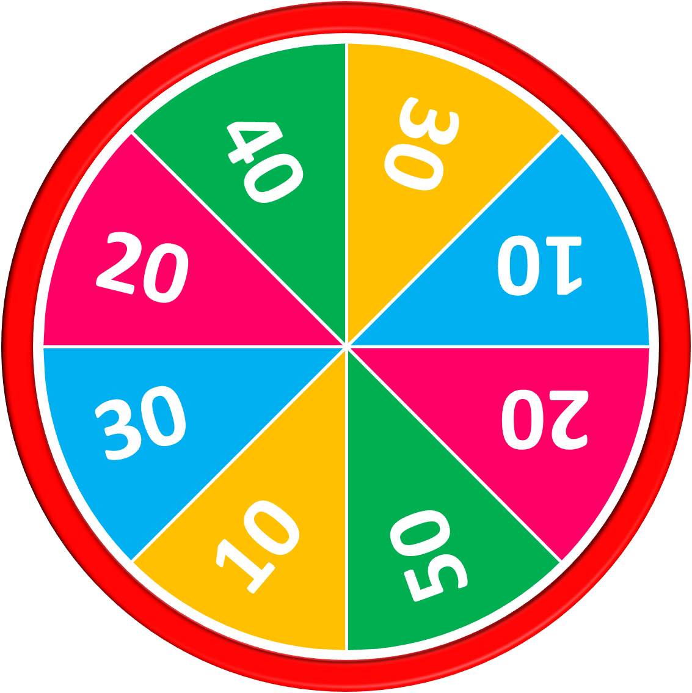
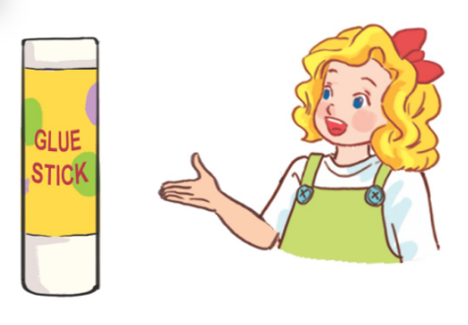
Whose glue stick is this? – It’s.........….
50
10
20
30
10
20
Answer
30
40
Mary’s
Spin
Stop

Slide 26
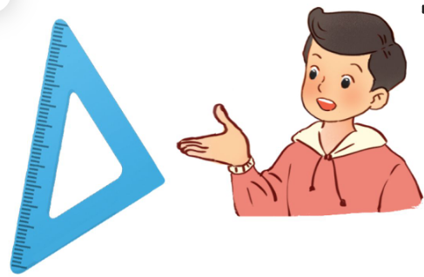
Whose set square is this? – It’s.........….
50
10
20
30
10
20
30
40
Answer
Nam’s
Stop
Spin

Slide 27
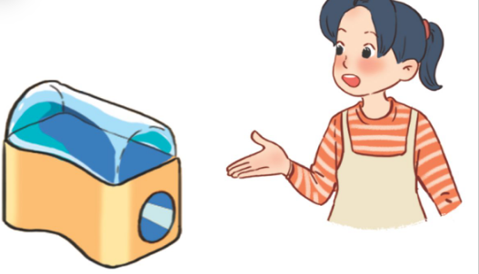
Whose pencil sharpener is this? – It’s.........….
50
10
20
30
10
20
30
40
Answer
Mai’s
Stop
Spin

Slide 28

Whose crayon is this? – It’s.........….
50
10
20
30
10
20
30
40
Answer
Bill’s
Stop
Spin

Slide 29

50
10
20
30
10
20
30
40
Exit

Slide 30
SUMMARY
1.Vocabulary:
Glue stick: keo dán
Pencil sharpener: gọt bút chì
Set square: thước ê –ke
Crayon: bút sáp màu
2. Sentence pattern:
-Whose pencil is this?
(Cây bút chì này là của ai vậy?
-> It’s Mary
(Là của Mary.)

