Slide 1
UNIT 8: IN OUR CLASSROOM
LESSON 2 ( 4, 5, 6)
Made by: Teacher: Nguyen Thi Thu Phuong

Slide 2





WARM UP

Slide 3




PLAY GAME
LUCKY FLOWERS
Notes:
Step 2: Have groups put the posters on the desk and practice the presentation. Encourage all members in the group to present. Go around the classroom and offer help where necessary.

Slide 4












Slide 5




Whoe _______ is this?
glue stick
Nga
It’s _____
Nga’s

Slide 6


Whose__________ is this?
pencil sharpener
Minh
It’s _____
Minh’s

Slide 7


Whose _______ is this?
crayon
Long
It’s _____
Long’s

Slide 8


Whose _______ is this?
pencil case
Hoa
It’s _____
Hoa’s

Slide 9

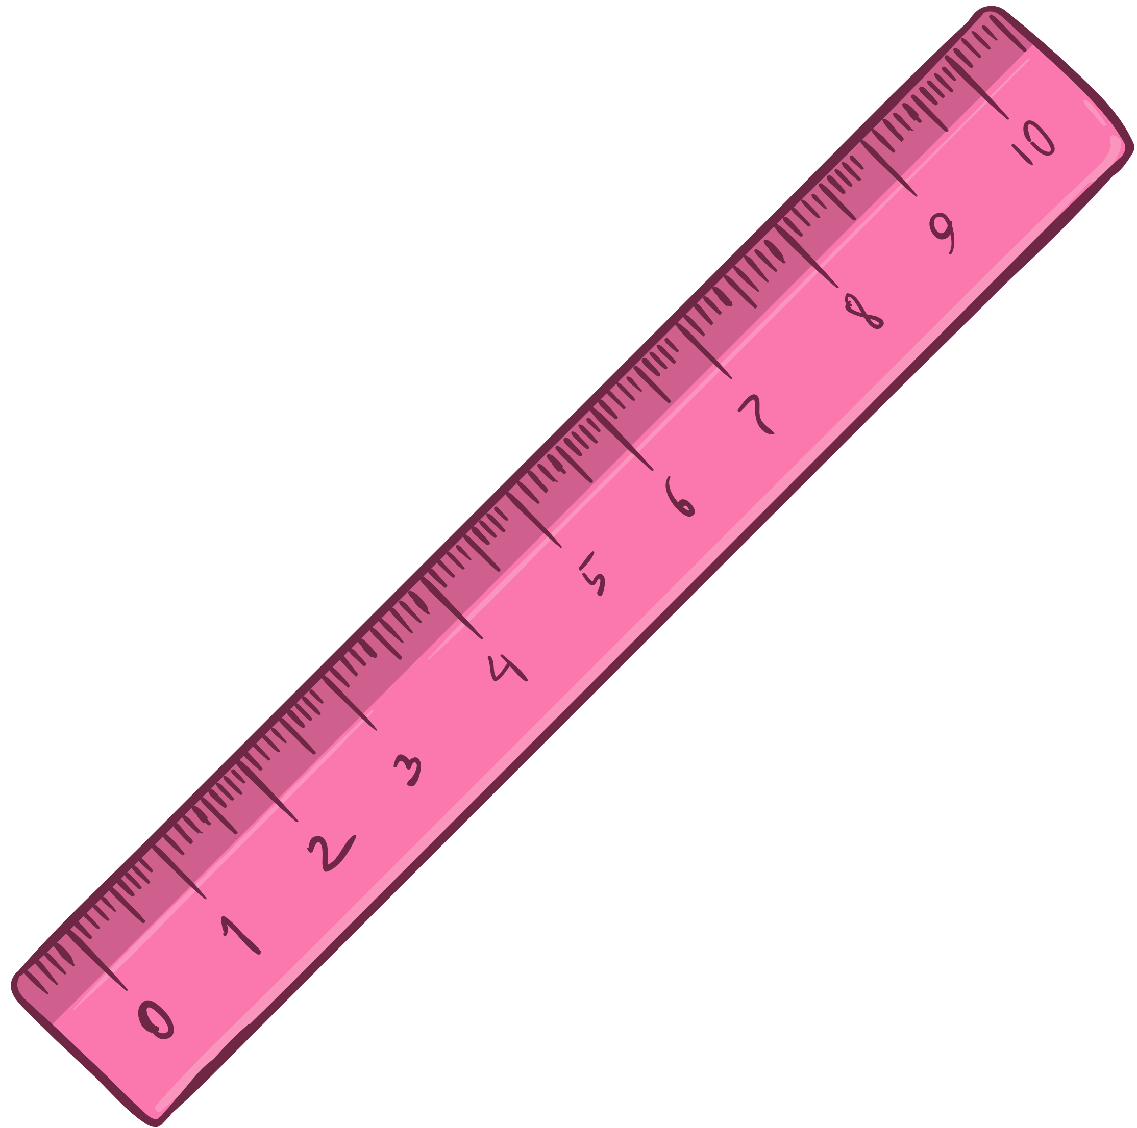
Whose _______ is this?
ruler
Ben
It’s _____
Ben’s

Slide 10


Whose _______ is this?
set square
Lan
It’s _____
Lan’s

Slide 11
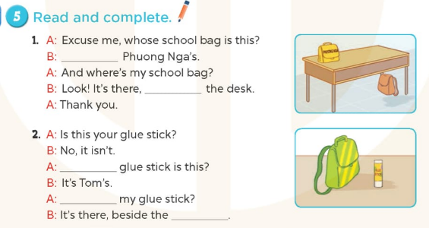
It’s
under
Whose
Where
school bag

Slide 12
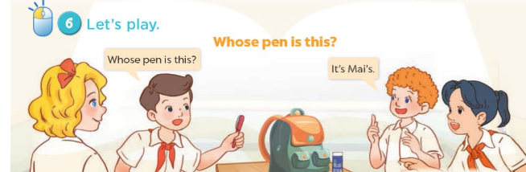

Slide 13

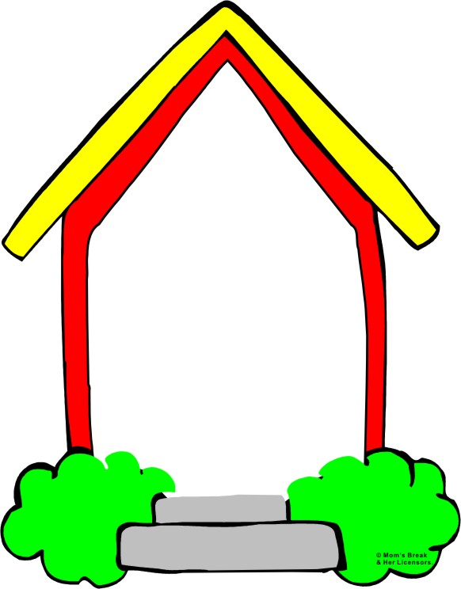
Homework:
- Practice more at home
- Prepare Unit 8- Lesson 3 ( 1, 2, 3)

