Slide 1


Slide 2
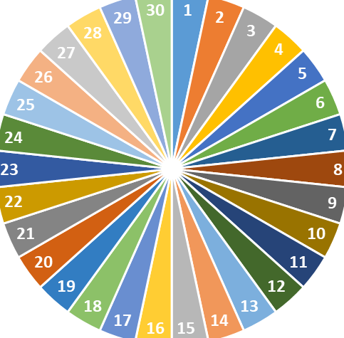
Check out the old lesson by spinning the wheel to call out the name
GV THAY DS HS LỚP CỦA MÌNH DẠY

Slide 3


WARM-UP
PELMANISM
1
2
3
4
5
6
hard
fast
much
carefully
long
quickly
7
8
9
10
11
12
more
more quickly
harder
more carefully
faster
longer

Slide 4
WARM-UP
PELMANISM
hard
fast
much
long
carefully
quickly
harder
faster
more
longer
more carefully
more quickly

Slide 5

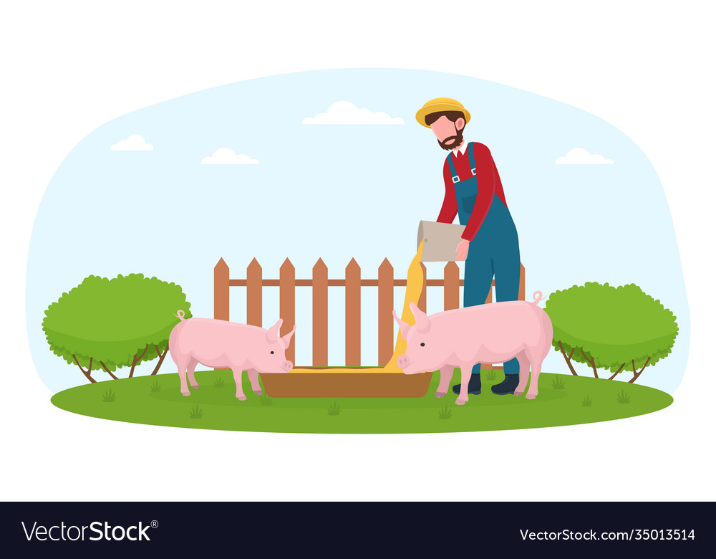
Unit
2
LIFE IN THE COUNTRYSIDE
LESSON 3: A CLOSER LOOK 2
The comparative forms of the adverbs

Slide 6
The comparative forms of the adverbs
– For most adverbs (often with two or more syllables), we make comparative forms by adding more.
Example:
slowly → more slowly
carefully → more carefully
– For adverbs that have the same forms as adjectives like fast, hard, soon, etc., we make comparative forms by adding -er.
Example:
fast → faster
hard → harder
– Some irregular adverbs:
well → better
badly → worse

Slide 7
COMPARATIVE ADVERBS
(So sánh hơn của trạng từ)
- Hầu hết các trạng từ (thường nhiều hơn hai âm tiết), chúng ta hình thành dạng so sánh hơn bằng cách thêm “more”: S + V + more + trạng từ dài
Example:
slowly → more slowly
carefully → more carefully
- Với những trạng từ có hình thức giống như tính từ như fast (nhanh), hard (khó/ chăm chỉ/ vất vả), soon (sớm),… chúng ta hình thành dạng so sánh hơn bằng cách thêm –ER :
S + V + trạng từ ngắn - ER
Example:
fast → faster
hard → harder
-
Một số trạng từ bất quy tắc:
well -> better
badly -> worse

Slide 8
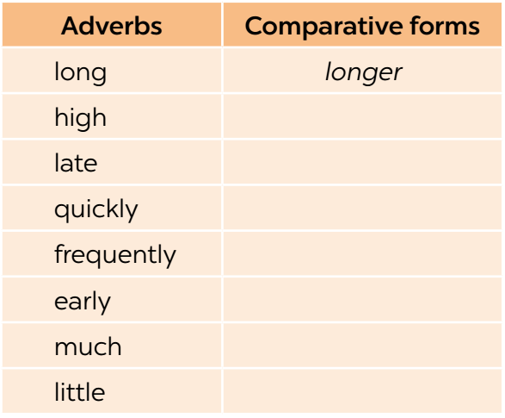
1
Write the comparative forms of the adverbs in the table below.
higher
later
more quickly
more frequently
earlier
more
less

Slide 9
2
Complete the sentences with the comparative forms of the adverbs in brackets.
1. Mai dances (beautifully) _______________ than Hoa does.
2. Please write (clearly) _____________. I can’t read it.
3. Life in the city seems to move (fast) _____ than that in the countryside.
4. If you want to get better marks, you must work much (hard) ______.
5. Today it’s raining (heavily) ____________ than it was yesterday.
more beautifully
more clearly
faster
harder
more heavily

Slide 10
3
Complete the sentences with suitable comparative forms of the adverbs from the box.
early soundly fast carefully quietly
1. After his accident last month, he is driving _____________ now.
2. A horse can run ______ than a buffalo.
3. You’re too loud. Can you speak a bit ____________?
4. After working hard all day on the farm, we slept ____________ than ever before.
5. The farmers started harvesting their crops ______ than expected.
Game

Slide 11


LUCKY NUMBERS
1
2
3
4
5
6
7
8
GA
2
4
6
8
10
12
14
GB
2
4
6
8
10
12
14

Slide 12
3
Complete the sentences with suitable comparative forms of the adverbs from the box.
early soundly fast carefully quietly
1. After his accident last month, he is driving _____________ now.
2. A horse can run ______ than a buffalo.
3. You’re too loud. Can you speak a bit ____________?
4. After working hard all day on the farm, we slept ____________ than ever before.
5. The farmers started harvesting their crops ______ than expected.
more carefully
faster
more quietly
more soundly
earlier

Slide 13
3
Complete the sentences with suitable comparative forms of the adverbs from the box.
early soundly fast carefully quietly
1. After his accident last month, he is driving _____________ now.
2. A horse can run ______ than a buffalo.
3. You’re too loud. Can you speak a bit ____________?
4. After working hard all day on the farm, we slept ____________ than ever before.
5. The farmers started harvesting their crops ______ than expected.
more carefully
faster
more quietly
more soundly
earlier

Slide 14
3
Complete the sentences with suitable comparative forms of the adverbs from the box.
early soundly fast carefully quietly
1. After his accident last month, he is driving _____________ now.
2. A horse can run ______ than a buffalo.
3. You’re too loud. Can you speak a bit ____________?
4. After working hard all day on the farm, we slept ____________ than ever before.
5. The farmers started harvesting their crops ______ than expected.
more carefully
faster
more quietly
more soundly
earlier

Slide 15
3
Complete the sentences with suitable comparative forms of the adverbs from the box.
early soundly fast carefully quietly
1. After his accident last month, he is driving _____________ now.
2. A horse can run ______ than a buffalo.
3. You’re too loud. Can you speak a bit ____________?
4. After working hard all day on the farm, we slept ____________ than ever before.
5. The farmers started harvesting their crops ______ than expected.
more carefully
faster
more quietly
more soundly
earlier

Slide 16
3
Complete the sentences with suitable comparative forms of the adverbs from the box.
early soundly fast carefully quietly
1. After his accident last month, he is driving _____________ now.
2. A horse can run ______ than a buffalo.
3. You’re too loud. Can you speak a bit ____________?
4. After working hard all day on the farm, we slept ____________ than ever before.
5. The farmers started harvesting their crops ______ than expected.
more carefully
faster
more quietly
more soundly
earlier

Slide 17



Slide 20
3
Complete the sentences with suitable comparative forms of the adverbs from the box.
early soundly fast carefully quietly
1. After his accident last month, he is driving _____________ now.
2. A horse can run ______ than a buffalo.
3. You’re too loud. Can you speak a bit ____________?
4. After working hard all day on the farm, we slept ____________ than ever before.
5. The farmers started harvesting their crops ______ than expected.
more carefully
faster
more quietly
more soundly
earlier

Slide 21
4
Read the situations and complete the sentences using the comparative forms of the adverbs in brackets.
1. The red car can run 200 km/h while the black car can run 160 km/h.
 The red car can run _______________________. (fast)
2. Nick can jump 1.5 m high while Tom can jump only 1.3 m.
Nick can jump ___________________. (high)
3. Mai and hoa both did well on the exam. Hoa got 80% of the answers correct and Mai got 90%.
Mai did ___________________________. (well)
faster than the black car
higher than Tom (can)
better on the exam than Hoa

Slide 22
4. My dad expected the workers to arrive at 7 a.m., but they arrived at 6:30 a.m.
The workers arrived __________________________. (early)
5. The buses run every 15 minutes. The trains run every 30 minutes.
 The buses run ____________________________. (frequently)
earlier than my dad expected
more frequently than the trains

Slide 23
* PRODUCTION
5
Work in pairs. Ask and answer to find out who:
– can run faster
– can jump higher
– stays up later at night
– gets up earlier in the morning
Example:
A: How fast can you run?
B: I can run 15 kilometres an hour.
A: OK, you can run faster than me.
Report your results to the class.

Slide 24
CONSOLIDATION
What have we learnt in this lesson?
How to use the comparative forms of adverbs

Slide 25

Homework
Do exercises in the workbook.
Prepair lesson4: Communication

Slide 26
* Homework
Do exercises in the workbook.
Prepare: Communication.

