Slide 1

Hello everyone !!!

Slide 2

WARM-UP
Brainstorming
2 minutes to start
RULE:
Types of pressure
- Work in 4 teams.
- In 2 minutes, write down on the posters as many types of pressure as possible
- The group with the most correct answers will be the winner.
What pressures do teenagers often face?
k

Slide 3
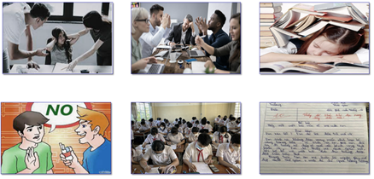

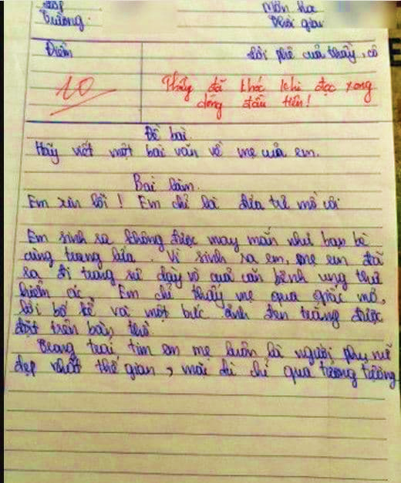

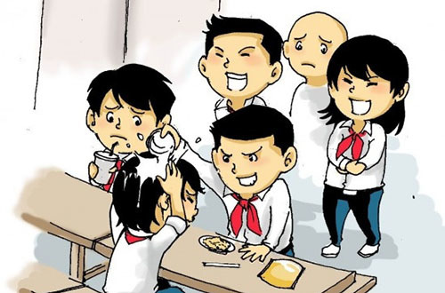
parents' expectations
homework and school (especially exams)
high score (mark)
Pressure from friends

Slide 4
What pressures do teenagers often face?
* Suggested answers:
Pressure from parents
Pressure from work
Pressure from schoolwork
Pressure from friends
Exam pressure
Pressure to get into gifted/ high schools
Pressure of getting higher marks
….

Slide 5

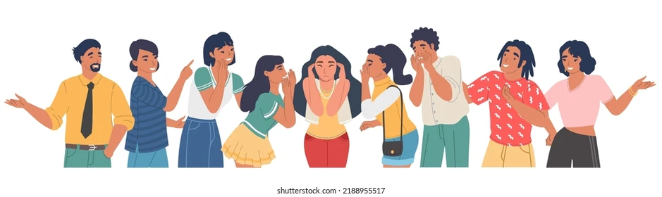
Unit
3
TEENAGERS
LESSON 6: SKILLS 2

Slide 6


* Vocabulary
parental (adj):
liên quan tới bố mẹ, thuộc bố mẹ
/pəˈrentl/

Slide 7

* Vocabulary
peer (n):
người ngang hàng, bạn đồng lứa
/pɪə(r)/

Slide 8
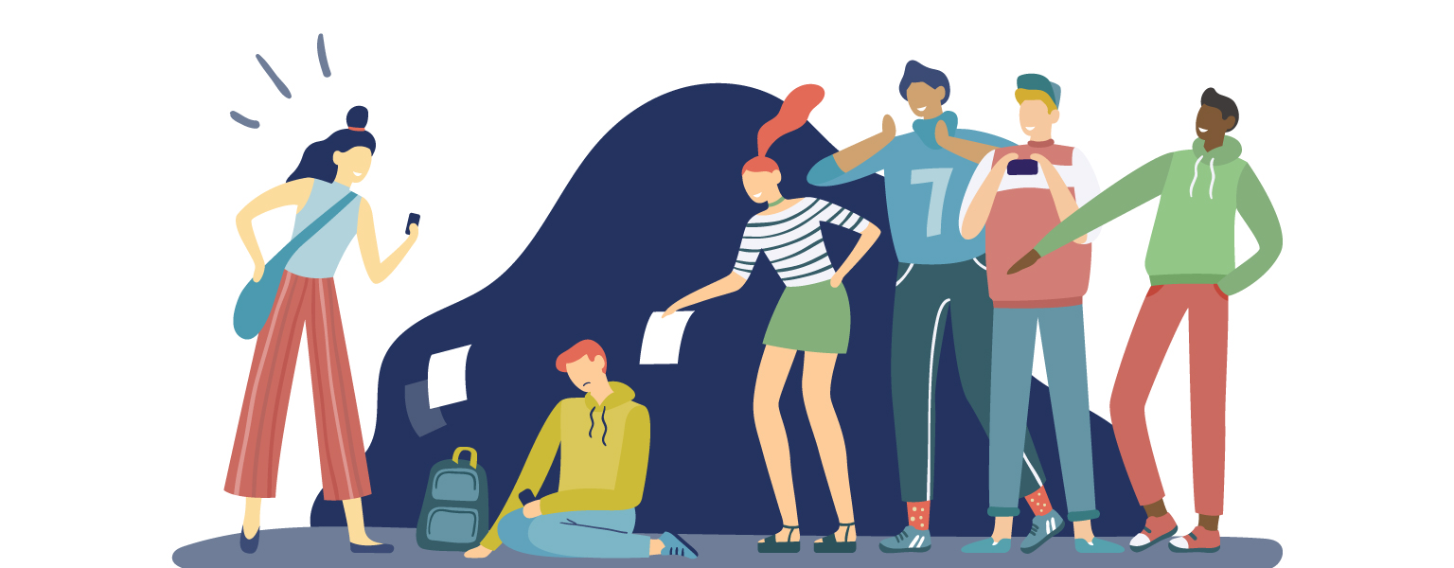
* Vocabulary
bully (v):
bắt nạt
/ˈbʊli/

Slide 9
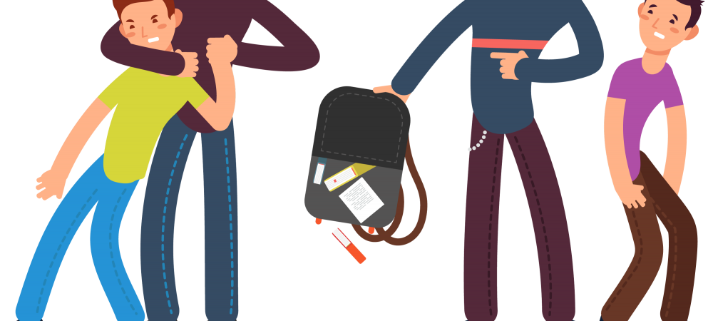
bullying (n):
sự bắt nạt
/ˈbʊliɪŋ/

Slide 10
* VOCABULARY
New words | Pronunciation | Meaning
1. parental (adj) | /pəˈrentl/ | liên quan tới bố mẹ, thuộc bố mẹ
2. peer (n) | /pɪə(r)/ | người ngang hàng, bạn đồng lứa
3. bully (v) | /ˈbʊli/ | bắt nạt
4. bullying (n) | /ˈbʊliɪŋ/ | sự bắt nạt

Slide 11
* Checking vocablary
New words | Pronunciation | Meaning
1. | /pəˈrentl/ | liên quan tới bố mẹ, thuộc bố mẹ
2. | /pɪə(r)/ | người ngang hàng, bạn đồng lứa
3. | /ˈbʊli/ | bắt nạt
4. | /ˈbʊliɪŋ/ | sự bắt nạt
parental (adj)
peer (n)
bully (v)
bullying (n)

Slide 12

I.LISTENING
1
Which types of pressure below do you think teens face?
pressure from schoolwork
parental pressure
pressure from work
pressure from their clubs

Slide 13
2
Listen to a conversation and choose the correct answer to each question.
1. How many students are talking?
One.
Two.
Three.
2. What are they discussing?
Their class forum.
Their stress.
Their community activities.

Slide 14
3
Listen to the conversation again and fill each blank with ONE word.
Problems | Solutions
Minh has pressure from his (1)________. | Minh should tell his parents about his interests and (2) __________.
Ann is unhappy about her (3) _____________. | Ann should feel (4)________ about her body.
Mi doesn’t get on with her (5)________. | She should (6) ______ to her mum.
parents
abilities
good
body / weight
talk
sister

Slide 15
II. WRITING
4
Match the causes of teen stress with the possible solutions. There may be more than one solution to a problem.
Causes of teen stress |  | Possible solutions
peer pressure too much schoolwork spending too much time on social media bullying |  | avoiding bullies wherever possible staying calm and relaxed turning off smartphones talking to teachers

Slide 16
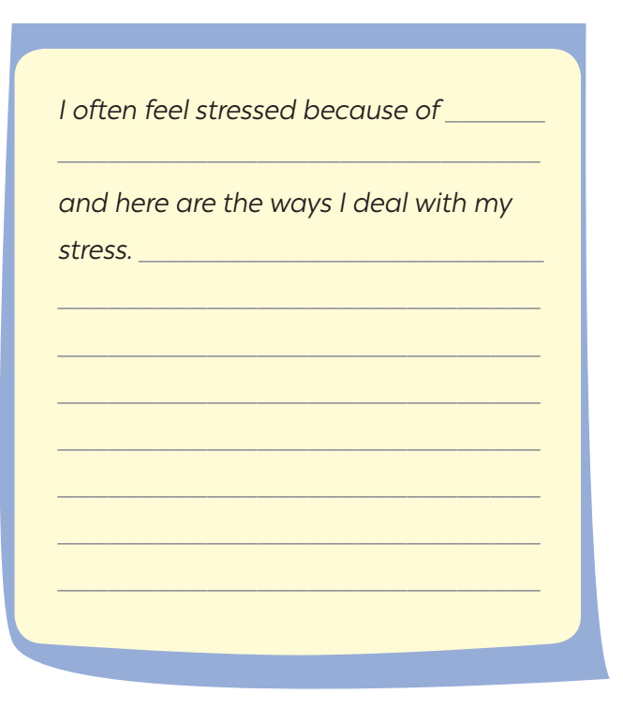
5
Write a paragraph (80 - 100 words) about the cause(s) of your stress and offer solutions.

Slide 17
5
Write a paragraph (80 - 100 words) about the cause(s) of your stress and offer solutions.
* MODEL WRITING
I often feel stressed because of schoolwork, and here are the ways I deal with my stress. First of all, I often talk to my parents about how I feel and what I expect my parents to help. Moreover, I stopped staying up late to play games or chat with my friends. I turn off my computer and smartphone at 10 p.m. Besides, I also tell my parents that I am making efforts;however there are some subjects that I don’t really like so I can’t get very high marks as they expect. I also stop going to extra classes and increase self-study.

Slide 18

* Homework
- Do exercises in the workbook.
- Rewrite the writing in the notebook.
- Prepare “ Looking back and project”

Slide 19
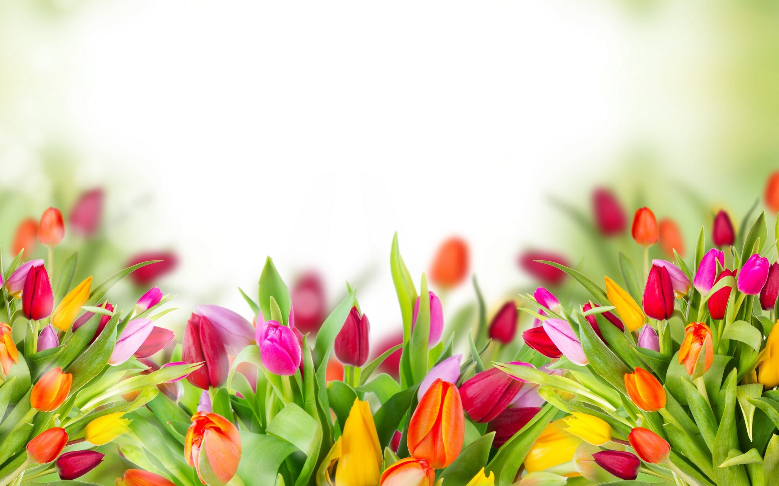
Thank you!
Have a nice day!

