Slide 1


Good morning class !!!

Slide 2


Unit
3
TEENAGERS
LESSON 7: LOOKING BACK & PROJECT

Slide 3
* WARM-UP
KIM’S GAME
RULE:
Work in groups of three or four students
Look at the pictures about kinds of pressure on the screen.
They will disappear after 2 seconds, so try to remember all the pictures without writing them down.
After all the pictures disappear, you have 1 minute to write down the kinds of pressure in each picture on your poster.
2 points for each correct answer

Slide 4


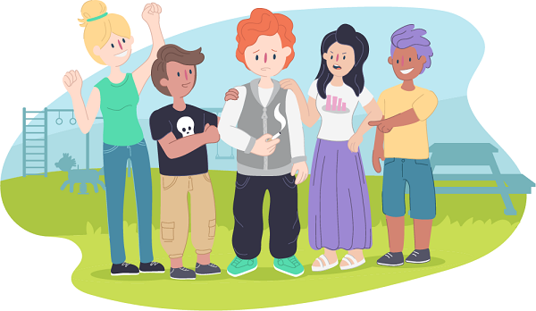
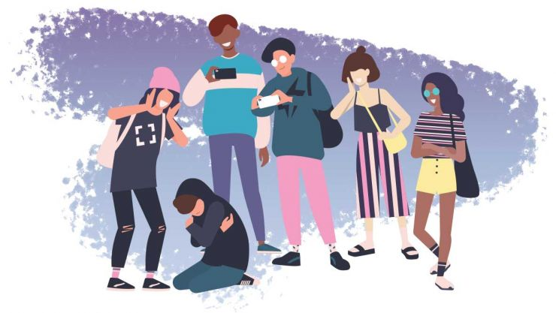

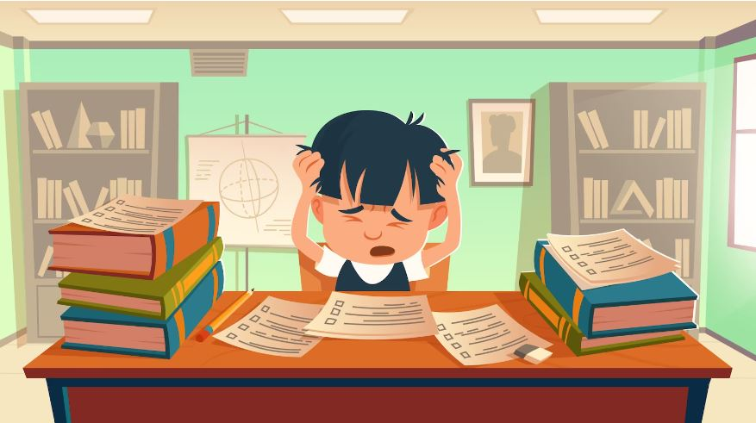
* WARM-UP
KIM’S GAME

Slide 5

* WARM-UP
KIM’S GAME
pressure from schoolwork
bullying
pressure from parents
pressure from friends
pressure from social media

Slide 6
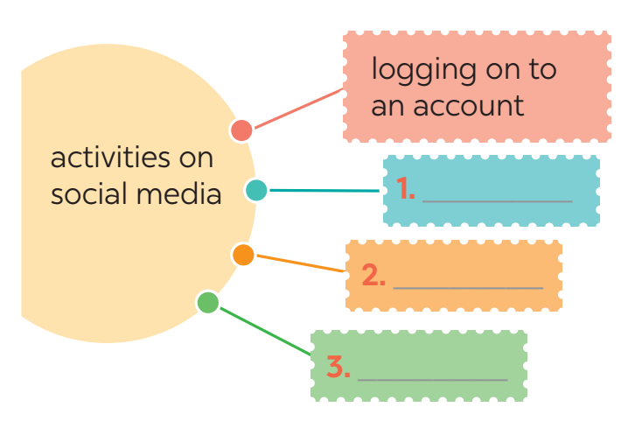
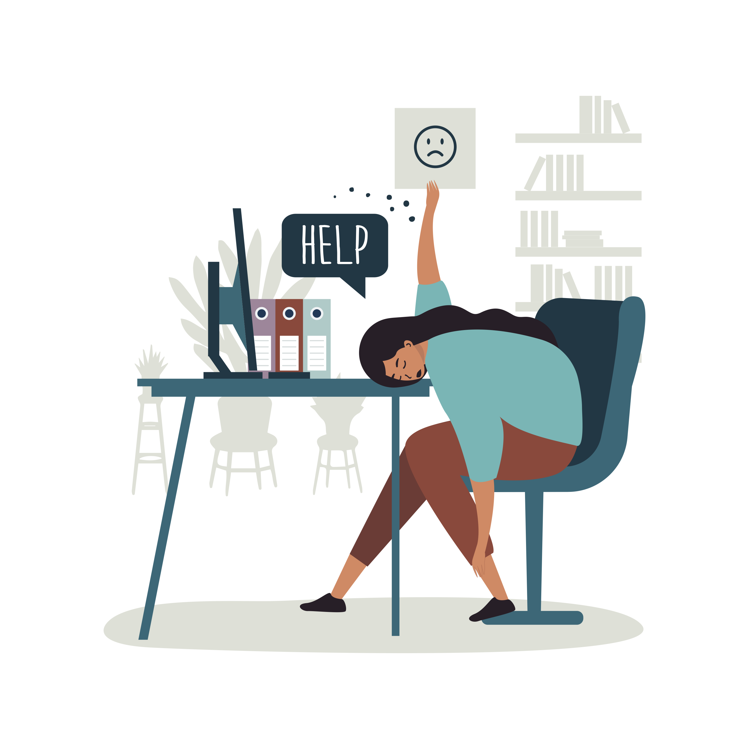



* VOCABULARY
1
1
Complete the webs with suitable words and phrases.
browsing websites
uploading pictures
checking notifcations

Slide 7

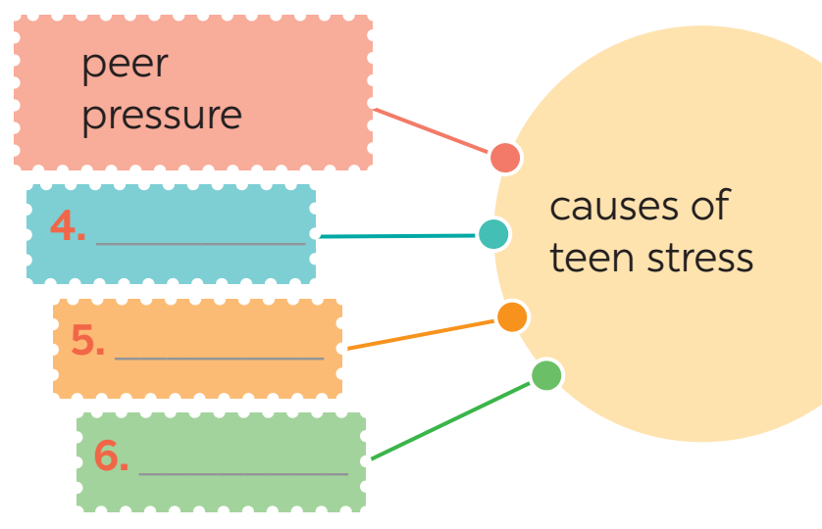


1
1
Complete the webs with suitable words and phrases.
pressure from parents
pressure from schoolwork
bullying

Slide 8
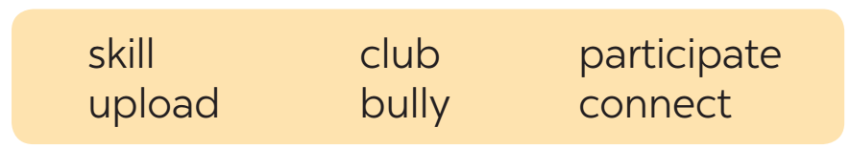

2
Fill in each blank with the correct form of the word from the box.
Mike has a busy and active life. He does well at school and (1)_____________ in many (2)______ like basketball and chess clubs. He is also a member of the school community projects, where he (3)___________ with other teens and learns new (4)________. He has many classes, but he can still manage his schoolwork well. Mike is also an active member of his class forum. He and his friends (5)___________ pictures and videos about their class activities. They also discuss homework, their problems, and how to deal with pressure from parents, friends, and schoolwork. The most common problem they discuss is how to deal with (6)_________________.
participates
clubs
connects
skills
upload
bullies / bullying
1
2
3
4
5

Slide 9

LUCKY apple!
1 ⁺
You get 1 plus

Slide 10

LUCKY apple!
You get 2 Lollipop Sticks

Slide 11

LUCKY apple!
Your reward is a round of applause

Slide 12

LUCKY apple!
You get 1 Lollipop Stick

Slide 13
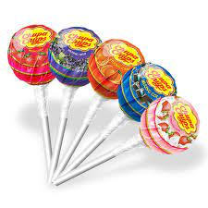
LUCKY apple!
You get 5 Lollipop Sticks

Slide 14
* GRAMMAR
3
Use the conjunctions provided to connect the sentences.
Mai is the head of the music club. She knows the members very well. SO
2. Lan wanted to go to the party. She couldn’t choose a suitable dress. BUT
Mai is the head of the music club, so she knows the members very well.
Lan wanted to go to the party, but she couldn’t choose a suitable dress.

Slide 15
3
Use the conjunctions provided to connect the sentences.
3. Tom felt stressed. He tried to finish his homework. HOWEVER
4. He isn’t a member of the chess club. He didn’t join the chess competition. THEREFORE
5. We will have a short holiday. We will feel very stressed. OTHERWISE
Tom felt stressed; however, he tried to finish his homework.
He isn’t a member of the chess club; therefore, he didn’t join the chess competition.
We will have a short holiday; otherwise, we will feel very stressed.

Slide 16
4
Complete the sentences below. Then compare your sentences with your partners.
Teens need to have good health, so _____________________.
2. His parents have high expectations of him, but ______________ .
3. Teenagers should develop social skills; otherwise ____________.
4. We sometimes feel lonely and sad; therefore, ______________.
5. He does very well at school; however, ____________________.

Slide 17
4
Complete the sentences below. Then compare your sentences with your partners.
Teens need to have good health, so _____________________.
2. His parents have high expectations of him, but ______________ .
3. Teenagers should develop social skills; otherwise ____________.
→Teens need to have good health, so they should do some sport(s).
→ His parents have high expectations of him, but they don’t care about his abilities.
→ Teenagers should develop social skills; otherwise, they may not be able to communicate with peers and other people.

Slide 18
4
Complete the sentences below. Then compare your sentences with your partners.
4. We sometimes feel lonely and sad; therefore, ______________.
5. He does very well at school; however, ____________________.
→We sometimes feel lonely and sad; therefore, we need our families and friends.
→ He does very well at school; however, he doesn’t have teamwork or communication skills.

Slide 19



* PROJECT

Slide 20

1. Think about a club you would like to have at your school. Brainstorm details about the club by answering these questions.
A: What club is it?
B: It’s a chess club.
A: What specific activities will the club have?
B: We will play chess and learn advanced lesson about playing chess. Also, you can make new friends.
A: How often will the club meet? When?
B: We will meet on Wednesday, from 2.00 – 4.00 in the afternoon.
A: What will you contribute to the club?
B: I will invite my friends to play chess there. I think I can win the prize for the club.

Slide 21

* Homework
Do exercises in the workbook.

Slide 22



