Slide 1

Warmly welcome to our class
English 8 A

Slide 2
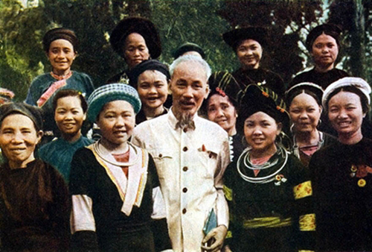
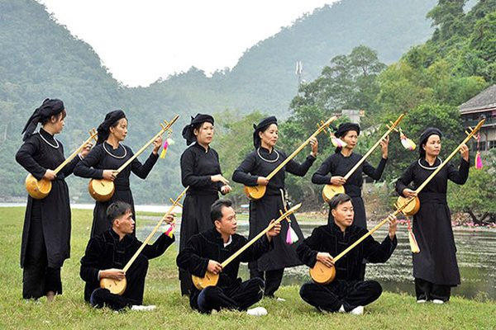
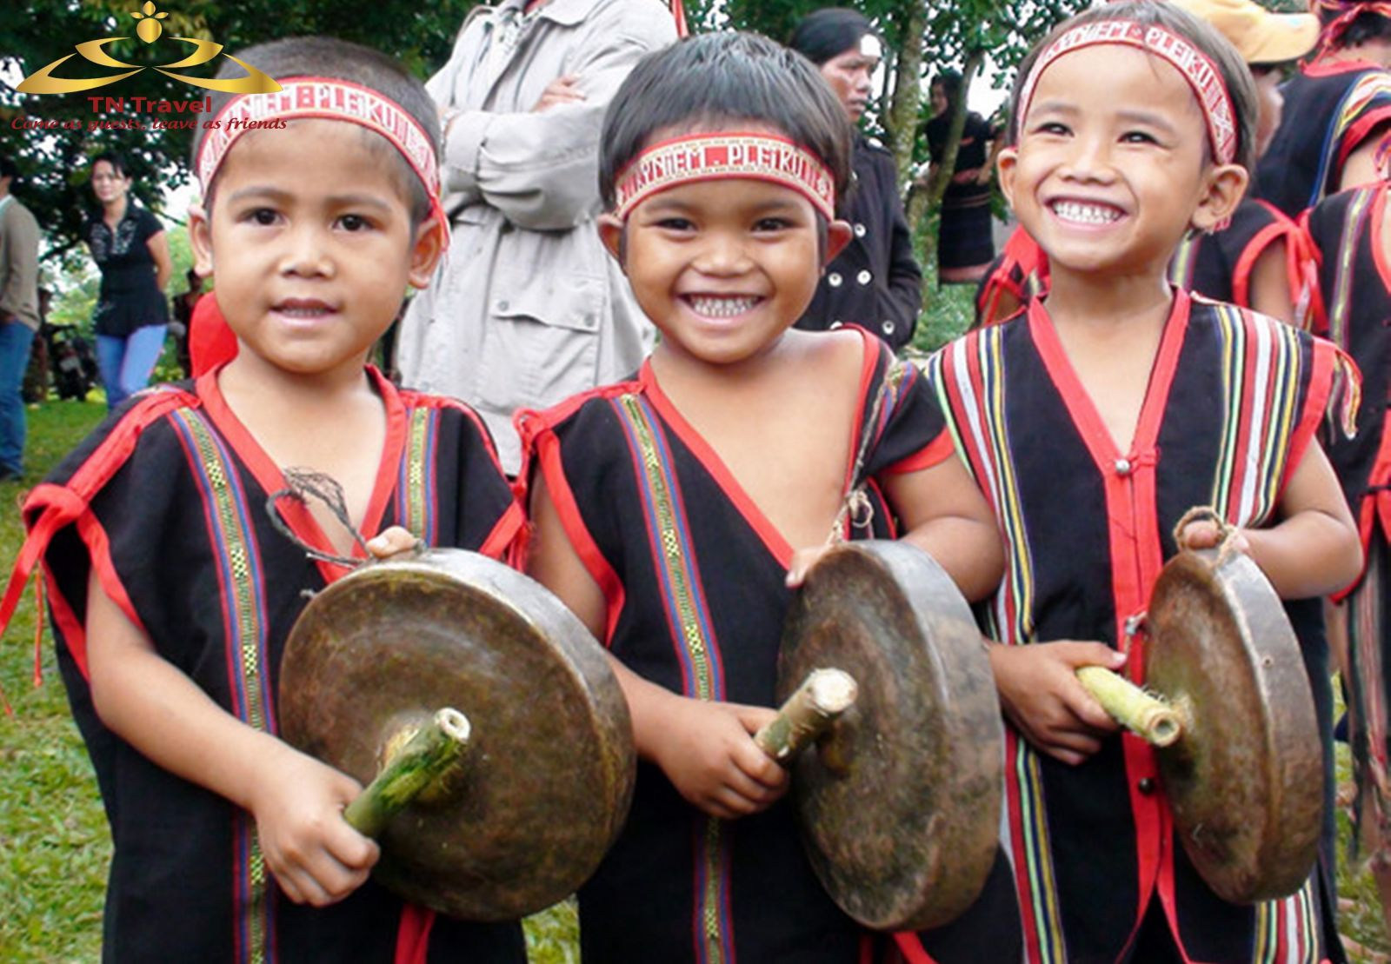
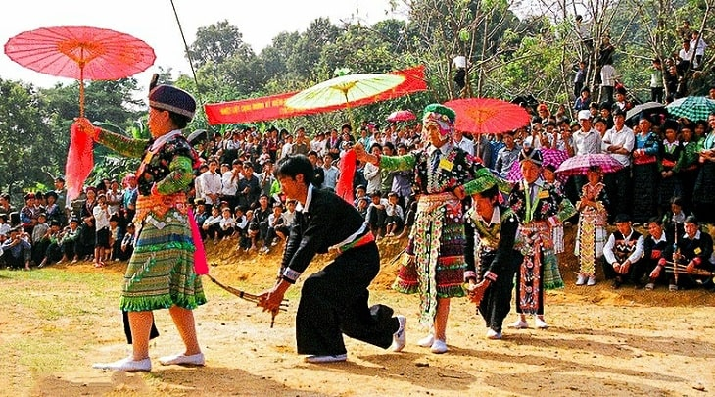
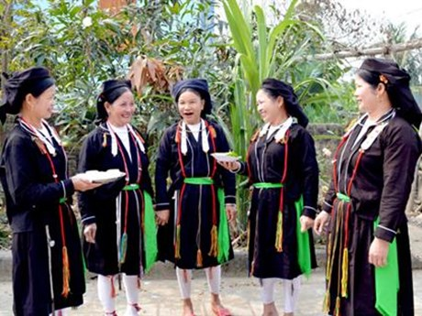

Slide 3

WARM-UP: NETWORK
The Koho
The Giay
The Muong
The Tay
Ethnic groups
The Bru-Van Kieu
The Nung
The Yao
The Bahnar
The Kinh
The Hmong
The Hani
The Brau

Slide 4
https://youtube.com/shorts/623qbfNza1w?si=J88pGhbqtHyN3d2A

Slide 5

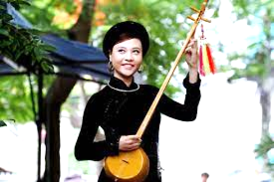
Unit
4
ETHNIC GROUPS OF VIET NAM
Unit
ETHNIC GROUPS OF VIET NAM
LESSON 1: GETTING STARTED
I’m from the Tay ethnic group

Slide 6
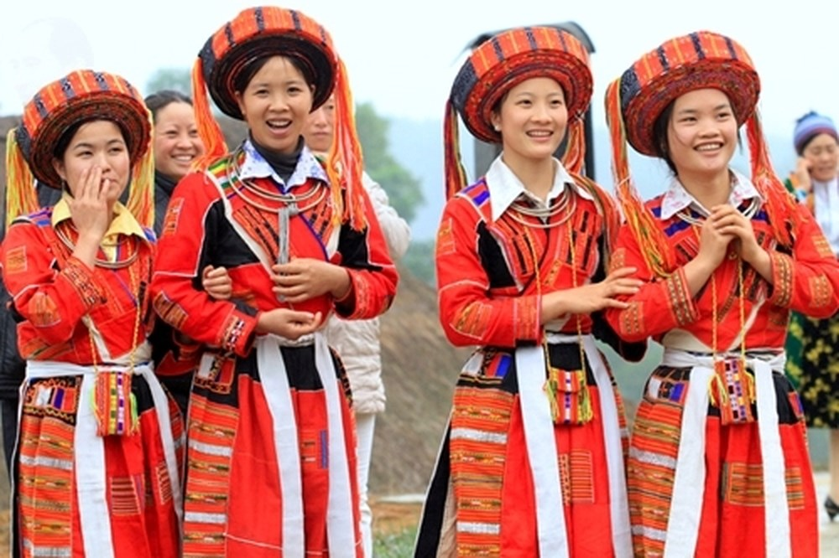
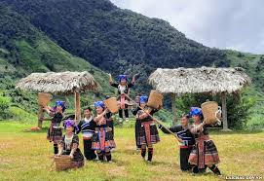

* Vocabulary:
- ethnic (group) (adj):
(nhóm) dân tộc
/ˈeθnɪk / (/gru:p/)

Slide 7
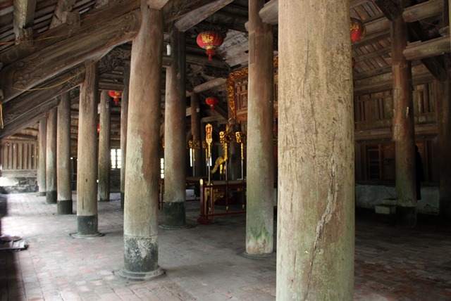
* Vocabulary:
- post (n):
cột
/pəʊst/

Slide 8
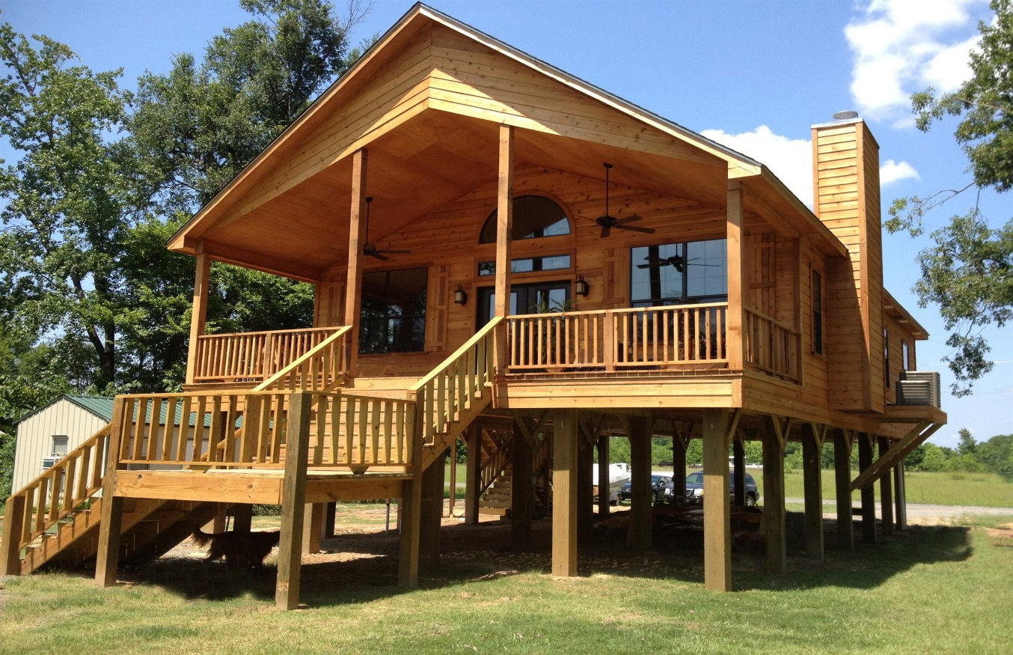
* Vocabulary:
- stilt house (n):
Nhà sàn
/stilt haus/
nhà sàn

Slide 9
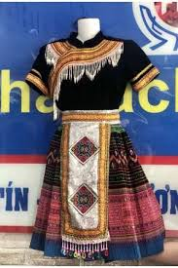
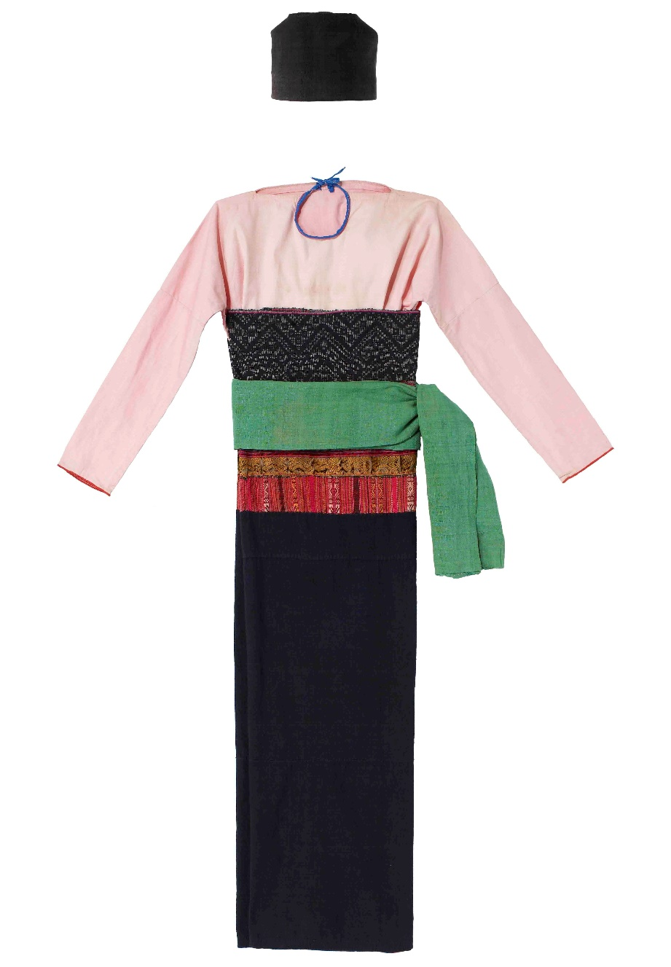
* Vocabulary:
- costume (n):
trang phục
/'kɔstju:m/

Slide 10
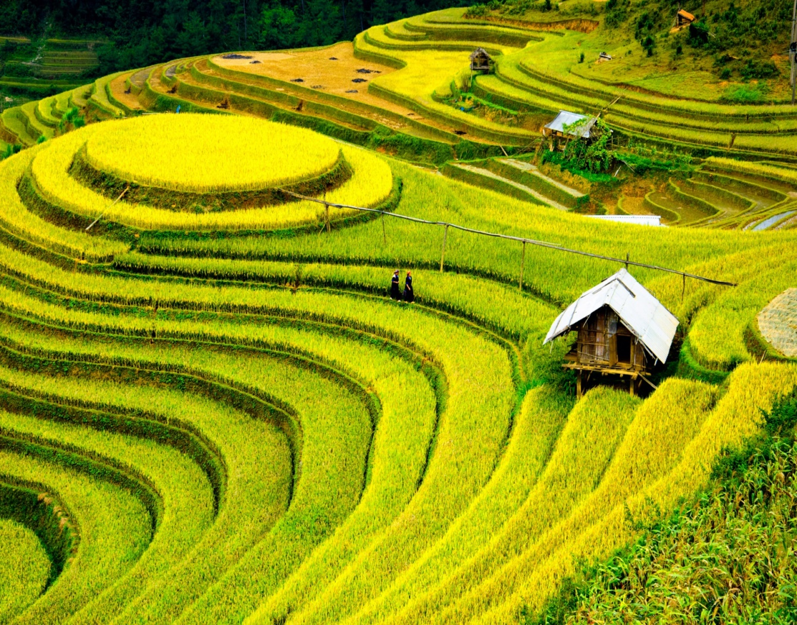
* Vocabulary:
- terraced field (n):
ruộng bậc thang
/ˈterəst fiːld /

Slide 11
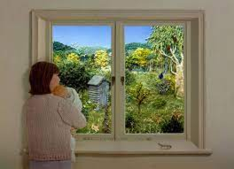
* Vocabulary:
- overlook (v):
nhìn ra
/ˌəʊ.vəˈlʊk/

Slide 12
* Vocabulary:
1. ethnic (group) (adj) | /ˈeθnɪk / (/gru:p/) | (nhóm) dân tộc
2. post (n) | /pəʊst/ | cột
3. overlook (v) | /ˌəʊ.vəˈlʊk/ | nhìn ra
4. stilt house (n) | /stilt haus/ | nhà sàn
5. costume (n) | /'kɔstju:m/ | trang phục
6. terraced field (n) | /ˈter.əst fiːld / | ruộng bậc thang

Slide 13
* Checking vocabulary:
Form |  | Vietnamese equivalent
1. ethnic (group) (adj) |  | a. nhìn ra
2. post (n) |  | b. nhà sàn
3. overlook (v) |  | c. (nhóm) dân tộc
4. stilt house (n) |  | d. cột
5. costume (n) |  | e. ruộng bậc thang
6. terraced field (n) |  | f. trang phục

Slide 14
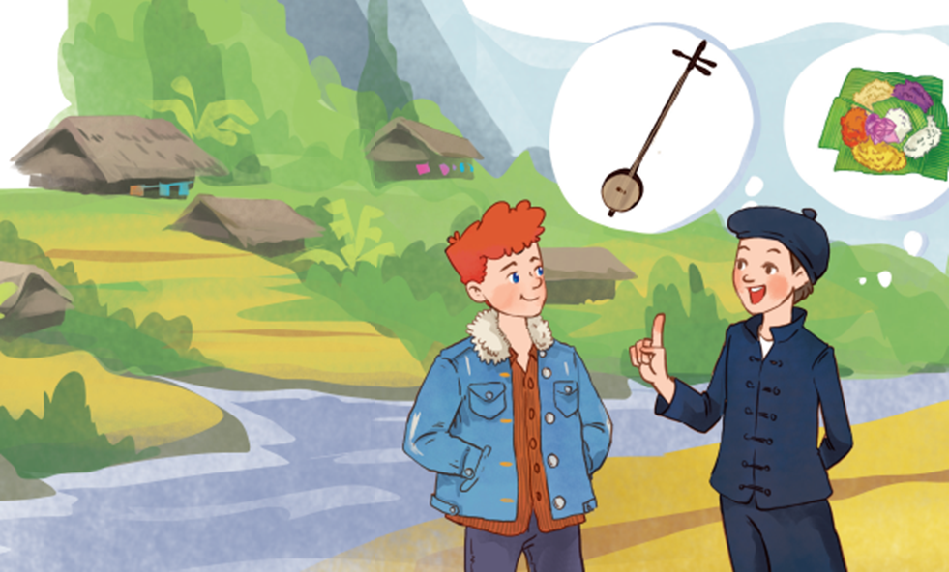
1
Listen and read.
- Who are they in the picture?
- What can you see in the picture?
- What do you think Lai and Tom talking about?
- Do you know anything about the Tay ethnic group?
- a village in the mountains
- a few stilt houses
- dan tinh
- five-colored sticky rice
…….
- Tom is a foreigner.
- Lai is an ethnic
Vietnamese.
Tom
Lai
They are talking about the ethnic group of Viet Nam ( The Tay ethnic group)

Slide 15
1
Listen and read.
Tom: Hi, I’m Tom. You look new here.
Lai: I am. I’m Lai from Ha Giang.
Tom: Oh, I’ve heard about beautiful Ha Giang. Do you live in the mountains?
Lai: Yes, I do. I’m from the Tay ethnic group. We are the second largest ethnic group in Viet Nam, only after the Kinh.
Tom: Oh … I once saw a bamboo house on high posts in a travel brochure. Do you live in a home like that?
Lai: Yes, we call it a “stilt house”. Our house overlooks terraced fields.
Tom: Awesome. What is life in your village like?
Lai: It’s peaceful. There are 16 houses in my village. We live very close to nature.
Tom: I love it. Can you tell me something about your culture?
Lai: Certainly. We have our own culture. You can see it in our folk dances, musical instruments like the dan tinh, and our special five-colour sticky rice.
Tom: It sounds interesting. I hope to visit Ha Giang one day.

Slide 16
2
Read the conversation again and circle the best answers.
1. What are Tom and Lai talking about?
A. Minority groups in Viet Nam.
B. Ha Giang.
C. Life of the Tay people.
2. A “stilt house” ______.
A. is a multi-storey home
B. is on high posts
C. always faces a field
3. Lai mentions ______ of the Tay people.
A. folk dances
B. popular festivals
C. costumes

Slide 17
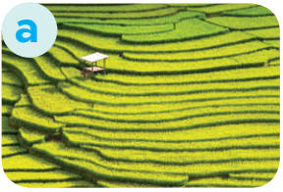
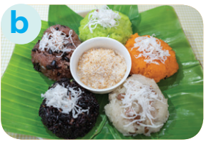

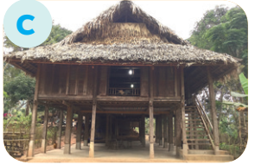
3
Match the pictures with the word and phrases from the conversation.
1. stilt house
2. terraced fields
3. bamboo
4. five-colour sticky rice

Slide 18
4
Complete the sentences with the words and phrases from the box.
overlooks musical instrument ethnic groups
folk dance traditional
1. I love mua sap, a popular _________ of the Thai people.
2. Their beautiful stilt house _________ a large rice field.
3. A: What is the name of a popular Tay’s __________________? - B: It’s dan tinh.
4. Every ethnic group has their own __________ culture.
5. Of the 54 ______________ in Viet Nam, the Kinh is the largest

Slide 19
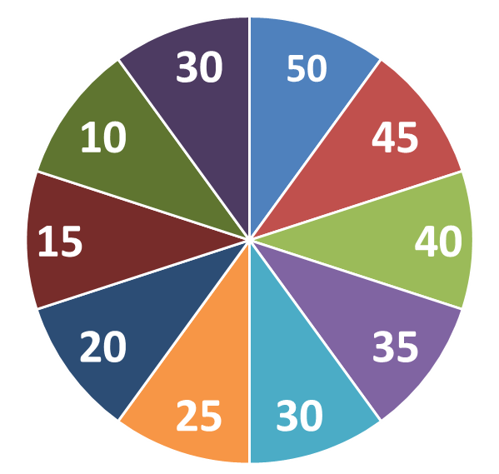
THE BIG WHEEL GAME
QUESTIONS
1
2
3
4
5
6

Slide 20
4
Complete the sentences with the words and phrases from the box.
overlooks musical instrument ethnic groups
folk dance traditional
1. I love mua sap, a popular _________ of the Thai people.
folk dance

Slide 21
4
Complete the sentences with the words and phrases from the box.
overlooks musical instrument ethnic groups
folk dance traditional
2. Their beautiful stilt house _________ a large rice field.
overlooks

Slide 22
4
Complete the sentences with the words and phrases from the box.
overlooks musical instrument ethnic groups
folk dance traditional
musical instrument
3. A: What is the name of a popular Tay’s __________________?
B: It’s dan tinh.

Slide 23
4
Complete the sentences with the words and phrases from the box.
overlooks musical instrument ethnic groups
folk dance traditional
traditional
4. Every ethnic group has their own __________ culture.

Slide 24
4
Complete the sentences with the words and phrases from the box.
overlooks musical instrument ethnic groups
folk dance traditional
ethnic groups
5. Of the 54 ______________ in Viet Nam, the Kinh is the largest

Slide 25
4
Fill in the blank box with one suitable word to complete the sentence
.
second
6. The Tay is the _________ largest ethnic group in Viet Nam, only after the Kinh.

Slide 26
4
Complete the sentences with the words and phrases from the box.
overlooks musical instrument ethnic groups
folk dance traditional
1. I love mua sap, a popular _________ of the Thai people.
2. Their beautiful stilt house _________ a large rice field.
3. A: What is the name of a popular Tay’s __________________? - B: It’s dan tinh.
4. Every ethnic group has their own __________ culture.
5. Of the 54 ______________ in Viet Nam, the Kinh is the largest
folk dance
overlooks
musical instrument
traditional
ethnic groups

Slide 27
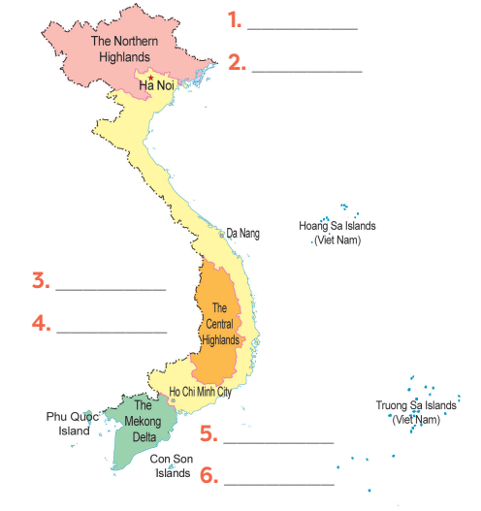
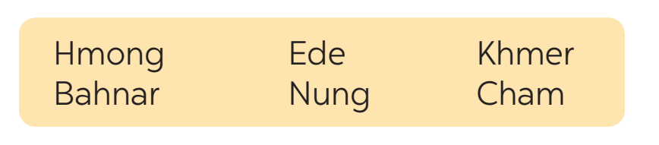
5
Game: Where are they?
Hmong
Nung
Ede
Bahnar
Khmer
Cham

Slide 28
1
Wrap-up
ETHNIC GROUPS OF VIET NAM
About ethnic groups
Topic of the unit
Vocabulary

Slide 29

2
Homework
- Learn by heart all the words that they have just learnt.
- Do exercises in the workbook.
- Prepare for the Project of the unit.

Slide 30
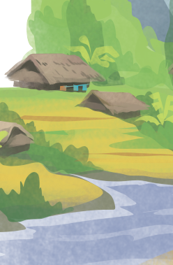
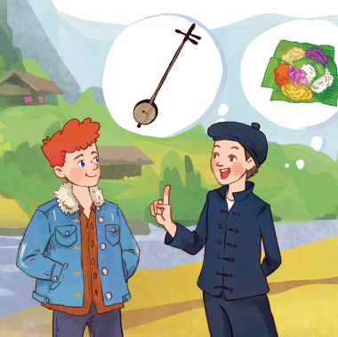

Slide 31


