Slide 1
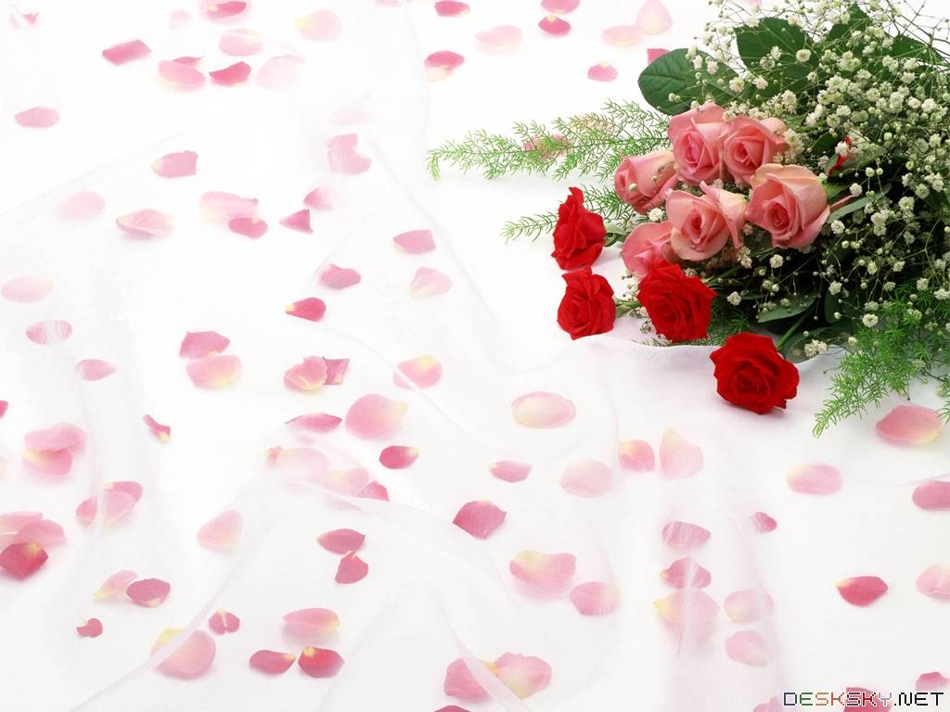
Warmly welcome to our class

Slide 2
WARM-UP
Sentence puzzling
1. that | is | your mother | ?
→ Is that your mother?
2. they | did | go to school | yesterday | ?
→ Did they go to school yesterday ?
3. What time | often | get up | do | you | ?
→ What time do you often get up ?

Slide 3


Unit
4
ETHNIC GROUPS OF VIET NAM
LESSON 3: A CLOSER LOOK 2
LESSON 3: A CLOSER LOOK 2
HOBBIES

Slide 4
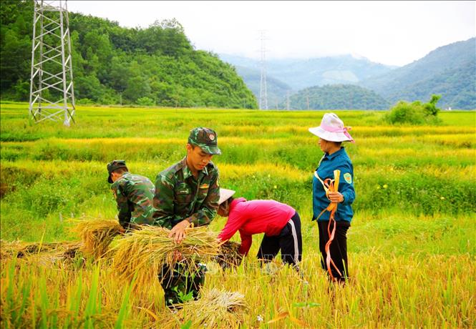

* Vocabulary
- harvest (v)
gặt hái, thu hoạch
/ˈhɑːvɪst/

Slide 5
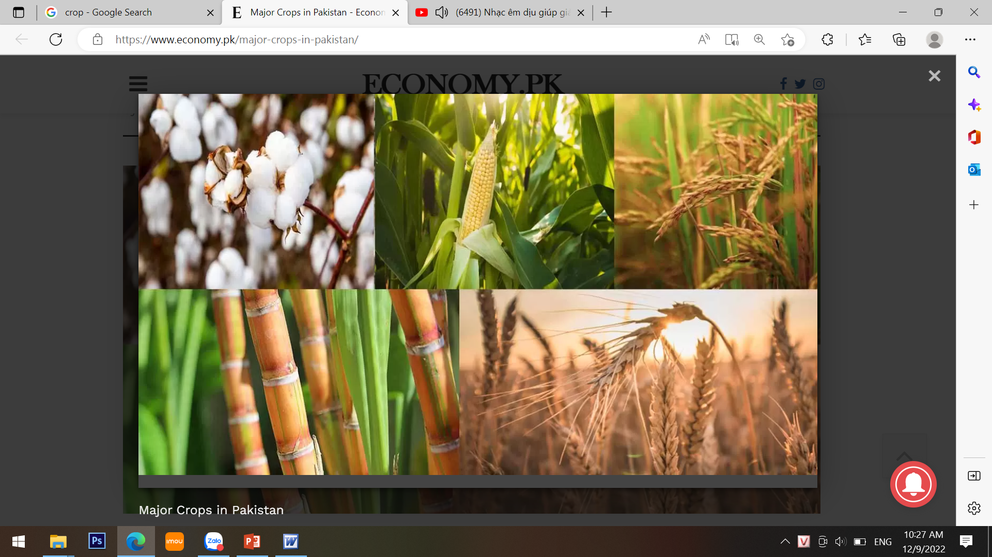
* Vocabulary
- crop (n):
vụ mùa, vụ trồng trọt
/krɒp/

Slide 6
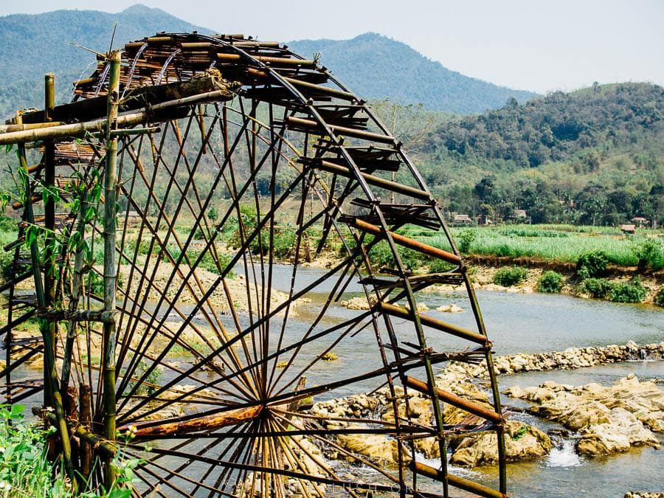
* Vocabulary
- waterwheel (n):
bánh xe nước
/ˈwɔːtəwiːl/

Slide 7
* Grammar:
* YES / NO QUESTION

Slide 8
* Cấu trúc câu hỏi Yes/ No
Câu hỏi Yes/No luôn bắt đầu bằng một trong những trợ động từ be, do, hoặc một động từ khiếm khuyết và có thể trả lời đơn giản là Yes hoặc No,
1. Câu hỏi Yes/ no với động từ “be”
Yes, S + be
No, S + be not
Be + S + adj/ N?
Ex:
- She is a teacher.
→ Is she a teacher ?
- This is interesting.
→ Is this interesting?
- They were happy
→ Were they happy?

Slide 9
2. Câu hỏi Yes/No với trợ động từ
Do/ Does/ Did + S + V(nguyên thể)?
- Yes, S + do/does/did
- No, S + don’t/doesn’t/ didn’t
Ex:
1. They often go to school in the morning
→ Do they often go to school in the morning ? ( Yes, they do/ No, they don’t.)
2. She had an English test Yesterday.
→ Did she have an English test yesterday? ( Yes, she did / No,she didn’t.)
3. Câu hỏi Yes/ No với động từ khuyết thiếu
* Can/ will/ should/ would + S + V(nguyên thể)?

Slide 10
YES / NO AND WH-QUESTION
1
Change the sentences into Yes / No questions.
1. Women play an important role in a Jrai family.
→ Do women play an important role in a Jrai family?
2. Mua sap is a popular folk dance of the Thai people.
→ Is mua sap a popular folk dance of the Thai people?

Slide 11
1
Change the sentences into Yes / No questions.
3. We didn’t have boarding schools for minority students in 1950.
→ Did you have boarding schools for minority students in 1950?
4. I attended the Ban Flower Festival in Dien Bien last year.
→ Did you attend the Ban Flower Festival in Dien Bien last year?
5. We will watch a documentary about the Khmer.
→ Will you watch a documentary about the Khmer?

Slide 12
* WH - QUESTION
Who
What
Question words
which
What
Where
What time
How many
How often
Why
How
When

Slide 13
* WH - QUESTION
Question word
When
How many
How often
What
Where
Who
Why
The information it needs
time
number
repetition
thing
place
people
reason

Slide 14
2
Choose the correct question word for each question below.
1. A: ______ do you like best about Sa Pa?
B: I like its local markets best.
A. Why B. What
2. A: ______ can we find the most beautiful terraced fields?
B: In Mu Cang Chai.
A. When B. Where
3. A: ______ is the Ban Flower Festival?
B: It’s in spring.
A. When B. Why

Slide 15
2
Choose the correct question word for each question below.
4. A: ______ tall is an average stilt house?
B: About 5 - 6 metres tall.
A. How B. What
5. A: ______ festival is more important for the Kinh: the Mid-Autumn or the Lunar New Year?
B: The Lunar New Year.
A. What B. Which

Slide 16
*COUNTABLE AND UNCOUNTABLE NOUNS
3
Write C (countable) or U (uncountable) for the underlined words.
Some minority (1) groups are farmers. They do not have much (2) land and they use simple farming techniques. After finding an (3) area for a garden, the men cut the (4) trees down and burn them. The (5) ash they collect helps enrich the soil. They then grow a few (6) crops like rice and corn.
____
2. ____
3. ____
4. ____
5. ____
6. ____
C
U
C
C
U
C

Slide 17
* Remmember
- a + danh từ số ít, bắt đầu bằng phụ âm: một
- an + danh từ số ít, bắt đầu bằng nguyên âm: một
- much + danh từ không đếm được: nhiều
- many + danh từ số nhiều: nhiều
- a little + danh từ không đếm được: một chút
- a few + danh từ số nhiều: một ít/ một vài

Slide 18
COUNTABLE AND UNCOUNTABLE NOUNS
4
Fill in the blank with a, much, many, a little, or a few.
1. My uncle has _____coffee plantation in Kon Tum.
2. How _______ ethnic groups live on the Hoang Lien Son mountain range?
3. There are only _______ waterwheels left in my village.
4. You should add ________ more water to your noodles. It’s a bit dry.
5. How ______ information about the Van Kieu have you collected?
a
many
a few
a little
much

Slide 19
COUNTABLE AND UNCOUNTABLE NOUNS
5
GAME: WORD GAMES
Work in groups. Think of six nouns related to each of the topics below, in which 3 nouns are countable and 3 nouns are uncountable.
Stilt house
Film
Leisure time
Living in the mountain

Slide 20
* Living in the mountains
+ Uncountable : thunder , snow ,heat ,wind light ,water...
+ Countable : radio, photo tomato , crops , house (nhà), forest,
* Leisure time
+Uncountable: fun,walking, cooking,swimming ,information
+ Countable: film, book , picture, game,

Slide 21
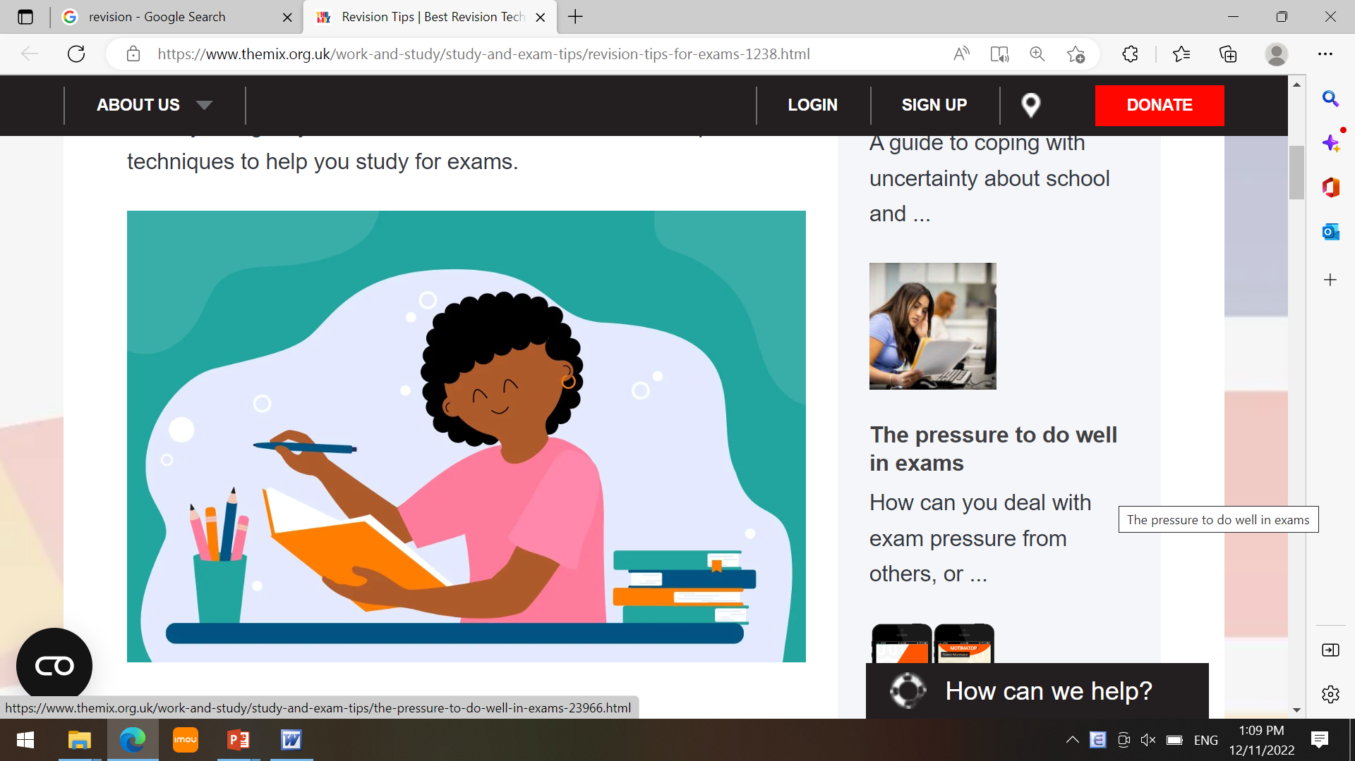
CONSOLIDATION
* Grammar: - Yes / No and Wh-questions
- Countable and uncountable nouns

Slide 22

* Homework
- Learn by heart all the words.
- Do exercises in the workbook.
- Prepare for Lesson 4 – Communication.

Slide 23


Thank you!
Goodbye!

