Slide 1

Good morning class !!!

Slide 2
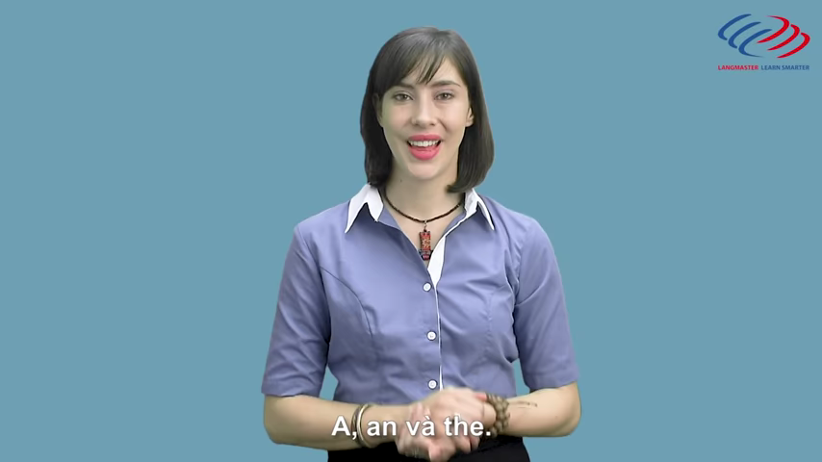
Watch video clip and answer question:
Option 2

Slide 3
* Grammar
When do we use a / an / the?

Slide 4


Unit
5
OUR CUSTOMS AND TRADITIONS
Unit
ETHNIC GROUPS OF VIET NAM
LESSON 3: A CLOSER LOOK 2
LESSON 3: A CLOSER LOOK 2
Zero articles
HOBBIES

Slide 5
When do we use a / an / the?
“a” thường đứng trước danh từ đếm được số ít, bắt đầu bằng một phụ âm.
- “an” thường đứng trước danh từ đếm được số ít bắt đầu bằng nguyên âm (e, u, o, a,i) hoặc âm “h” câm.

Slide 6
When do we use a / an / the?
- “the” thường đứng trước danh từ khi:
+ vật thể hay nhóm vật thể là duy nhất hoặc được xem là duy nhất
+ danh từ này vừa được đề cập trước đó
+ danh từ này được xác bằng 1 cụm từ hoặc 1 mệnh đề
+ đặt trước một danh từ chỉ một đồ vật riêng biệt mà người nói và người nghe đều hiểu
+ trước so sánh nhất (đứng trước first, second, only..) khi các từ này được dùng như tính từ hoặc đại từ

Slide 7
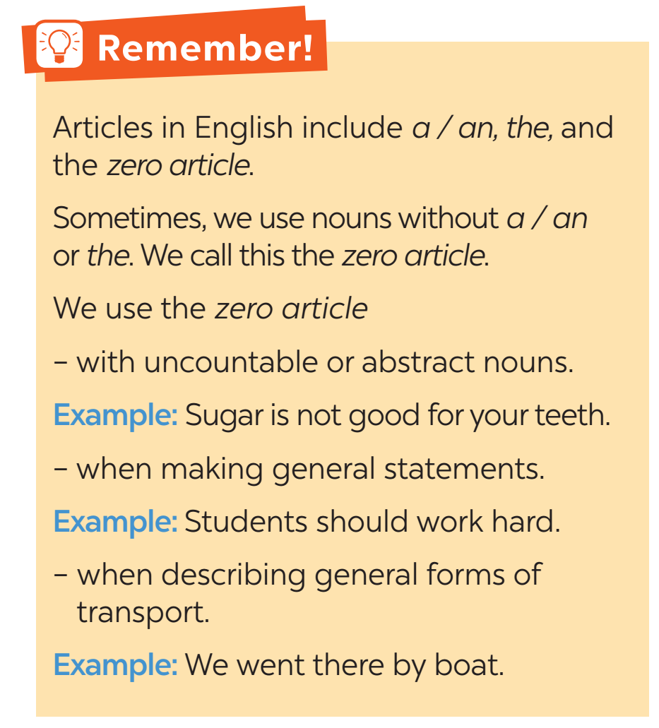
We can use noun without a / an or the. We call this case zero article.

Slide 8
* PRACTICE
1
Choose the correct option in each sentence below.
1. It takes more than a / an hour to drive to Can Tho.
2. It’s a / Ø tradition for children to wake up early on Christmas Day.
3. The Ok Om Bok Festival takes place in the / Ø October.
4. We went to Can Tho by an / Ø air.
5. A: Where’s a / the book?
B: I thought you left it next to the TV.

Slide 9
2
Which of the underlined parts in each question is incorrect? Find and correct it.
1. The worshipping Kitchen Gods is a long-time tradition of the
A B C
Vietnamese.
2. People organise the worshipping ceremony at noon so that a
A B C
Kitchen Gods can leave for Heaven at 12 o’clock.
→ Ø
→ the

Slide 10
PRACTICE
3. Most families in the Viet Nam prepare oﬀerings for the Kitchen Gods.
A B C
4. The oﬀerings include a set of flowers and fruits, a paper clothes,
A B C
and three carps.
5. The Vietnamese people believe that the Kitchen Gods go to
A B
Heaven on carps.
C
→ Ø
→ Ø
→ Ø

Slide 11
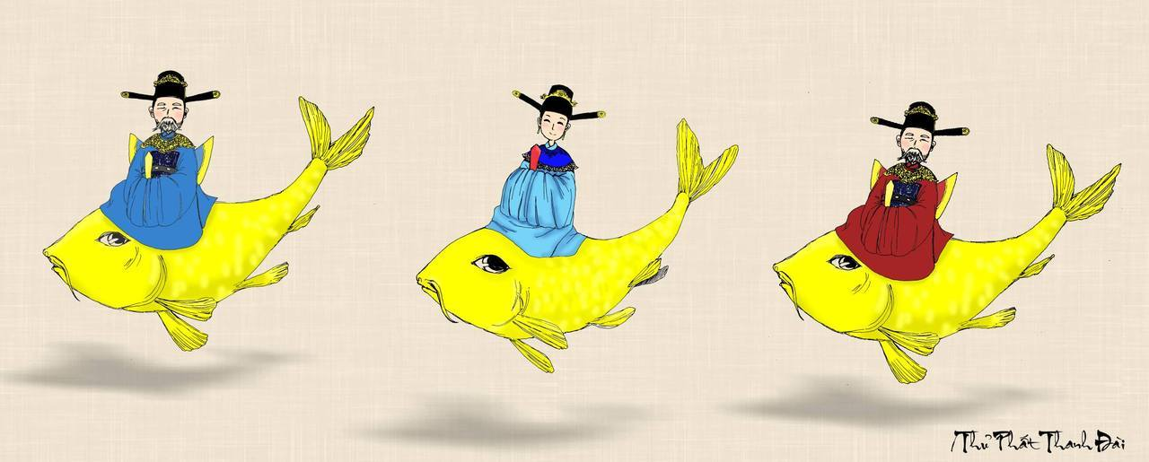
The Kitchen Gods Worshipping Ceremony.
When is it?
On the 23rd day of the twelfth lunar month.

Slide 12
PRACTICE
What happens in this ceremony?
Vietnamese people prepare offerings for the Kitchen Gods, who will report the family’s affairs over the past year to the Jade Emperor.

Slide 13
3
Complete the sentences with a, an, the, or Ø (zero article).
Ø
1. It is a custom in my family to have ______ breakfast at home on Sundays.
2. When visiting a family home in some countries, you should bring ______ small gift with you.
3. Our village festival is held on the 10th of ______ January.
4. ancient Egyptians worshipped ______ Sun.
5. Many people think that hard work is ______ important Vietnamese value.
a
Ø
the
an

Slide 14
4
Complete the text with the or Ø (zero article).
A recent study in (1) ______ UK shows that family time traditions are good for (2) ______ teens. These traditions include family members playing card games, watching their favourite TV programmes, or performing (3) ______ karaoke shows at weekends with one another. These activities often lead to lots of laughter and (4) ______ fun conversations. By taking part in such activities, teens strengthen
(5) ______ bonds with their family.
the
Ø
Ø
Ø
the

Slide 15

FURTHER PRACTICE
5
- Work in group
- Each group has a list of five sentences.
- Find and correct the mistakes in sentences.
- Say “Bingo!” as soon as your group finishes.
- The first group to come up with all the correct answers wins.

Slide 16
* FURTHER PRACTICE
5
1. I usually meet my cousin at the weekends.
2. My uncle moved to United States three years ago.
3. Our teachers assigned us a homework for our history and science classes.
4. I turn off the light and go to the bed at 11 p.m.
5. I loved a book you gave me. Even though it is a very long story, I finished it in a night.
→ Ø
→ the United States
→ Ø
→ Ø
→ the

Slide 17
CONSOLIDATION
1
Wrap-up
FISHING GAME

Slide 18
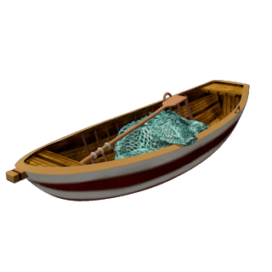
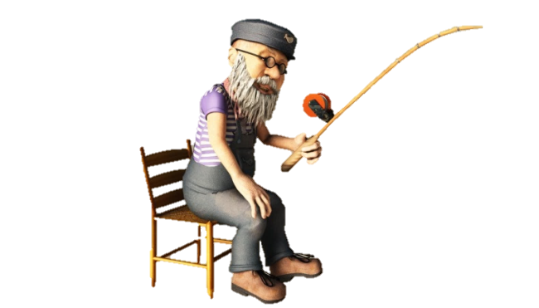
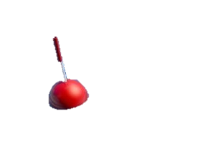
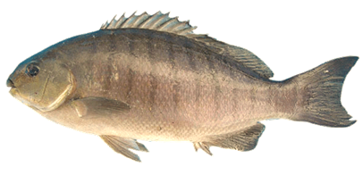

Are you coming to ........... party next Saturday?
GREAT!
the
a
Ø
the
an

Slide 19
I bought .......new TV set yesterday.
GREAT!
a
the
Ø
a
an

Slide 20
He thinks that ............... love is what will save us all
GREAT!
Ø
the
a
Ø
an

Slide 21
She was wearing ...... ugly dress when she met him.
GREAT!
an
the
a
an
Ø

Slide 22

* Homework
Make 5 sentences by using the articles.
Do exercises in the workbook.

Slide 23
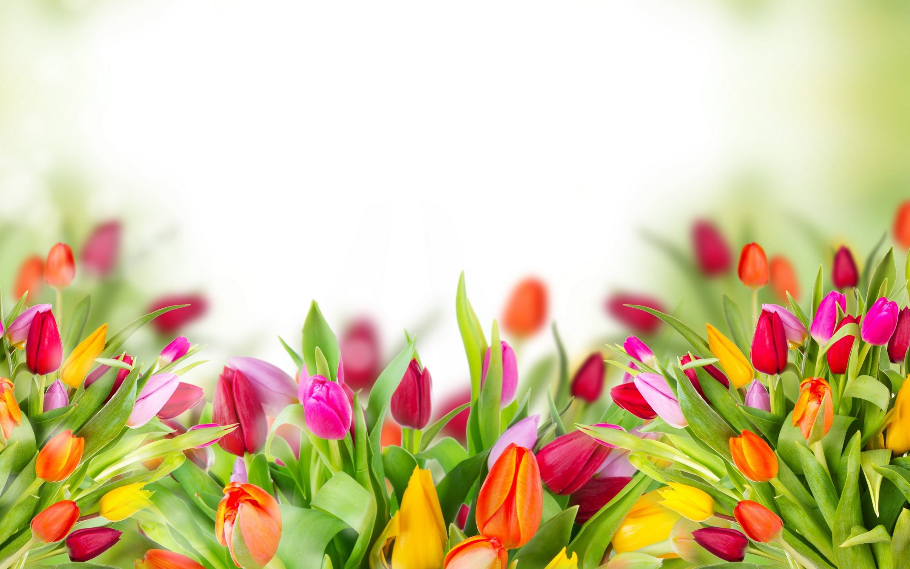
Thank you!
Have a nice day!

Slide 24

Website: hoclieu.vn
Fanpage: facebook.com/www.tienganhglobalsuccess.vn/

Slide 25
WARM-UP
Option 1
Look and answer

Slide 26
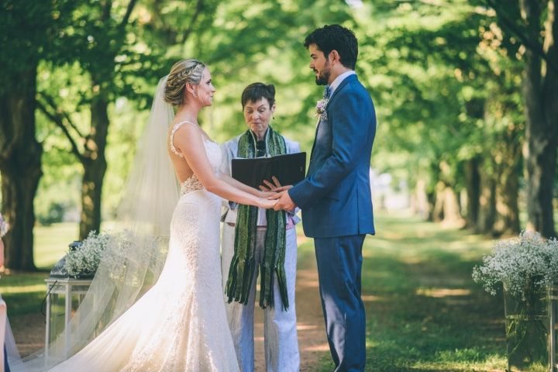
WARM-UP
Option 1
wedding ceremony

Slide 27
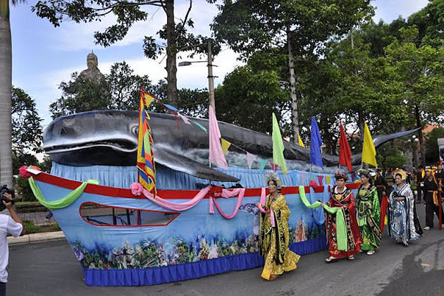
WARM-UP
Option 1
whale worship

Slide 28
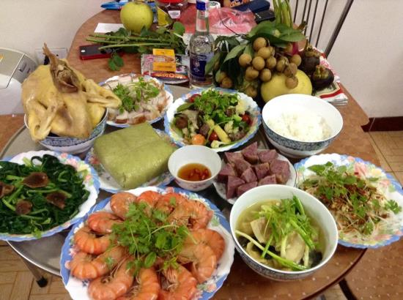
WARM-UP
Option 1
food offerings

Slide 29
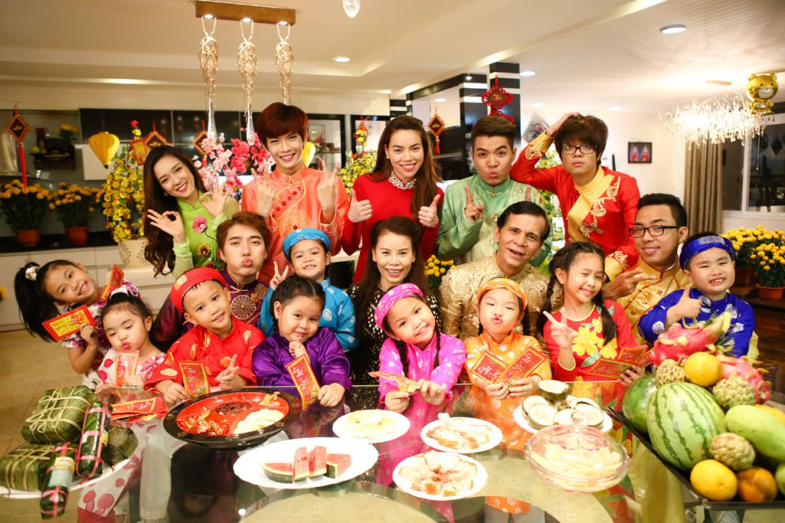
WARM-UP
Option 1
family reunion

Slide 30
WARM-UP
Option 1
1.We held a family reunion last week.
2. My mom prepares food offerings at Tet.

