Slide 1

Good morning class !!!

Slide 2
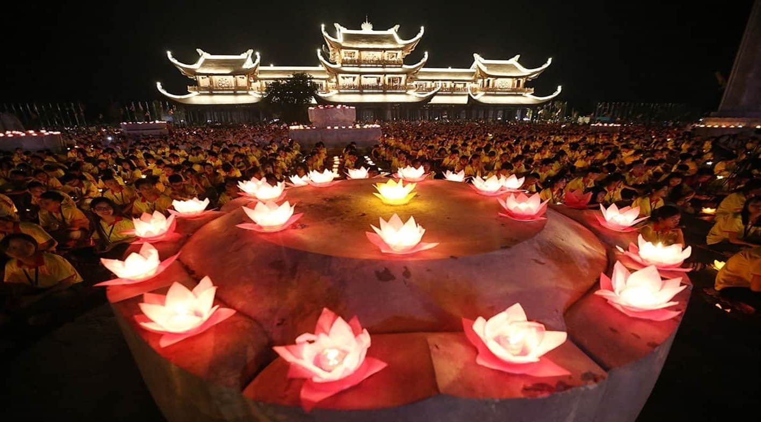
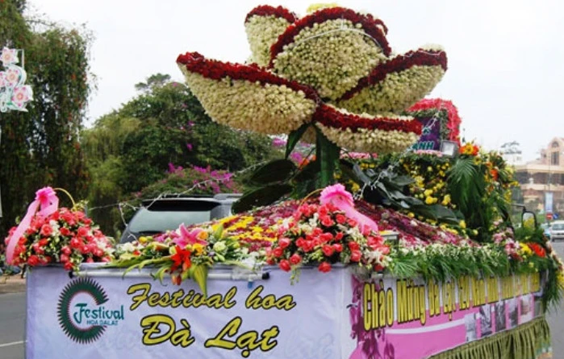
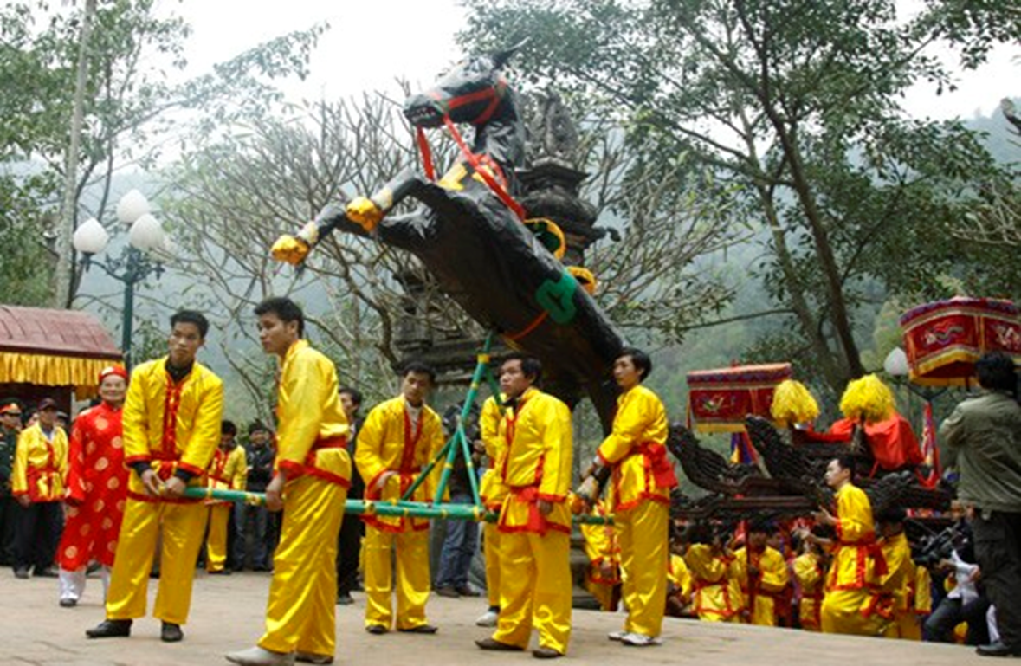
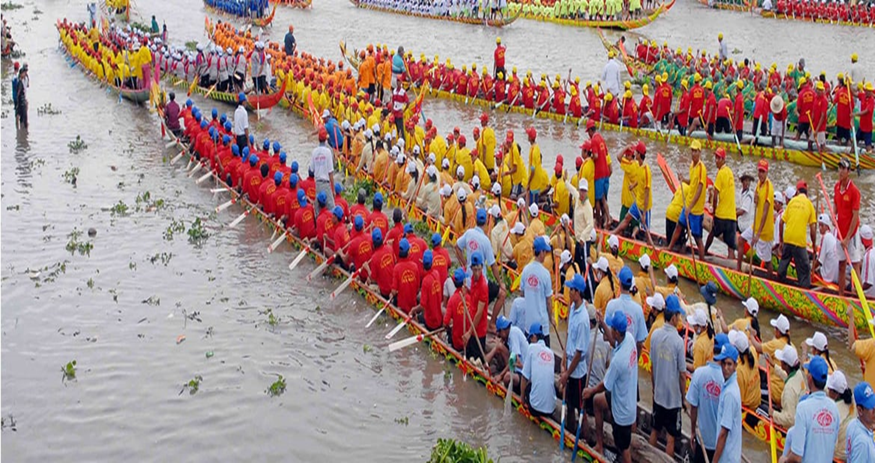
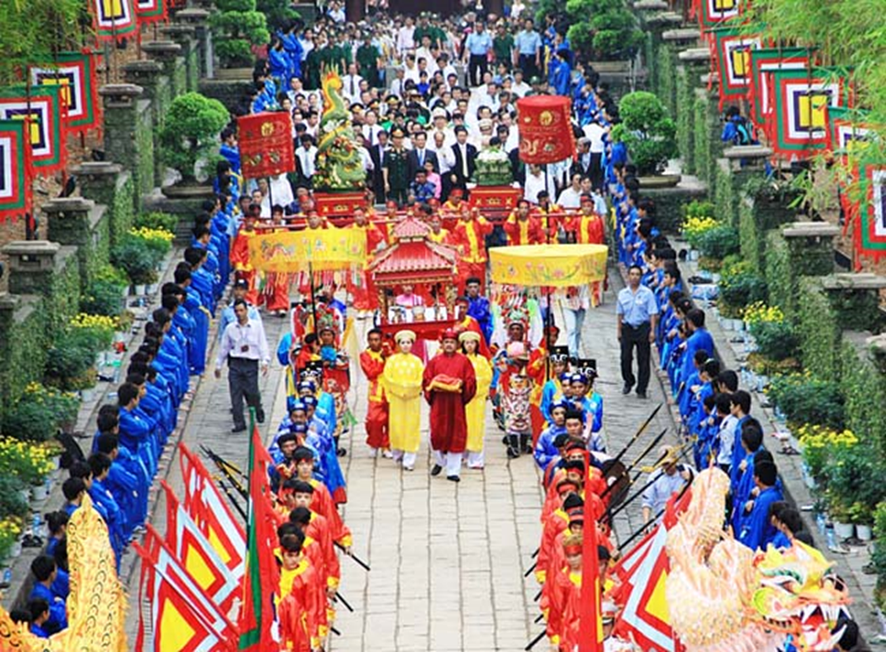
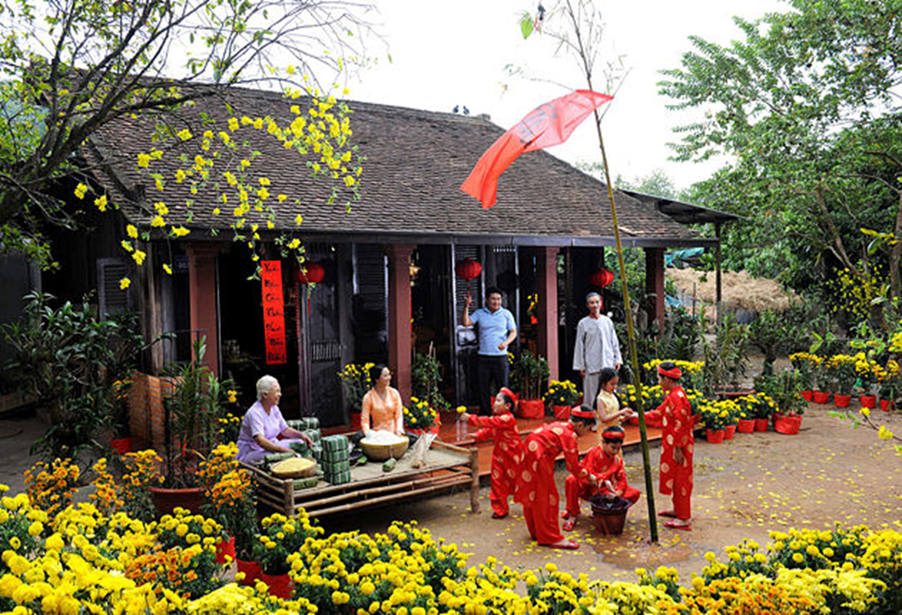
WARM-UP
Match the pictures and the names of the festivals
PELMANISM
1
2
3
4
5
6
7
8
9
10
11
12
boat racing festival
Buddha’s
Birthday
Hung King
Temple festival
Da Lat Flower
Festival
Lunar
New Year
Giong festival

Slide 3

5
OUR CUSTOMS AND TRADITIONS
Unit
LESSON 7: LOOKING BACK & PROJECT
LESSON 3: A CLOSER LOOK 2
VOCABULARY REVIEW
GRAMMAR REVIEW
Unit
PROJECT

Slide 4
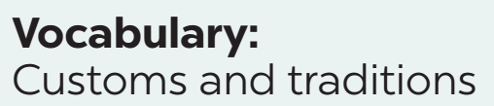


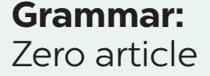
WARM-UP

Slide 5
* VOCABULARY
1
Choose the correct option to complete each sentence below.
1. It is becoming a ______ for many families in Viet nam to celebrate Women’s day and family day.
A. habit B. custom
2. ______, we hold the Spring festival on the 15th of January in lunar calendar.
A. Traditionally B. In the past
3. Janet is from a family of doctors, but she broke with ______ when she went to an art college.
A. tradition B. habit

Slide 6
1
Choose the correct option to complete each sentence below.
4. having dinner at my grandparents’ house on Saturdays is one of the customs our family ______.
A. does B. practises
5. Story telling is a great way to ______ the local tradition alive.
A. maintain B. keep

Slide 7
2
Fill in each blank with the suitable form of the word given.
1. Kien was so tall that no one recognized him at the family _______ last summer. (union)
2. My mum puts in a lot of eﬀort to prepare ________ to worship our ancestors. (oﬀer)
3. The festival ______ gathered on the riverside to cheer the boat racers. (go)
4. Dragon-snake (Rong ran len may) is a __________ Vietnamese game for children. It is very enjoyable. (tradition)
5. We happened to see some locals ___________ animals in their village temples. (worship)
reunion
offerings
goers
traditional
worshipping

Slide 8
* GRAMMAR
3
Complete the sentences with a, an, the or Ø (zero article).
Ø
1. These days, many teenagers write ______ emails instead of letters.
2. My dad bought ______ ornamental kumquat tree for Tet.
3. I don’t like that restaurant. ______ food there isn’t very good.
4. Don’t wear ______ hat when you go into a temple or a pagoda.
5. It’s becoming a custom for us to stay out very late on ______ New Year’s Eve.
an
The
a
Ø

Slide 9
4
Complete the text with a, an, the or Ø (zero article).
Here are two easy ways to raise children’s awareness of (1) ______ customs and traditions. First, it is (2) ______ good idea for parents to teach children to cook. By doing this, children can learn and preserve their family recipes. Second, parents can take children to (3) ______ local festivals. This helps them discover (4) ______ culture of their community and develop (5) ______ understanding of local traditions.
Ø
a
Ø
the
an

Slide 10
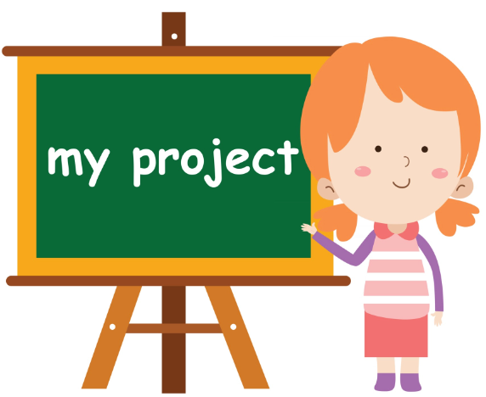
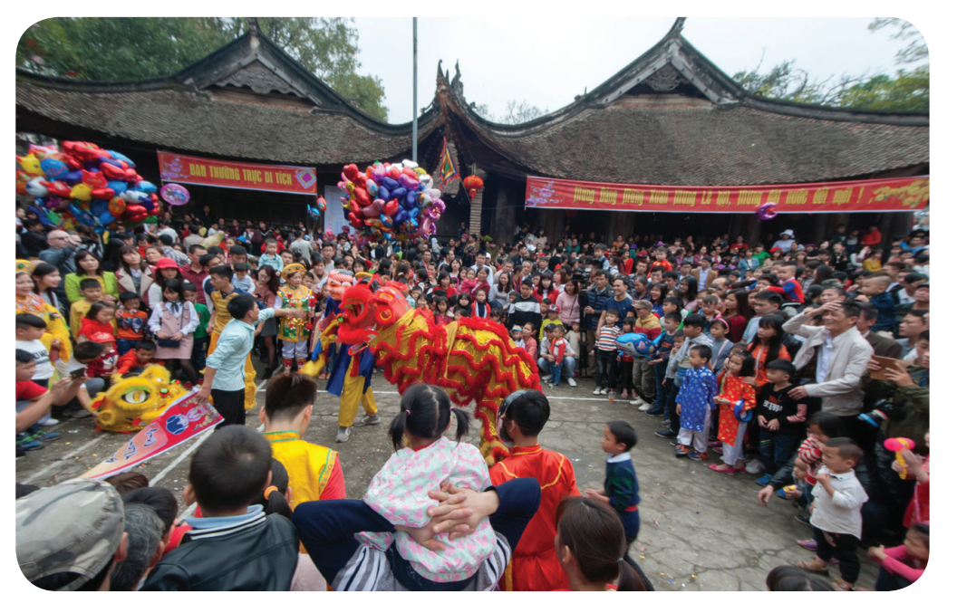
* PROJECT
LOCAL CUSTOMS AND TRADITIONS

Slide 11
* Work in groups.
1. Choose a custom or tradition practised in your hometown.
Lunar New Year

Slide 12
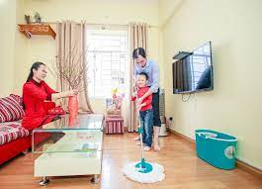
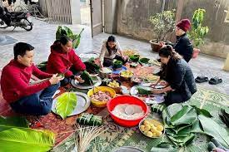
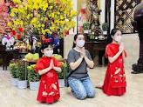
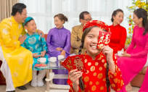
3. Report your finding to your class. You can use visual aids to illustrate your report.
Lunar New Year, or Tet, is considered the most important festival and holiday in Vietnam. All schools, companies, factories are temporarily closed. It is the occasion for family unions and gatherings when people return to their families. To prepare for this special day, most Vietnamese people prepare by cleaning and decorating their houses as well as cooking delicious foods. There are a lot of special Vietnamese customs during this time that you could learn. For example, the importance of the first person visiting the house on the new year, wishing greetings of New Year, ancestral worship, and giving lucky money to elderly people and children . During Tet, Vietnamese people will visit their relatives, go to pagodas and temples to pray for a better upcoming year.

Slide 13
2. Search for information about that custom or tradition. You can ask your parents or grandparents about it.
- Who practises it?
- Where and when do people practise it?
- What do people do?
- Why do people practise that custom / tradition?

Slide 14
* CONSOLIDATION
Vocabulary review
Grammar review
Project: Local customs and traditions

Slide 15

CONSOLIDATION
2
Homework
Learn the new words by heart.
Prepare for the next lesson.

