Slide 1

Good morning class !!!

Slide 2

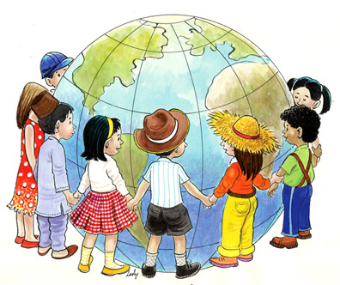
Unit
6
LIFESTYLES
LESSON 1: GETTING STARTED
Lifestyle differences

Slide 3

* WARM-UP
Answer the questions:
1. What is the video about?
2. In Viet Nam, how to two men greet when they meet?
3. Do people in Thailand shake hands when meeting?
-> About ways of greetings around the world.
-> They shake hands or say hello.
-> No. They greet each other with a “Wai” and say “Sawadee”.
LIFESTYLE DIFFERENCES

Slide 4


* Vocabulary
- Lifestyle (n):
lối sống
/ˈlaɪfstaɪl/

Slide 5
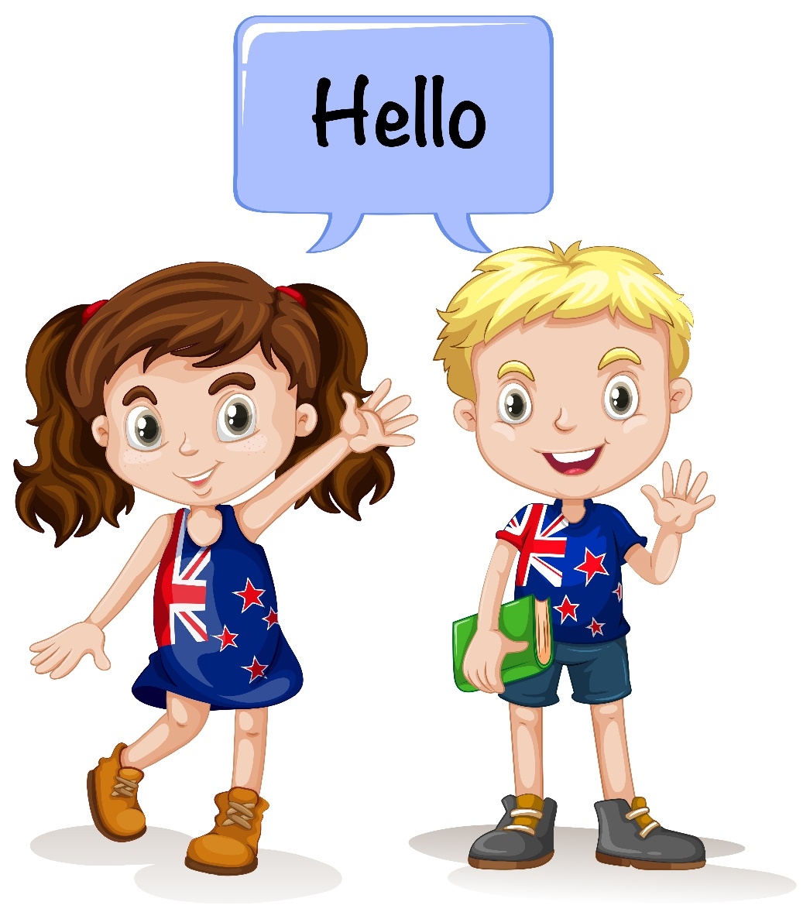
* Vocabulary
- greet (v):
chào hỏi
﻿/ɡriːt/

Slide 6
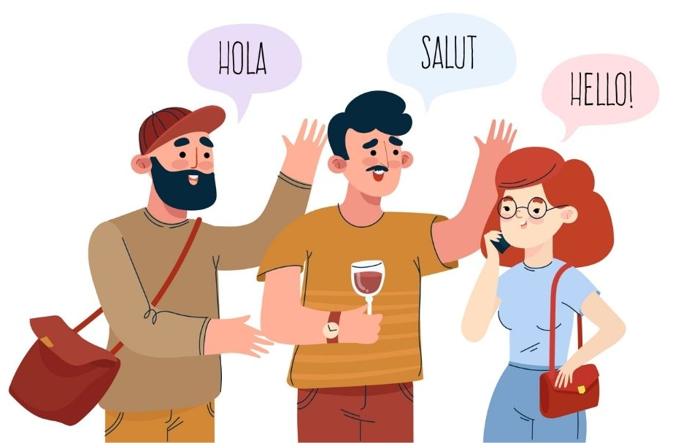
* Vocabulary
- greeting (n):
lời chào
﻿/ˈɡriːtɪŋ/

Slide 7
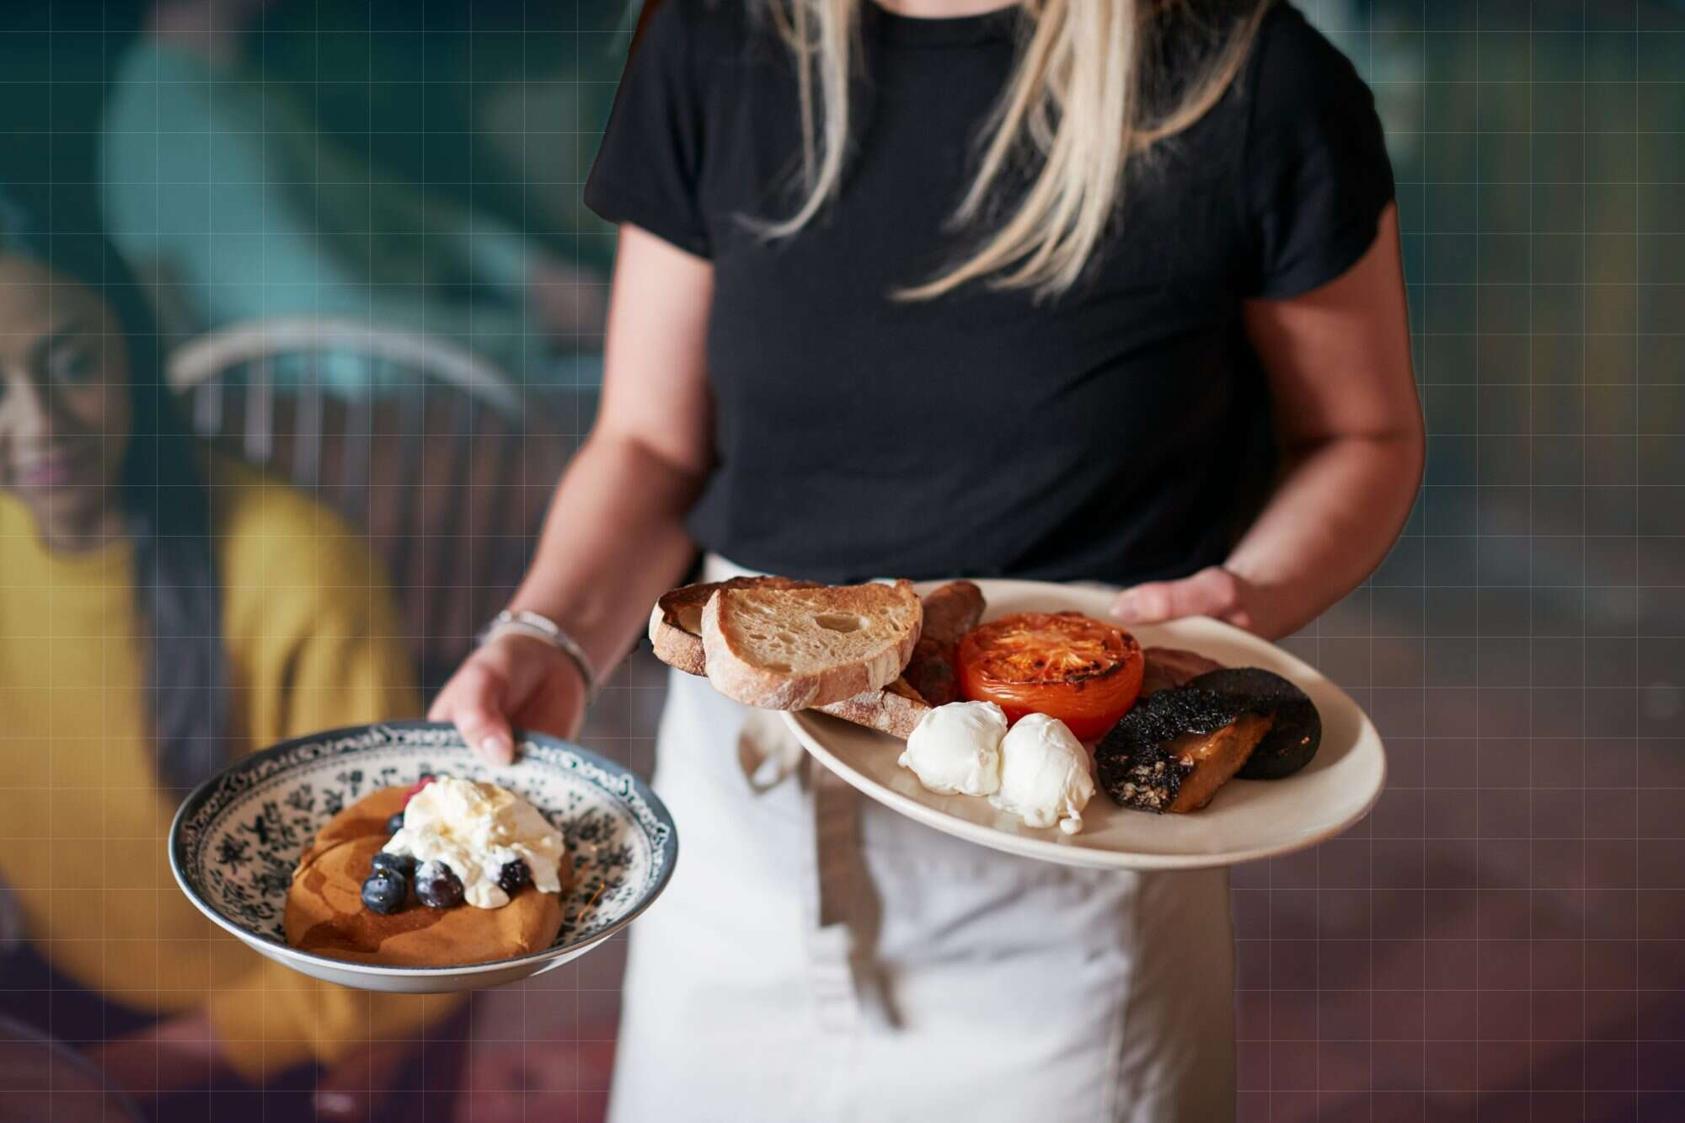
* Vocabulary
-serve (v):
phục vụ
/sɜːv/

Slide 8

* Vocabulary
common practice (n):
thông lệ
﻿/ˈkɒmən ˈpræktɪs/

Slide 9
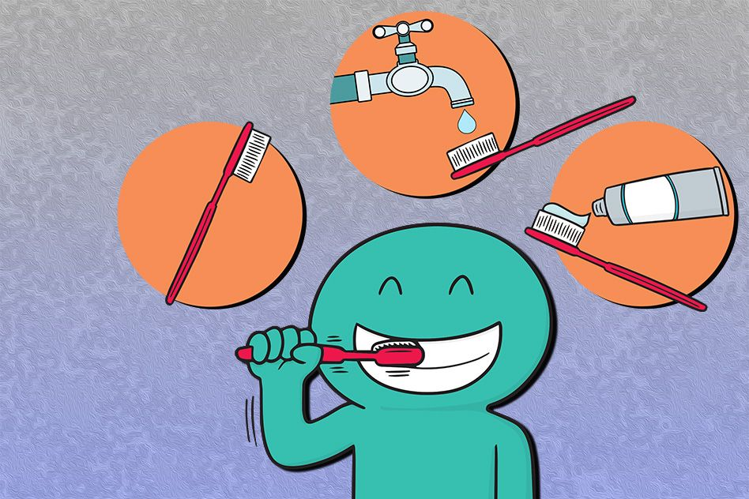
* Vocabulary
- habit:
thói quen
ˈhæbɪt`
in the habit of:
có thói quen làm gì

Slide 10
* Vocabulary
New words | Pronunciation | Meaning
1. lifestyle (n) | /ˈlaɪfstaɪl/ | lối sống
2. greet (v) | ﻿/ɡriːt/ | chào, chào hỏi
3. greeting (n) | ﻿/ˈɡriːtɪŋ/ | lời chào
4. serve (v) | ﻿/sɜːv/ | phục vụ
5. common practice (n) | /ˈkɒmən ˈpræktɪs/ | thông lệ
6. in the habit of | ﻿/ɪn ðə ˈhæbɪt əv/ | có thói quen làm gì

Slide 11
* Checking Vocabulary
New words | Meaning
 | lối sống
 | chào, chào hỏi
 | lời chào
 | phục vụ
 | thông lệ
 | có thói quen làm gì
1. lifestyle (n)
2. greet (v)
3. greeting (n)
4. serve (v)
5. common practice (n)
6. in the habit of

Slide 12
1
Listen and read.
﻿Nam: Hello, Tom. How’re things?
Tom: Oh good. I like it here. The lifestyle is interesting and different from that in my country.
Nam: Really?
Tom: Sure. Students here call their teachers by their title “teacher”, not by their names.
Nam: Right. How do you greet your teachers?
Tom: We usually say “Hello” or “Good morning” then Mr, Mrs, or Miss and their surnames, for example “Good morning, Mr Smith.”
Nam: Are there other differences?
Tom: People buy and sell a lot of street food here. In my country people usually buy food in a store or a restaurant.
Nam: Yeah. Buying street food is a common practice in my city.
﻿Tom: And I’ve noticed that many people have breakfast on the street too! In my country, we typically have a light breakfast at home.
Nam: I see. But here many adults are in the habit of having breakfast outside of their homes. If they’re not in a hurry, they’ll even have a leisurely coffee there.
Tom: That’s fascinating!

Slide 13
2
﻿Read the conversation again and complete the table.
﻿In Nam’s country | ﻿In Tom’s country
﻿– Students greet teachers by their title. – People eat breakfast (2) ______________. – People buy and sell food on the roadside. | ﻿– Students refer to their teachers as Mr, Mrs, or Miss and their teachers’ (1)________. – People eat breakfast at home. – People often buy food in a (3) __________________.
surnames
on the street
store / restaurant

Slide 14
3
Complete the sentences with the words and phrases from the box.
greet
practice
lifestyle
serve
in the habit of
﻿1. A balanced diet and exercise are important for a healthy ________.
2. Handshaking, bowing, and hugging are some of the ways in which people _________ one another.
3. Waiters and waitresses ________ food in restaurants.
4. Going out for breakfast has become a common _______in this city.
5. My mum is _____________ keeping everything in the kitchen bright and clean.
Game

Slide 15
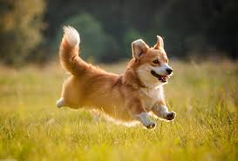


Gift box secret game

Slide 16














Slide 17









3
Complete the sentences with the words and phrases from the box.
greet
practice
lifestyle
serve
in the habit of
restaurant
6. In my country people usually buy food in a store or a …………….
5k
GO HOME

Slide 18
3
Complete the sentences with the words and phrases from the box.
greet
practice
lifestyle
serve
in the habit of
restaurant
1. A balanced diet and exercise are important for a healthy ________.
10 điểm
GO HOME

Slide 19
3
Complete the sentences with the words and phrases from the box.
greet
practice
lifestyle
serve
in the habit of
restaurant
2. Handshaking, bowing, and hugging are some of the ways in which people _________ one another.
10 Điểm
GO HOME

Slide 20
3
Complete the sentences with the words and phrases from the box.
greet
practice
lifestyle
serve
in the habit of
restaurant
3. Waiters and waitresses ________ food in restaurants.
2 cây kẹo
GO HOME

Slide 21
3
Complete the sentences with the words and phrases from the box.
greet
practice
lifestyle
serve
in the habit of
restaurant
4. Going out for breakfast has become a common _______ in this city.
5k
GO HOME

Slide 22
3
Complete the sentences with the words and phrases from the box.
greet
practice
lifestyle
serve
in the habit of
restaurant
5. My mum is _______________ keeping everything in the kitchen bright and clean.
10 k
GO HOME

Slide 23
3
Complete the sentences with the words and phrases from the box.
greet
practice
lifestyle
serve
in the habit of
﻿1. A balanced diet and exercise are important for a healthy ___________.
2. Handshaking, bowing, and hugging are some of the ways in which people _________ one another.
3. Waiters and waitresses ________ food in restaurants.
4. Going out for breakfast has become a common _________ in this city.
5. My mum is _______________ keeping everything in the kitchen bright and clean.

Slide 24
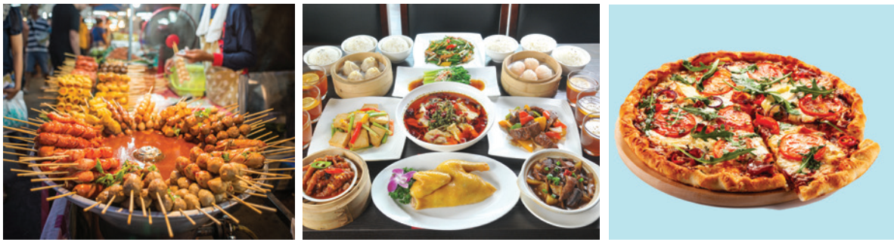





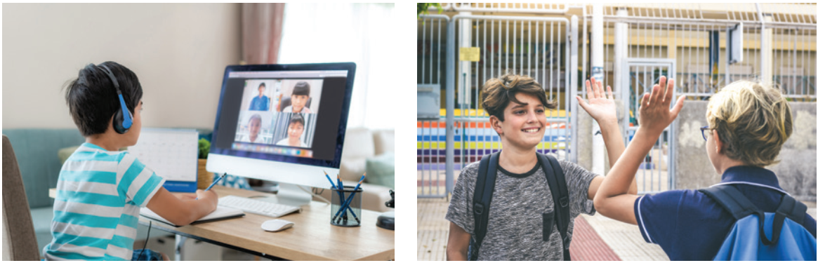
4
﻿Label each picture with a word or phrase from the box.
greeting
online learning
pizza
street food
food in restaurant

Slide 25

5
Work in pairs. Ask and answer questions in the quiz.
1. Which is probably the most common way
of greeting around the world?
A. Shaking hands.
B. Sticking out one’s tongue.
2. In the USA, people greet each other by ______.
A. shaking heads
B. saying “hello”

Slide 26
5
Work in pairs. Ask and answer questions in the quiz.
3. Thais greet their elders by saying “sawadee” and ______.
A. saying their surname
B. slightly bowing to them
4. The Maori of New Zealand greet each other by ______.
A. kissing each other’s cheek
B. pressing their noses together

Slide 27
5
Work in pairs. Ask and answer questions in the quiz.
5. How do people in Japan normally greet each other?
A. They bow to each other.
B. They hug each other.

Slide 28

* CONSOLIDATION
What have we learnt in this lesson?
identify the topic of the unit
use lexical items related to lifestyles
identify the language features that are covered in the unit

Slide 29

homework
- Name a list of 10 ways of greetings from different countries.
- Do exercises in the workbook.
- Start preparing for the Project of the unit

Slide 30

Thank you!
Have a nice day!

