Slide 1


Warm - up
Notes:
MADE BY FACEBOOK :TRAN THI THANH TAM

Slide 2
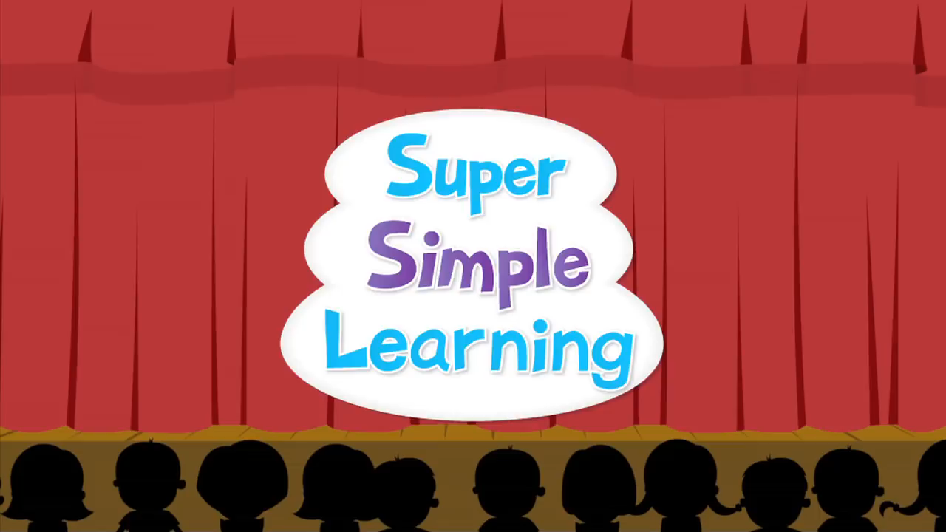

SING AND DANCE THE SONG: HELLO
Notes:
Made by FACEBOOK: TRAN THI THANH TAM

Slide 3

CHATTING
Notes:
Made by Facebook: TRAN THI THANH TAM

Slide 4

UNIT 1 : ALL ABOUT ME!
LESSON 1 ( 1, 2, 3)
Notes:
MADE BY FACEBOOK :TRAN THI THANH TAM

Slide 5



Countryside :
miền quê, nông thôn
Notes:
MADE BY FACEBOOK :TRAN THI THANH TAM

Slide 6
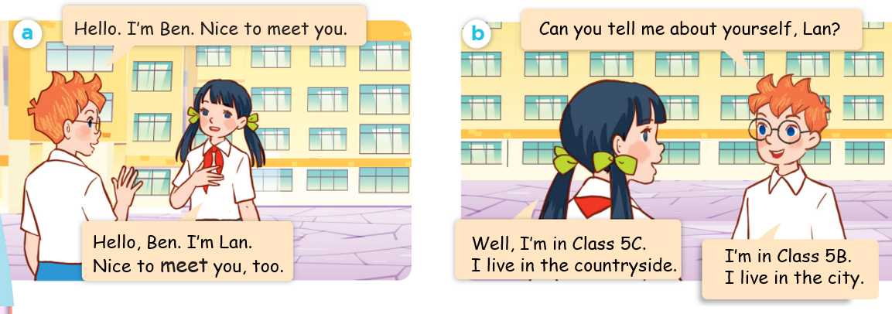
1.Look, listen and repeat
Notes:
MADE BY FACEBOOK :TRAN THI THANH TAM

Slide 7
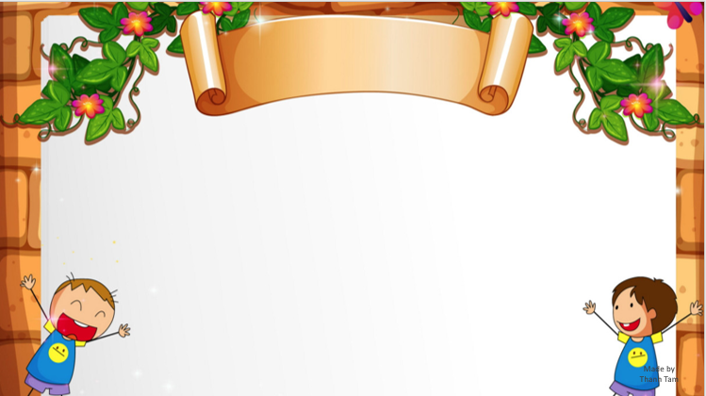
SENTENCE PATTERN
Notes:
MADE BY FACEBOOK :TRAN THI THANH TAM

Slide 8
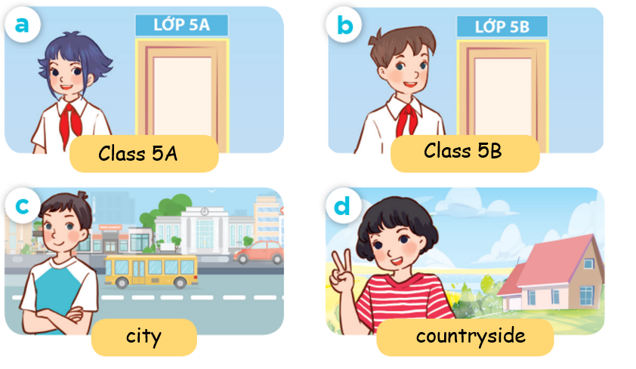
2.Listen, point and say
Can you tell me about yourself?
class 5A
I’m in …................
city
I live in the …..................
Notes:
MADE BY FACEBOOK :TRAN THI THANH TAM

Slide 9
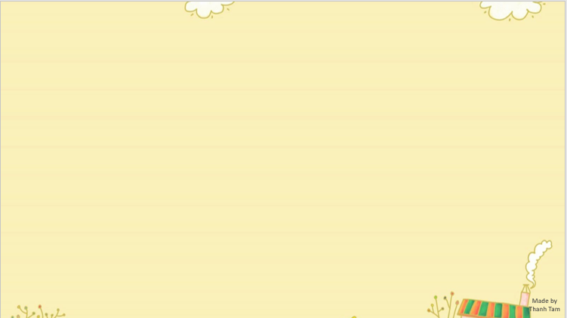
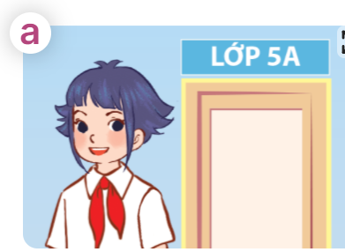
Can you tell me about yourself?
I’m in ……
Notes:
MADE BY FACEBOOK :TRAN THI THANH TAM

Slide 10
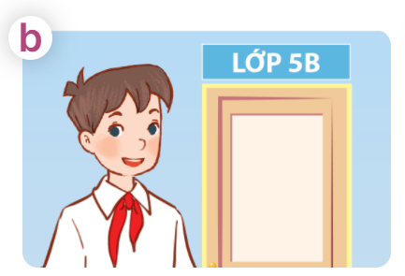
Can you tell me about yourself?
I’m in ……………………………………………….…….
Notes:
MADE BY FACEBOOK :TRAN THI THANH TAM

Slide 11
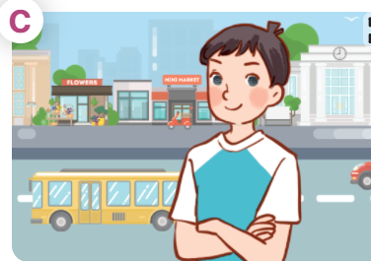
Can you tell me about yourself?
I live in the …………………………………….
Notes:
MADE BY FACEBOOK :TRAN THI THANH TAM

Slide 12
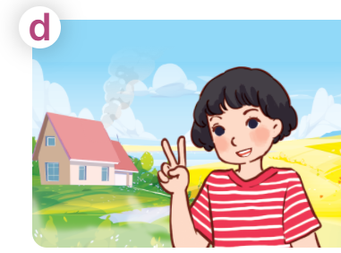
Can you tell me about yourself?
I live in the ……………………………………………….…….
Notes:
MADE BY FACEBOOK :TRAN THI THANH TAM

Slide 13


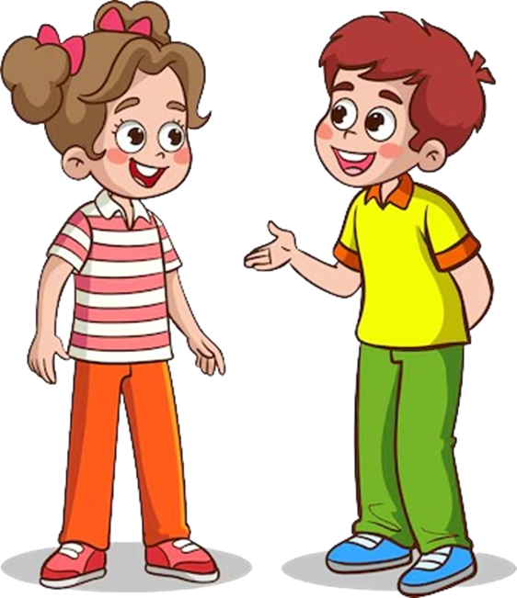
Can you tell me
about yourself?
city
town
countryside
I’m in Class
_____.
5B
mountains
5A
I live in the
______.

Slide 14
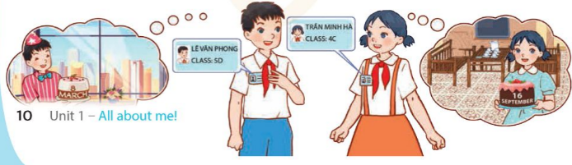
3. Let’s talk
Can you tell me about yourself?
My name’s...................
Phong
I live in ..................................
the city
I’m in ..........................
My birthday is in ..........................
Class 5D
March
Notes:
MADE BY FACEBOOK :TRAN THI THANH TAM

Slide 15

Let's play
CHOOSE PRESENTS
Notes:
MADE BY FACEBOOK :TRAN THI THANH TAM

Slide 16


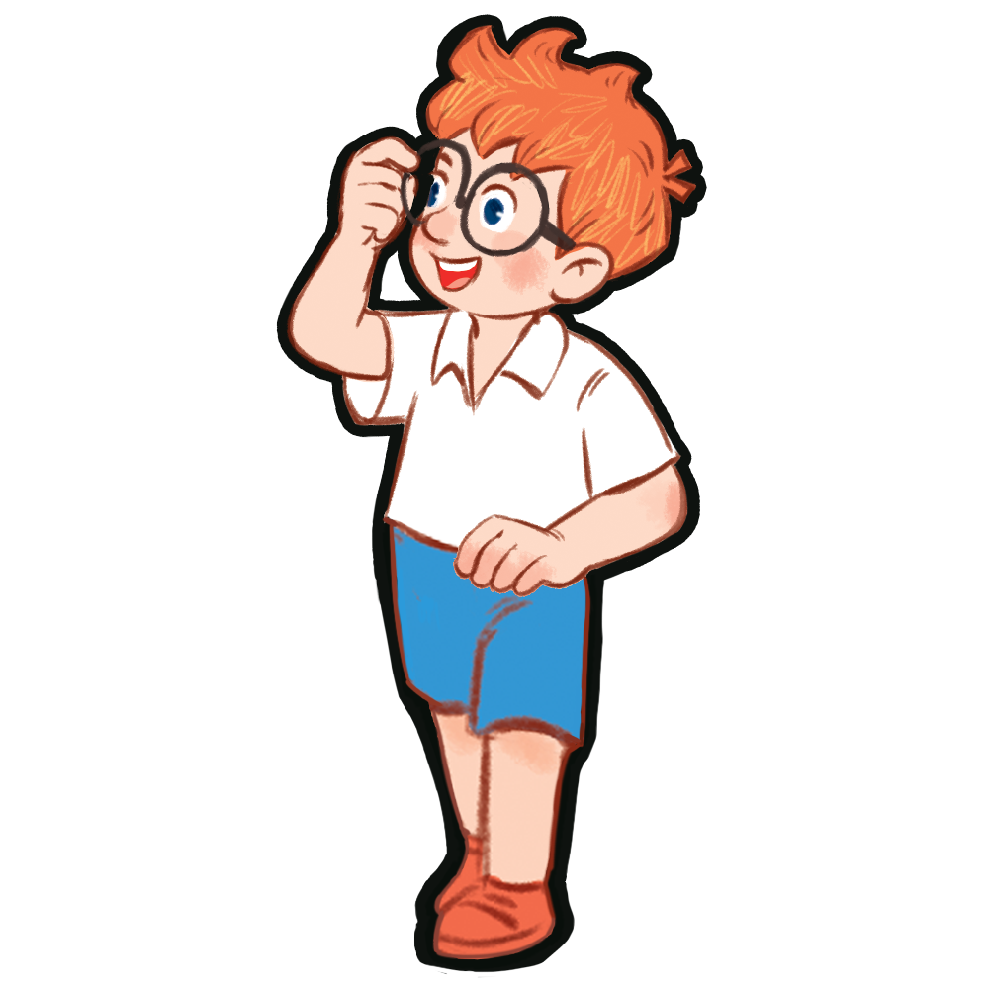


CHOOSE PRESENTS
1
2
3
4
5
6
NEXT
Notes:
MADE BY FACEBOOK :TRAN THI THANH TAM

Slide 17

Can you tell me about yourself?
BACK
Notes:
MADE BY FACEBOOK :TRAN THI THANH TAM

Slide 18
BACK
Notes:
MADE BY FACEBOOK :TRAN THI THANH TAM

Slide 19
Can you tell me about yourself?
BACK
Notes:
MADE BY FACEBOOK :TRAN THI THANH TAM

Slide 20
Can you tell me about yourself?
BACK
Notes:
MADE BY FACEBOOK :TRAN THI THANH TAM

Slide 21
BACK
Notes:
MADE BY FACEBOOK :TRAN THI THANH TAM

Slide 22
Can you tell me about yourself?
BACK
Notes:
MADE BY FACEBOOK :TRAN THI THANH TAM

Slide 23

Notes:
MADE BY FACEBOOK :TRAN THI THANH TAM

Slide 24
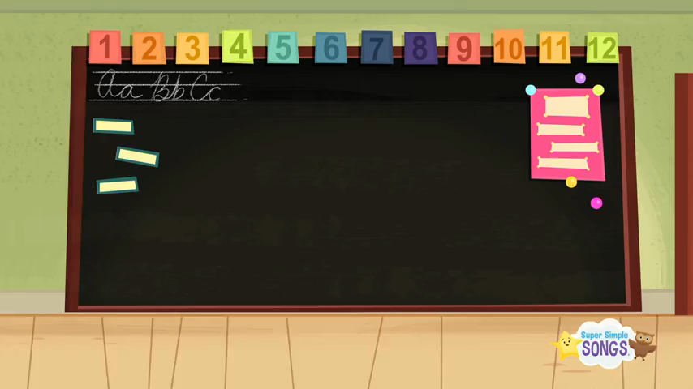
SING AND DANCE THE SONG: HELLO
Notes:
Made by FACEBOOK: TRAN THI THANH TAM

Slide 25
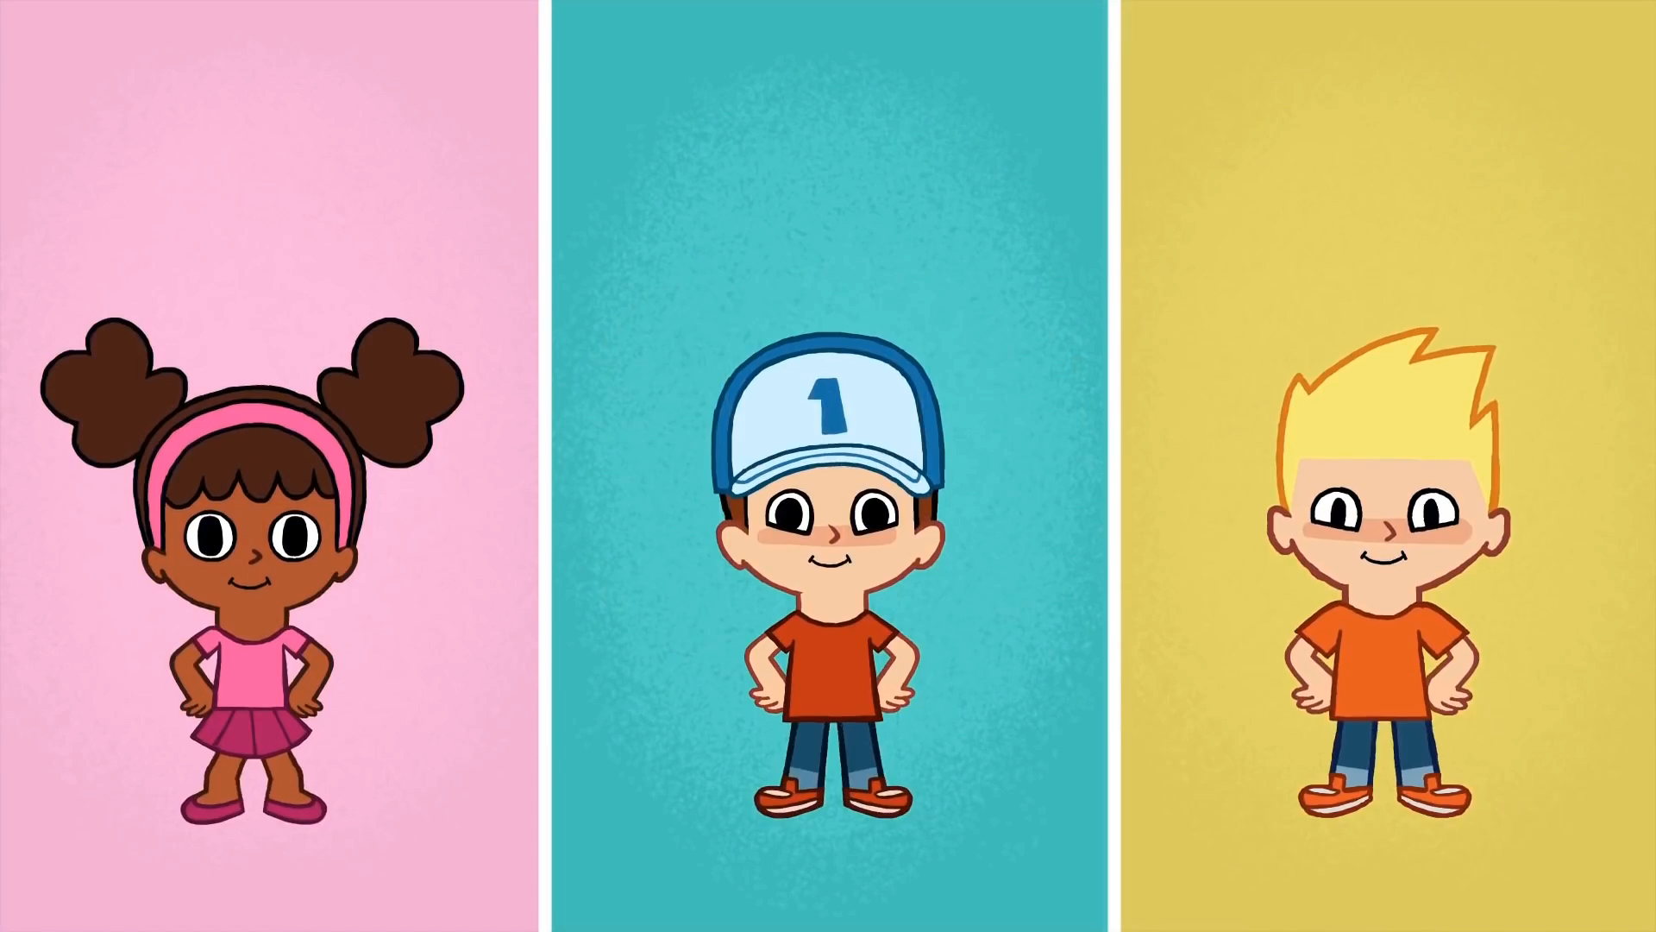
* SING AND DANCE: BYE BYE GOODBYE SONG

