Slide 1


Nguyen Du Primary School
WELCOME TO
OUR CLASS 5
Teacher: Trần Thị Thanh Tâm

Slide 2

UNIT 4: OUR FREE – TIME ACTIVITIES
LESSON 2 ( 1, 2, 3)
Notes:
MADE BY FACEBOOK :TRAN THI THANH TAM

Slide 3

CONTENTS
1
WARM -UP
2
LOOK, LISTEN AND REPEAT
3
VOCABULARY
4
LISTEN, POINT AND SAY
5
LET’S TALK
6
PLAY GAME
Notes:
MADE BY FACEBOOK :TRAN THI THANH TAM

Slide 4

Warm - up
Game: LUCKY WHEEL
Notes:
MADE BY FACEBOOK :TRAN THI THANH TAM

Slide 5


SPIN AND SAY
Play table tennis
Ride my bile
Play the viloin
Water the flowers
Listen to music
Click the needle to start and then again to stop the wheel. Then READ ALOUD.
weekend

Slide 6

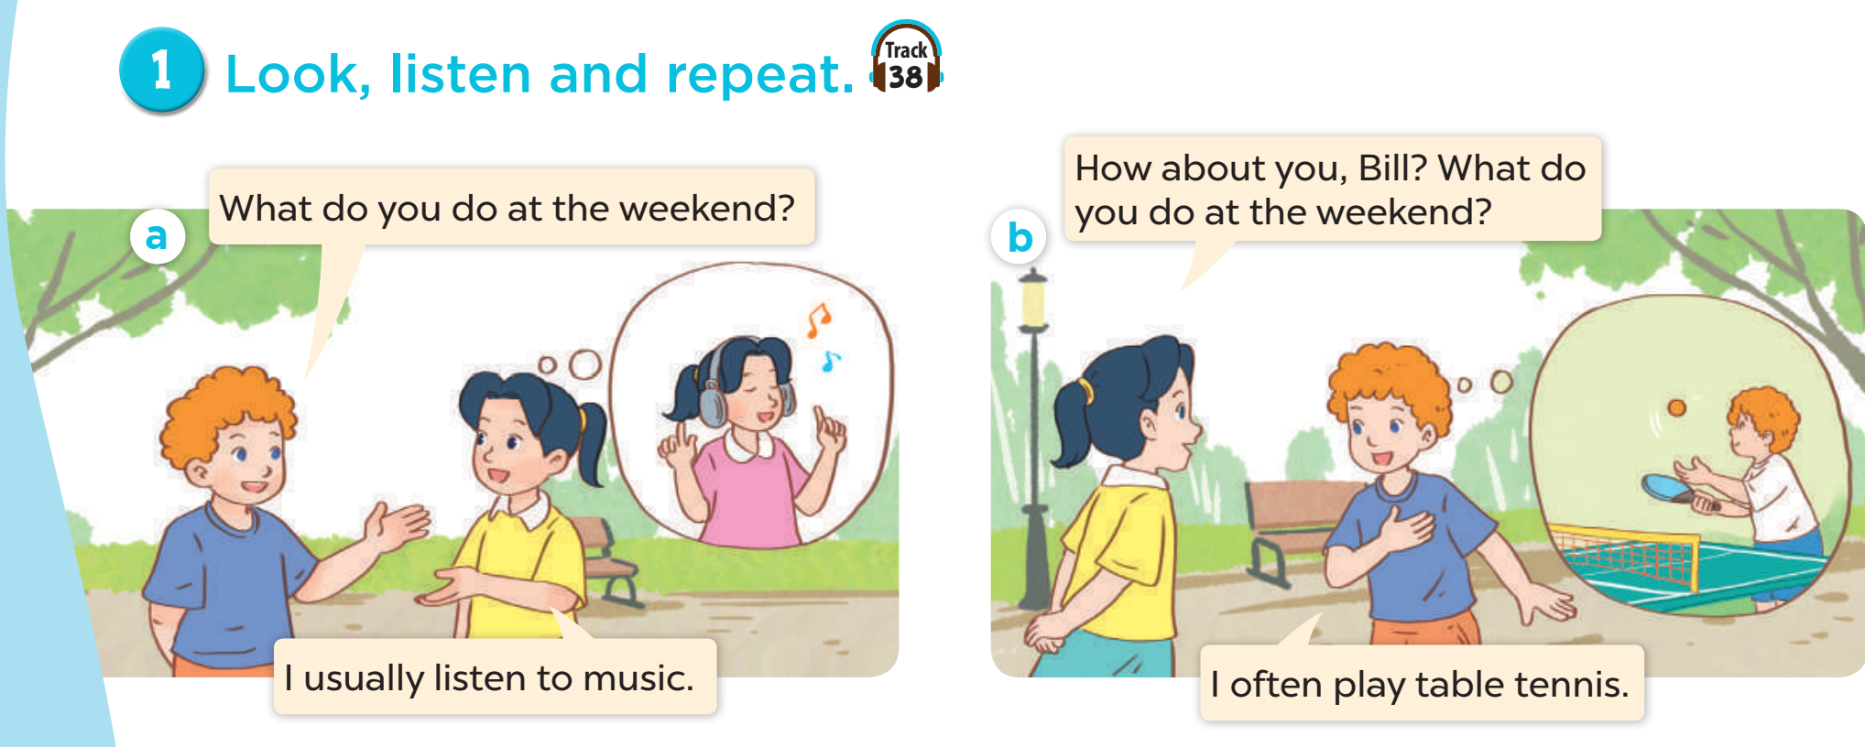

Notes:
MADE BY FACEBOOK :TRAN THI THANH TAM

Slide 7

Notes:
MADE BY FACEBOOK :TRAN THI THANH TAM

Slide 8

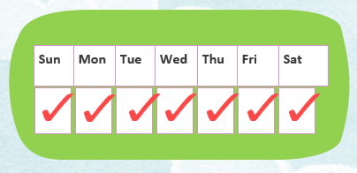
Always: luôn luôn
Notes:
MADE BY FACEBOOK :TRAN THI THANH TAM

Slide 9
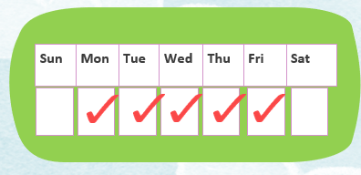
Usually: thường thường
Notes:
MADE BY FACEBOOK :TRAN THI THANH TAM

Slide 10
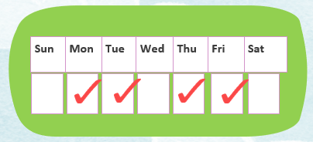
Often: thường, hay
Notes:
MADE BY FACEBOOK :TRAN THI THANH TAM

Slide 11
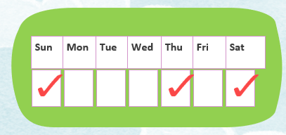
Sometimes: thỉnh thoảng
Notes:
MADE BY FACEBOOK :TRAN THI THANH TAM

Slide 12

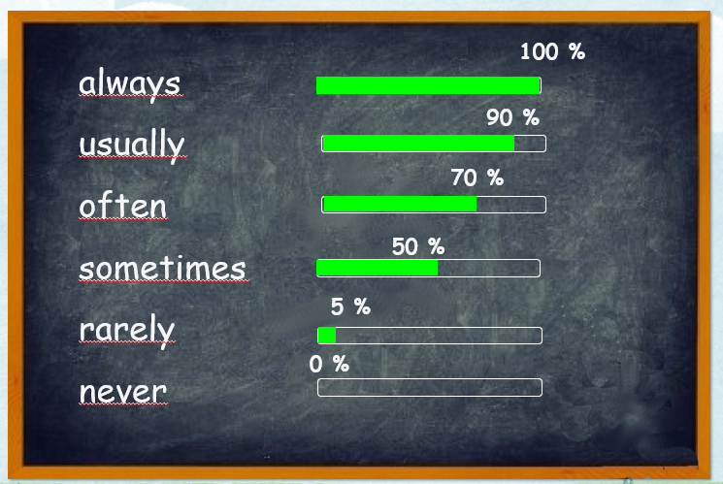
VOCABULARY
Always: luôn luôn
Usually: thường thường
Often: thường, hay
Sometimes: thỉnh thoảng
Notes:
MADE BY FACEBOOK :TRAN THI THANH TAM

Slide 13
PLAY GAME
Unscramble the letters
Notes:
MADE BY FACEBOOK :TRAN THI THANH TAM

Slide 14


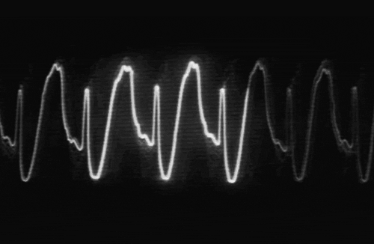


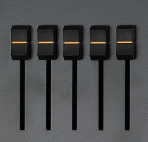




NEFTO
OFTEN
Notes:
Click on the red button to reveal the answer.

Slide 15
SALYWA
ALWAYS
Notes:
Click on the red button to reveal the answer.

Slide 16
LULYSUA
USUALLY
Notes:
Click on the red button to reveal the answer.

Slide 17
MESMESOTI
SOMETIMES
Notes:
Click on the red button to reveal the answer.

Slide 18
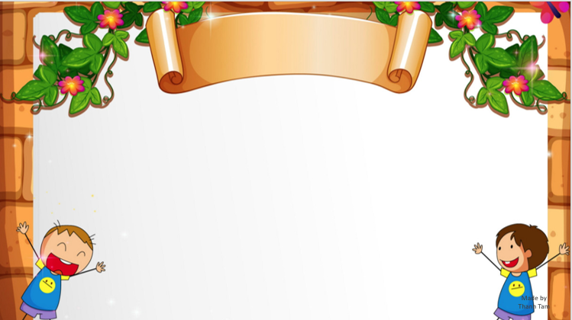
SENTENCE PATTERN
Notes:
MADE BY FACEBOOK :TRAN THI THANH TAM

Slide 19

Hỏi xem ai đó làm gì vào cuối tuần
What do you do at the weekend ?
( Bạn làm gì vào cuối tuần vậy? )
I always read stories.
(Tôi luôn luôn đọc truyện.)
Notes:
MADE BY FACEBOOK :TRAN THI THANH TAM

Slide 20
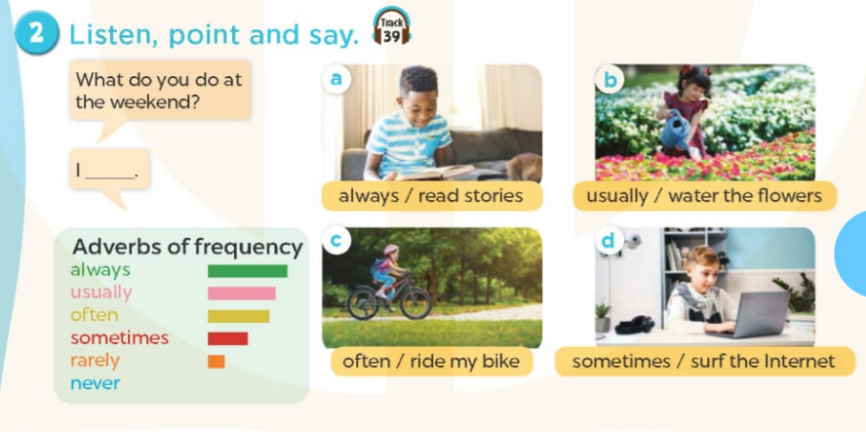
always read stories.
Notes:
MADE BY FACEBOOK :TRAN THI THANH TAM

Slide 21
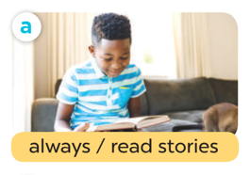
What do you do at the weekend?
I……………………………………………………..…....
always read stories.
Notes:
MADE BY FACEBOOK :TRAN THI THANH TAM

Slide 22
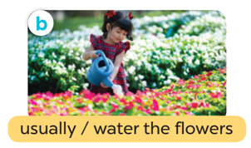
What do you do at the weekend?
I……………………………………………………..…............
usually water the flowers.
Notes:
MADE BY FACEBOOK :TRAN THI THANH TAM

Slide 23
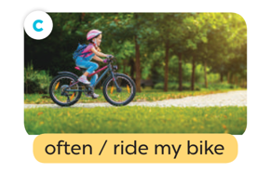
What do you do at the weekend?
I……………………………………………………..…......
often ride my bike.
Notes:
MADE BY FACEBOOK :TRAN THI THANH TAM

Slide 24
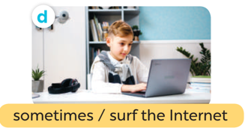
What do you do at the weekend?
I……………………………………………………..…............
sometimes surf the internet.
Notes:
MADE BY FACEBOOK :TRAN THI THANH TAM

Slide 25


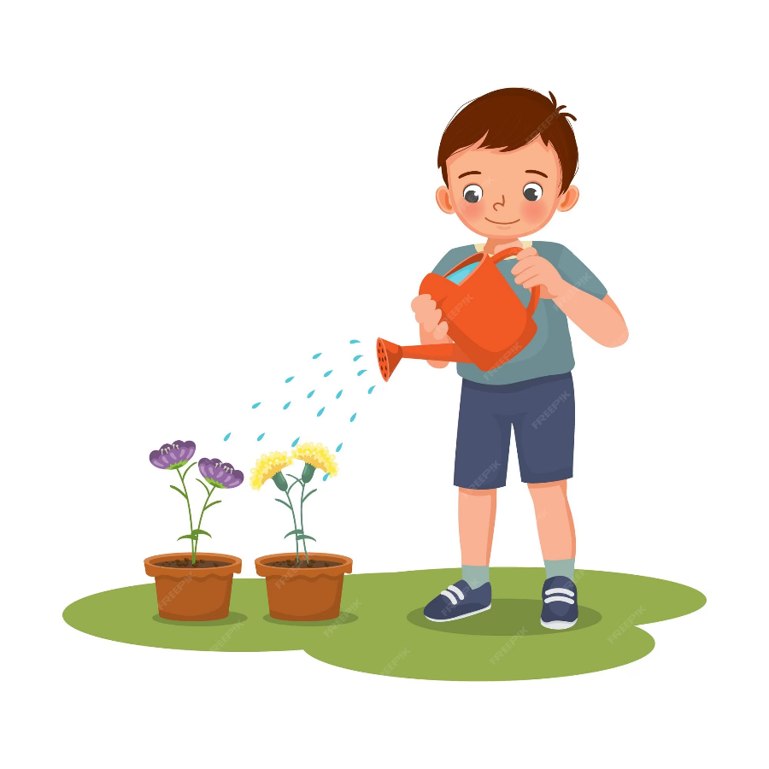
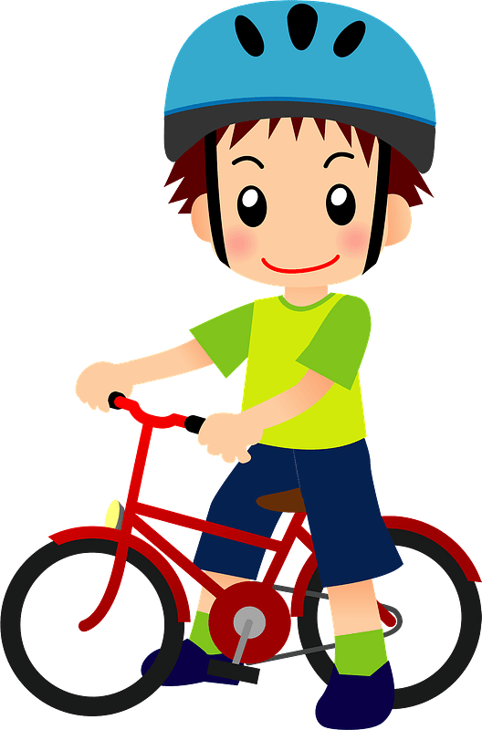
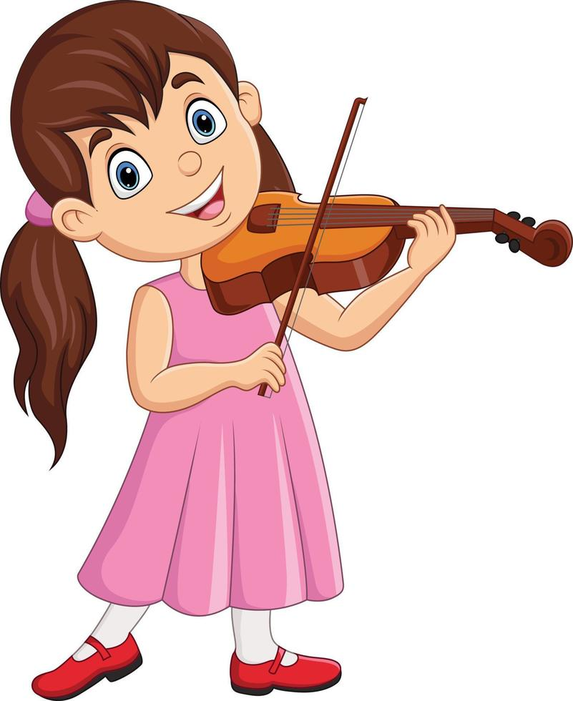
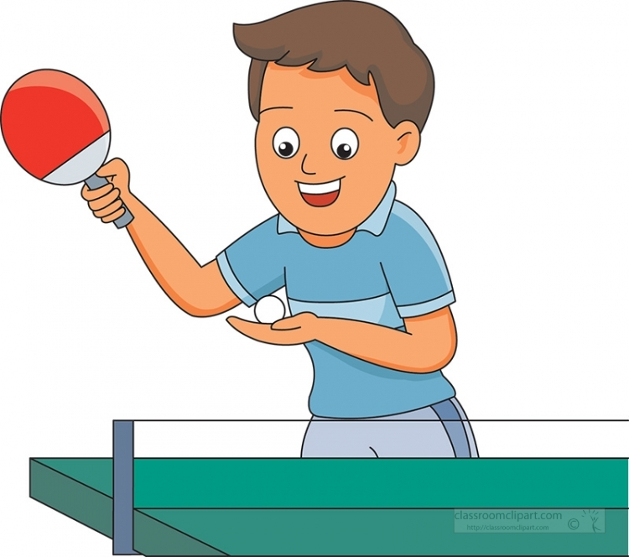
3. Let’s talk
What do you do at the weekend?
What do you like doing in your free time?
I …………………….

Slide 26



PLAY GAME
Choose the best answer
Notes:
Step 2: Have groups put the posters on the desk and practice the presentation. Encourage all members in the group to present. Go around the classroom and offer help where necessary.

Slide 27

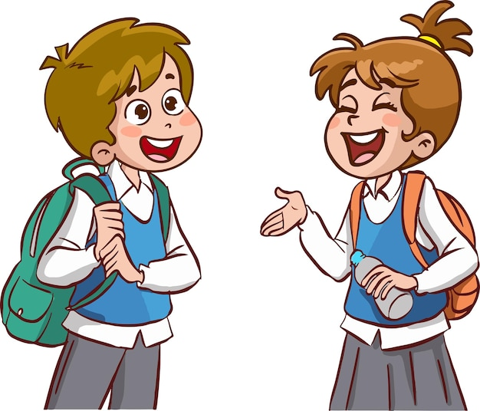
What do you do at the weekend?
70 %
I …………………… play the violin.
A. always
B. sometimes
C. often

Slide 28
What do you do at the weekend?
50 %
I …………………… surf the Internet.
A. often
B. rarely
C. sometimes

Slide 29
What do you do at the weekend?
100 %
I ……………… ride my bike.
A. always
B. never
C. usually

Slide 30
What do you do at the weekend?
90 %
I …………………. read stories.
A. sometimes
B. never
C. usually

Slide 31
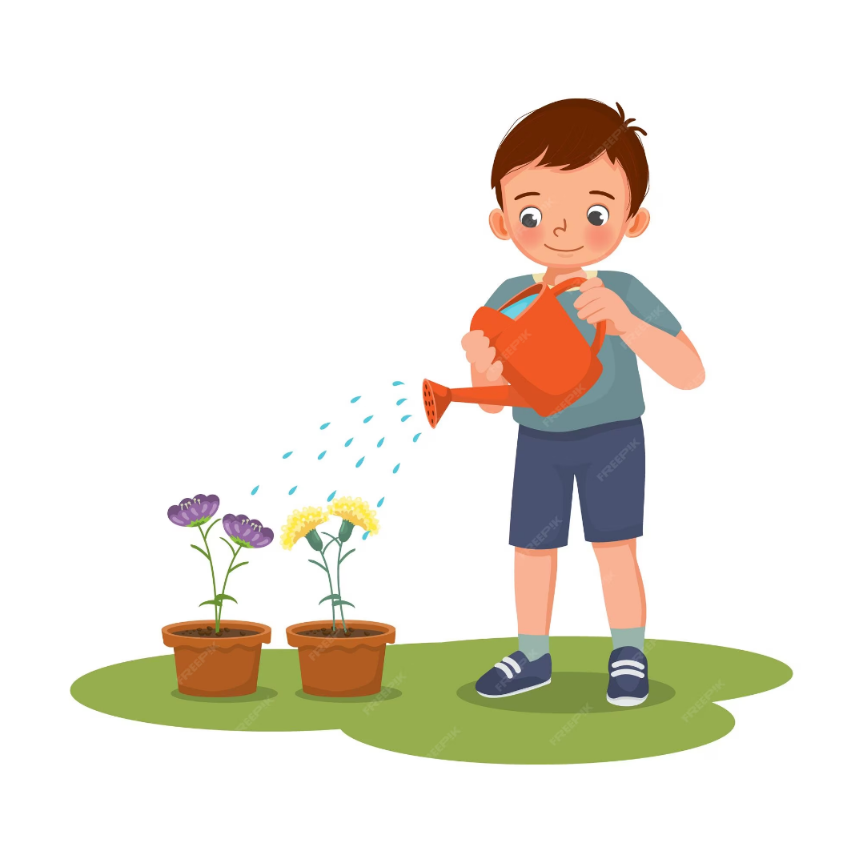
5 %
What do you do at the weekend?
I ……………. water the flowers.
A. always
B. rarely
C. often

Slide 32

What do you do at the weekend?
0 %
I ……………… play table tennis.
A. never
B. often
C. usually

Slide 33
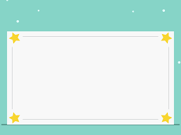
SUMMARY
1.Vocabulary:
Always: luôn luôn
Usually: thường thường
Often: thường, hay
Sometimes: thỉnh thoảng
2. Sentence pattern:
-What do you do at the weekend?
(Bạn làm gì vào cuối tuần vậy?)
-> I always read stories.
(Tôi luôn luôn đọc truyện.)

Slide 34
Notes:
MADE BY FACEBOOK :TRAN THI THANH TAM

Slide 35

Homework:
- Learn by heart vocabulary and sentence pattern
- Prepare Unit 4- lesson 2 ( 4, 5, 6)
Notes:
MADE BY FACEBOOK :TRAN THI THANH TAM

Slide 36

Notes:
MADE BY FACEBOOK :TRAN THI THANH TAM

