Slide 1


UNIT 5: MY FUTURE JOB
LESSON 2 ( 4, 5, 6)
Notes:
MADE BY FACEBOOK :TRAN THI THANH TAM

Slide 2
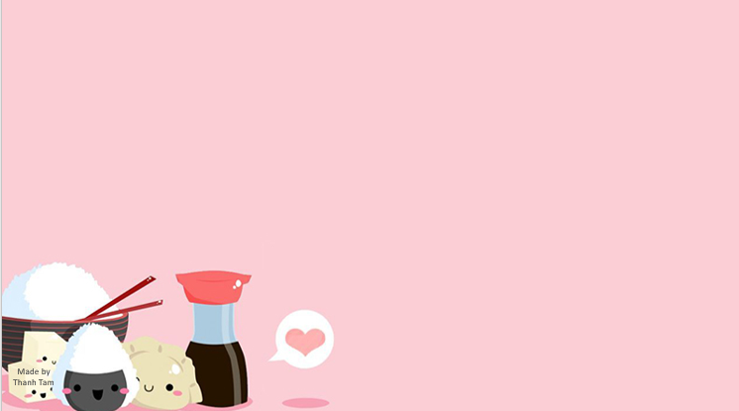
CONTENTS
1
WARM –UP - REVIEW
2
LISTEN AND TICK
3
READ AND COMPLETE
4
LET’S PLAY
5
PLAY GAME
Notes:
MADE BY FACEBOOK :TRAN THI THANH TAM

Slide 3

Warm - up
Notes:
MADE BY FACEBOOK :TRAN THI THANH TAM

Slide 4


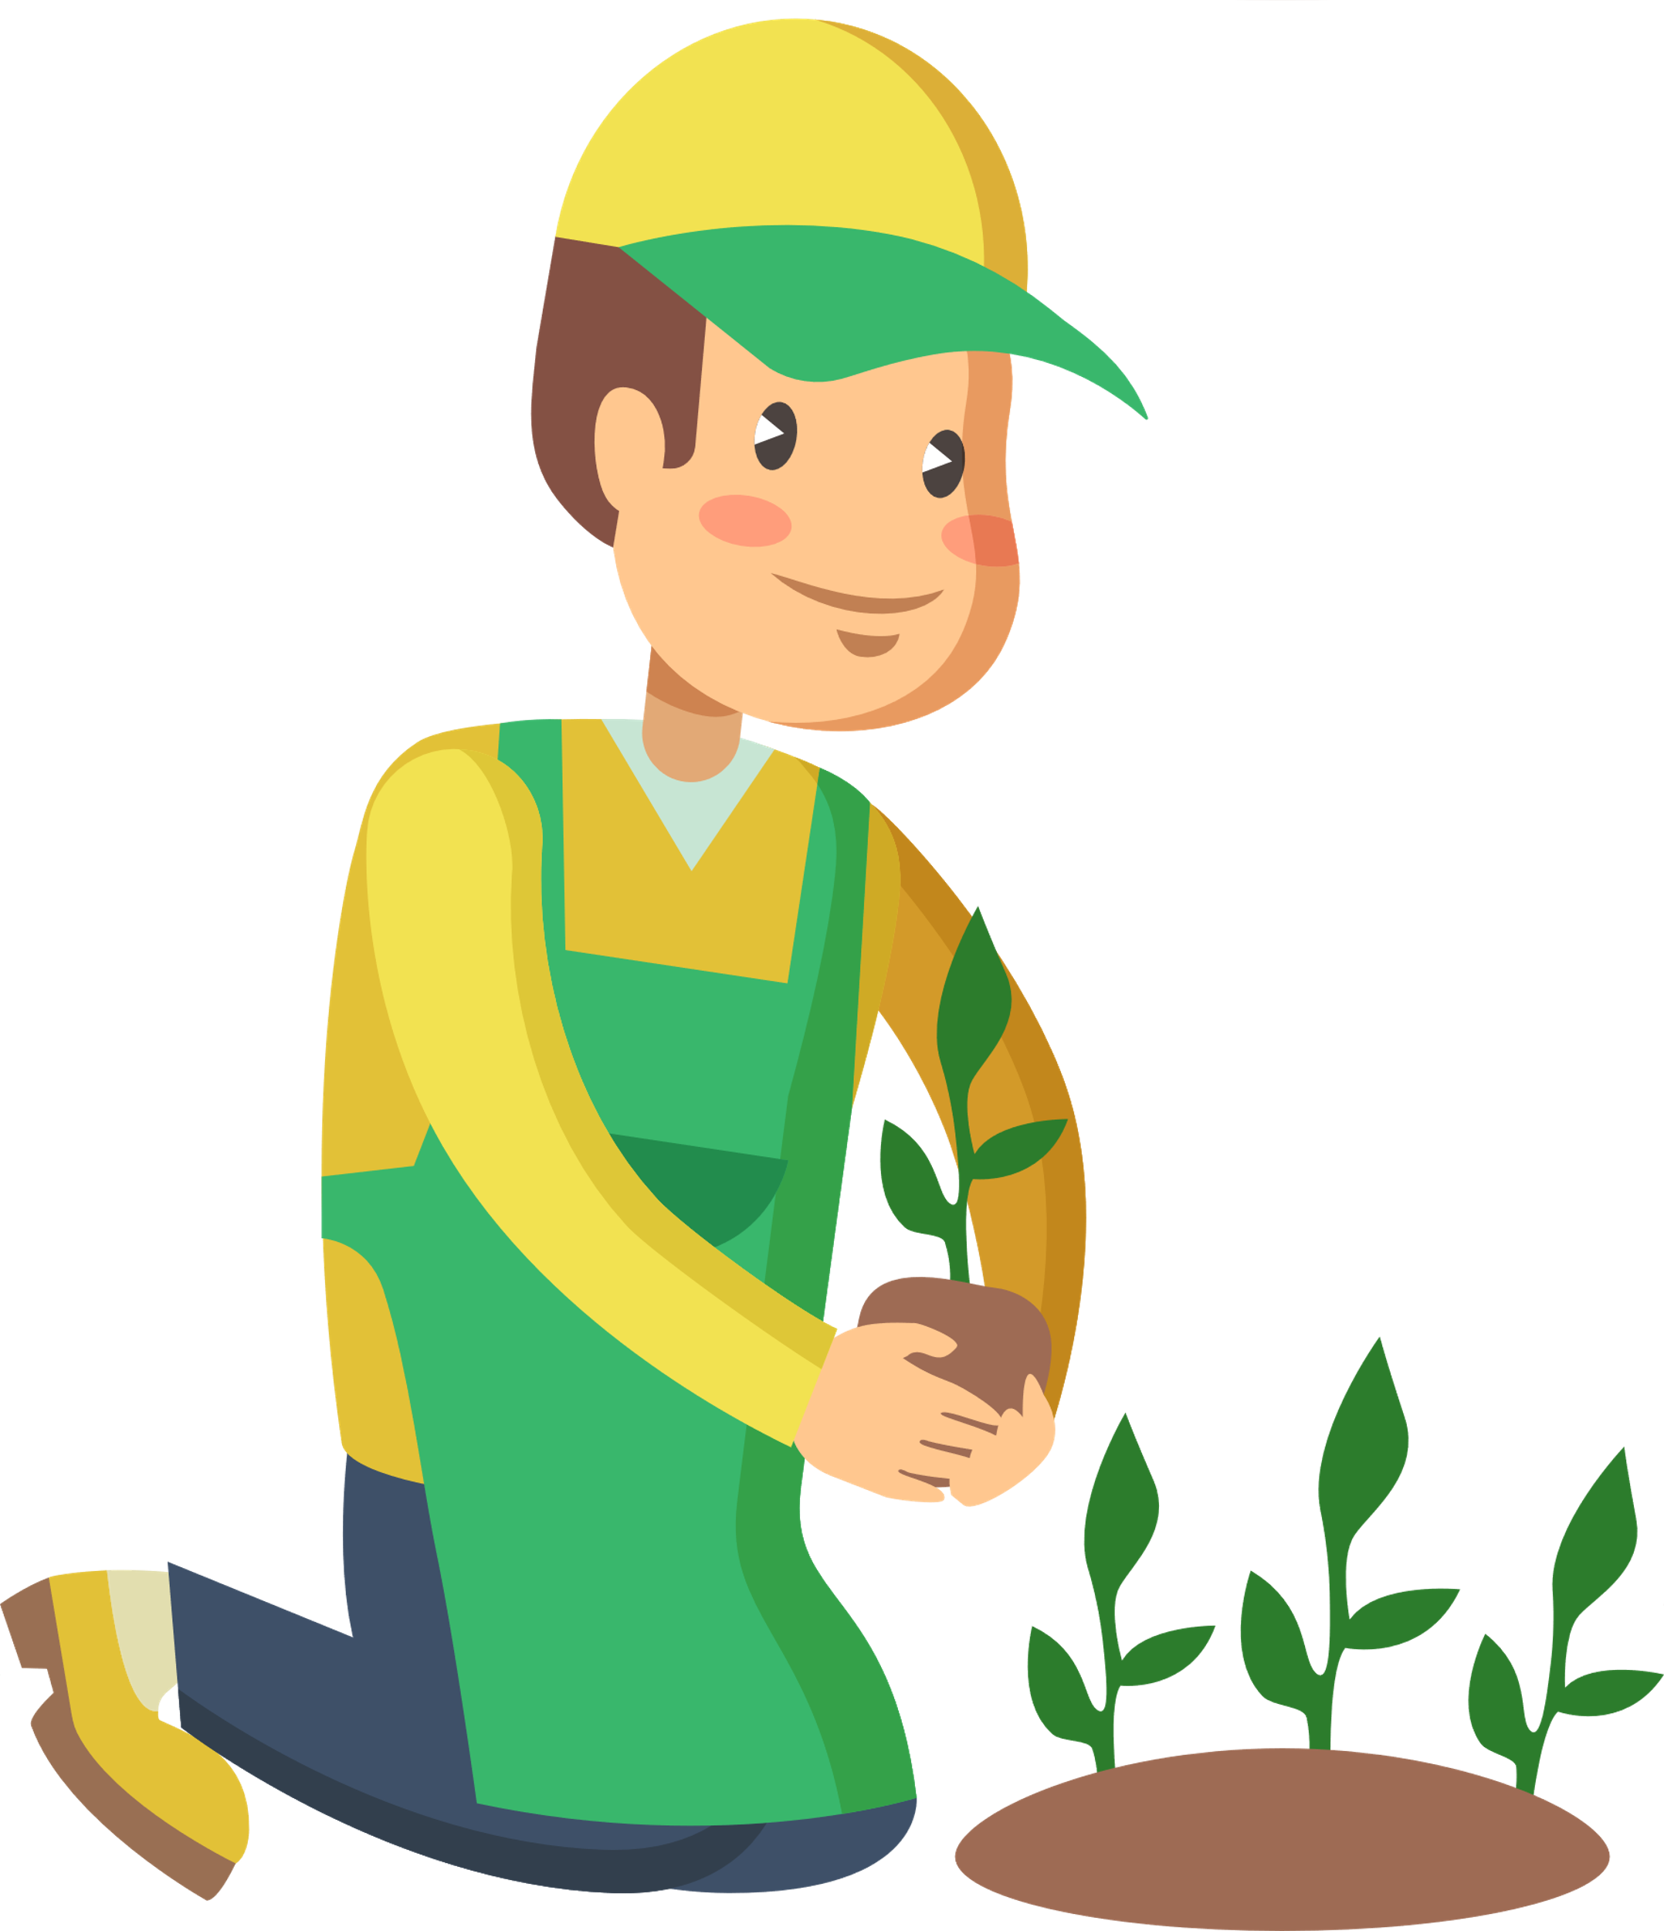
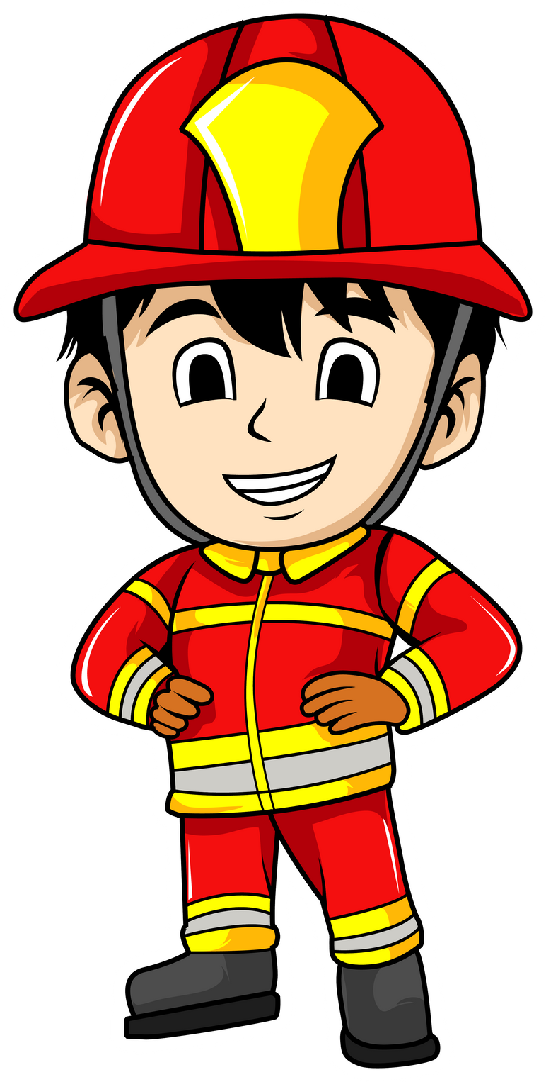

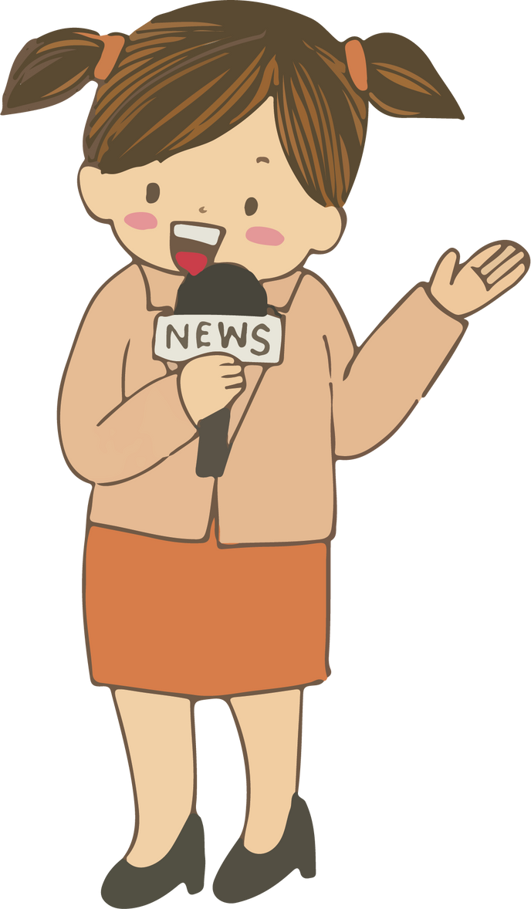

MATCHING GAME
doctor
gardener
teacher
reporter
firefighter
writer

Slide 5

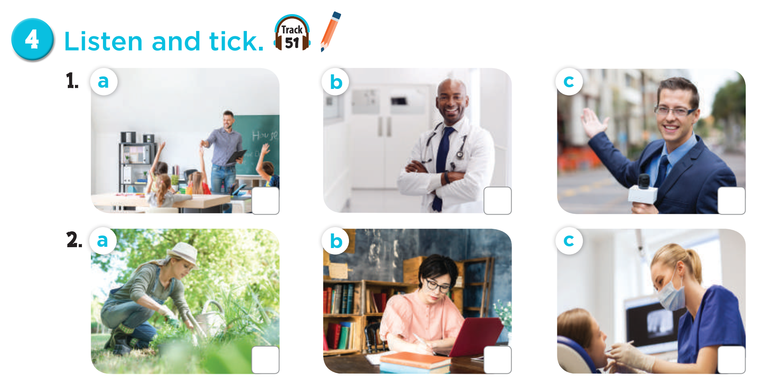


Notes:
MADE BY FACEBOOK :TRAN THI THANH TAM

Slide 6
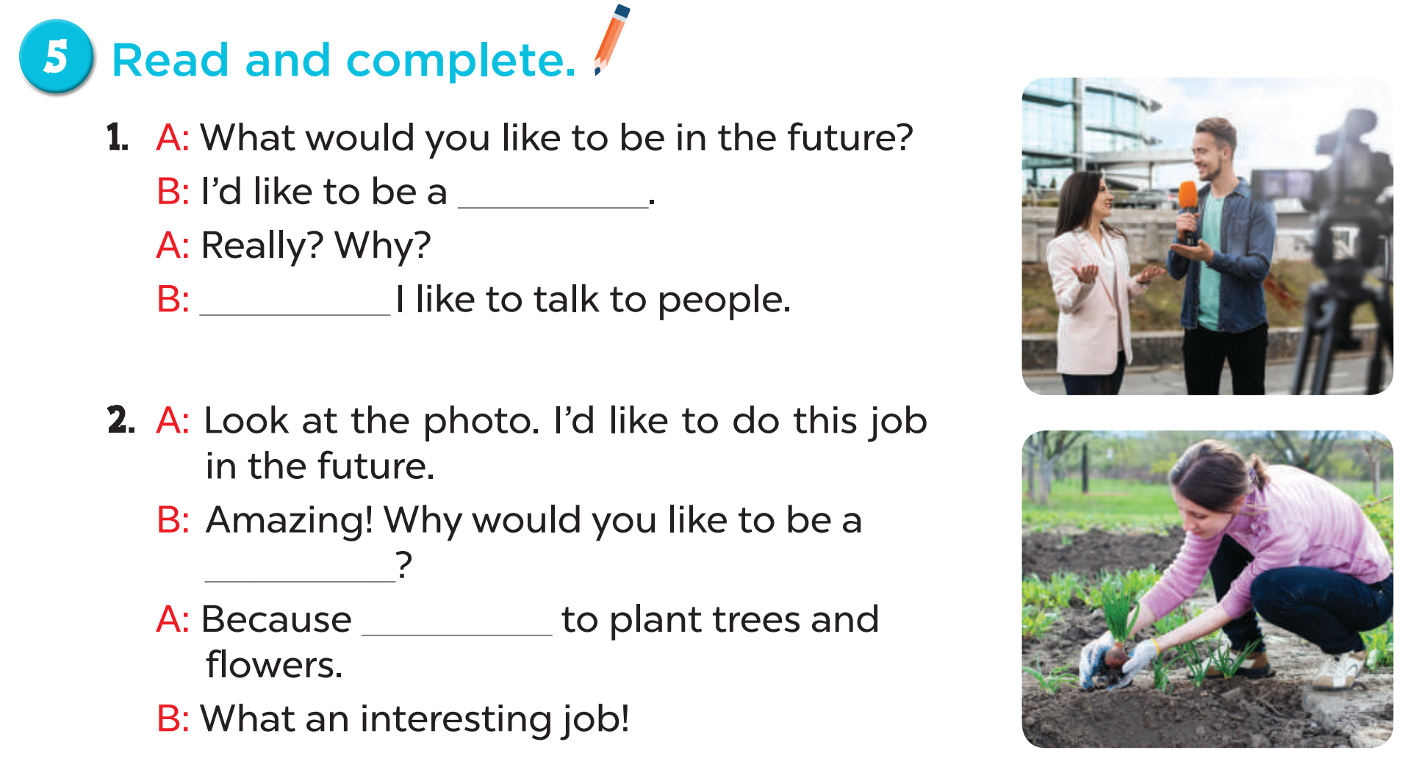
reporter
Because
gardener
I’d like

Slide 7
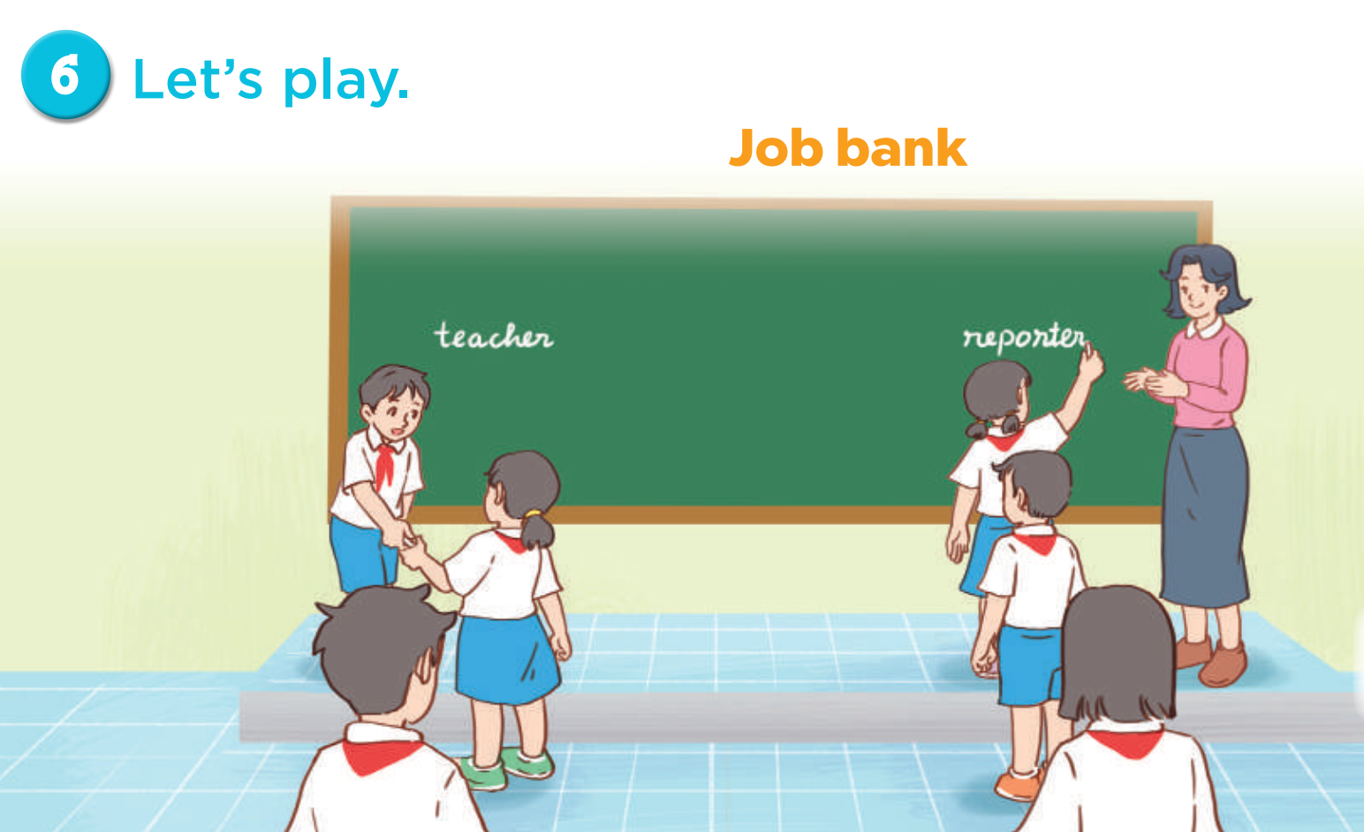
Notes:
MADE BY FACEBOOK :TRAN THI THANH TAM

Slide 8


Let's play GAME
REODER THE WORDS
Notes:
MADE BY FACEBOOK :TRAN THI THANH TAM

Slide 9
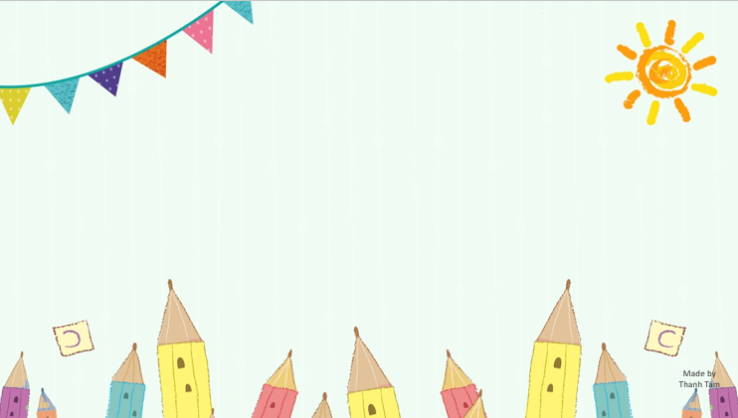
like /future/ the/What/ you /to/ in/ would/ be/?/
What would you like in the future to be?
What you would like to be in the future?
What would you like to be in the future?
Notes:
MADE BY FACEBOOK :TRAN THI THANH TAM

Slide 10
be / I’d / firefighter / like / a/ to/./
I’d like a firefighter to be.
I’d like to be a firefighter.
I’d to be like a firefighter.
Notes:
MADE BY FACEBOOK :TRAN THI THANH TAM

Slide 11
you/to/ like /Why/writer /would/a/ be/?/
Why you would like to be a writer?
Why would you like to be a writer?
Why would you to be like a writer?
Notes:
MADE BY FACEBOOK :TRAN THI THANH TAM

Slide 12
children/to/Because/teach/ I’d/like/./
Because I’d teach like to children.
Because I’d like teach to children.
Because I’d like to teach children.
Notes:
MADE BY FACEBOOK :TRAN THI THANH TAM

Slide 13
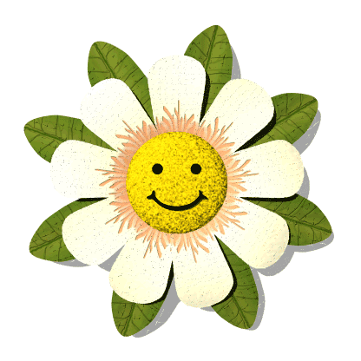
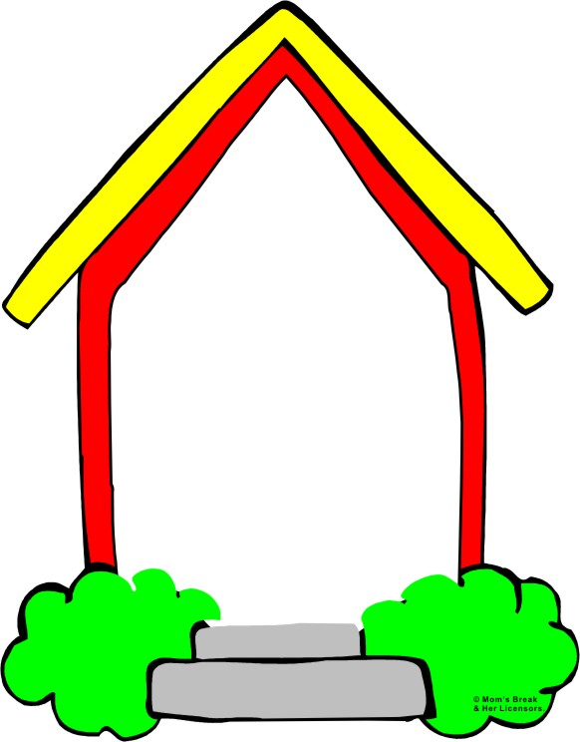
Homework:
- Practice more at home
- Prepare Unit 5- Lesson 3 ( 1, 2, 3)
Made by
Thanh Tam
Notes:
MADE BY FACEBOOK :TRAN THI THANH TAM

Slide 14

Notes:
MADE BY FACEBOOK :TRAN THI THANH TAM

