Slide 1


Warm - up
Notes:
MADE BY FACEBOOK :TRAN THI THANH TAM

Slide 3

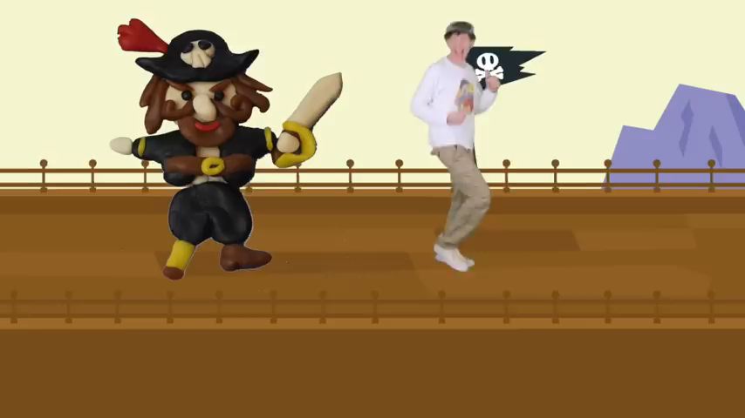
Watch the video and tell about the jobs you hear
Notes:
Made by FACEBOOK: TRAN THI THANH TAM

Slide 4



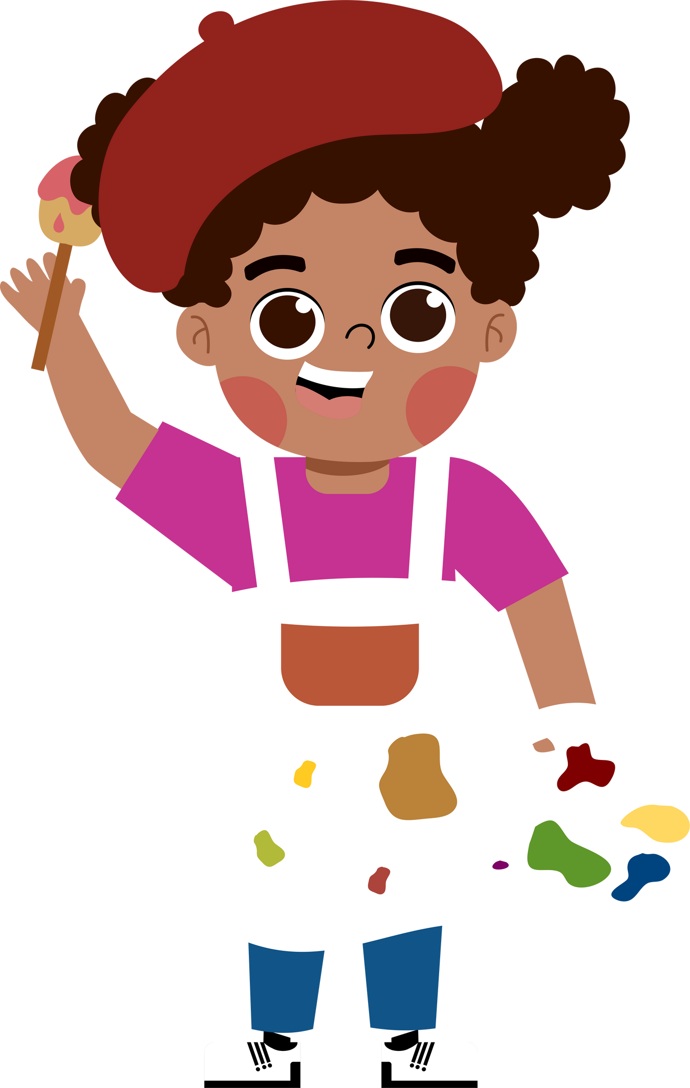
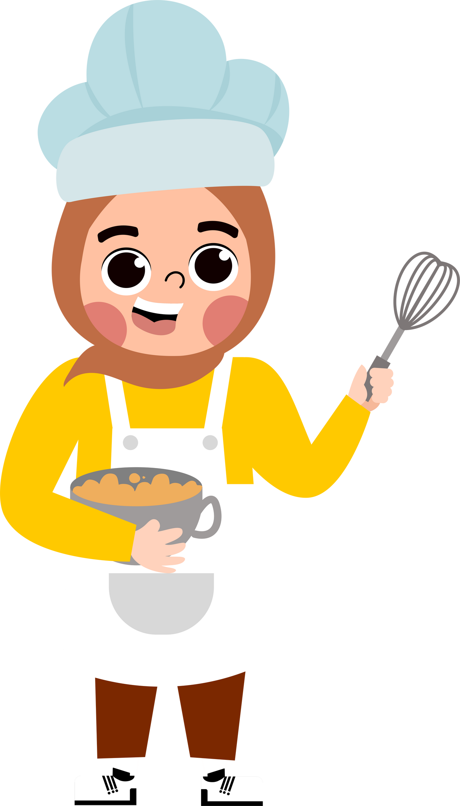



UNIT 5:MY FUTURE JOB
LESSON 1 ( 1, 2, 3)
Notes:
MADE BY FACEBOOK :TRAN THI THANH TAM

Slide 5
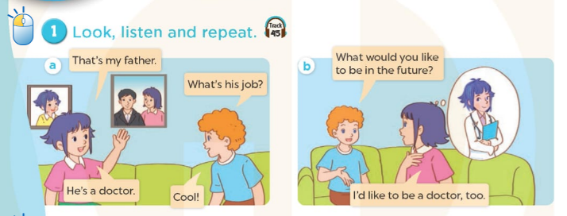

Notes:
MADE BY FACEBOOK :TRAN THI THANH TAM

Slide 6
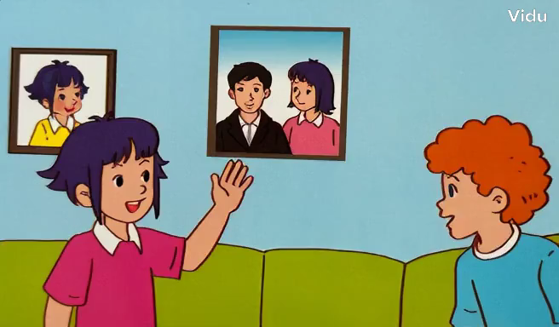

Slide 7

Notes:
MADE BY FACEBOOK :TRAN THI THANH TAM

Slide 8

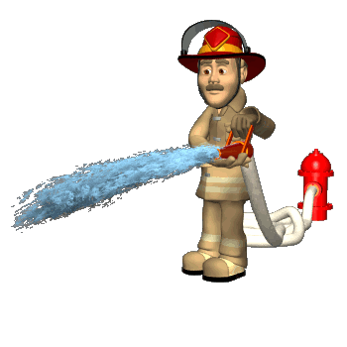
firefighter:
lính cứu hoả
Notes:
MADE BY FACEBOOK :TRAN THI THANH TAM

Slide 9

Gardener:
người làm vườn
Notes:
MADE BY FACEBOOK :TRAN THI THANH TAM

Slide 10
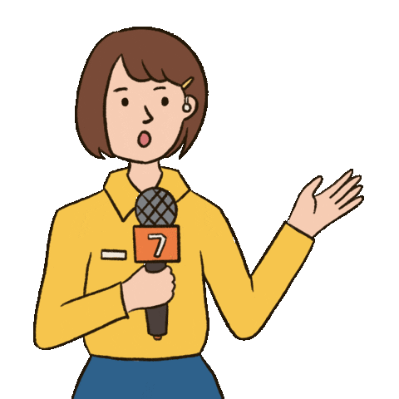
Reporter:
phóng viên
Notes:
MADE BY FACEBOOK :TRAN THI THANH TAM

Slide 11

Writer:
nhà văn
Notes:
MADE BY FACEBOOK :TRAN THI THANH TAM

Slide 12

VOCABULARY
Firefighter: lính cứu hỏa
Gardener: người làm vườn
Reporter: phóng viên
Writer: nhà văn

Slide 13

Notes:
Made by Facebook: TRAN THI THANH TAM

Slide 14
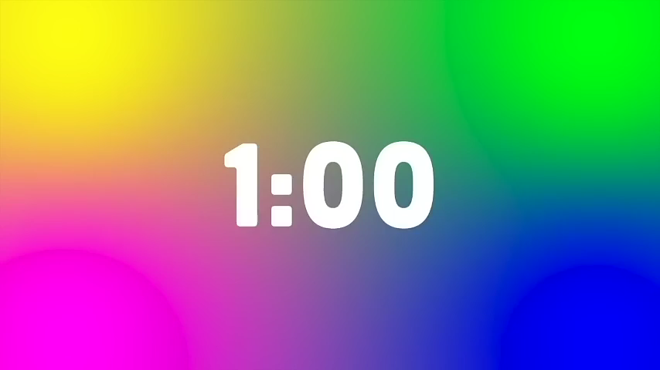
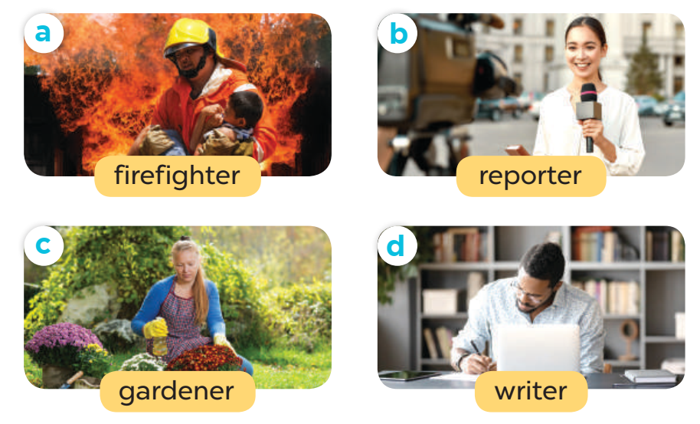
2.Listen, point and say
What would you like to be in the future?
firefighter
I’d like to be a…..................
Notes:
MADE BY FACEBOOK :TRAN THI THANH TAM

Slide 15
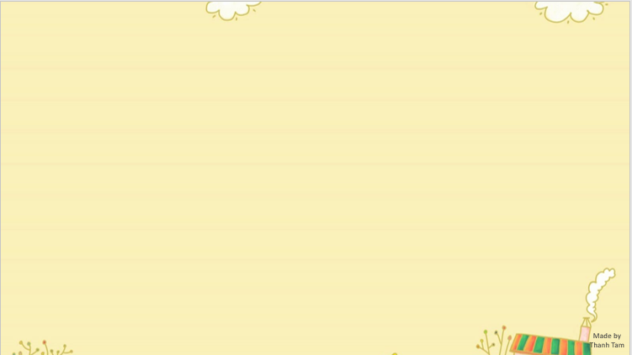

What would you like to be in the future?
firefighter
I’d like to be a…..................
Notes:
MADE BY FACEBOOK :TRAN THI THANH TAM

Slide 16

What would you like to be in the future?
reporter
I’d like to be a…..................
Notes:
MADE BY FACEBOOK :TRAN THI THANH TAM

Slide 17

What would you like to be in the future?
gardener
I’d like to be a…..................
Notes:
MADE BY FACEBOOK :TRAN THI THANH TAM

Slide 18

What would you like to be in the future?
writer
I’d like to be a…..................
Notes:
MADE BY FACEBOOK :TRAN THI THANH TAM

Slide 19

Let's play
LUCKY NUMBERS
Notes:
MADE BY FACEBOOK :TRAN THI THANH TAM

Slide 20

1
2
3
Next
4
5
6

Slide 21
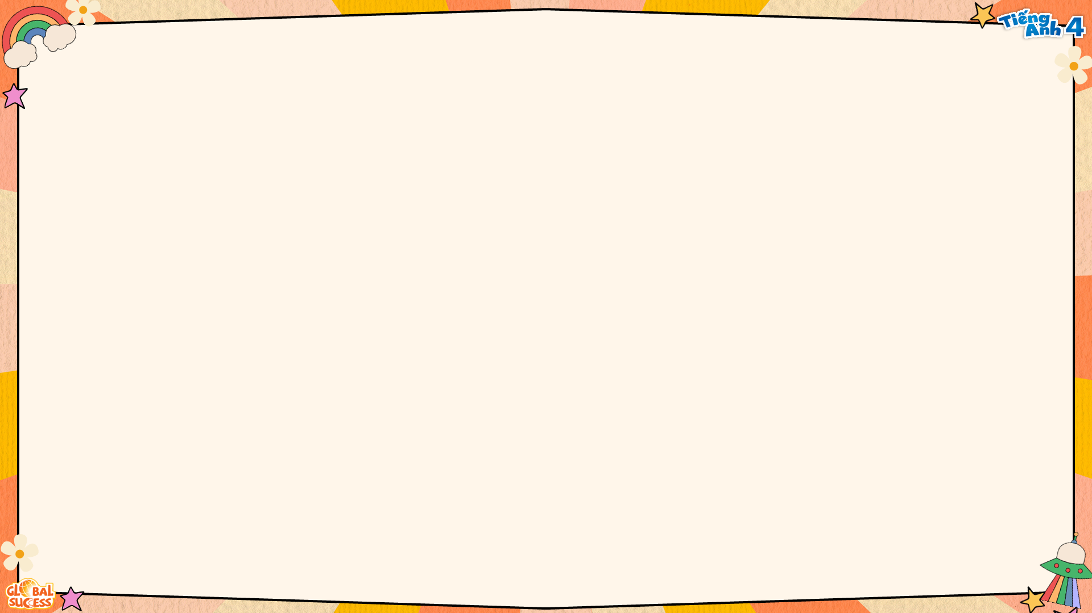


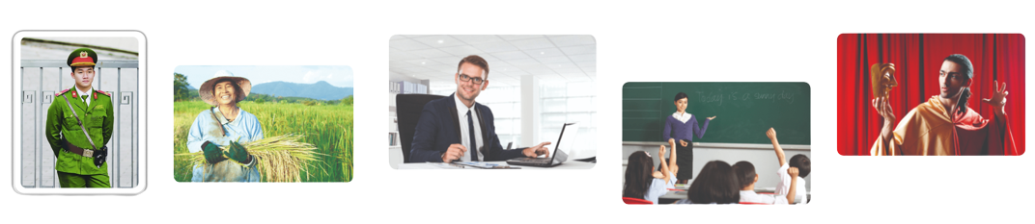

JOBS
MsPham
0936082789
A firefighter
A doctor
A singer
an actor
a policeman
a farmer
a teacher

Slide 22


What would you like to be in the future?
Well done
BACK
teacher
I’d like to be a…..................
Notes:
Teacher says the first sentence. Student replies using the new structure. Click the rabbit to go back to question slide.

Slide 23
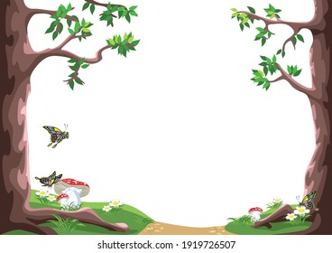
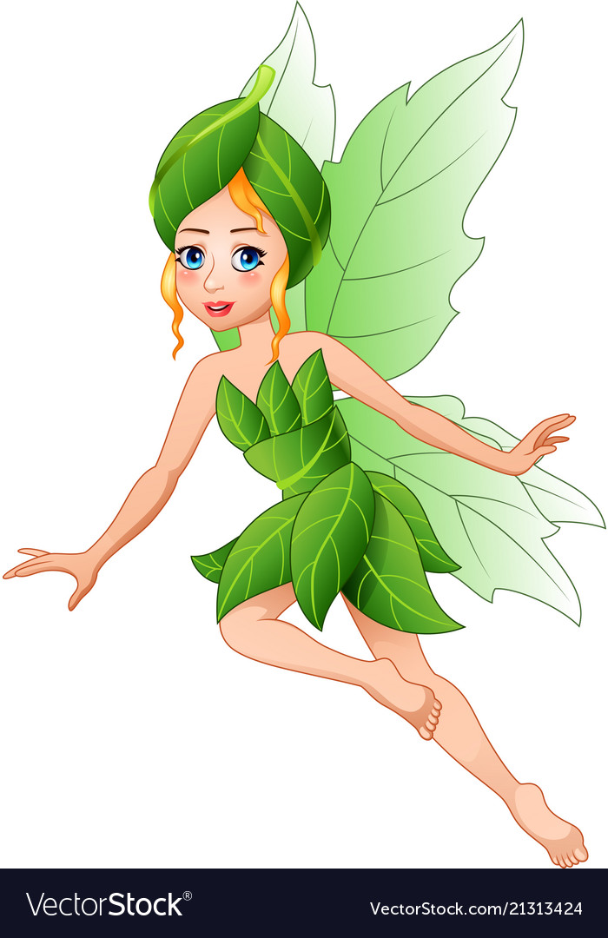
LUCKY NUMBER
BACK

Slide 24
What would you like to be in the future?
Well done
BACK
doctor
I’d like to be a…..................
Notes:
Teacher says the first sentence. Student replies using the new structure. Click the rabbit to go back to question slide.

Slide 25
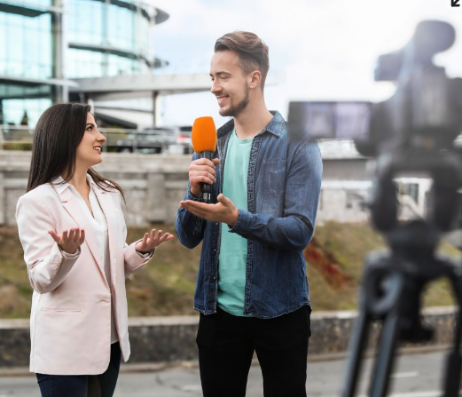
What would you like to be in the future?
Well done
BACK
reporter
I’d like to be a…..................
Notes:
Teacher says the first sentence. Student replies using the new structure. Click the rabbit to go back to question slide.

Slide 26
LUCKY NUMBER
BACK

Slide 27
What would you like to be in the future?
Well done
BACK
firefighter
I’d like to be a…..................
Notes:
Teacher says the first sentence. Student replies using the new structure. Click the rabbit to go back to question slide.

Slide 28
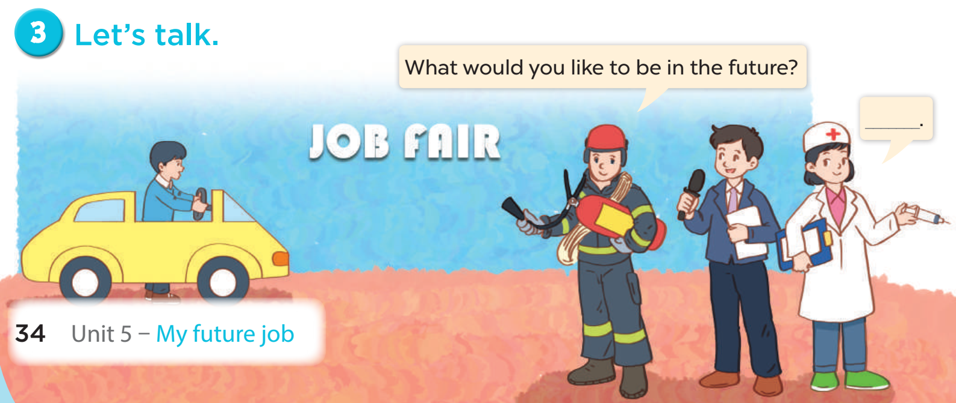
Notes:
MADE BY FACEBOOK :TRAN THI THANH TAM

Slide 29

SUMMARY

Slide 30
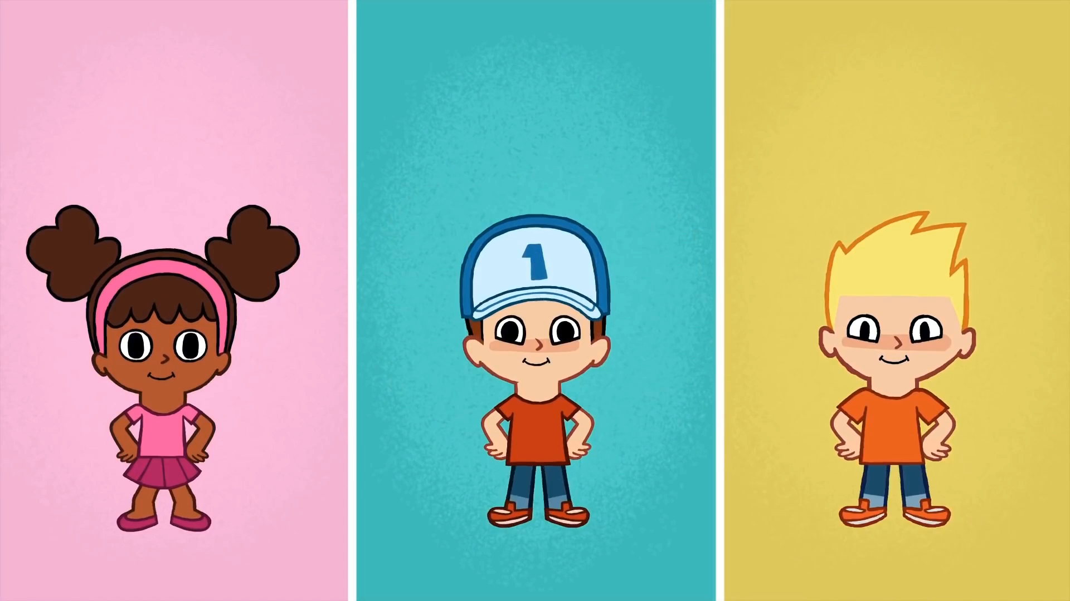
* SING AND DANCE: BYE BYE GOODBYE SONG

Slide 31

Notes:
MADE BY FACEBOOK :TRAN THI THANH TAM

