Slide 1

An Thang Primary School
WELCOME TO
OUR CLASS
Teacher: Nguyen Thi Canh
Notes:
MADE BY FACEBOOK :TRAN THI THANH TAM

Slide 2

Sing a song
Notes:
Made by Facebook: TRAN THI THANH TAM

Slide 3


Game:
RING THE BELL!

Slide 4






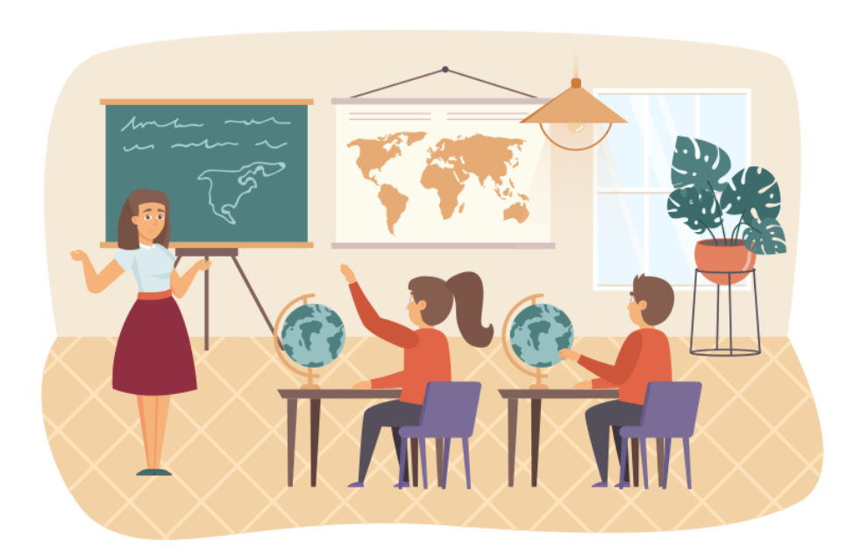


Choose a, b or c. Then say.
6
1
2
3
4
5
7
8
9
10
START
The map is _______ the board.
a. on
b. beside
c. under

Slide 5

6
1
2
3
4
5
7
8
9
10
START
Whose _______is this? - It’s Nam’s.
a. glue stick
b. set square
c. pencil

Slide 6

6
1
2
3
4
5
7
8
9
10
START
Whose _______ is this? - It’s Bill’s.
a. book
b. crayon
c. map

Slide 7
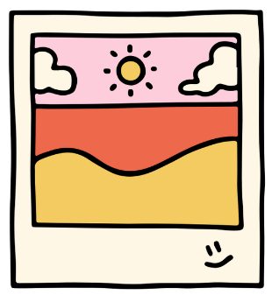
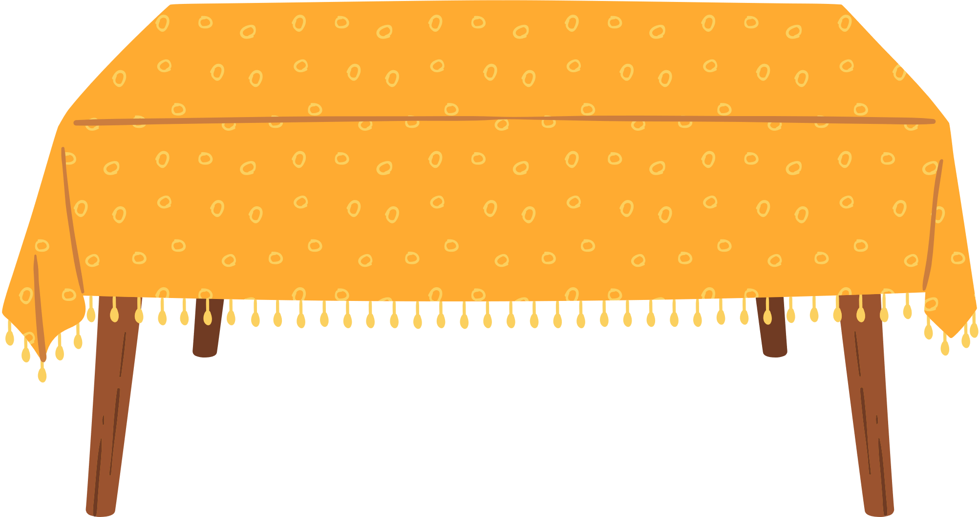
6
1
2
3
4
5
7
8
9
10
START
The photo is _______ the table.
a. in front of
b. over
c. above

Slide 8






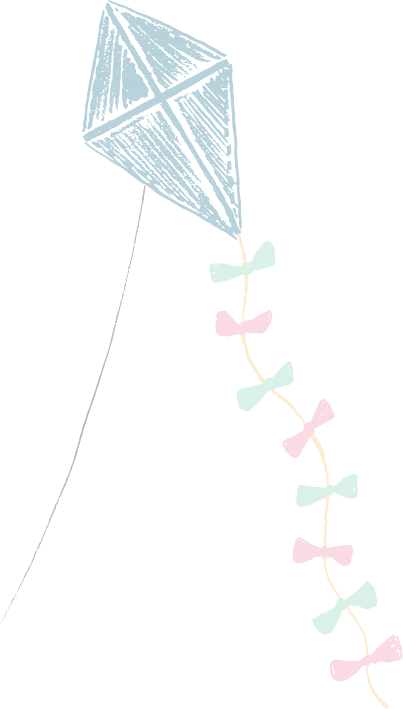






Slide 9





Unit 8
IN OUR CLASSROOM
Lesson 3 – Part 1.2.3

Slide 10



1.Listen and repeat.

Slide 11






Listen and point.
'
above
'
The picture is above the window.

Slide 12
Listen and repeat.
'
above
'
The picture is above the window.

Slide 13
Listen and point.
'
beside
'
The map is beside the board.

Slide 14
Listen and point.
'
beside
'
The map is beside the board.

Slide 15
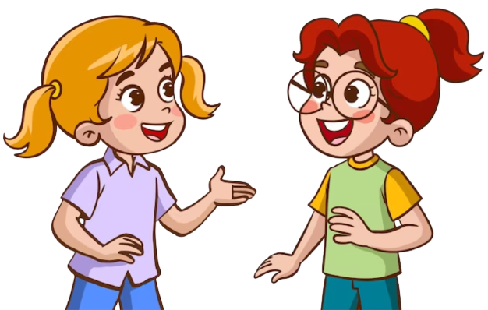
Practice ! ! !
above The picture is above the window.
beside The map is beside the board.
‘
‘
‘
‘

Slide 17
2.Circle, listen and check.

Slide 18







2.Circle, listen and check
a. above
b. under
c. beside
a. above
b. under
c. beside
a. behind
b. over
c. above

Slide 19






SWAP your BOOKS!

Slide 20
Let’s check!
'
'
'
a. above
b. under
c. beside

Slide 21
Circle, listen and check!
'
'
'
a. over
b. above
c. under

Slide 22
Circle, listen and check!
'
'
'
a. behind
b. over
c. above

Slide 23
Circle, listen and check!
a. above
b. under
c. beside
a. above
b. under
c. beside
a. behind
b. over
c. above

Slide 25
3.Let’s chant.

Slide 26


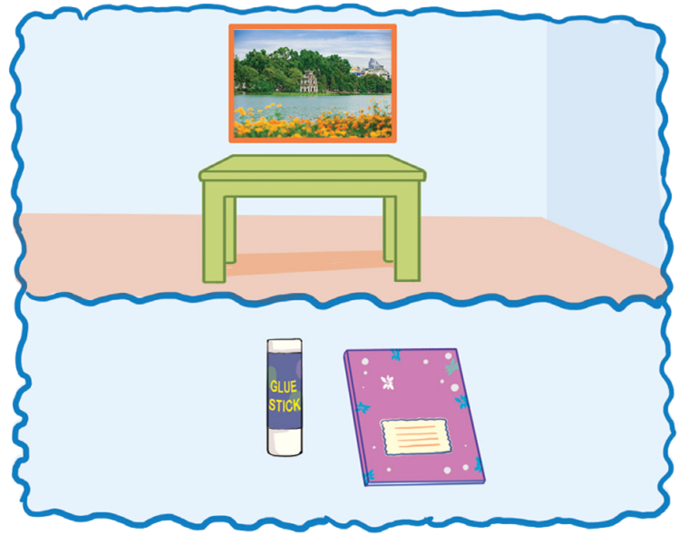

Listen and repeat.
Where is the photo?
It’s above the table.
Where is the glue stick?
It’s beside the notebook.

Slide 27
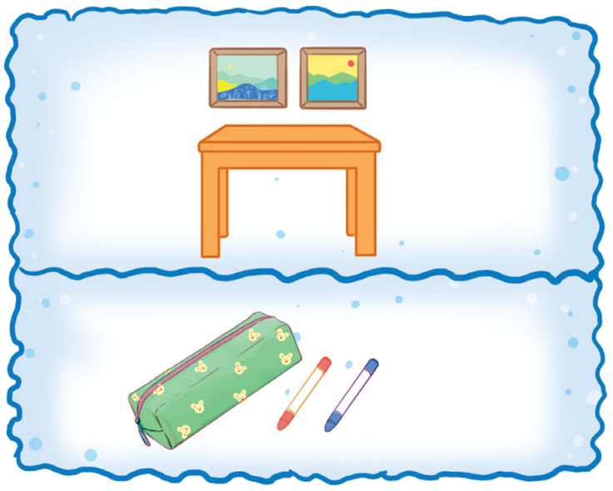
Listen and repeat.
Where are the pictures?
They’re above the table.
Where are the crayons.
They’re beside the pencil case.

Slide 28




Look and point.
Where is the photo?
It’s above the table. Where is the glue stick?
It’s beside the notebook.
Where are the pictures? They’re above the table. Where are the crayons? They’re beside the pencil case.

Slide 29

Listen and point.
Where is the photo?
It’s above the table. Where is the glue stick?
It’s beside the notebook.

Slide 30
Listen and point.
Where are the pictures? They’re above the table. Where are the crayons? They’re beside the pencil case.

Slide 31
Listen and repeat.
Where is the photo?
It’s above the table.
Where is the glue stick?
It’s beside the notebook.

Slide 32
Listen and repeat.
Where are the pictures?
They’re above the table.
Where are the crayons.
They’re beside the pencil case.

Slide 33
Sing and clap.
Where is the photo?
It’s above the table. Where is the glue stick?
It’s beside the notebook.
Where are the pictures? They’re above the table. Where are the crayons?
They’re beside the pencil case.

Slide 35

GAME

Slide 36
PASSING BALL

Slide 37








The crayon is beside
the pencil case.

Slide 38
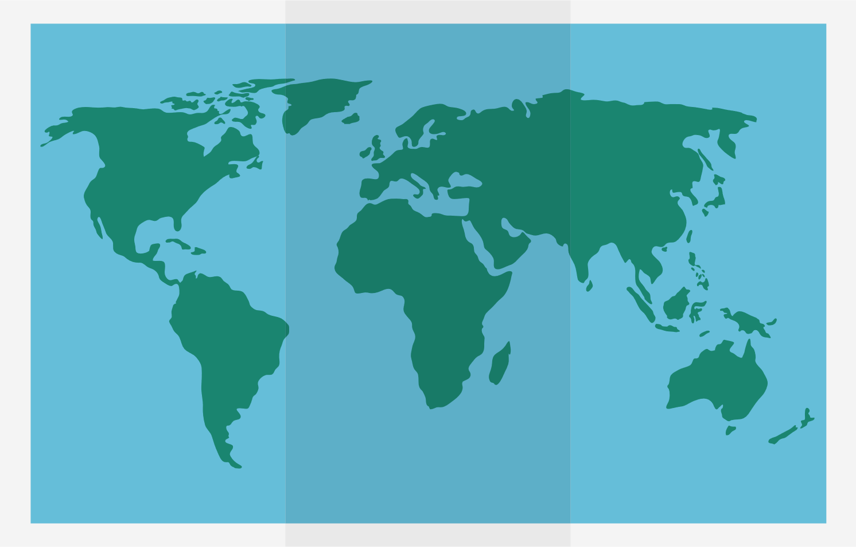

The map is above the bookcase.

Slide 39
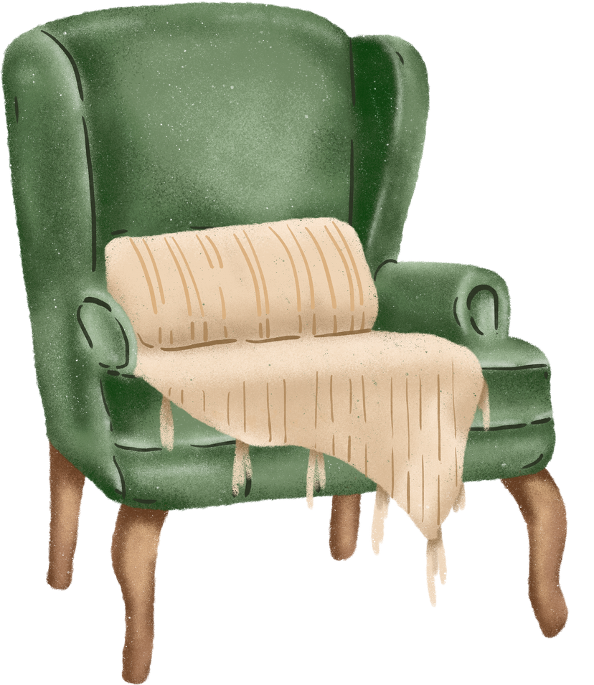

The cat is beside the chair.

Slide 40


The bike is under the tree.

Slide 41


The lamp is beside the sofa.

Slide 42

The cat is under the box.

Slide 43

The books are in the school bag.

