Slide 1


An Thang Primary School
WELCOME TO
OUR CLASS 3
Teacher: Nguyen Thi Canh
Notes:
MADE BY FACEBOOK :TRAN THI THANH TAM

Slide 2

CONTENTS
1
WARM -UP
2
VOCABULARY
3
LOOK, LISTEN AND REPEAT
4
LISTEN, POINT AND SAY
5
LET’S TALK
6
PLAY GAME
Notes:
MADE BY FACEBOOK :TRAN THI THANH TAM

Slide 3

Warm - up
Notes:
MADE BY FACEBOOK :TRAN THI THANH TAM

Slide 4

Let's play
MATCHING
Notes:
MADE BY FACEBOOK :TRAN THI THANH TAM

Slide 5


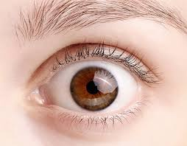

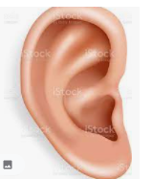
CHECK VOCABULARY:MATCHING
eye
hand
ear
nose
face

Slide 6

UNIT 4 OUR BODIES
LESSON 2 ( 1, 2, 3)
Notes:
MADE BY FACEBOOK :TRAN THI THANH TAM

Slide 7

Notes:
MADE BY FACEBOOK :TRAN THI THANH TAM

Slide 8

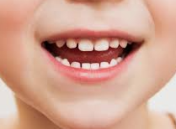

Mouth : miệng
Notes:
MADE BY FACEBOOK :TRAN THI THANH TAM

Slide 9
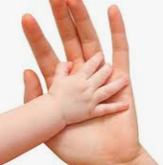
Touch : sờ, chạm
Notes:
MADE BY FACEBOOK :TRAN THI THANH TAM

Slide 10
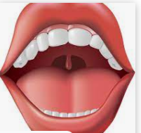
Open : mở, há
Notes:
MADE BY FACEBOOK :TRAN THI THANH TAM

Slide 11

Let's play
Notes:
MADE BY FACEBOOK :TRAN THI THANH TAM

Slide 12
What and where
1
touch
2
3
open
4
5
6
mouth

Slide 13

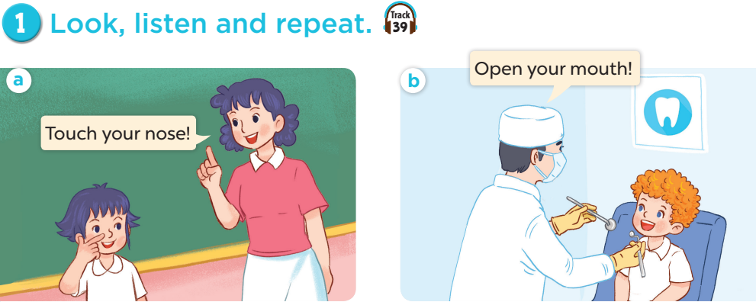
Notes:
MADE BY FACEBOOK :TRAN THI THANH TAM

Slide 14

SENTENCE PATTERN
Notes:
MADE BY FACEBOOK :TRAN THI THANH TAM

Slide 15

Đưa ra lời chỉ dẫn
Touch your hair!
(Hãy chạm vào tóc của bạn !)
Open your mouth!
( Hãy mở miệng ra !)
Notes:
MADE BY FACEBOOK :TRAN THI THANH TAM

Slide 16
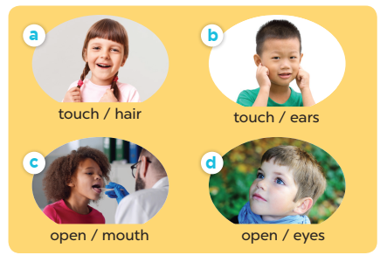


2. Point and say
Notes:
MADE BY FACEBOOK :TRAN THI THANH TAM

Slide 17
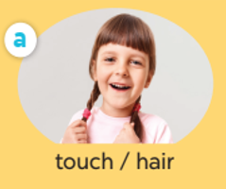
touch
……… your hair.
Notes:
MADE BY FACEBOOK :TRAN THI THANH TAM

Slide 18

touch
……… your ears.
Notes:
MADE BY FACEBOOK :TRAN THI THANH TAM

Slide 19

open
……… your mouth.
Notes:
MADE BY FACEBOOK :TRAN THI THANH TAM

Slide 20

open
……… your eyes.
Notes:
MADE BY FACEBOOK :TRAN THI THANH TAM

Slide 21
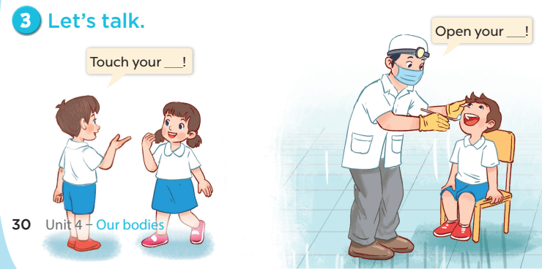
Notes:
MADE BY FACEBOOK :TRAN THI THANH TAM

Slide 22

LET ’S PLAY
Chinese Whispers

Slide 23
Chinese Whispers
Group 1
Group 2
Touch your mouth.
Open your eyes.
Notes:
Made by Facebook: TRAN THI THANH TAM

Slide 24
Chinese Whispers
Group 1
Group 2
Touch your ears.
Open your mouth.
Notes:
Made by Facebook: TRAN THI THANH TAM

Slide 25

SUMMARY
Notes:
MADE BY FACEBOOK :TRAN THI THANH TAM

Slide 26
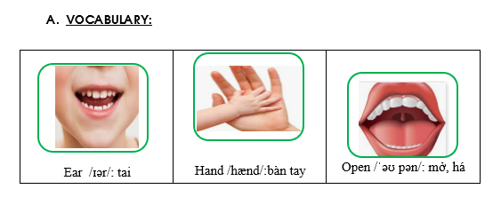
Notes:
Made by Facebook: TRAN THI THANH TAM

Slide 27
SENTENCE PATTERN
Notes:
MADE BY FACEBOOK :TRAN THI THANH TAM

Slide 28
Đưa ra lời chỉ dẫn
Touch your hair!
(Hãy chạm vào tóc của bạn !)
Open your mouth!
( Hãy mở miệng ra !)
Notes:
MADE BY FACEBOOK :TRAN THI THANH TAM

Slide 29

SING: HEAD, SHOULDERS, KNEES AND TOES
Notes:
Made by FACEBOOK: TRAN THI THANH TAM

Slide 30


