Slide 1

Unit 2
Our names
Lesson 1

Slide 2
WARM-UP
01

Slide 3





PLAY

Slide 4




Goodbye, class.
Goodbye, class.
Hello, teacher.
Hello, class.
Goodbye, teacher.

Slide 5
How are you?
I’m fine. Thank you.
Hello. I’m Lan.
Nice to meet you.
Thanks.

Slide 6
Bye, Quan.
Thanks, Mai.
Bye, Mai.
How are you Mai?
Hello, Mai.

Slide 7
Hello, I'm Mai.
Bye, Mai.
This is Quan.
Hello, Mai. I’m Quan.
Hello Quan.

Slide 8
I’m fine. Thanks.
How old are you?
How you are?
How are you?
How am I?

Slide 9


EXIT

Slide 10
EXPLORATION
02

Slide 11
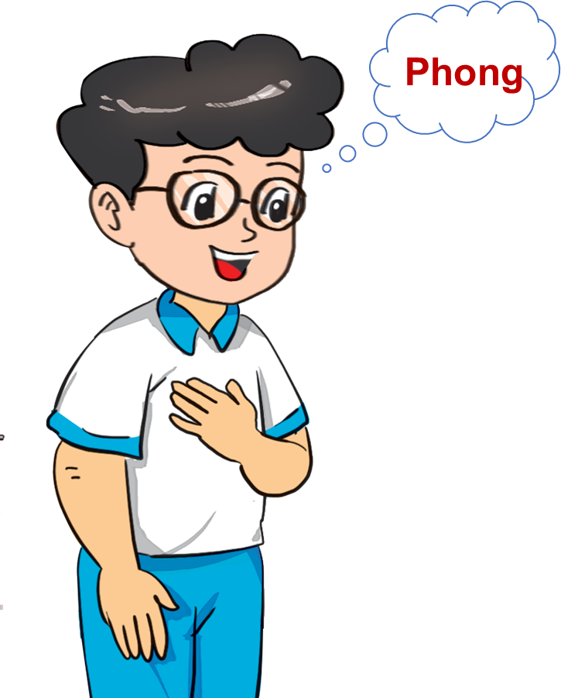
New words
My
/maɪ/

Slide 12
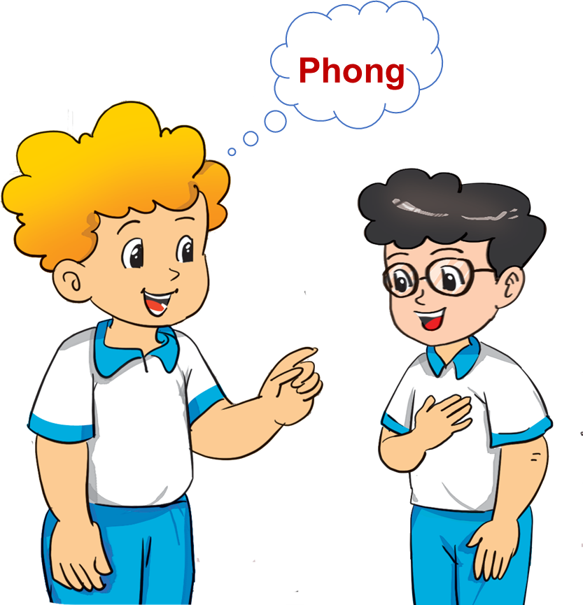
New words
your
/jɔː/

Slide 13
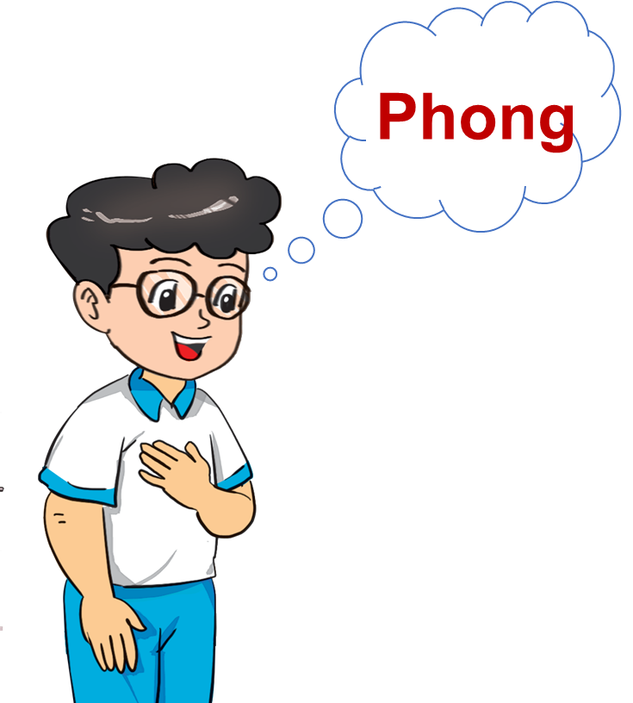
New words
name
/neɪm/

Slide 14

New words
What
/wʌt/

Slide 15
A. New words
My
name
/maɪ/
/neɪm/
your
What
/jɔː/
/wʌt/

Slide 16


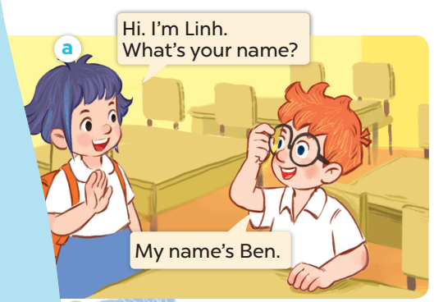
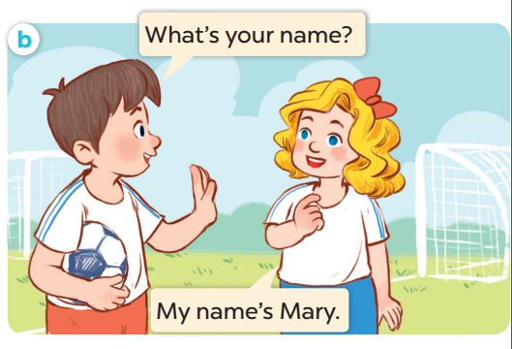

Slide 17
MODEL SENTENCES
03

Slide 18
B. Structure
Hỏi và trả lời về tên
What’s your name?
I’m + (name).
(Bạn tên gì?)
(Tên mình là ….)
What’s your name?
My name’s + (name).
(Bạn tên gì?)
(Tên mình là ….)

Slide 19
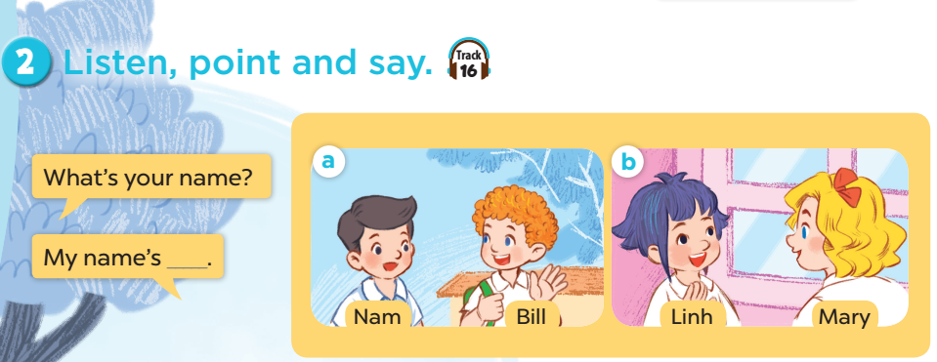

Slide 20



2. Point and say.
What's your name?
My name's ___________ .
Bill

Slide 21
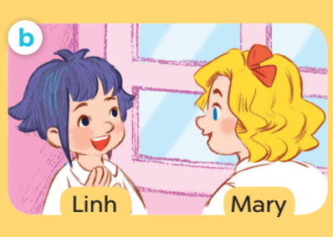
2. Point and say.
What's your name?
My name's ___________ .
Mary

Slide 22
PRACTICE
04

Slide 23





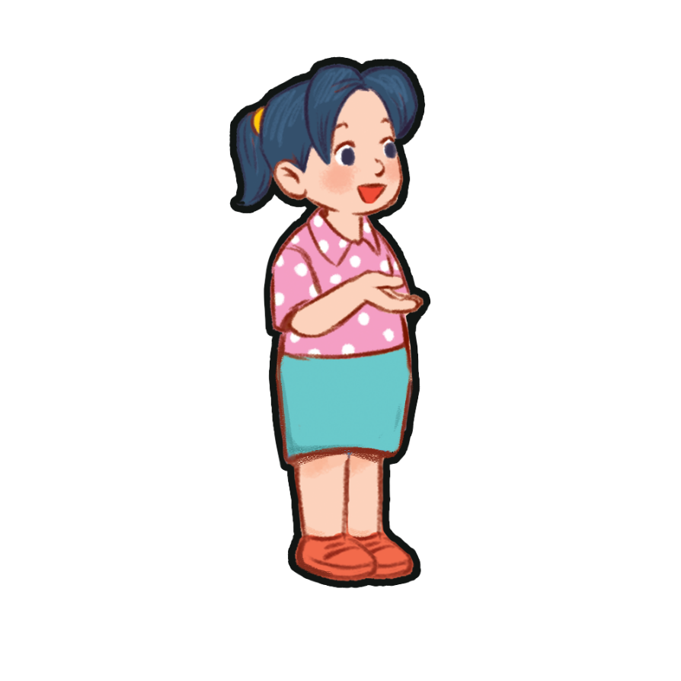
3. Let's talk.
What's your name?
My name's ___________ .

Slide 24
FUN TIME
05

Slide 25








Ms Huyền Phạm
0936.082.789
Notes:
Ms Huyền Phạm - 0936.082.789 – YOUTUBE: MsPham. Facebook: Dạy và học cùng công nghệ.

Slide 26

What’s your name?
____ Quan.
I’m
Im
Ms Huyền Phạm
0936.082.789
Notes:
Ms Huyền Phạm - 0936.082.789 – YOUTUBE: MsPham. Facebook: Dạy và học cùng công nghệ.

Slide 27
What’s ____ name?
My name’s Mr.Loc.
your
you
Ms Huyền Phạm
0936.082.789
Notes:
Ms Huyền Phạm - 0936.082.789 – YOUTUBE: MsPham. Facebook: Dạy và học cùng công nghệ.

Slide 28
What’s your name?
____ name’s Tony.
I’m
My
Ms Huyền Phạm
0936.082.789
Notes:
Ms Huyền Phạm - 0936.082.789 – YOUTUBE: MsPham. Facebook: Dạy và học cùng công nghệ.

Slide 29
What’s your name?
____ Miss Hien.
My name
My name’s
Ms Huyền Phạm
0936.082.789
Notes:
Ms Huyền Phạm - 0936.082.789 – YOUTUBE: MsPham. Facebook: Dạy và học cùng công nghệ.

Slide 30
My name’s Tom.
What’s you name?
What’s your name?
Ms Huyền Phạm
0936.082.789
Notes:
Ms Huyền Phạm - 0936.082.789 – YOUTUBE: MsPham. Facebook: Dạy và học cùng công nghệ.

Slide 31

Good job!
Ms Huyền Phạm
0936.082.789
Notes:
Ms Huyền Phạm - 0936.082.789 – YOUTUBE: MsPham. Facebook: Dạy và học cùng công nghệ.

Slide 32

THANK YOU!

