Slide 1







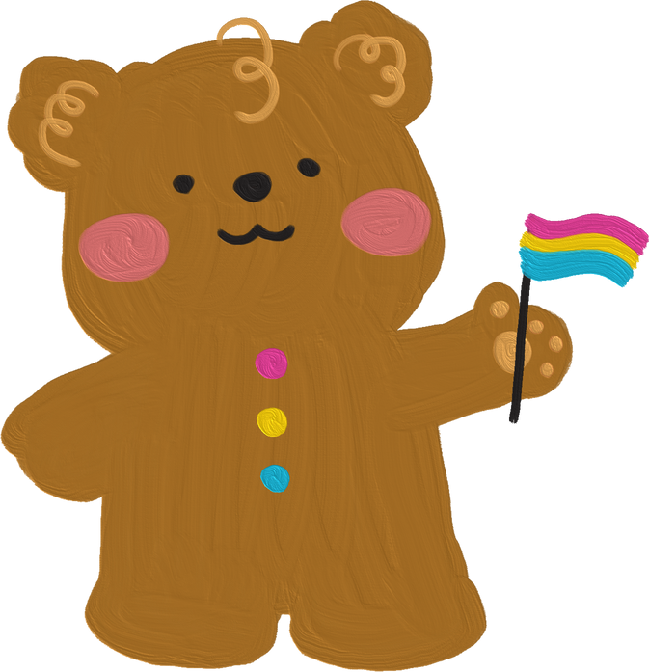
Grade 3

Slide 2


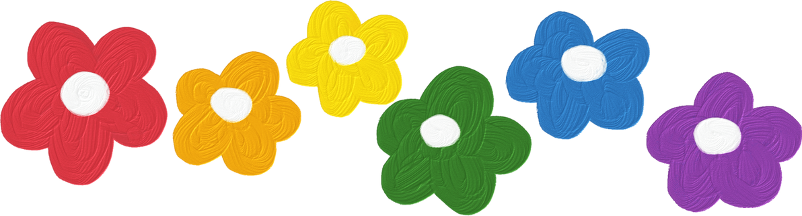
1.Warm-up and review

Slide 3






WORD
GAME
Notes:
- Teacher uses flashcards to review vocabulary from Unit 1 to Unit 5.
- Then asks pupils to look at the given letter, rearrange them to find the correct word.
- Teacher gives points or candies to the fastest pupil with the correct answer.

Slide 4



Question
1
N
B
E
Hint: This is a name.

Slide 5
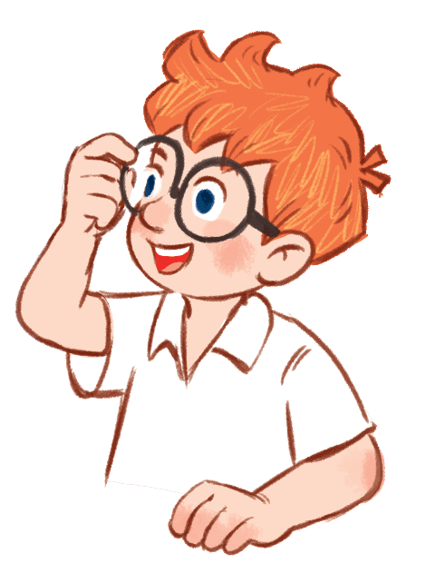
Question
1
B
E
N

Slide 6
Question
2
A
F
C
E
Hint: This is a part of your body.

Slide 7

Question
2
F
A
C
E

Slide 8
Question
3
E
T
H
G
I
Hint: This is a number.

Slide 9

Question
3
E
I
G
H
T

Slide 10
Question
4
W
I
S
M
G
N
M
I
Hint: This is a hobby.

Slide 11
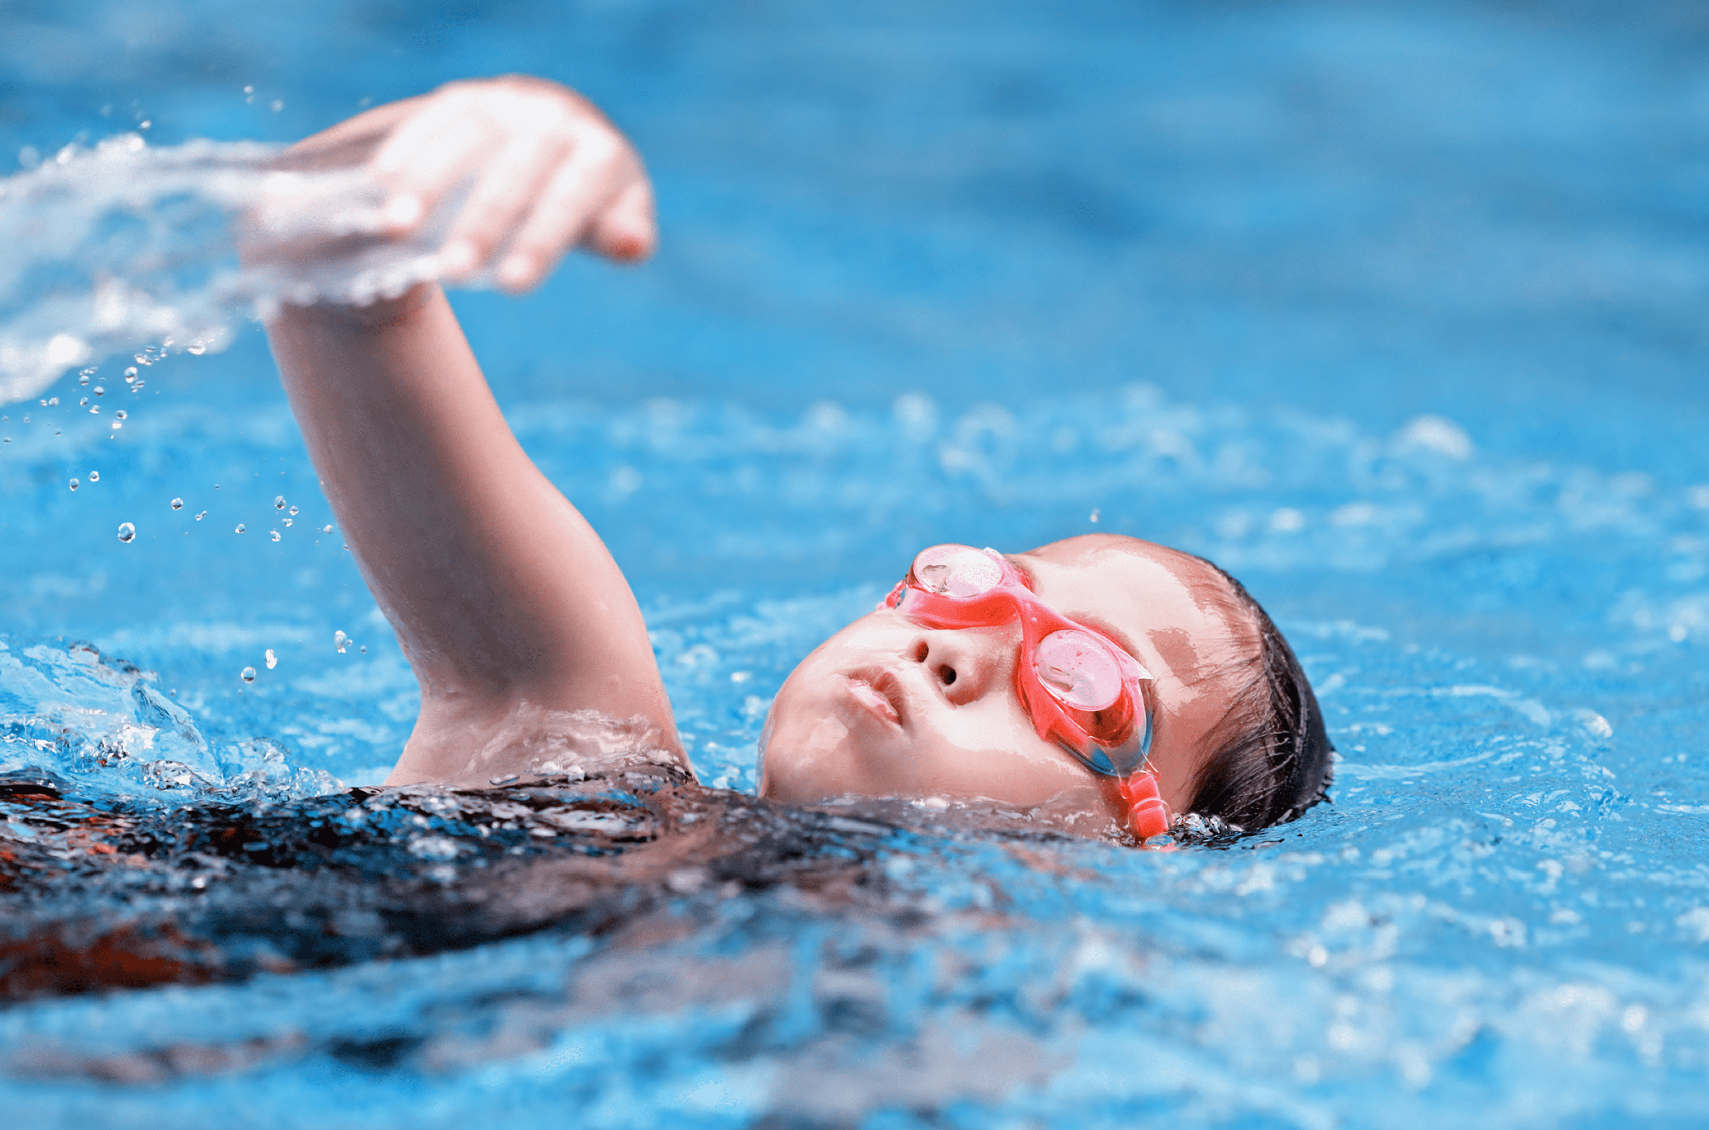
Question
4
S
W
I
M
M
I
N
G

Slide 12




2. Find, circle
and match

Slide 13
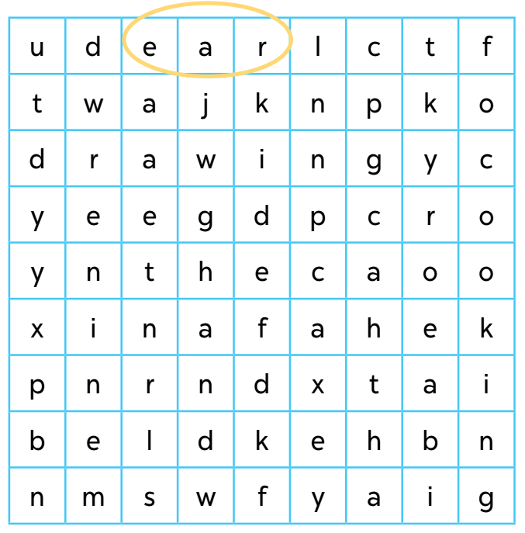

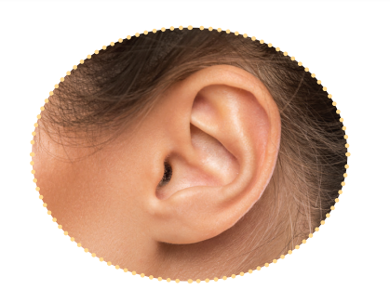




Slide 20
2. Quiz time

Slide 21
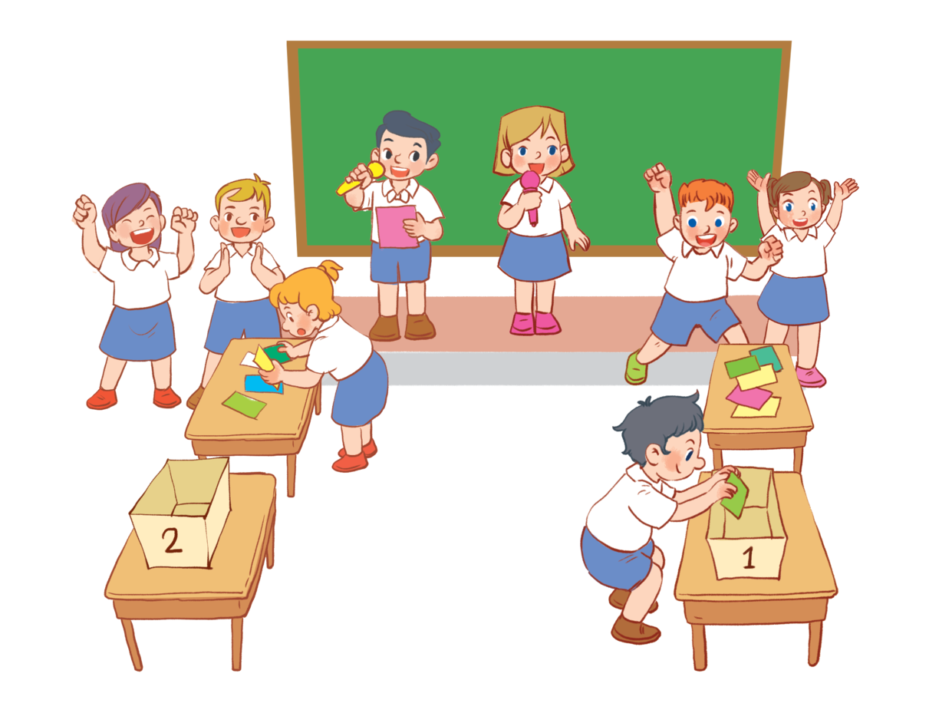

Slide 22
3. Look and match.

Slide 23
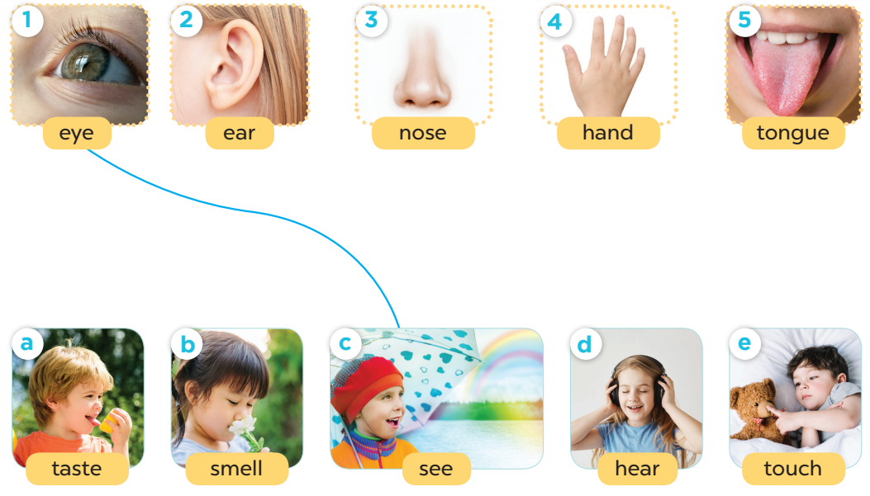

Slide 24
5. Fun corner and wrap-up

Slide 25




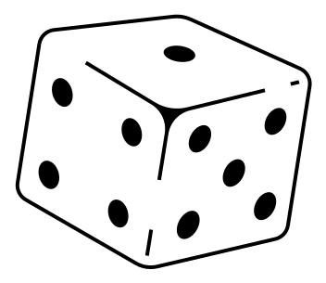



Game time!
Notes:
Vocabulary review.

Slide 26


We can use THIS BODY PART to smell.
a nose
Notes:
A nose

Slide 27
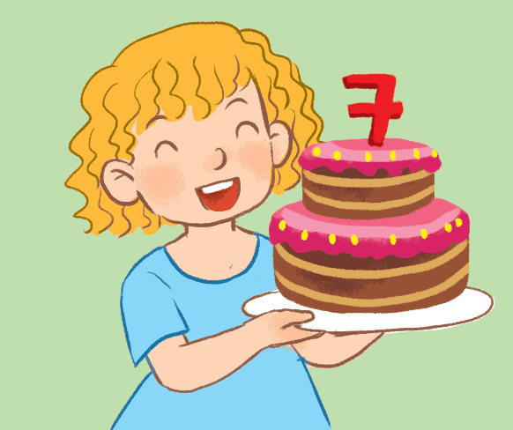
2. It’s between Number six and eight.
seven
Notes:
Number 7

Slide 28

3. We say it to greet people.
Hello/ Hi!
Notes:
Hello/ Hi!

Slide 29

4. We can use this to listen to music.
an ear
Notes:
dancing

Slide 30
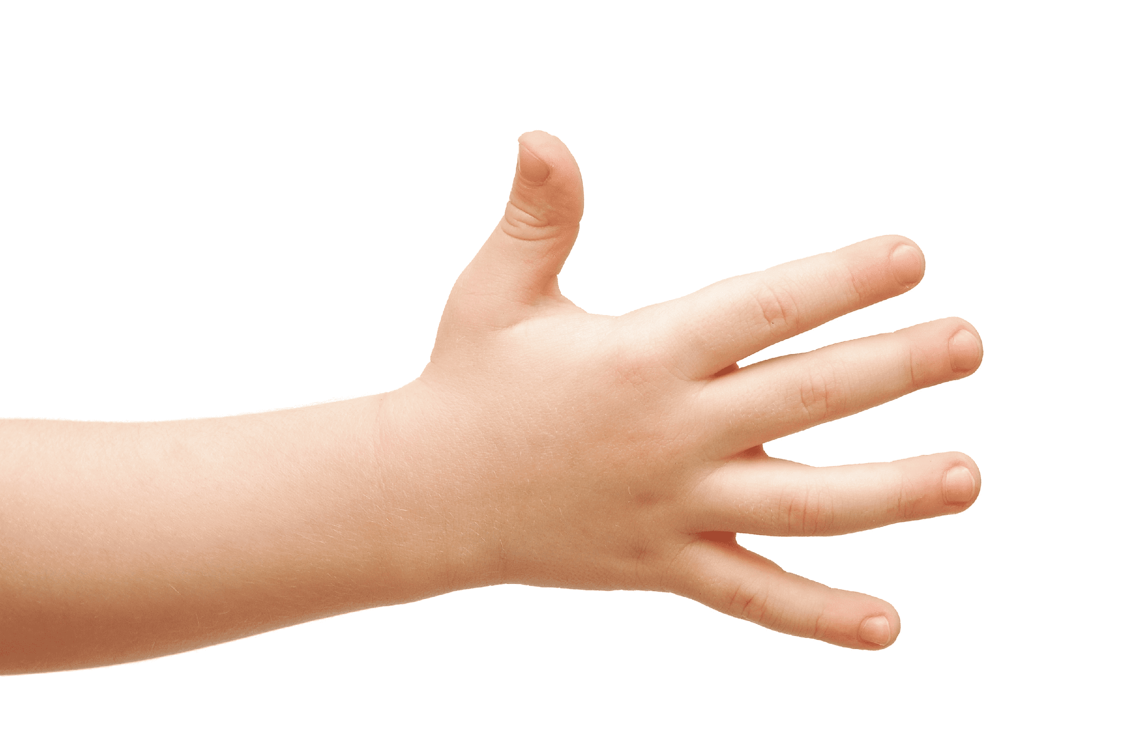
5. We use it to touch things.
a hand
Notes:
A hand

