Slide 1



6
Our school
LESSON 3 - PERIOD 6

Slide 2
Contents
Warm-up and review
Activity 2
01
02
Activity 3
Activity 6
03
04
Chant
Read and complete.
Let’s write.
Project
Fun corner
05
Game

Slide 3

WARM-UP AND REVIEW

Slide 4
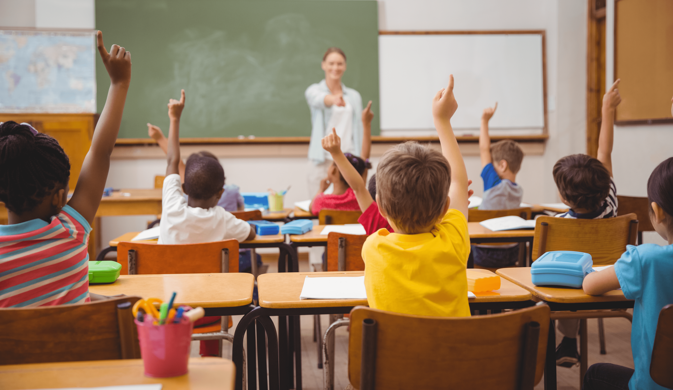

Is this your classroom?
Yes, it is.

Slide 5
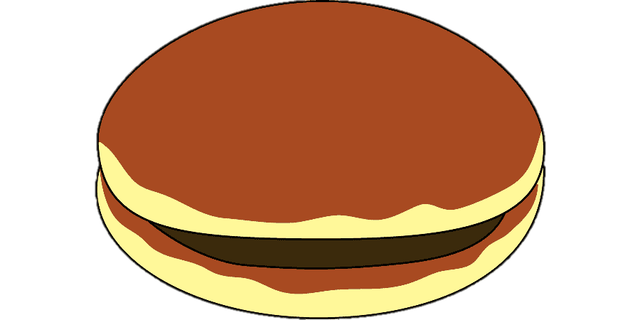
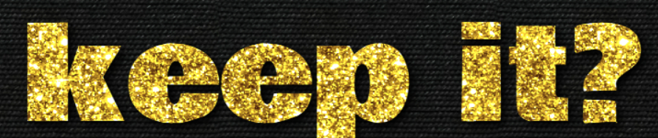
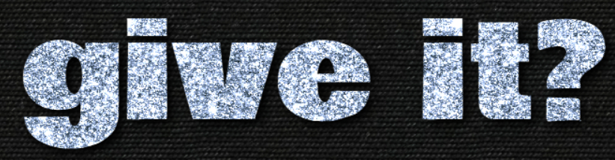
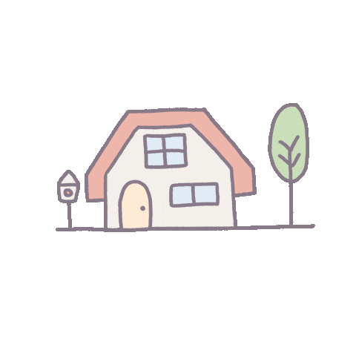
2 points
or

Slide 6
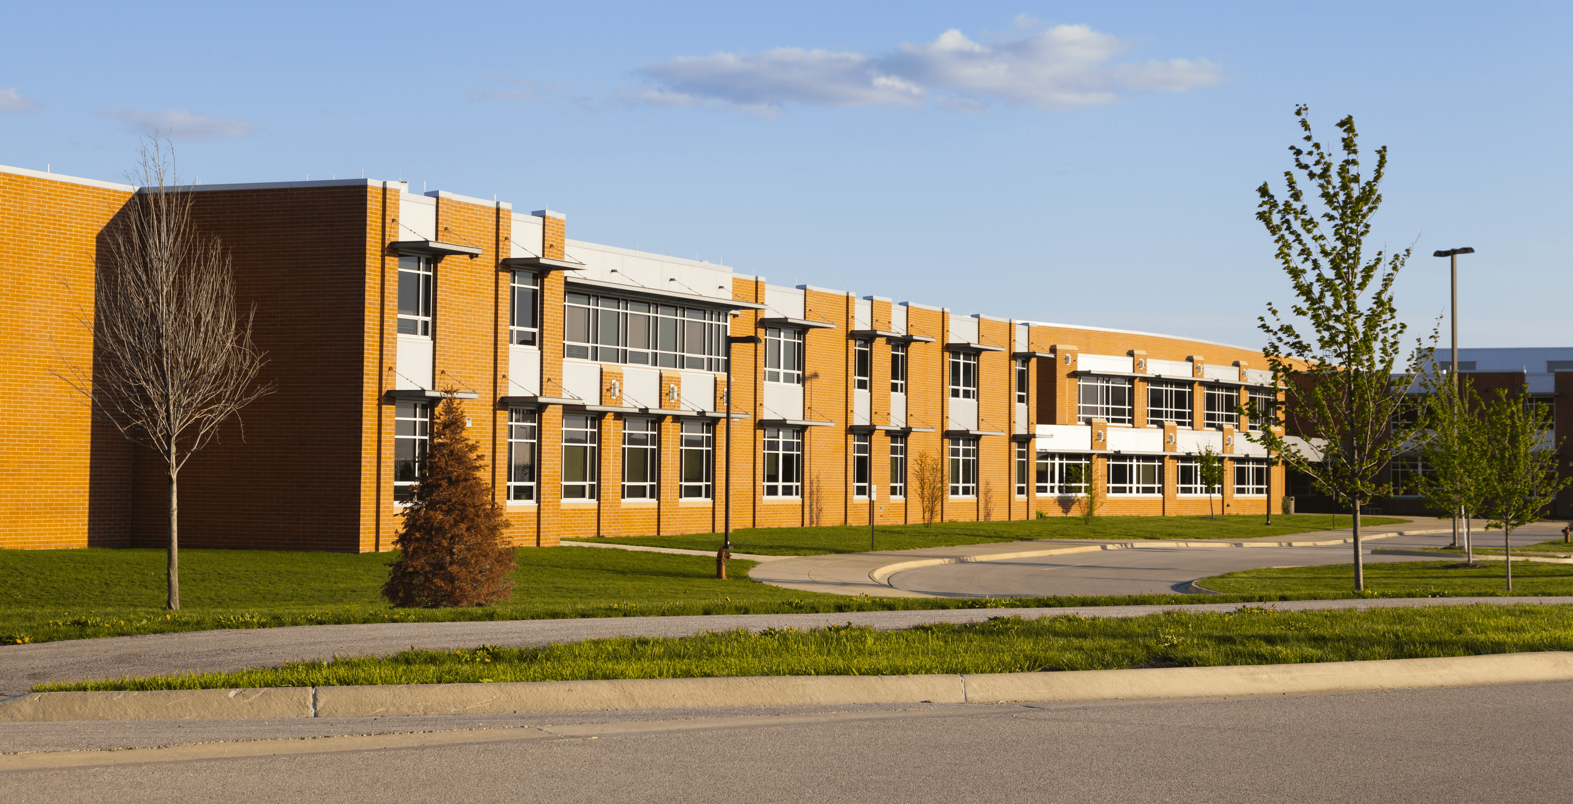
Is this your school?
Yes, it is.

Slide 7
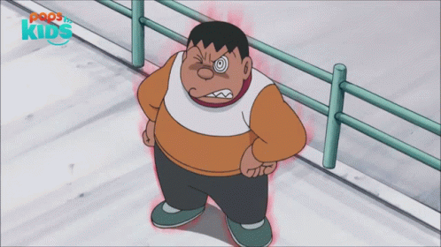

- 1 point
or

Slide 8
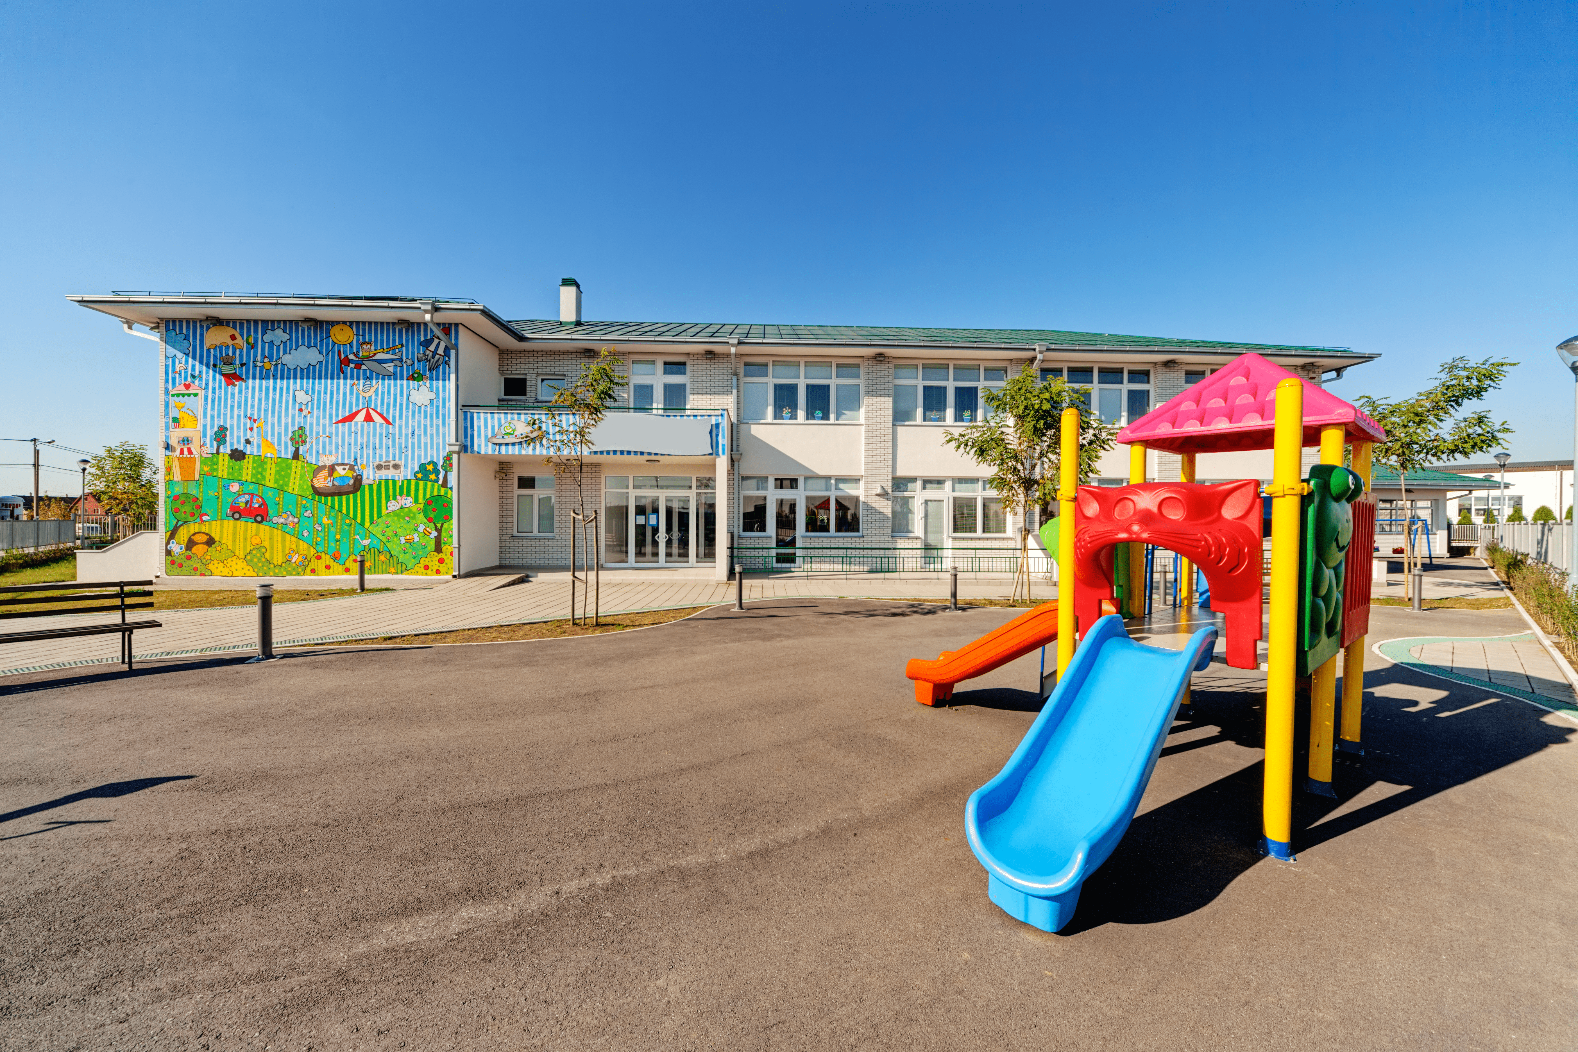
Is that our playground?
Yes, it is.

Slide 9
3 points
or

Slide 10
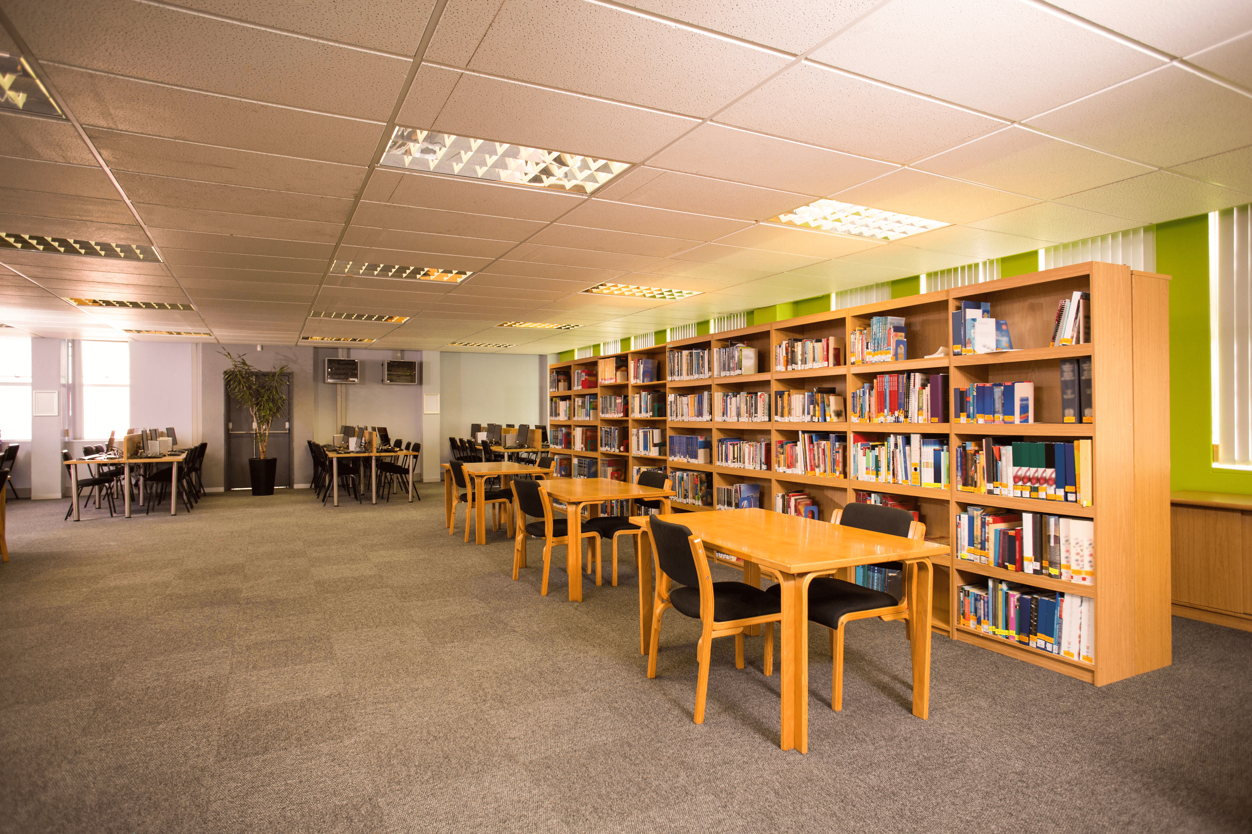
We like reading books.
Let’s go to the library.

Slide 11
- 2 points
or

Slide 12
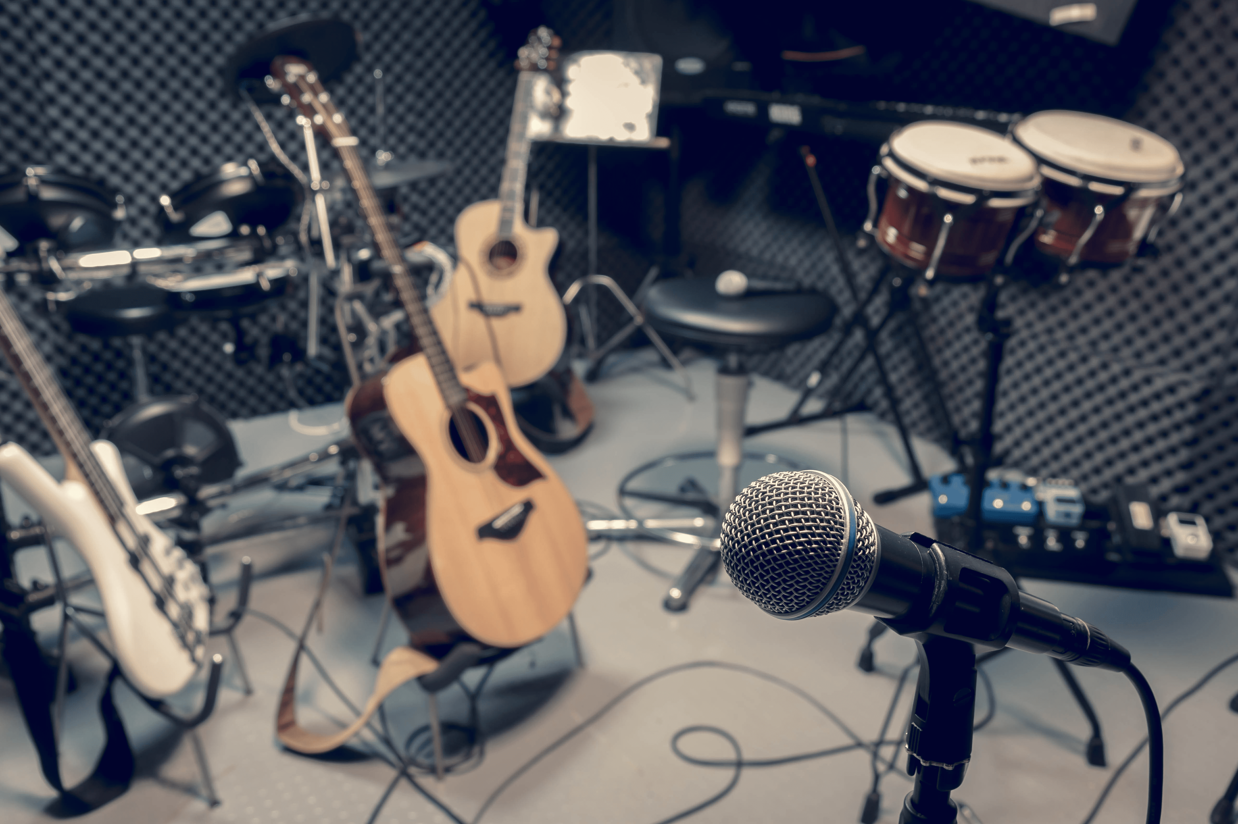
I like playing the piano.
Let’s go to the music room.

Slide 13
4 points
or

Slide 14
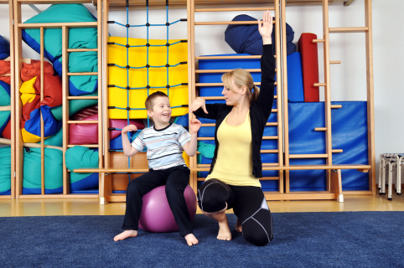
We like playing sports.
Let’s go to the gym.

Slide 15
3 points
or

Slide 16

I like computers.
Let’s go to the computer room.

Slide 17
6 points
or

Slide 18
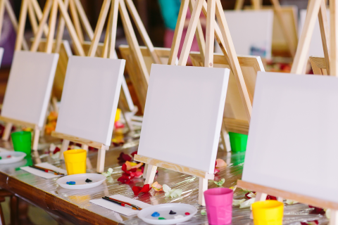
I like drawing pictures.
Let’s go to the art room.

Slide 19
0 point
or

Slide 20
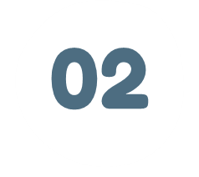
READ AND COMPLETE.

Slide 21
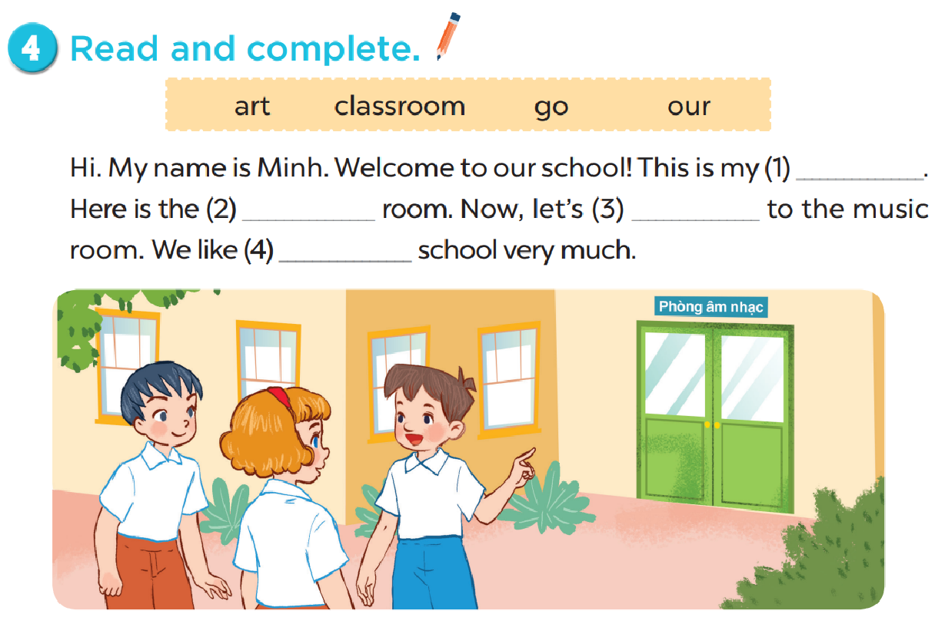
classroom
art
go
our

Slide 22

LET’S WRITE.

Slide 23
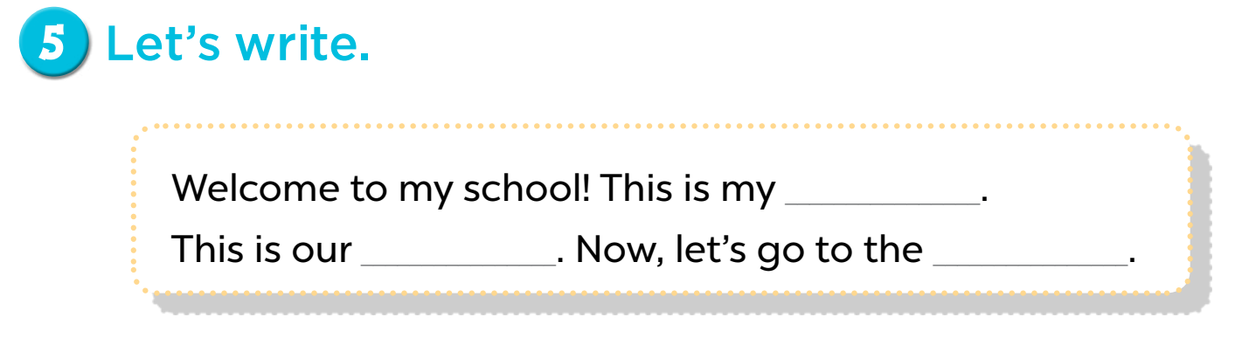

Slide 24

PROJECT

Slide 25
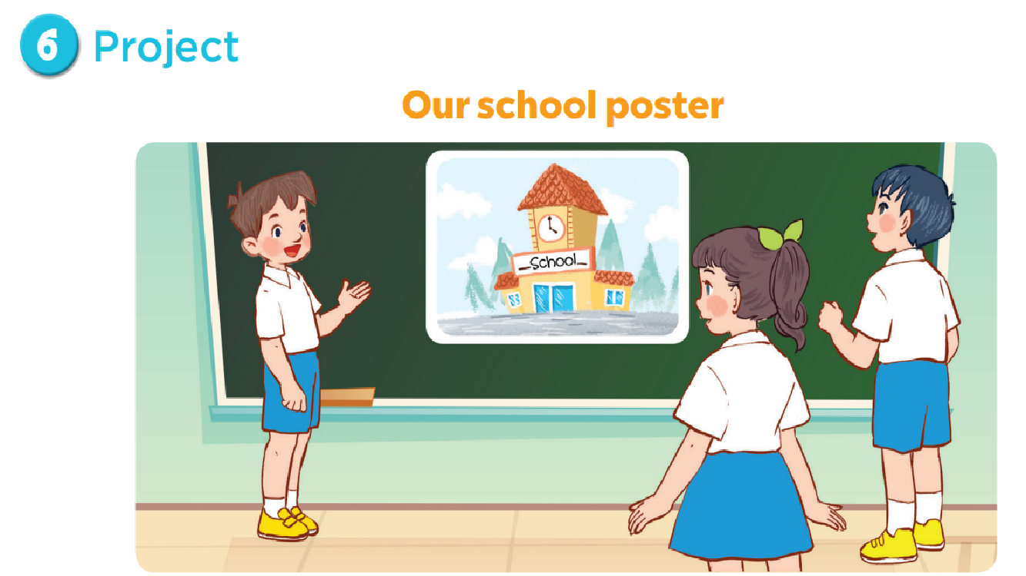

Slide 26

FUN CORNER

Slide 27
0
0
0
O
O
O
X
X
X
1
2
3
X
X
X
0
0
0
O
O
O
X
X
X
4
5
6
X
X
X
0
0
0
O
O
O
X
X
X
7
8
9
X
X
X

Slide 28
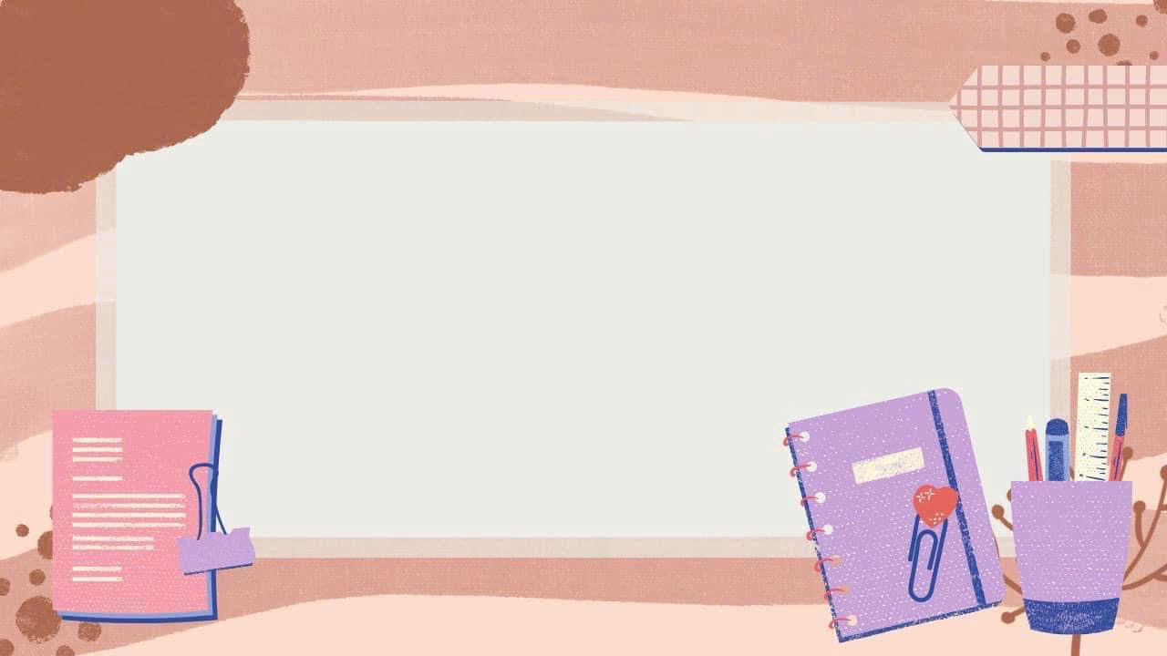
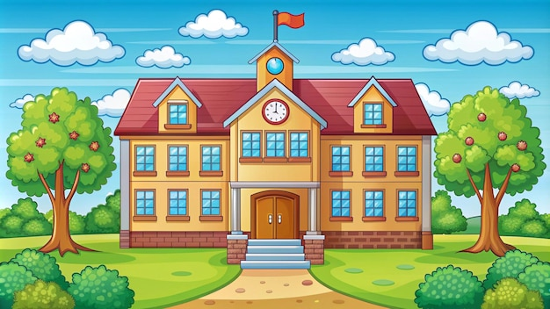


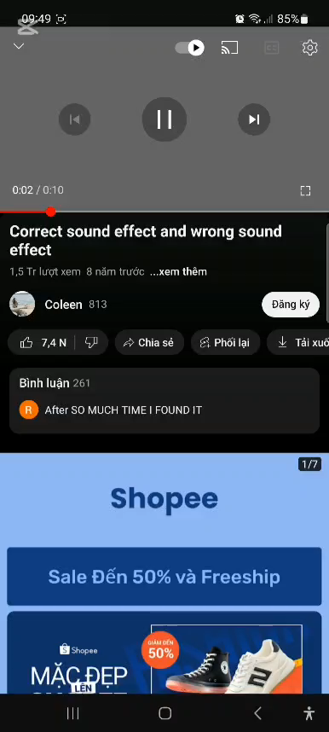
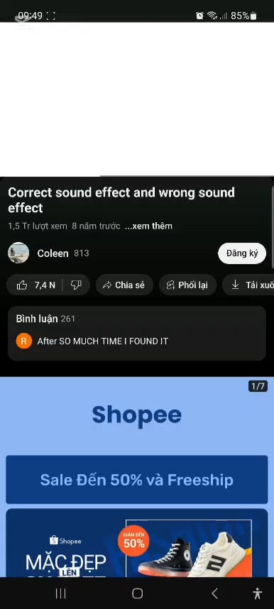
This is my school.
This is our playground.
This is our library.
Back

Slide 29

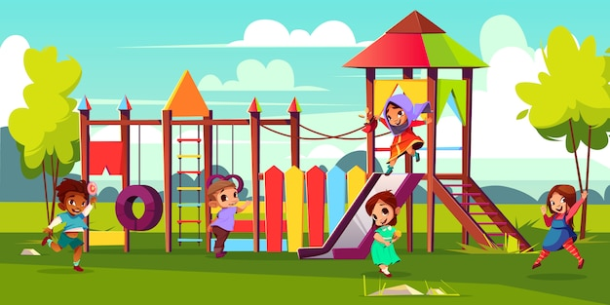
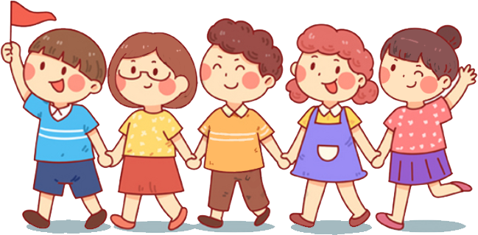

That is our gym.
Let’s go to the playground.
Is this my school?
Back

Slide 30
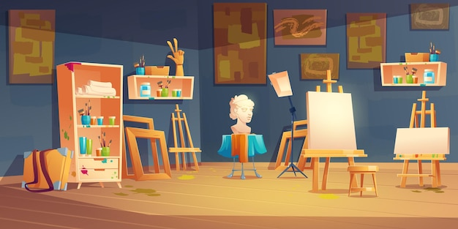
I like drawing
I like paiting
This is our art room
Back

Slide 31
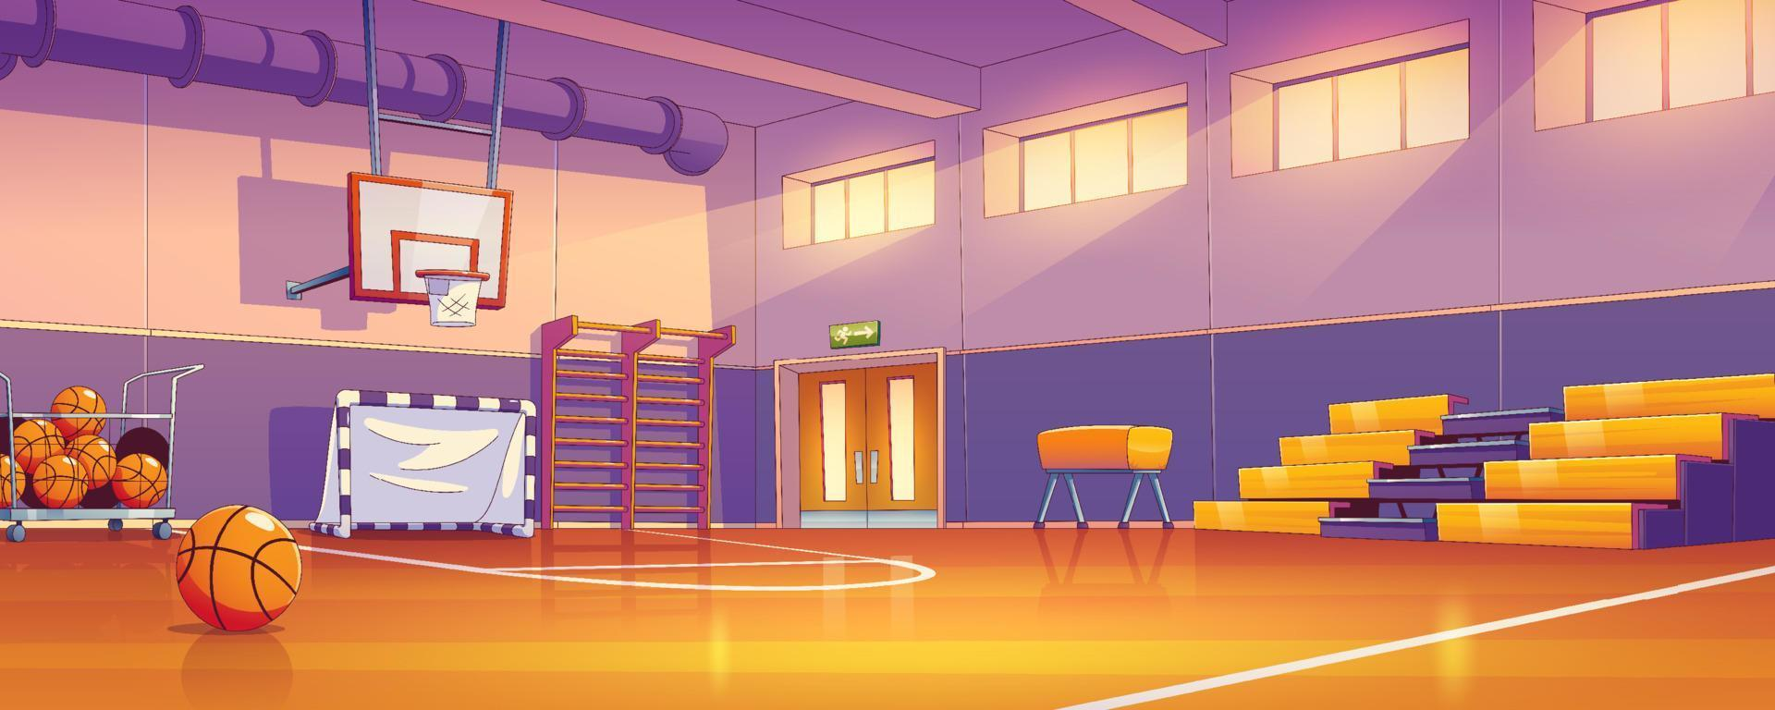
Let’s go to the playground.
Let’s go to the gym.
Is this my school?
Back

Slide 32
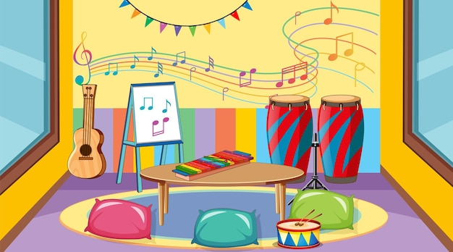
Let’s go to the music room
I like singing
This is my classroom
Back

Slide 33
I like singing
Let’s go to the classroom
This is our music room
Let’s go to the music room
Back

Slide 34
I like computer
Let’s go to the computer room
This is our computer room
Let’s go to the library.
Back

Slide 35
I like drawing
Let’s go to the library
Let’s go to the art room
Let’s go to the music room
Back

Slide 36
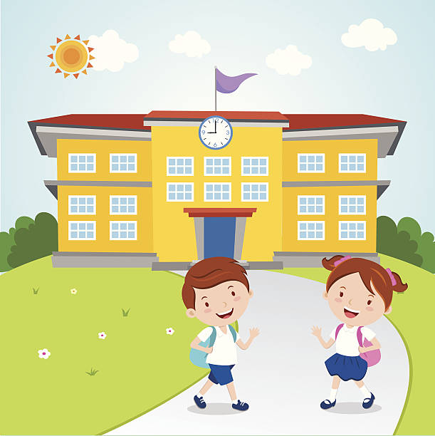
This is our playground
This is our classroom
Welcome to our school!
Back

