Slide 1


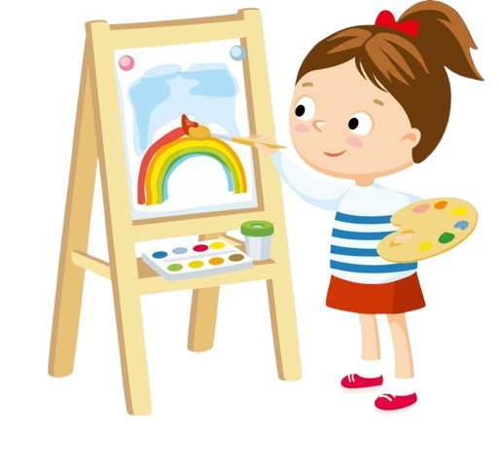

Unit 5
My hobbies
Lesson 1
Teacher: Hoang Thi Khanh Ly

Slide 2
Warm-up
Let’s play a game

Slide 3




Lucky numbers
1
2
3
4
5
6

Slide 4




What’s this?
A. It’s a finger
B. It’s a nose
+20
C. It’s a hand
D. It’s a hair

Slide 5
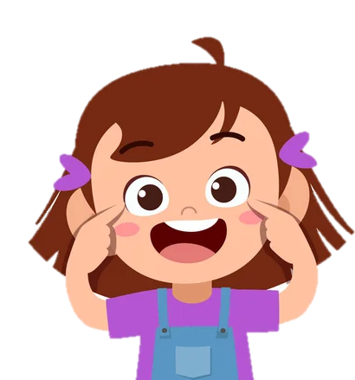

A. Touch your nose
B. Touch your ears
+15
C. Touch your eyes
D. Touch your hand

Slide 6

+15

Slide 7
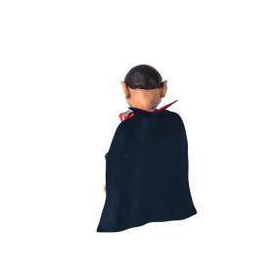
+30

Slide 8

+50

Slide 9



What’s this?
A. It’s an eye
C. It’s a nose
+10
B. It’s a mouth
D. It’s an ear

Slide 10
Unit 5
My hobbies
Lesson 1
Teacher: Hoang Thi Khanh Ly

Slide 11
VOCABULARY

Slide 12
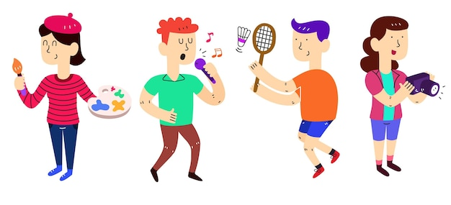
Hobby (n)
/ˈhɒb.i/
Sở thích

Slide 13


singing (n)
/ˈsɪŋ.ɪŋ/
hát

Slide 14
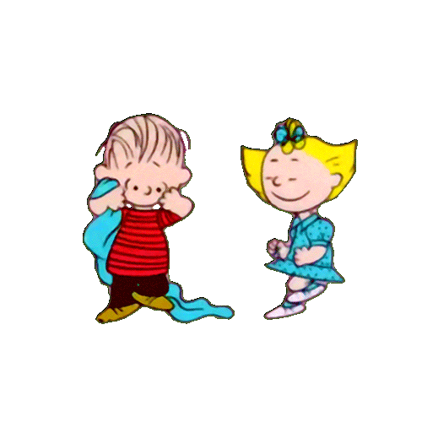
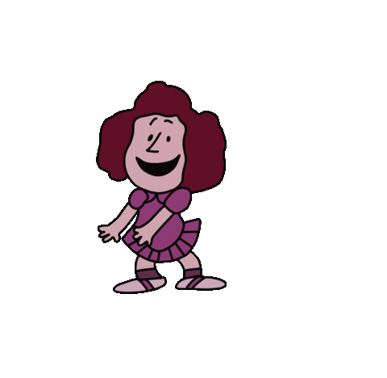
dancing (n)
/ˈdɑːn.sɪŋ/
nhảy

Slide 15
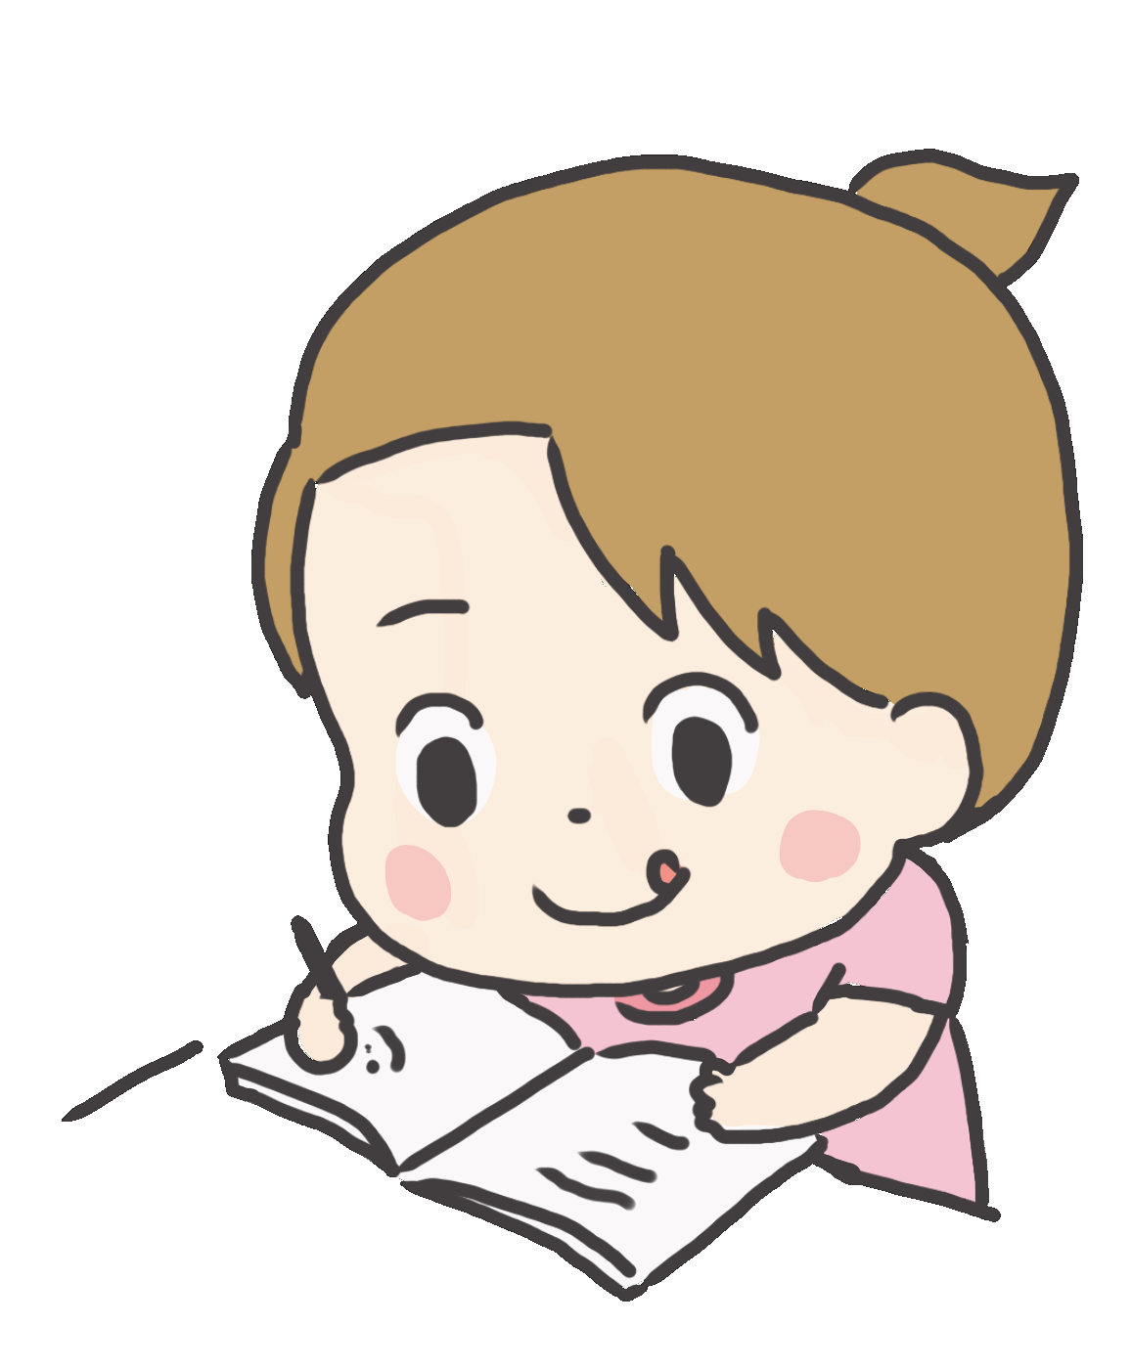
drawing (n)
/ˈdrɔː.ɪŋ/
vẽ

Slide 16

swimming (n)
/ˈswɪm.ɪŋ/
bơi

Slide 17
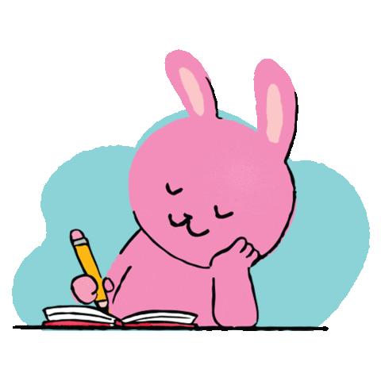

VOCABULARY
Hobby (n): sở thích
singing (n): hát
dancing (n): nhảy
drawing (n): vẽ
swimming (n): bơi

Slide 18
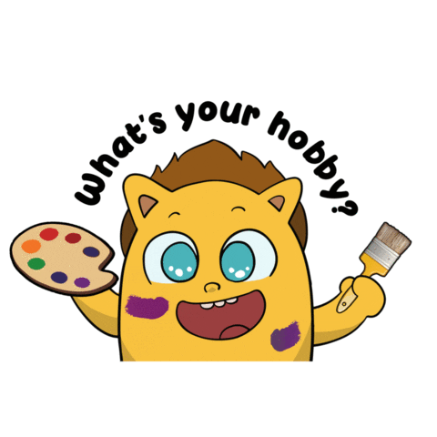

1 Look, listen and repeat

Slide 19

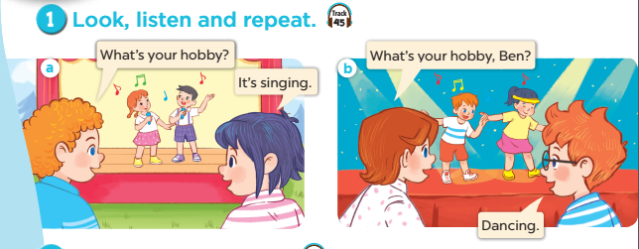

Slide 20
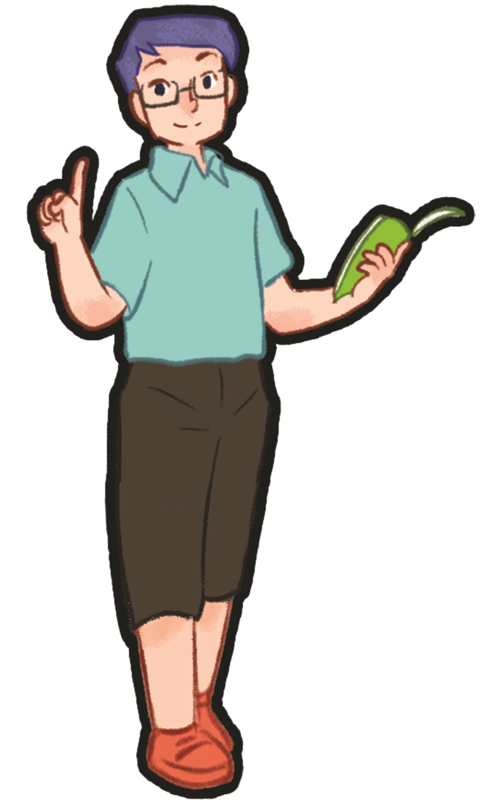

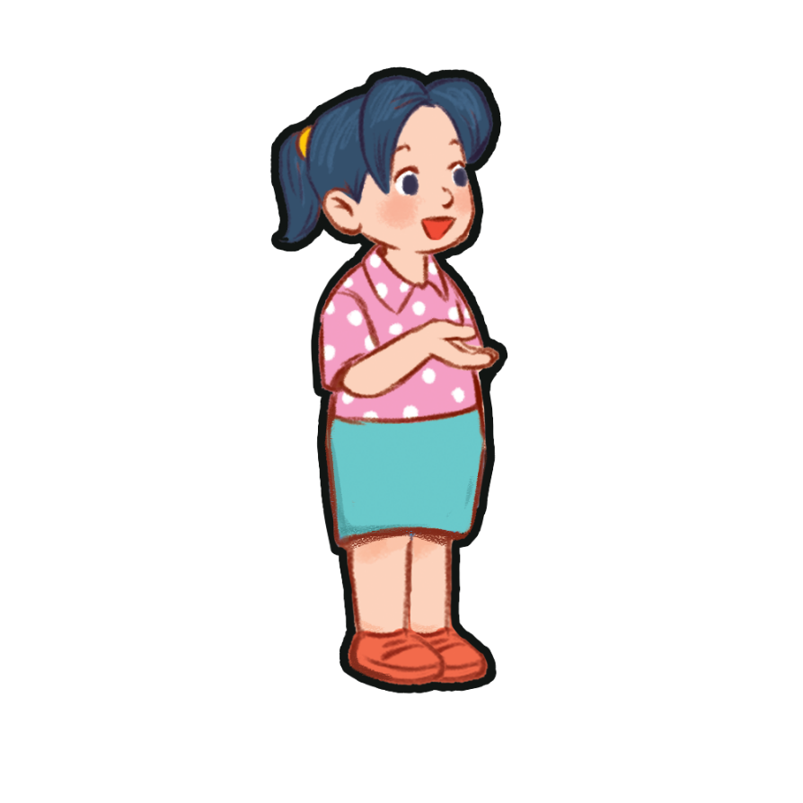
STRUCTUTE
What's your hobby?
It’s + (sở thích).

Slide 21
2 Listen, point and say

Slide 22
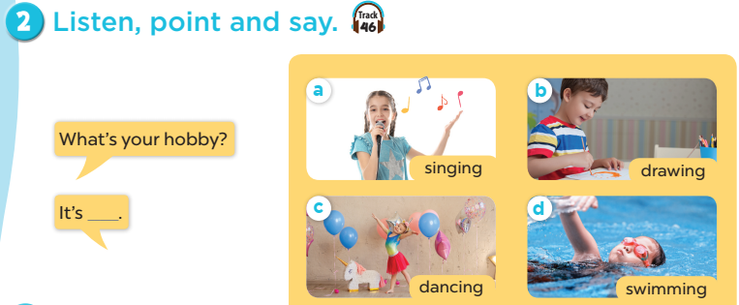
Notes:
Step 1: Have pupils look at the pictures and elicit the names of the pupils. Have the class repeat the words a few time.
Step 2: Ask 2 pupils to do as an example.
Step 4: Ask pupils to work in pairs, pointing to the questions and pictures and giving the answers.
Step 5: Invite few pairs to the front of the class and make questions and answers.

Slide 23

singing

Slide 24
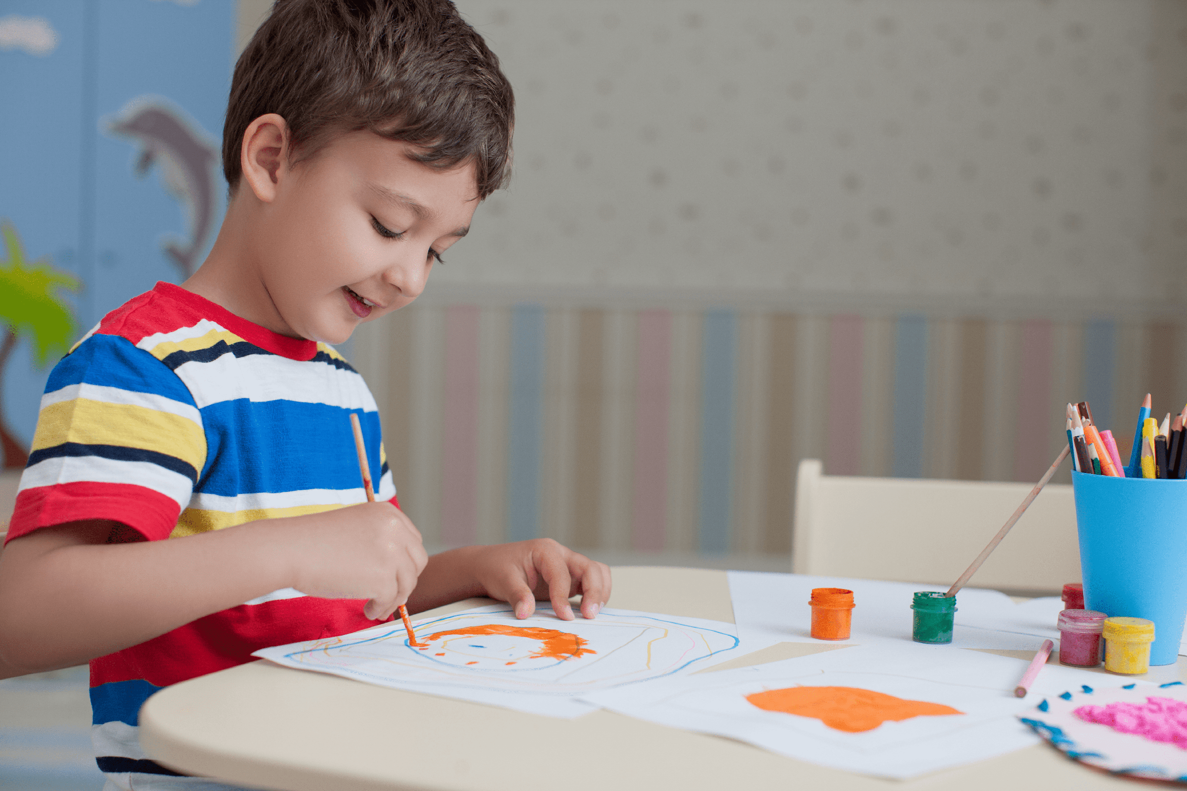
drawing

Slide 25
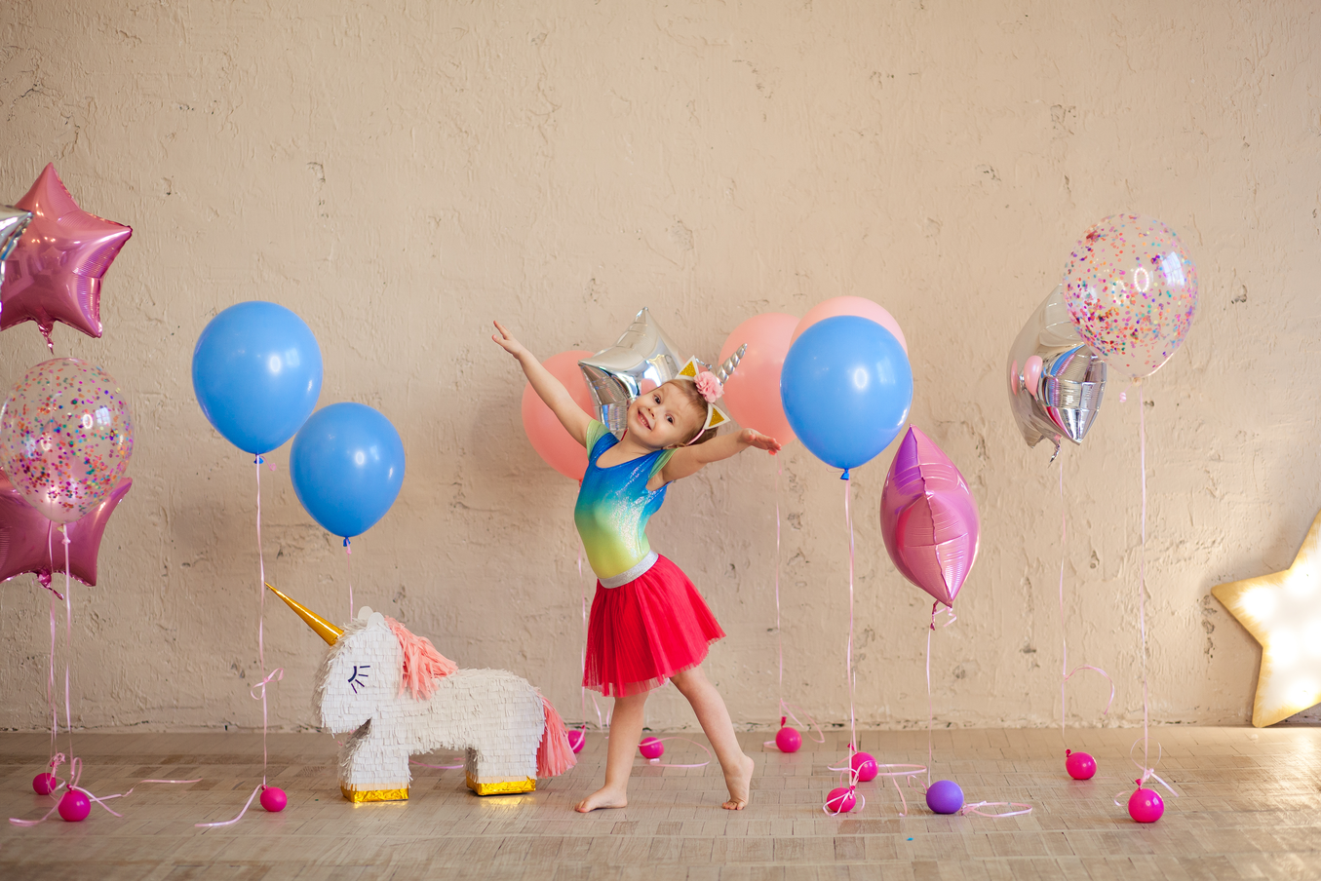
dancing

Slide 26
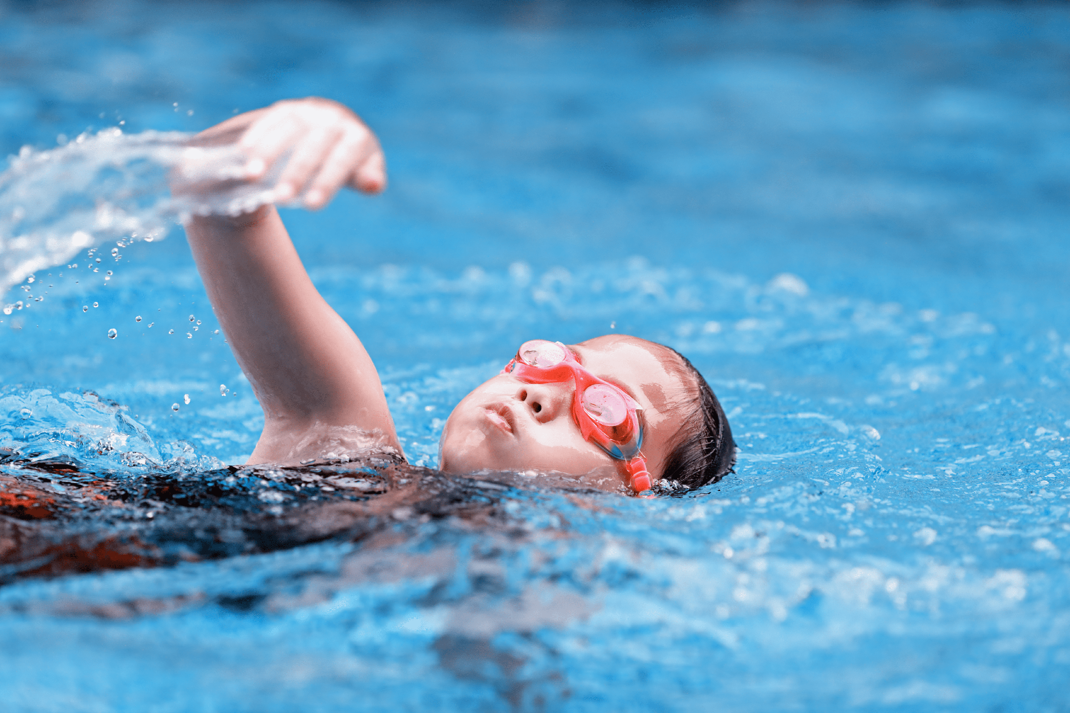
swimming

Slide 27

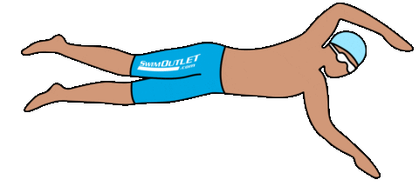
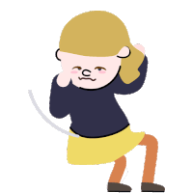
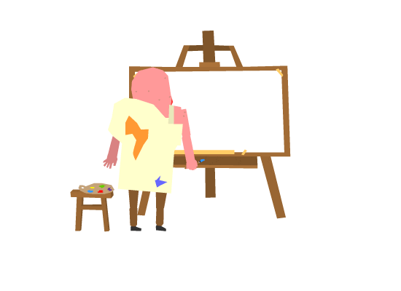
What's your hobby?
It’s ___________ .
singing
swimming
dancing
drawing

Slide 28
3 Let’s talk

Slide 29



What's your hobby?
It’s ___________ .

Slide 30
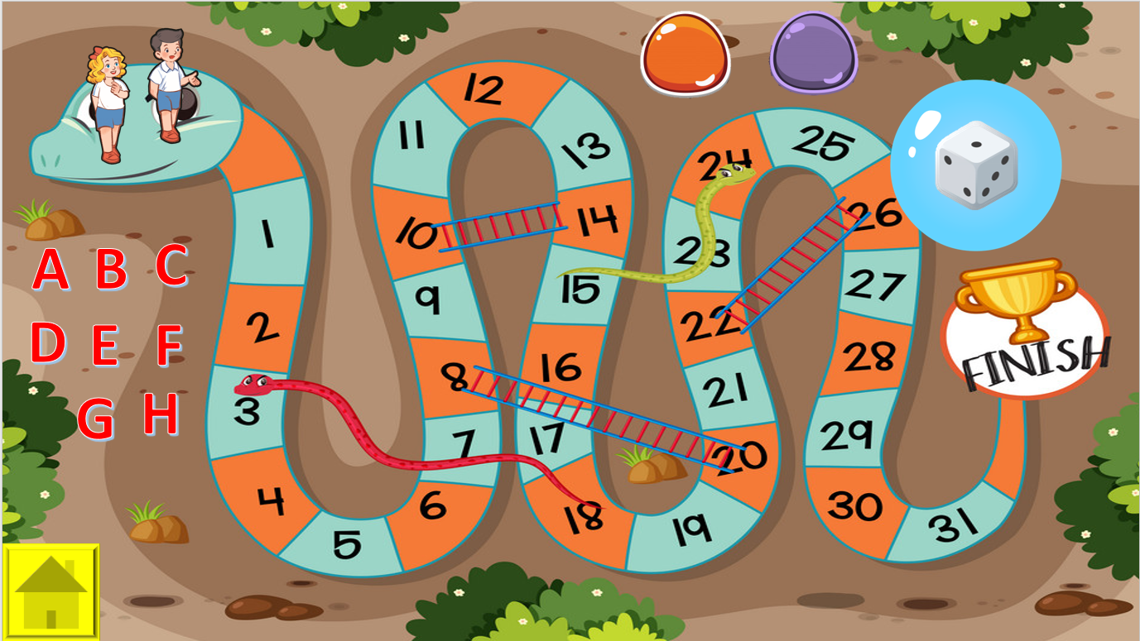

Fun corner & Wrap-up
5
Next
Notes:
1. GV chia cả lớp thành hai đội, mỗi đội chọn một nhân vật (Nam hoặc Mary) làm đại diện
3. HS chọn chữ cái mình thích để đi đến câu hỏi.
2. Nếu HS trả lời đúng, GV cho HS quay về Menu và chọn quân xúc xắc quay lấy điểm để đi ( như trò cá ngựa)
3. Nhấn vào nút màu tương ứng với nhân vật (tương ứng với số chấm trên xúc xắc) để cho nhân vật đi.
4. Đội nào về đích trước sẽ thắng.

Slide 31
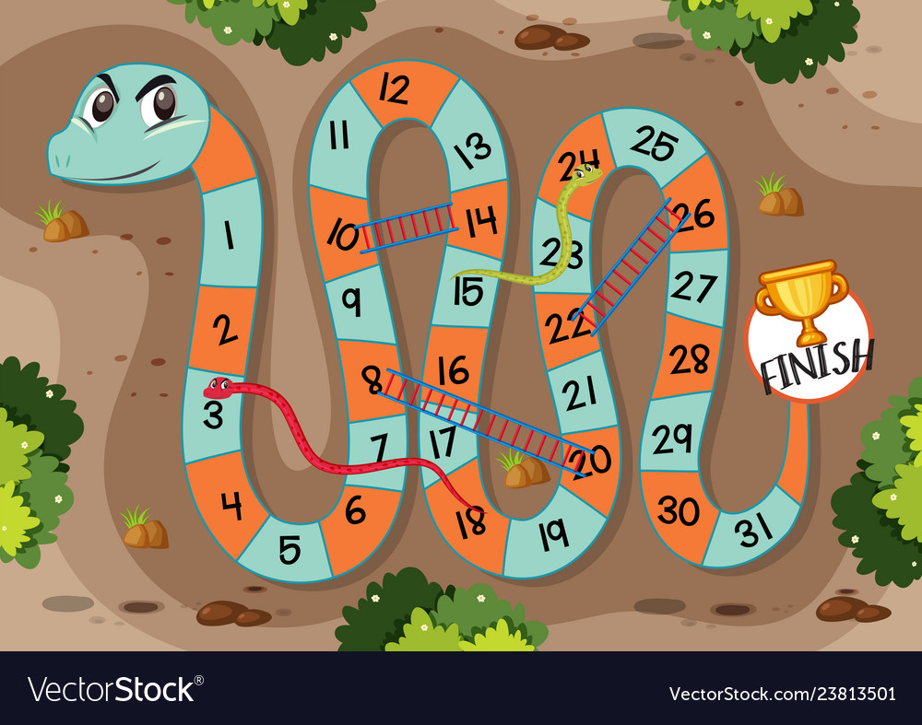











+5
+3
A
B
C
+2
+3
D
E
F
+2
G
H
+3
+2
+3
+5
+2

Slide 32

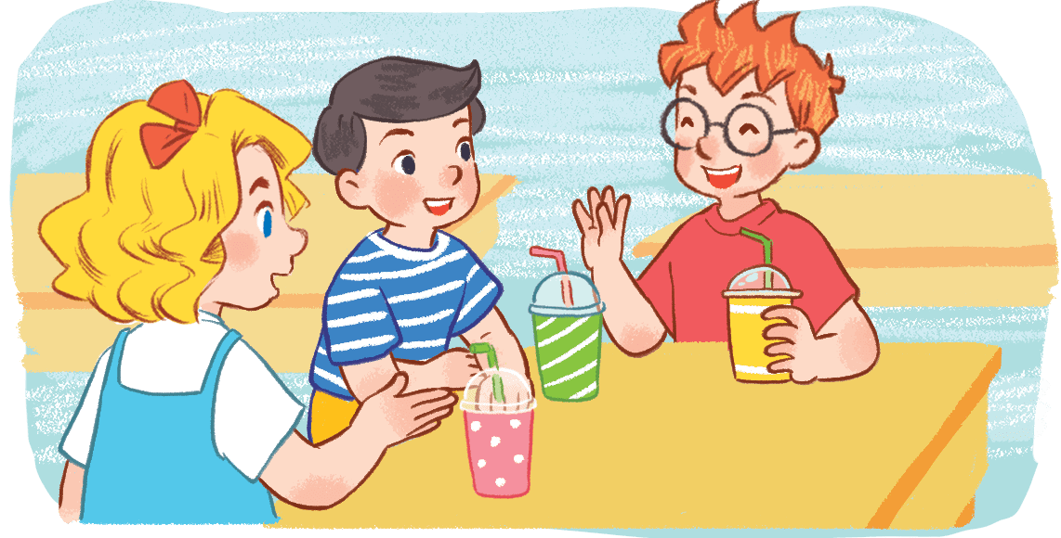


Mary: What’s your hobby?
Ben: ____ drawing.
A
This is
B
It’s
C
My is
MENU
Notes:
Hs chọn đúng, GV mời 2 bạn trong đội hội thoại

Slide 33
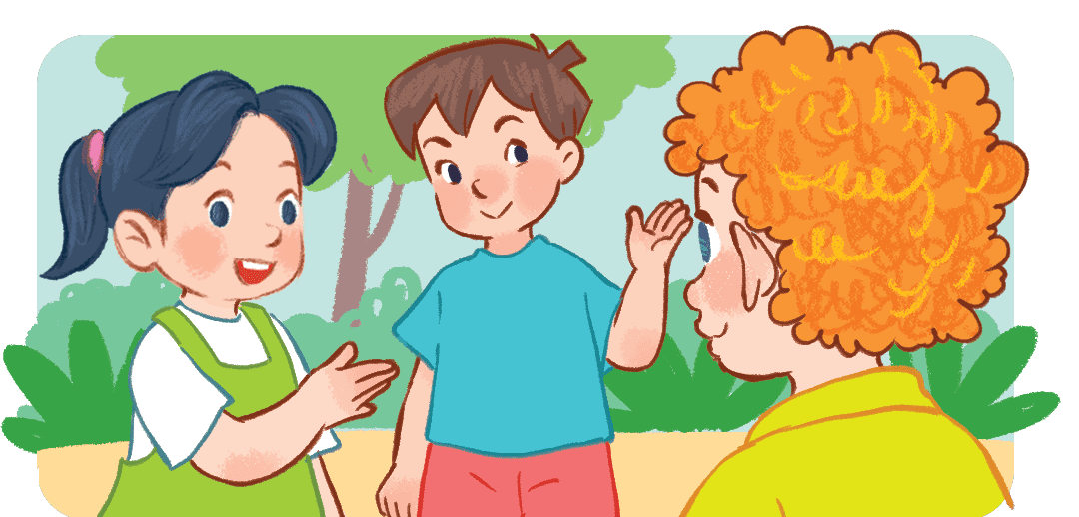
Mai: What’s your hobby?
Bill: ________________.
A
This is swimming.
B
It’s swimming.
C
It’s drawing.
MENU

Slide 34
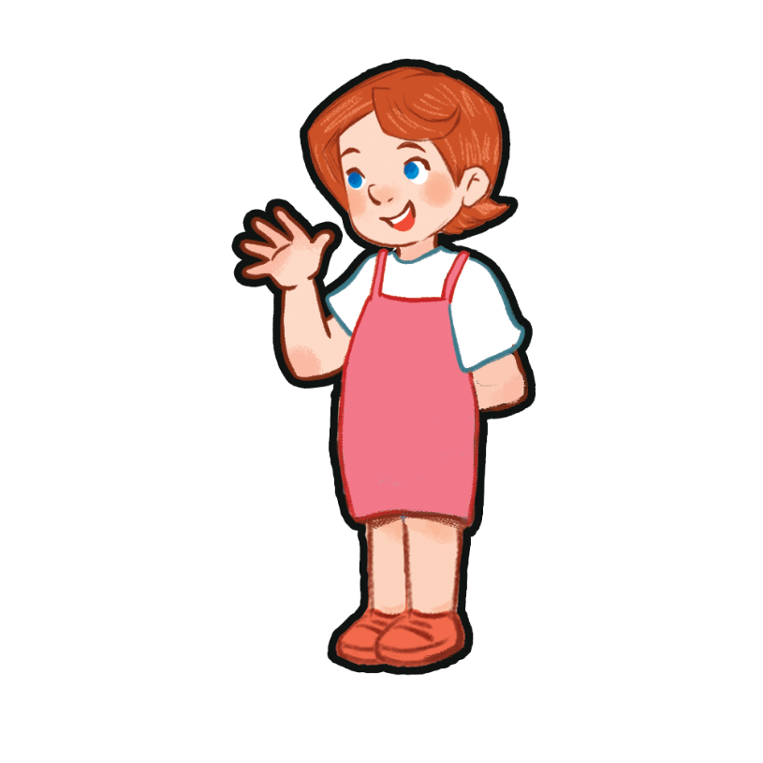
Ben: What’s your ________?
Lucy: It’s singing.
A
name
B
hobbies
C
hobby
MENU

Slide 35
Lucy: __________________?
Mai: It’s singing.
A
What’s your hobby?
B
What’s you hobby?
C
What’s my hobby?
MENU

Slide 36
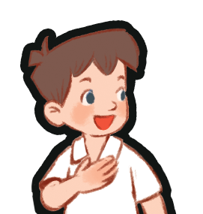
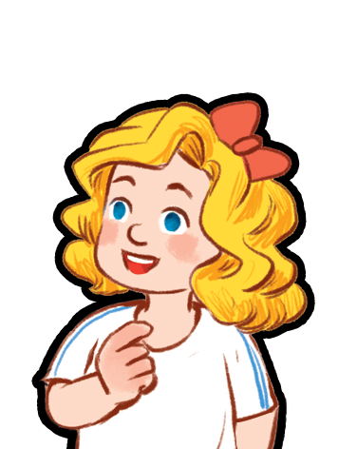
Minh: What’s _____ hobby?
Mary: _____ dancing.
B
your / It’s
A
you/ It’s
C
your/ This is
MENU

Slide 37

Minh: How are you?
Bill: _____________
A
I’m five years old
B
Fine. Thank you.
C
My name’s Bill
MENU

Slide 38


A: What’s your hobby?
B: _______________
A
It’s dancing
B
It’s drawing
C
It’s singing
MENU

Slide 39
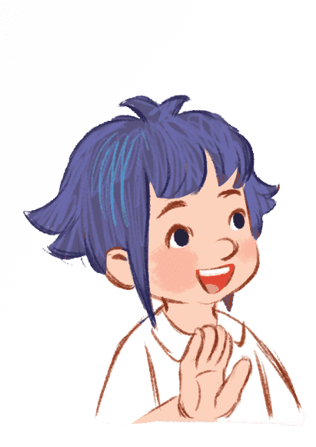
Linh: Bye, Bill.
Bill: ___________, Linh.
A
Thank you
B
Fine
C
Goodbye
MENU

Slide 40


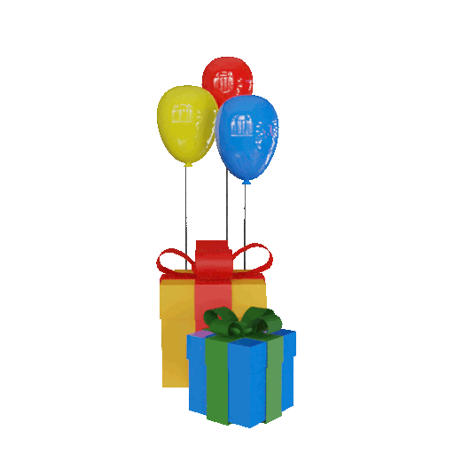

Slide 41

THANK YOU!

