Slide 1




WELCOME TO OUR CLASS TODAY
An Tien primary school
Class 4
Unit 7 : What do you like doing?
Lesson 1 : P. 1,2
Teacher : Nguyễn Thị Nhung

Slide 2


to our class today !

Slide 3
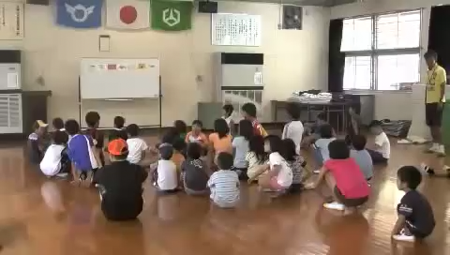

Slide 5


Unit 7 : What do you like doing?
Lesson 1 : P 1,2

Slide 6
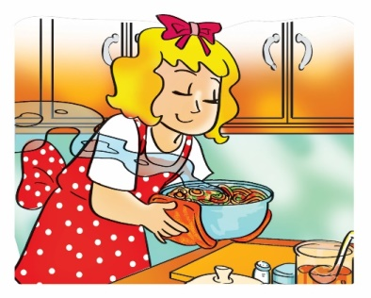
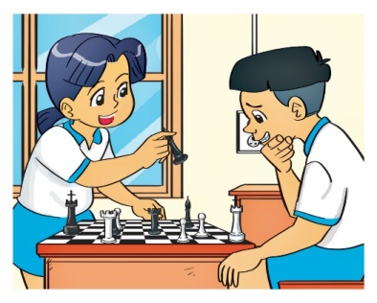
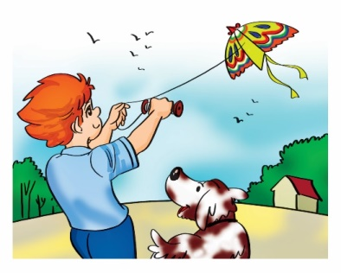
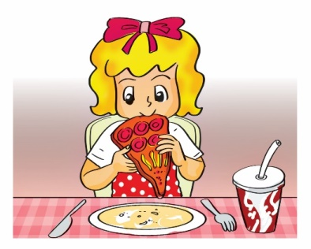
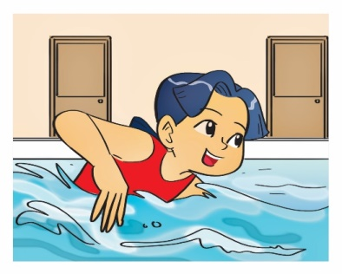
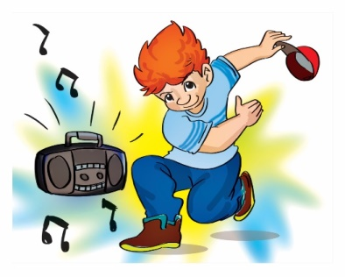
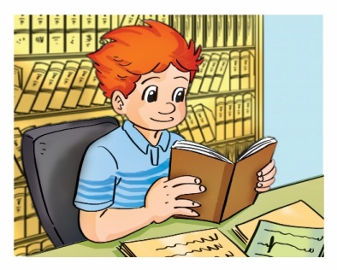
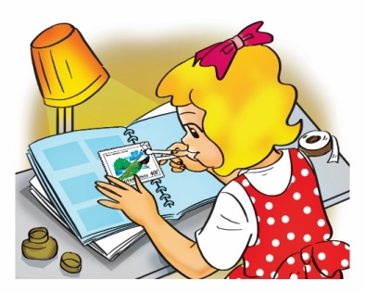
MsPham-0936082789
A. Vocabulary
Verb (v)
cook
play
fly
eat
Nấu ăn
Chơi
Thả, bay
Ăn
swim
dance
read
collect
Bơi
Nhảy
Đọc
Sưu tầm

Slide 7
MsPham-0936082789
A. Vocabulary
Verb (v)
V-ing
cooking
playing
flying
eating
cook
play
fly
eat
swimming
dancing
reading
collecting
swim
dance
read
collect

Slide 8
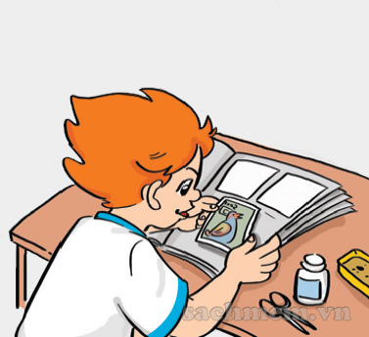
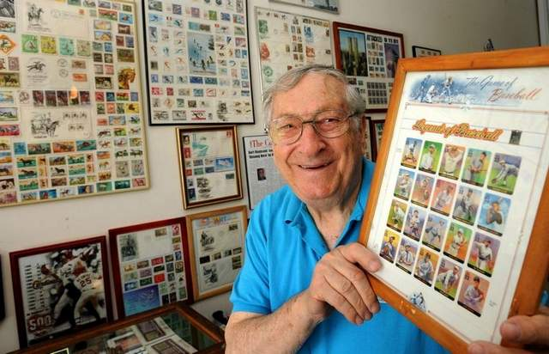
1. Look, listen and repeat
- Collecting stamps :
Sưu tầm tem

Slide 9
1. Look, listen and repeat
https://www.sachmem.vn/books/3/exercises/56

Slide 10


Game
Lucky animals

Slide 11
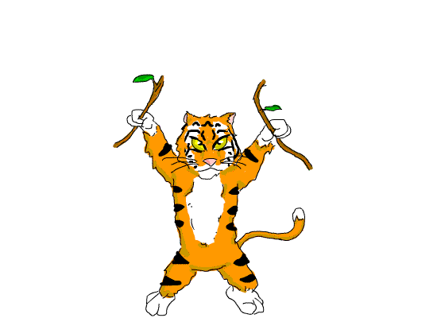

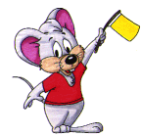

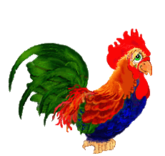



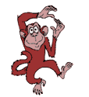


Slide 12


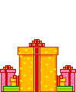

Slide 13
Interview!
Name | like .....
.................................
...............................
Report :
In my group, I like........................
Mi likes ..................
.................................

Slide 14
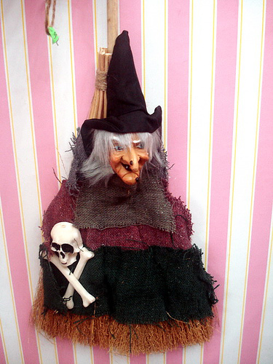
You are unlucky

Slide 15
You are unlucky

Slide 16

You’re Lucky

Slide 17
You’re Lucky

Slide 18
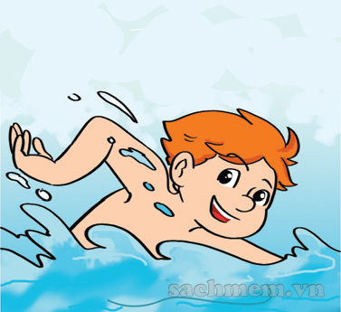
- What do you like doing?
- I like swimming.

Slide 19
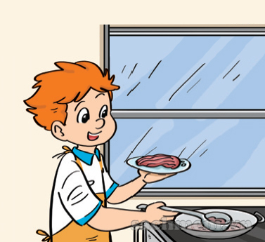
- What do you like doing?
- I like cooking.

Slide 20
- What do you like doing?
- I like collecting stamps.

Slide 21
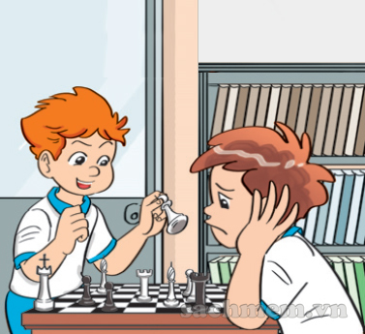
- What do you like doing?
- I like playing chess

Slide 22
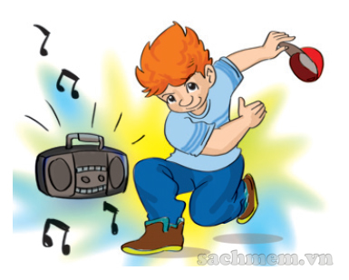
- What do you like doing?
- I like dancing.

Slide 23
collecting stamps
swimming
dancing
Like
watching TV
cooking
reading
playing chess
listening to music

Slide 24
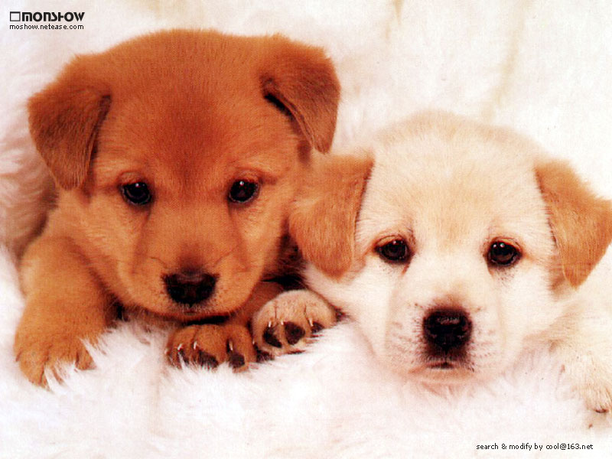
Thank you for your attention!
Thank you for your attention!

Slide 25


