Slide 2


















5
My future job

Slide 3





TABLE OF CONTENTs
  01. Warm-up
  02. Look, listen and repeat.
  03. Listen, point and say.
  04. Let’s talk.
  05. Fun corner and wrap-up

Slide 4




01.
Warm-up

Slide 5







He cooks food in the restaurant. Who is he?
cook
student

Slide 6
She works at school. She teaches pupils. Who is she?
actor
teacher

Slide 7

He works in a police station. Who is he?
cook
policeman

Slide 8

She takes care of sick people.
Who is she?
doctor
farmer

Slide 9

She’s young, she studies at school. Who is she?
pupil
teacher

Slide 10
She works on a farm. Who is she?
policeman
farmer

Slide 11

He can sing very well. Who is he?
actor
singer

Slide 12
New words
Look, listen and repeat.

Slide 13






firefighter

Slide 14

writer

Slide 15

gardener

Slide 16

reporter

Slide 17
Who is faster?

Slide 18
02.
Look, listen and repeat.

Slide 19

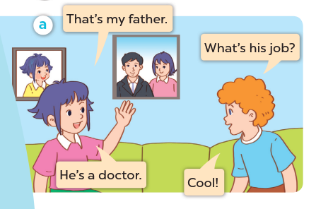


Look, listen and repeat.

Slide 20
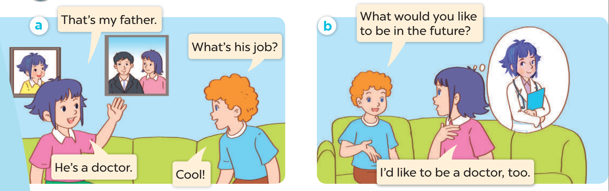
Listen and repeat.

Slide 21
03.
Listen, point and say.

Slide 22


Listen and repeat.

Slide 24
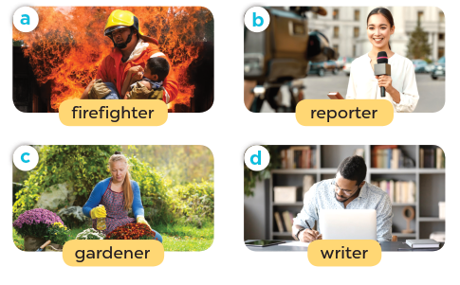
Listen, point and say.

Slide 25
Work in pairs, ask and answer.

Slide 26
03.
Let’s talk.

Slide 27
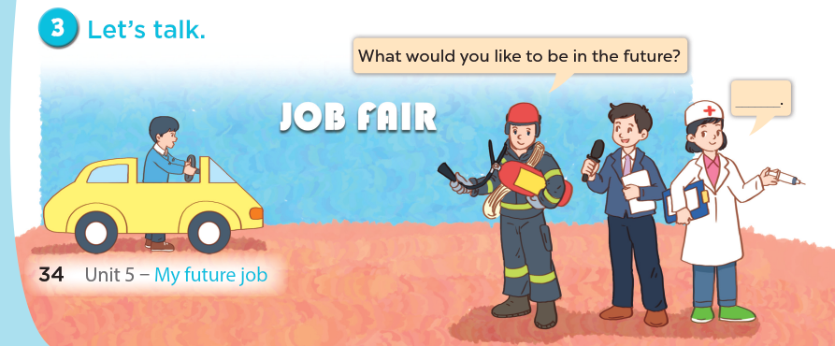

Slide 28
04.
Fun corner and wrap-up

Slide 29
PASS THE BALL

Slide 30
HOW TO PLAY
Pass the balls: When the music stops, whoever has a ball must stand up and either ask or answer the question on the screen.
Notes:
GV có thể thay tranh khác hoặc bỏ tranh để hs nói về mình.

Slide 31
PASS THE BALL!
STOP!

Slide 32

QUESTION:
ANSWER:
here
gardener.

Slide 33
PASS THE BALL!
STOP!

Slide 34
QUESTION:
Question here
ANSWER:
here
firefighter.

Slide 35
PASS THE BALL!
STOP!

Slide 36

QUESTION:
Question here
ANSWER:
here
writer

Slide 37
PASS THE BALL!
STOP!

Slide 38

QUESTION:
Question here
ANSWER:
here
reporter.

Slide 39
PASS THE BALL!
STOP!

Slide 40

QUESTION:
Question here
ANSWER:
here
writer

Slide 41
PASS THE BALL!
STOP!

Slide 42

QUESTION:
Question here
ANSWER:
here
gardener.

Slide 43
PASS THE BALL!
STOP!

Slide 44

QUESTION:
Question here
ANSWER:
here
reporter.

Slide 45
PASS THE BALL!
STOP!

Slide 46

QUESTION:
Question here
ANSWER:
here
reporter.

Slide 47
PASS THE BALL!
STOP!

Slide 48

QUESTION:
Question here
ANSWER:
here
writer

Slide 49
Website: hoclieu.vn
Fanpage: facebook.com/www.tienganhglobalsuccess.vn

