Slide 1



Slide 2



6
Our school
LESSON 1 PERIOD 2

Slide 3





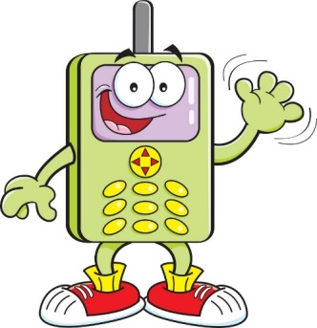



1
Warm-up & Review
1
2
4
3
5
7
8
6
Notes:
GV xem video hướng dẫn
HS chọn điện thoại mình thích để đi đến câu hỏi.
HS trả lời đúng được đi đến bảng nhận điểm
Nếu HS trả lời sai, GV nhấn nút HOME để về Menu

Slide 4

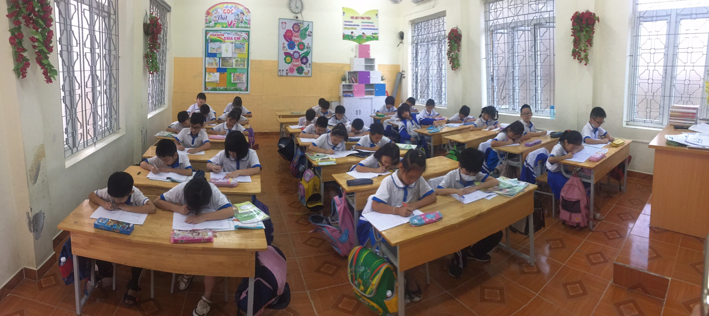

Is this our classroom?
No, it isn’t.

Slide 5


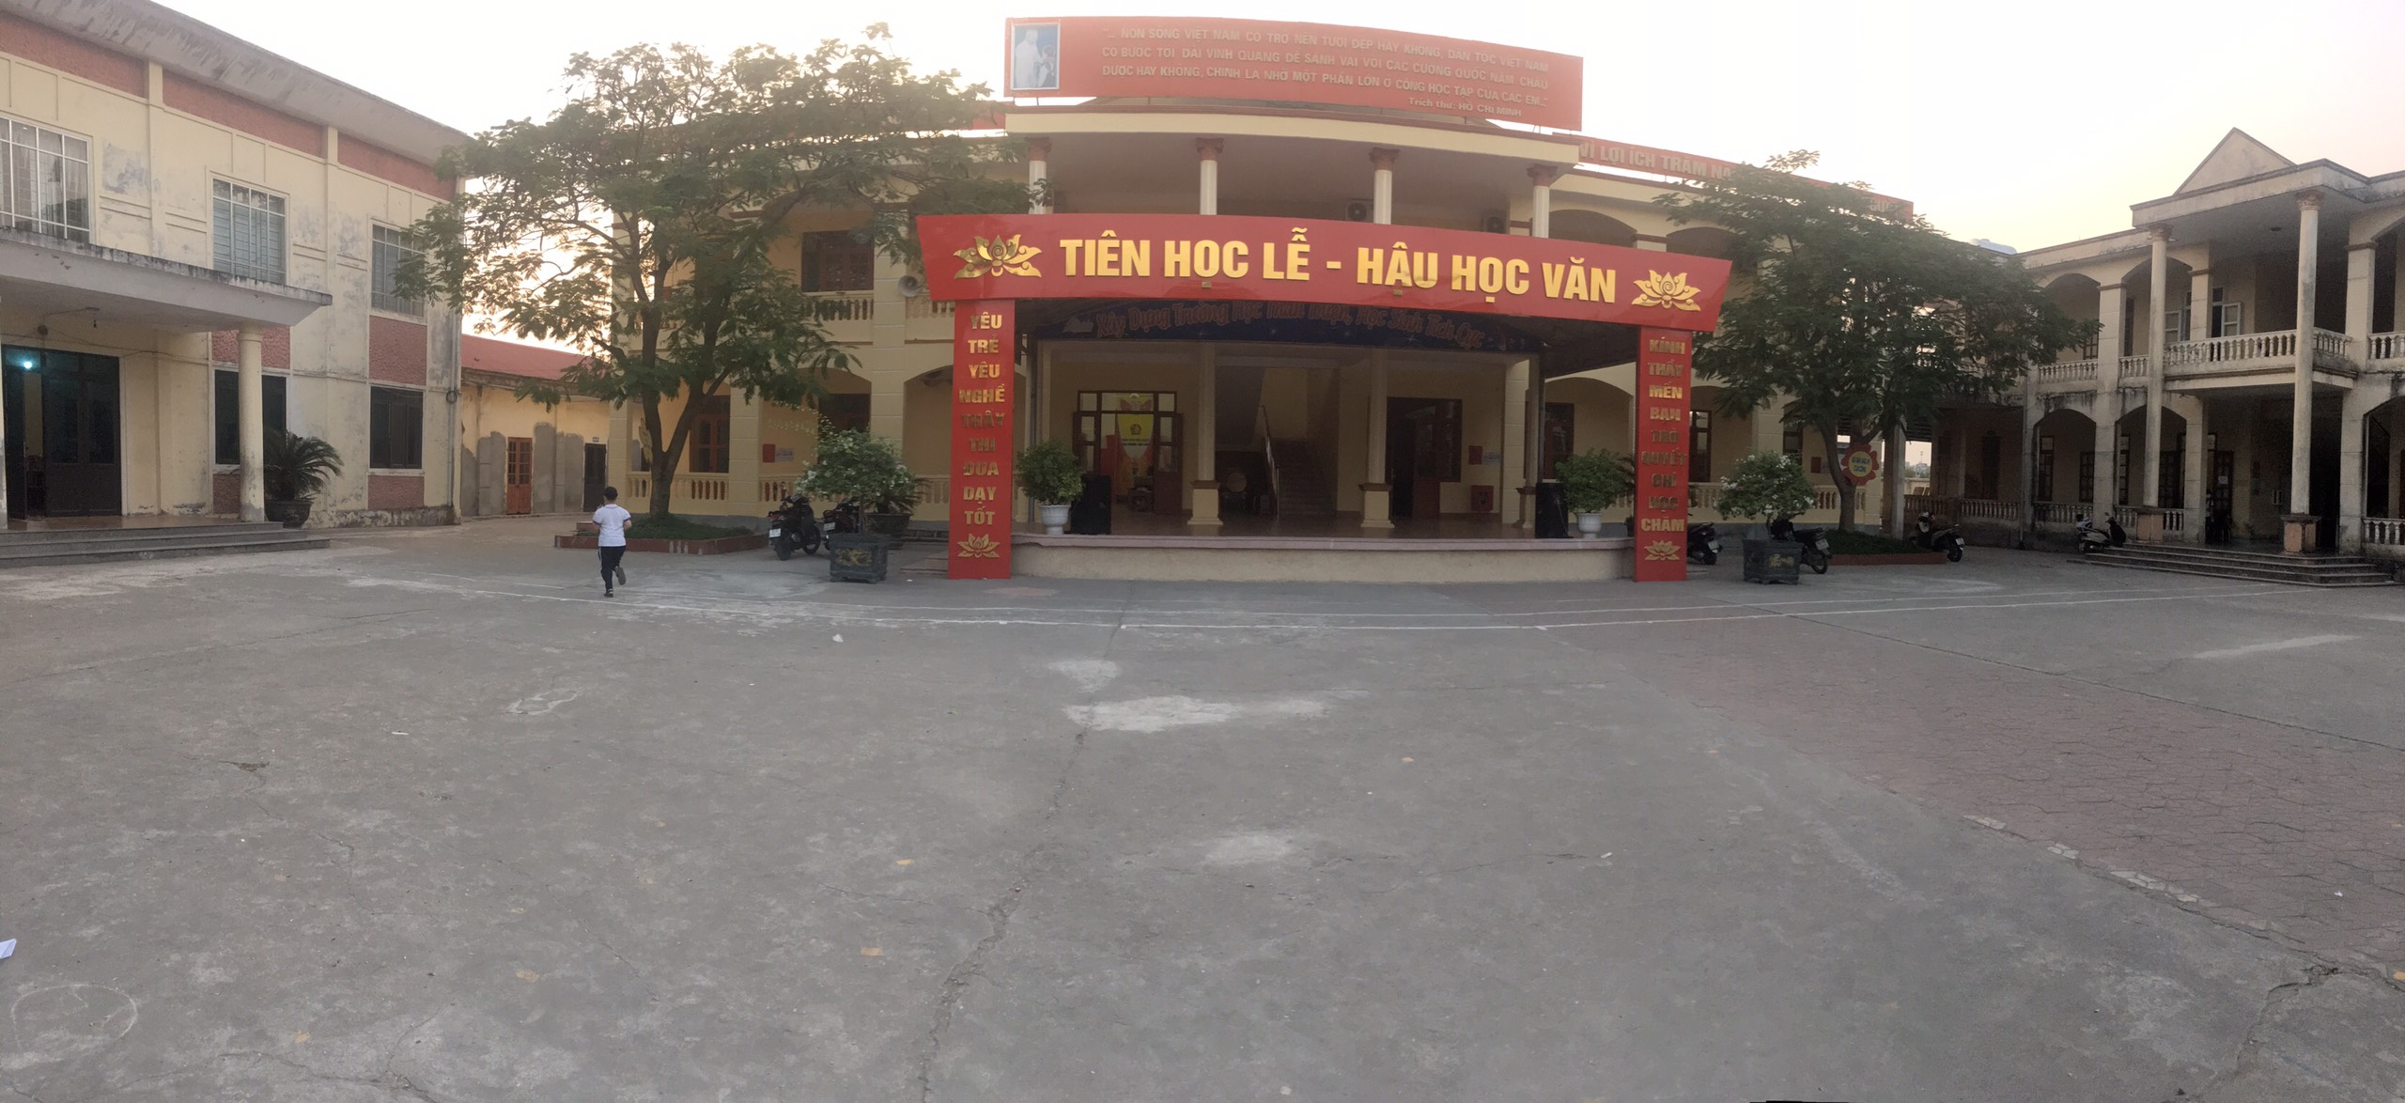
Is this
our
school?
No, it isn’t.

Slide 6
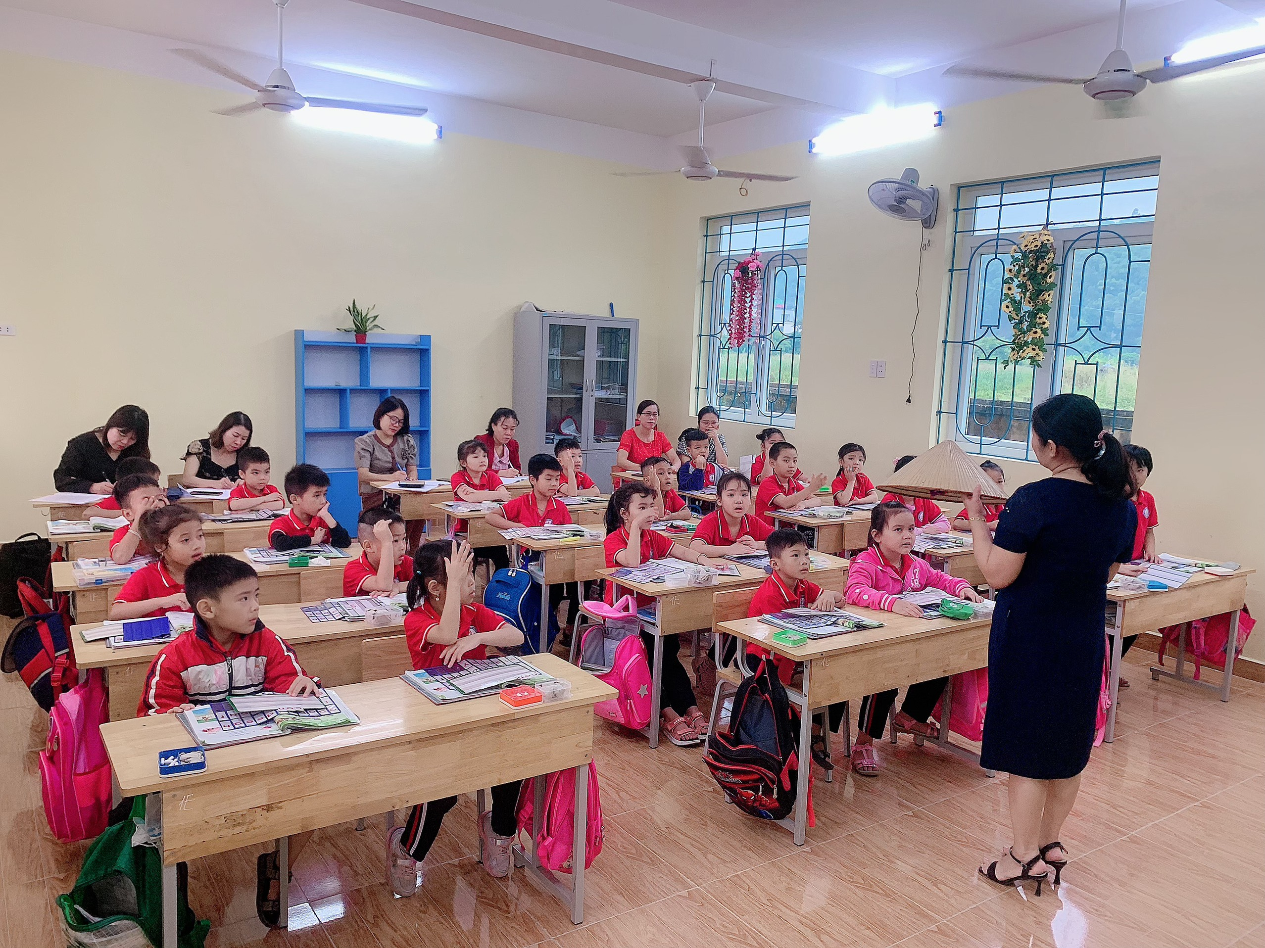
Is this our classroom?
No, it isn’t.

Slide 7
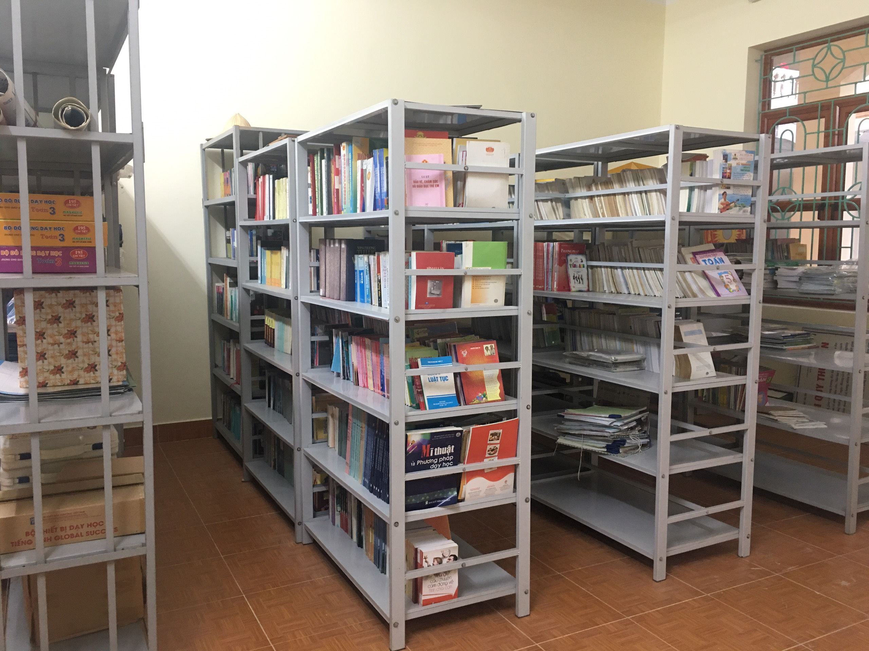

Is this our library?
Yes, it is.

Slide 8
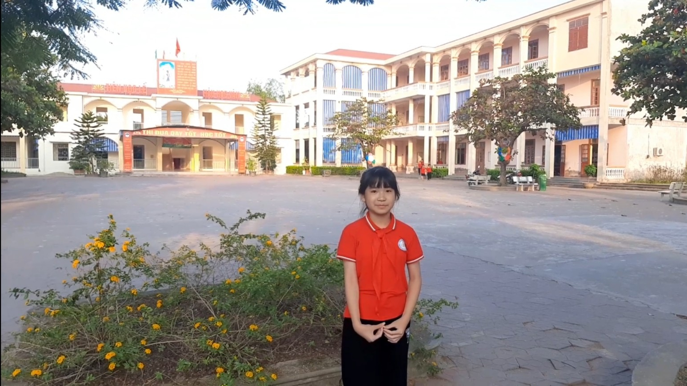
Is this our school?
Yes, it is.

Slide 9
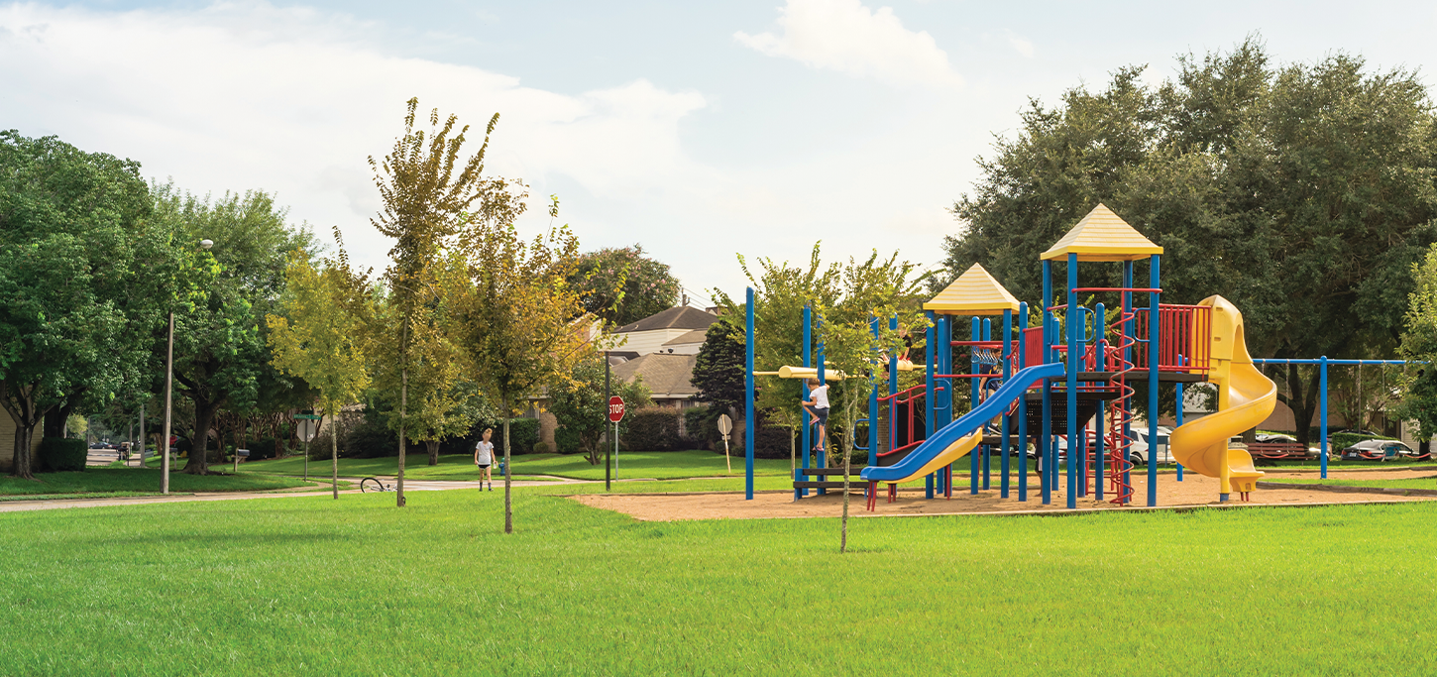

Is this our playground?
No, it isn’t.

Slide 10












Slide 12
Table of contents
Warm-up and review
Activity 4
01
02
Activity 5
Activity 6
03
04
Listen and tick
Look, complete and read
Let’s sing
Fun corner
Extra stuffs
05
06
Game
Links

Slide 13

Hello, boys and girls. Welcome to our lesson today.

Slide 14

WARM-UP and REVIEW

Slide 15
Warm-up

Slide 16
Is this……..?
Divide class into 3 teams.
Each teams has 1 sticky ball.
Play the music, students in each team take turn to pass the ball. After the music ends, 3 students have the ball – stand up and say the name, using the sentence model.
1
2
3

Slide 17

LISTEN AND TICK.

Slide 18



Slide 19

LOOK, COMPLETE AND READ.

Slide 20
library
playground
school
classroom
isn’t
it isn’t

Slide 21

LET’S SING.

Slide 23

FUN CORNER

Slide 24






5
10
15
20
15
25
10
→

Slide 25
Read and choose.
………… this your classroom?
Is
Is
Are

Slide 26
Read and choose.
That is our…………………………
playground
playground
classroom

Slide 27
Read and choose.
Is ……….your classroom?
they
that
that

Slide 28
Read and choose.
Is that your library?
Yes, it isn’t.
Yes, it is.

Slide 29
Read and choose.
Is that ………….school?
look
your
your

Slide 30
Read and choose.
Is this our playground?
No, it isn’t.
No, it is.

Slide 31
Read and choose.
Is that your……………..?
library
school
school

Slide 32

EXTRA STUFFS

Slide 33

Website: sachmem.vn
Fanpage: www.facebook.com/sachmem.vn

