Slide 1
Activity
vocabulary
By Ms Nhung Nguyen

Slide 2
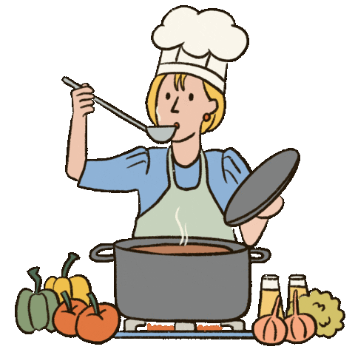
cooking
1
By Ms Nhung Nguyen

Slide 3
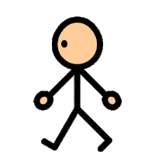
walking
2
By Ms Nhung Nguyen

Slide 4
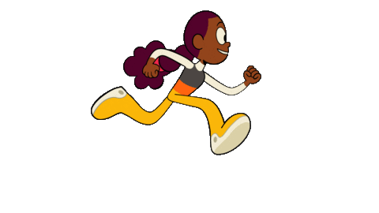
running
3
By Ms Nhung Nguyen

Slide 5
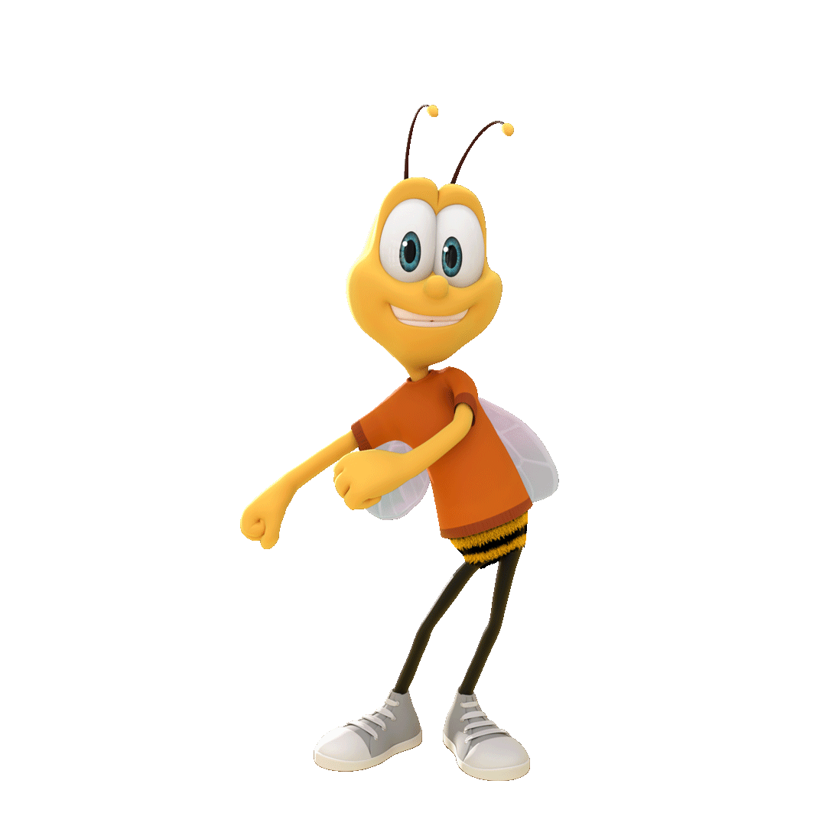
dancing
4
By Ms Nhung Nguyen

Slide 6

singing
5
By Ms Nhung Nguyen

Slide 7
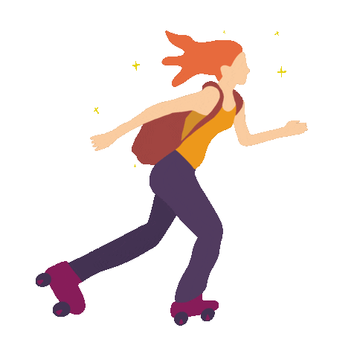
skating
6
By Ms Nhung Nguyen

Slide 8

reading
7
By Ms Nhung Nguyen

Slide 9

writing
8
By Ms Nhung Nguyen

Slide 10
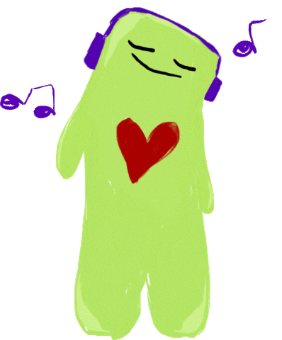
listening
to music
9
By Ms Nhung Nguyen

Slide 11
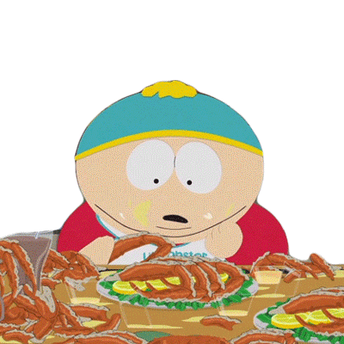
eating
10
By Ms Nhung Nguyen

Slide 12

drinking
11
By Ms Nhung Nguyen

Slide 13
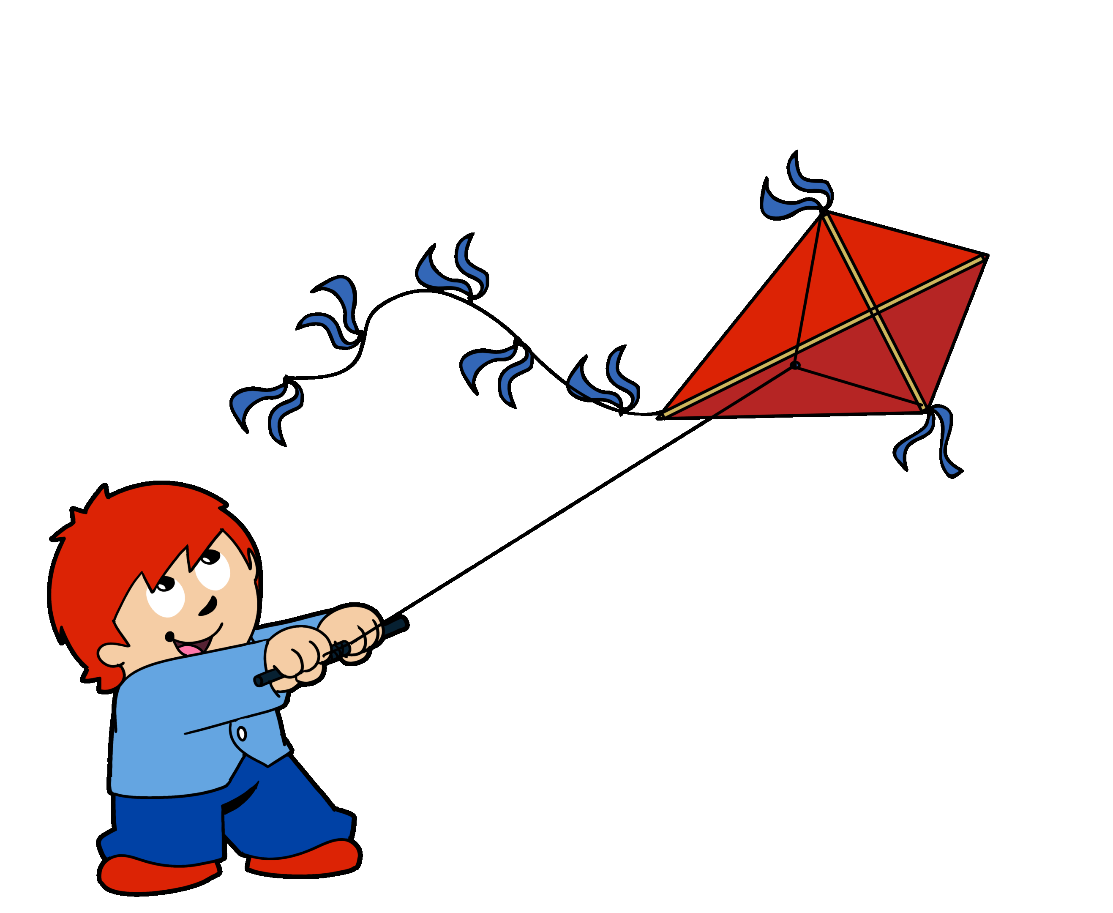
flying a kite
12
By Ms Nhung Nguyen

Slide 14
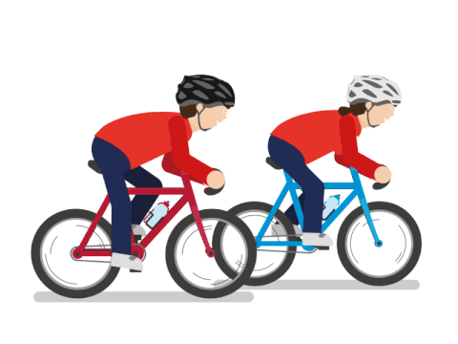
cycling
13
By Ms Nhung Nguyen

Slide 15
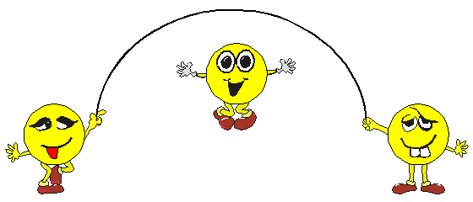
skipping
14
By Ms Nhung Nguyen

Slide 16
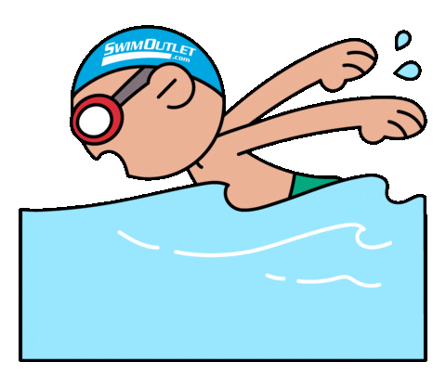
swimming
15
By Ms Nhung Nguyen

Slide 17
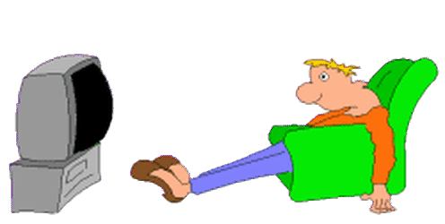
watching TV
16
By Ms Nhung Nguyen

Slide 18
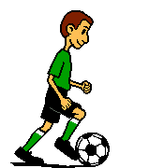
playing football
17
By Ms Nhung Nguyen

Slide 19
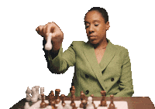
playing chess
18
By Ms Nhung Nguyen

Slide 20
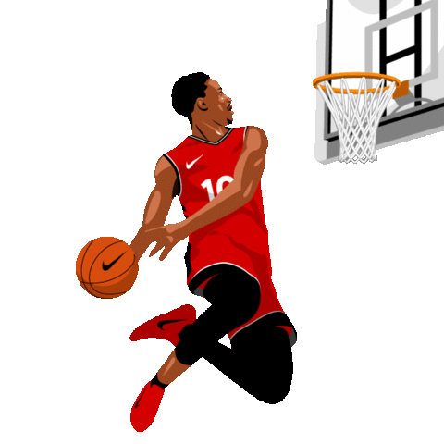
playing basketball
19
By Ms Nhung Nguyen

Slide 21
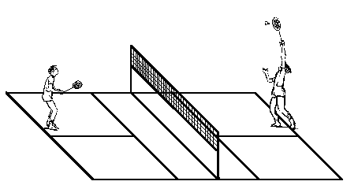
playing badminton
20
By Ms Nhung Nguyen

Slide 22
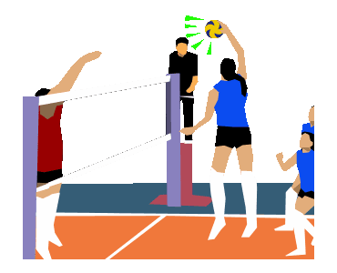
playing volleyball
21
By Ms Nhung Nguyen

Slide 23
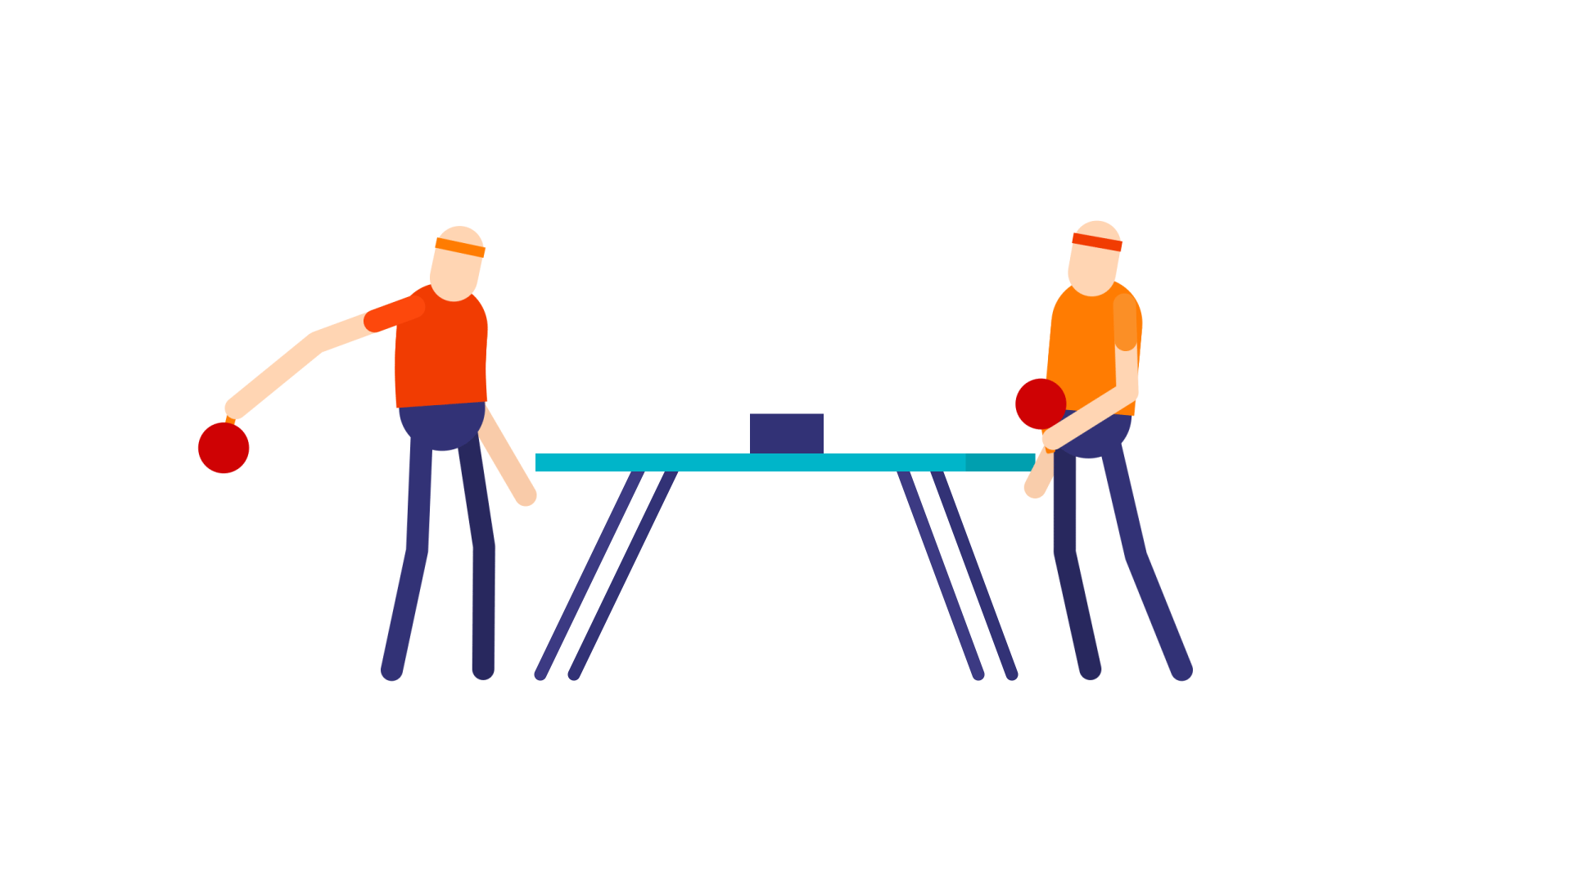
playing table tennis
22
By Ms Nhung Nguyen

Slide 24













An Tien Primary School
By Ms Nhung Nguyen

