Slide 1




WELCOME TO OUR CLASS TODAY
An Tien primary school
Class 5
Unit 8 : In our classroom
Lesson 2 : P. 1,2,3
Teacher : Nguyễn Thị Nhung

Slide 2
Warm up

Slide 3
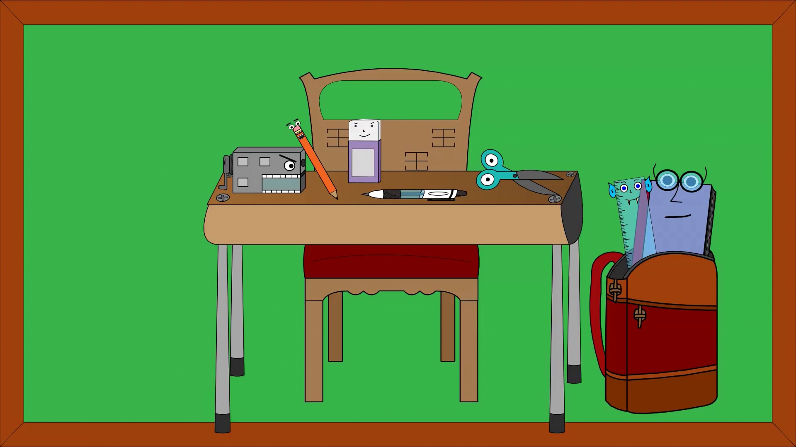

Slide 4
Unit 8
In our classroom
Lesson 2

Slide 5
https://hoclieu.vn/skill/cd37ef10-8ea6-4e3b-b184-948bfd200deb?lessonId=08dc84ad-fd4c-41ec-8bbb-2d0ecc22925f

Slide 6


Game

Slide 8
Join the quiz:
https://quizizz.com/admin/quiz/674dd271e063e37da322aedf?searchLocale=

Slide 9
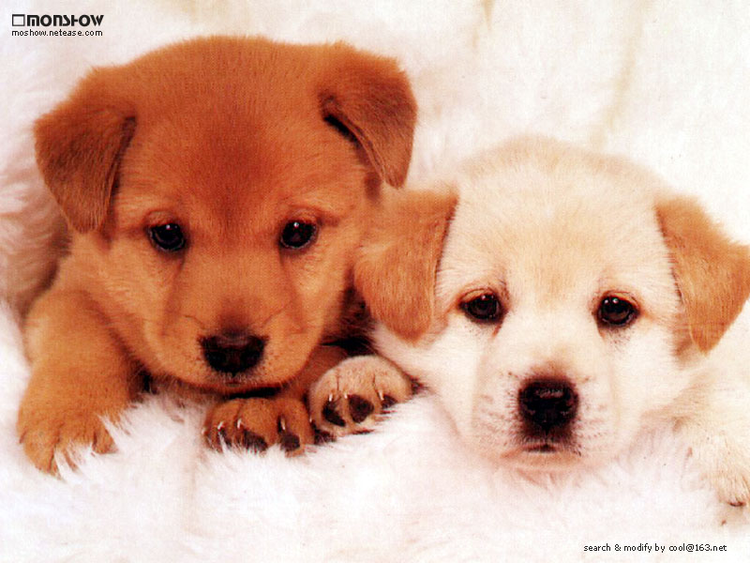

Thank you for your attention!
Thank you for your attention!

