Slide 1




WELCOME TO OUR CLASS TODAY
An Tien primary school
Class 5
Unit 8 : In our classroom
Lesson 1 : P. 4,5,6
Teacher : Nguyễn Thị Nhung

Slide 2
Warm up

Slide 3
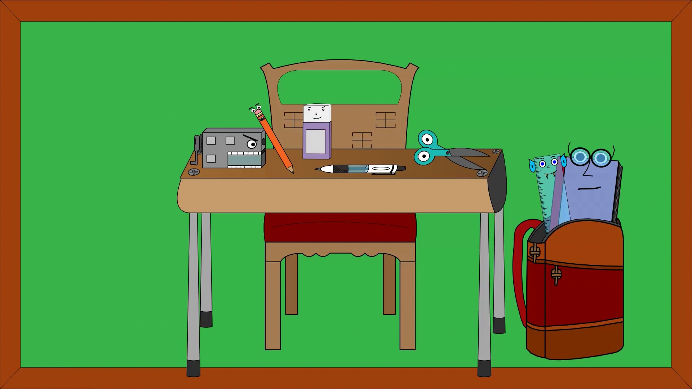

Slide 4
Unit 8
In our classroom
Lesson 2

Slide 5


Game

Slide 6



Slide 7





















1
2
3
4
5
6
7
8
1
2
3
4
5
6
7
8
1 point
3 points
Take 5 points
2 points
4 points
Notes:
7

Slide 8
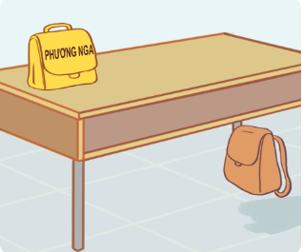



A: Excuse me, whose school bag is this?
B: _________ Phuong Nga’s.
a. It
b. It’s

Slide 9

A: Where’s my school bag?
B: Look! It’s there,__________the desk.
a. under
b. on

Slide 10
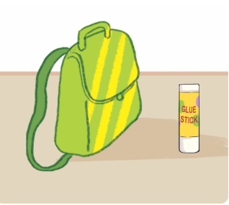
A: ______ glue stick is this?
B: It’s Tom’s.
a. Whose
b. Who

Slide 11
A: _________my glue stick?
B: It’s there.
a. Where’s
b. Where

Slide 12
A: Where’s my glue stick?
B: It’s there, beside the ________.
a. book
b. school bag

Slide 13


Slide 16
Goodbye!

