Slide 1


Slide 3

TEAM DIVISION
Team 1
Team 2
Team 3
Team 4
Unit 11 – Lesson 2
Notes:
Divide class into 4 teams

Slide 4




CLASSROOM RULES
1. Be quiet!
2. Listen!
3. Sit nicely!
4. Raise your hand to speak!
Unit 11 – Lesson 2
Notes:
Set the rules in class.

Slide 5


WARM UP
“What’s the weather?”
Unit 11 – Lesson 2
Notes:
Play the song “My school – Going to school”

Slide 6
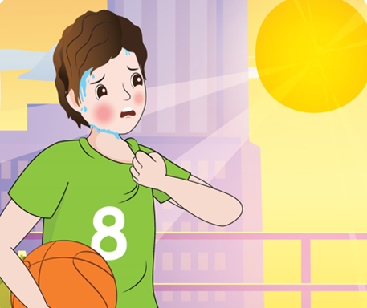





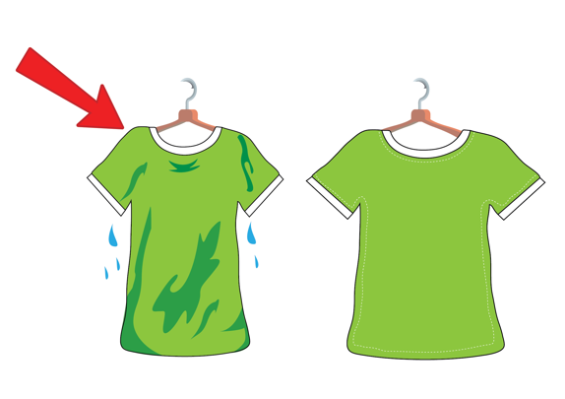
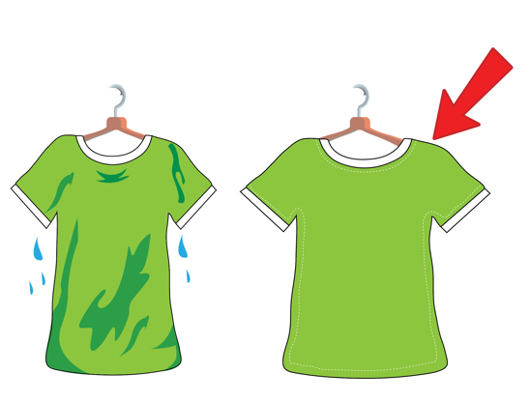
REVISION
Unit 11 – Lesson 2
Notes:
Remind students the words they learnt in previous lesson by flashcards and book.

Slide 7


UNIT 11 – WEATHER
Lesson 2
Period 2
Unit 11 – Lesson 2

Slide 8

4
Listen and read.
It is sunny and dry. I am in the garden now.
Tommy, what is the weather like today?
What was the weather like yesterday?
It was wet and windy.
Unit 11 – Lesson 2
Notes:
Ask students to look at the picture in the book (or show it on the screen): “Now whole class, look at this picture and answer my questions”
How many people are there in the picture? Who are they? What’s Tommy doing? What is the weather like?
Ask students to look at the screen and listen to the audio CD (Track 48) twice.

Slide 9

4
Listen and read.
What is the weather like today?
=> It is sunny.
What was the weather like yesterday?
=> It was hot.
Unit 11 – Lesson 2
Notes:
Introduce the structure: What was the weather like yesterday? and What is the weather like today? to talk about the weather in the past and at present.

Slide 10

Pair work
Pair work
Role play
Role play
Unit 11 – Lesson 2

Slide 11


Notes:
Students play individually. If student has a correct answer, he/ she will be given a sticker.
Explain that you are going to give instructions. Give a question with an illustration, students must choose the duck float with the correct answer.
Model the activity, e.g. feed the cat.
Play game until the last question.

Slide 12







WEATHER

Slide 13



Click on the right answer to complete the sentence
were
are
is
GREAT!
NEXT
is
What ____ the weather like today?

Slide 14
Click on the right answer to complete the sentence
was
is
are
GREAT!
NEXT
What ____ the weather like yesterday?
was

Slide 15
Click on the right answer to complete the sentence
is
was
are
GREAT!
NEXT
What was the weather like yesterday?
It____ sunny.
was

Slide 16
Click on the right answer to complete the sentence
were
are
is
GREAT!
NEXT
What is the weather like today?
It____ cloudy
is

Slide 17
Click on the right answer to complete the sentence
was
is
are
GREAT!
NEXT
What is the weather like yesterday?
It ____ cold.
was

Slide 18
Click on the right answer to complete the sentence
were
are
is
GREAT!
NEXT
What is the weather like today?
It____ rainy.
is

Slide 19
THANK YOU!

Slide 20







CONGRATULATION
Unit 11 – Lesson 2
Notes:
Extra game:
Divide the class into four teams.
Each turn, students work in teams, look at the picture, the questions and the options, then answer.
When they have the correct answer, their car will move one step.
Model the activity, e.g. It is rainy today.
Play game until the team that finishes first.

Slide 21



is.
BACK
It is/ was rainy today.
Unit 11 – Lesson 2
Notes:
Divide the class into four teams.
Each turn, students work in teams, look at the picture, the questions and the options, then answer.
When they have the correct answer, their car will move one step.
Model the activity, e.g. It is rainy today.
Play game until the team that finishes first.

Slide 22
was
BACK
It was/ is cloudy yesterday.
Unit 11 – Lesson 2

Slide 23
is
BACK
What is/was the weather like today?
Unit 11 – Lesson 2

Slide 24
was
BACK
What is/was the weather like yesterday?
Unit 11 – Lesson 2

Slide 25
are
BACK
There is/ are clouds today.
Unit 11 – Lesson 2

Slide 26

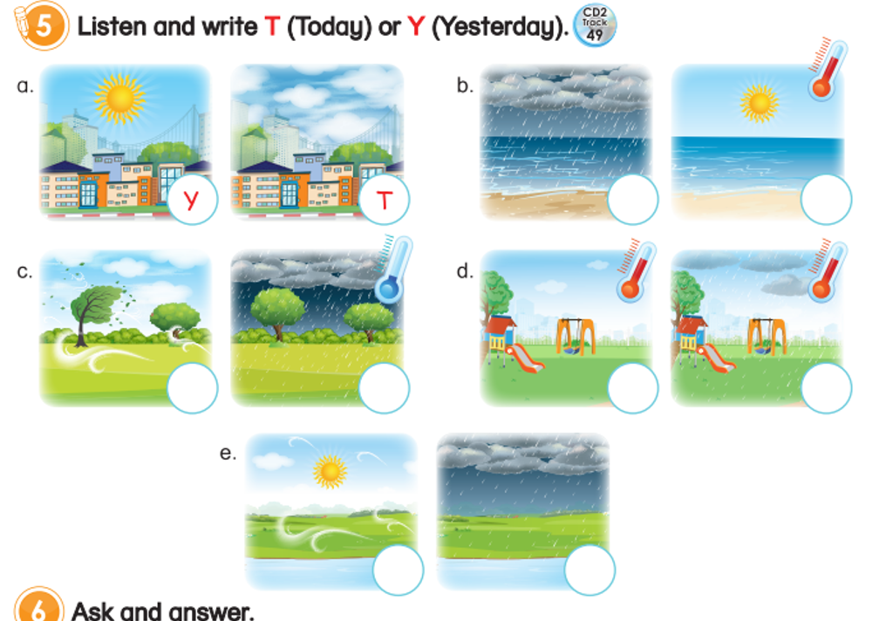
5
Listen and write T (Today) or Y (Yesterday).
T
T
Unit 11 – Lesson 2
Notes:
Point to the table and ask students “How many pictures can you see?” and let students answer.
Review about the words in the pictures (. walk the dog, go to school, play chess, visit grandparents)
Give students three minutes to do this task individual.

Slide 27

5
Listen and write T (Today) or Y (Yesterday).
Y
T
Y
T
T
Y
T
Y
Unit 11 – Lesson 2
Notes:
Point to the table and ask students “How many pictures can you see?” and let students answer.
Review about the words in the pictures (. walk the dog, go to school, play chess, visit grandparents)
Give students three minutes to do this task individual.

Slide 28
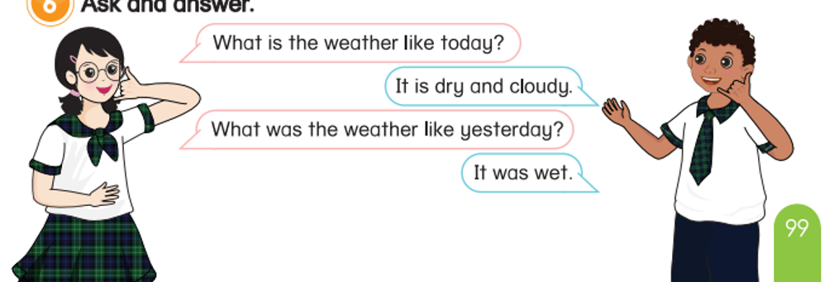
6
Ask and answer.
Tom doesn’t painting
on Saturdays. He goes skateboarding.
Unit 11 – Lesson 2
Notes:
Divide the class into pairs.
Ask students to work in pair. One asks and one answer about the weather today and yesterday.
Give students time to do the task.
Call some pairs to perform in front of the class.

Slide 29


6
Ask and answer.
Tom doesn’t painting
on Saturdays. He goes skateboarding.
Unit 11 – Lesson 2
Notes:
Divide the class into pairs.
Ask students to work in pair. One asks and one answer about the weather today and yesterday.
Give students time to do the task.
Call some pairs to perform in front of the class.

Slide 30


… Day … Month …. Date … Year
Unit 11: Weather
Lesson 2. Period 2
Vocabulary:
sunny
cloudy
windy
rainy
hot
wet
cold
dry
Unit 11 – Lesson 2
Notes:
Review all the words they have learned by using flashcards.
Count the stars.
Give compliments.

Slide 31


CÔNG TY CỔ PHẦN PHÁT TRIỂN GIÁO DỤC
VIỆT NAM VPBOX
Hà Nội
Tầng 2, Nhà A, Nhà Khách La Thành, số 226 Vạn Phúc, P.Liễu Giai,
Quận Ba Đình, Hà Nội.
ĐT: (024) 3 3793 2405
phonics.hanoi@vpbox.edu.vn
Thành Phố Hồ Chí Minh
Số 270A, Lý Thường Kiệt, P.14, Quận 10.
ĐT: (028) 3 820 5934
phonics.hcm@vpbox.edu.vn
www.vpbox.edu.vn
https://phonics-smart.edu.vn

