Slide 1


Slide 3


TEAM DIVISION
TEAM 1
TEAM 2
TEAM 3
TEAM 4
Unit 11 – Phonics
Notes:
Divide class into 4 teams

Slide 4




CLASSROOM RULES
1. Be quiet!
2. Listen!
3. Sit nicely!
4. Raise your hand to speak!
Unit 11 – Phonics
Notes:
Set the rules in class.

Slide 5


WARM UP
“The Alphabet song”
Unit 11 – Phonics
Notes:
Play the song “The Alphabet song”

Slide 6




REVISION
dolphin Saturday strong fishing
Unit 11 – Phonics
Notes:
Play the song “My school – Going to school”

Slide 7


GO
FISHING
Unit 11 – Phonics
Notes:
There are some questions and three or four fish have the answers. The students have to choose the correct answer.
Ask students to look at the question with a picture and three or four options.
Ask students to raise hands to answer.
Invite the fastest hand to stand up and give the answer.

Slide 8














3
2. this
.
dolphin
1. that

Slide 9
3
2. this
.
3. Saturday
1. that

Slide 10
2
4. wet
3. this
3. weather
2. strong

Slide 11
3
2. weather
3. fishing
1. wet
4. strong

Slide 12
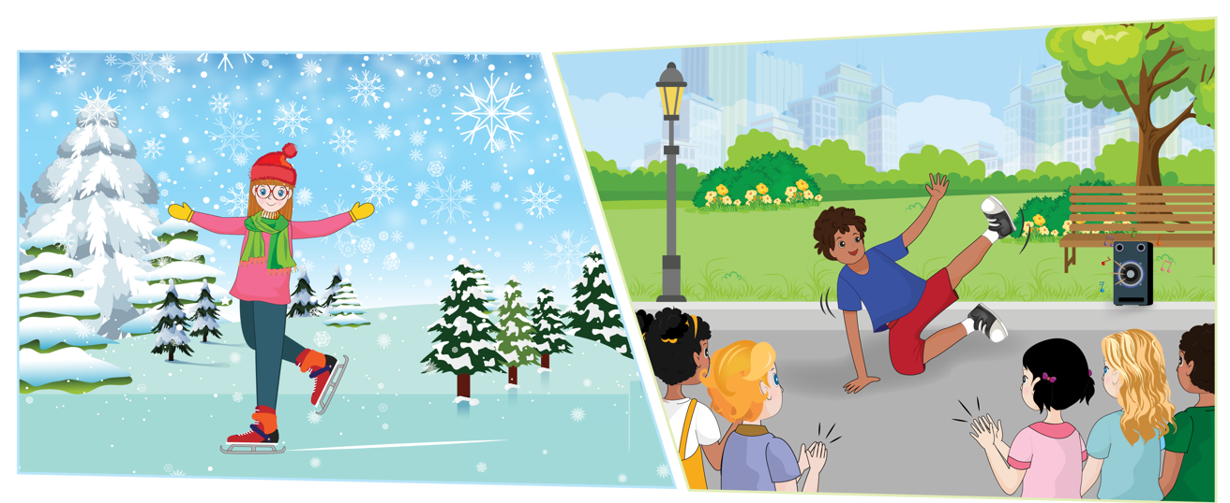

UNIT 11 – WEATHER
PHONICS
Unit 11– Phonics

Slide 13


1
Listen and repeat.
windy
Unit 11 – Phonics
Notes:
Play the audio (Track 53) and ask students to listen to strong sound /w/.
Have students observe and mimic the position of the lips and the tongue when the sound /w/ is pronounced.
Ask students to repeat the sound.
Introduce the two words that have the /w/ sound: dolphin and Saturday. Then have them listen to and repeat the word.
Do the same with sound /th/.

Slide 14

1
Listen and repeat.
wet
Unit 11 – Phonics
Notes:
Play the audio (Track 53) and ask students to listen to strong sound /d/.
.

Slide 15

1
Listen and repeat.
weather
Unit 11 – Phonics
Notes:
Ask students to listen and repeat word by word. Windy – wet – weather – this

Slide 16
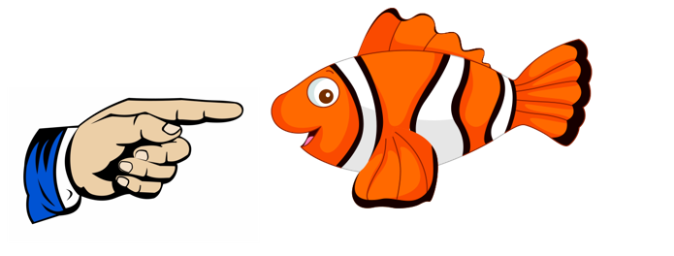
1
Listen and repeat.
this
Unit 11 – Phonics
Notes:
Ask students to listen and repeat word by word. Windy – wet – weather – this

Slide 17




1
Listen and repeat.
windy
weather
this
wet
Unit 11 – Phonics
Notes:
Ask students to listen and repeat word by word. Windy – wet – weather – this

Slide 18
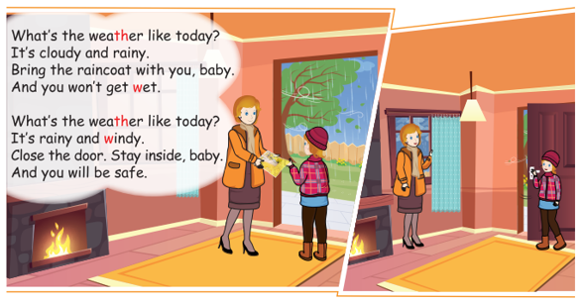
2
Let’s chant!
Unit 11 – Phonics
Notes:
Point to each person in the pictures and ask students “How many pictures can you see? How many people are there? Who are they? What are they doing?” and let students answer.
Get students to listen to the audio CD (Track 54).
Get students to listen to and repeat each line before reading it.
Give time for students practice the story in groups.

Slide 19


2
Let’s chant!
Unit 11 – Phonics
Notes:
Tell students that they are going to look at the pictures and ask: “How many sentences can you see?
Ask students look at the pictures and elicit the words from the pictures. Focus students' attention on Sentence a and model the task.
Get students to listen to the audio CD (Track 40 ) and do the task individually.

Slide 20
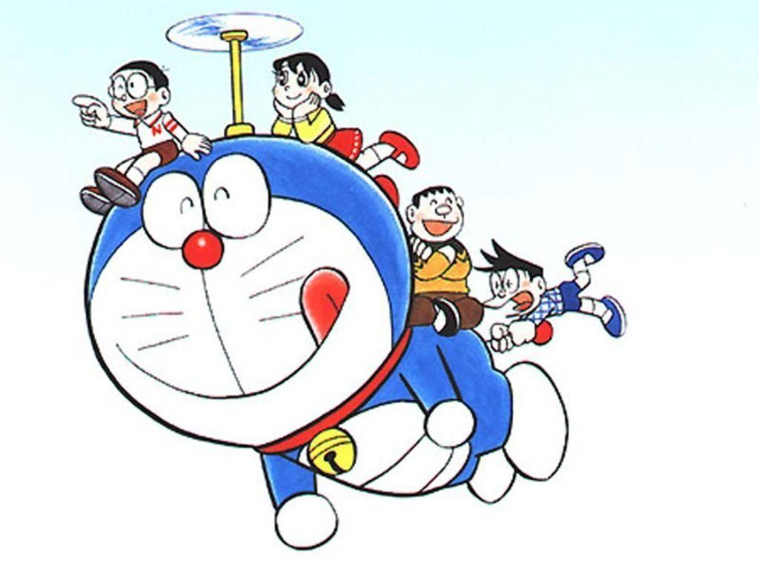

Travelling with Doraemon
Notes:
Divide the class into two teams.
Ask students will travel with Doraemon if they give the correct answer or else.
Each turn, students work in teams, look at the picture, then raise hand to get turn.
Invite the fastest hand to stand up and give their answer

Slide 21









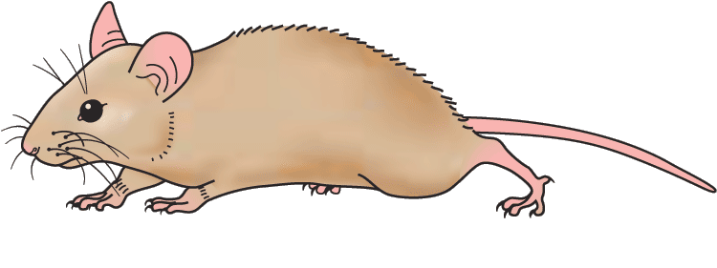
Han River bridge
Danang Vietnam
Question
A. weather
B. windy
wrong
right
Unit 11 – Phonics
Notes:
Divide the class into two teams.
Ask students will travel with Doraemon if they give the correct answer or else.
Each turn, students work in teams, look at the picture, then raise hand to get turn.
Invite the fastest hand to stand up and give their answer

Slide 22
Han River bridge
Danang Vietnam
Question
A. wet
B. windy
wrong
right
Unit 11 – Phonics

Slide 23
Han River bridge
Danang Vietnam
Question
A. that
B. this
wrong
right
Unit 11 – Phonics

Slide 24
Han River bridge
Danang Vietnam
Question
A. weather
B. windy
wrong
right
Unit 11 – Phonics

Slide 25
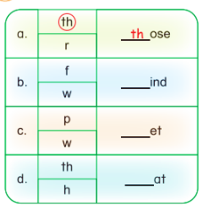
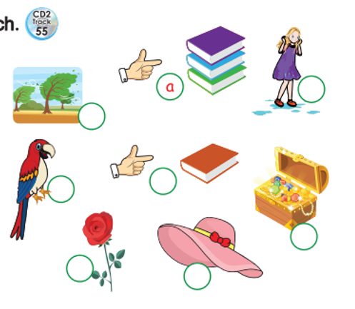
3
Listen, circle and write. Match.
Unit 11 – Phonics
Notes:
Point to each person in the pictures and ask students “How many pictures can you see? and let students answer. Review about the words in the pictures (wet, windy, this, weather)
Lead-in: Now, we are going to look at the pictures, listen, circle and write
Get students to listen to the audio CD (Track 55).

Slide 26
3
Listen, circle and write. Match.
c
w
b
w
d
th
Unit 11 – Phonics
Notes:
Point to each person in the pictures and ask students “How many pictures can you see? and let students answer. Review about the words in the pictures (wet, windy, this, weather)
Lead-in: Now, we are going to look at the pictures, listen, circle and write
Get students to listen to the audio CD (Track 55).

Slide 27

WRAP UP
Unit 11 – Phonics
Notes:
Review all the words they have learned by using flashcards.
Count the stars.
Give compliments.

Slide 28


… Day … Month …. Date … Year
Unit 11: Weather
Lesson Phonics
Vocabulary
Windy
Wet
This
Weather
Unit 11 – Phonics
Notes:
Review all the words they have learned by using flashcards.
Count the stars.
Give compliments.

Slide 29


CÔNG TY CỔ PHẦN PHÁT TRIỂN GIÁO DỤC
VIỆT NAM VPBOX
Hà Nội
Tầng 2, Nhà A, Nhà Khách La Thành, số 226 Vạn Phúc, P.Liễu Giai,
Quận Ba Đình, Hà Nội.
ĐT: (024) 3 3793 2405
phonics.hanoi@vpbox.edu.vn
Thành Phố Hồ Chí Minh
Số 270A, Lý Thường Kiệt, P.14, Quận 10.
ĐT: (028) 3 820 5934
phonics.hcm@vpbox.edu.vn
www.vpbox.edu.vn
https://phonics-smart.edu.vn

