Slide 1


Slide 3

TEAM DIVISION
Team 1
Team 2
Team 3
Team 4
Unit 12– Lesson 2
Notes:
Divide class into 4 teams

Slide 4
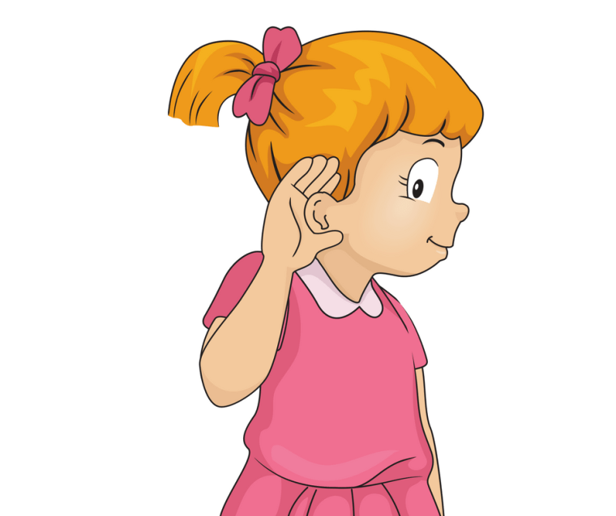

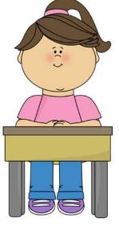

CLASSROOM RULES
1. Be quiet!
2. Listen!
3. Sit nicely!
4. Raise your hand to speak!
Unit 12– Lesson 2

Slide 5


WARM UP
“Shake break song”
Unit 12– Lesson 2
Notes:
Play the song “Shake break song”

Slide 6
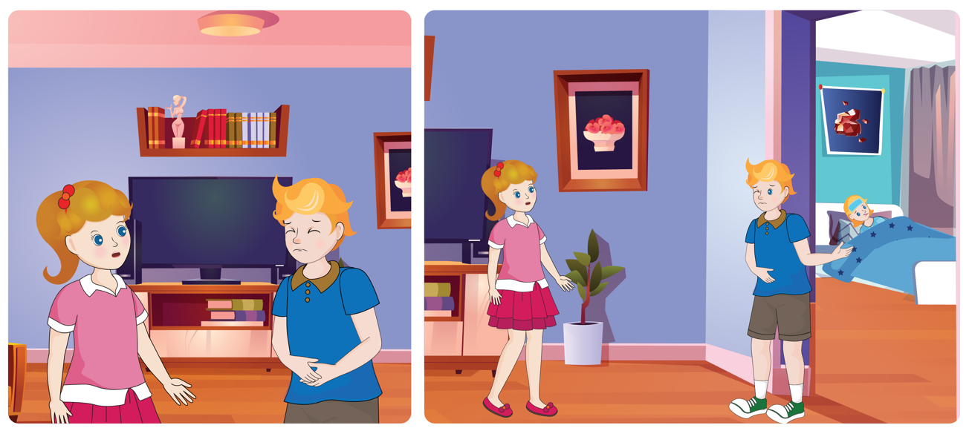

UNIT 12 – HEALTH
Period 1

Slide 7

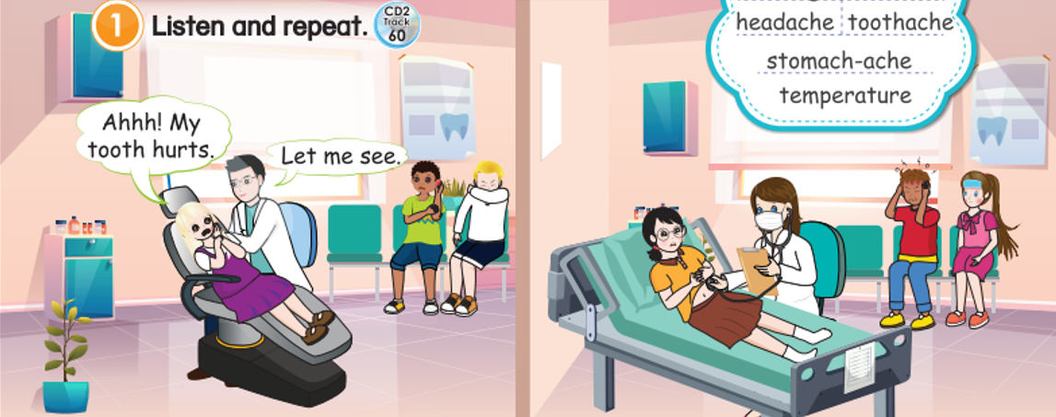
1
Listen and repeat.
Unit 12– Lesson 2
Notes:
Ask students to look at the picture in the book (or show it on the screen): “Now class, look at the picture and answer the questions”
T: Where are the kids?
T: What is the doctor doing?
Ask students to look at the screen and listen to the audio CD (Track 60) twice.
Ask students to open the book on page 106, part 1, look, listen and repeat.

Slide 8

1
Listen and repeat.
cough
Unit 12– Lesson 2
Notes:
Ask students to listen and repeat word by cough, headache, earache, toothache, stomachache, temperature, hurt.

Slide 9
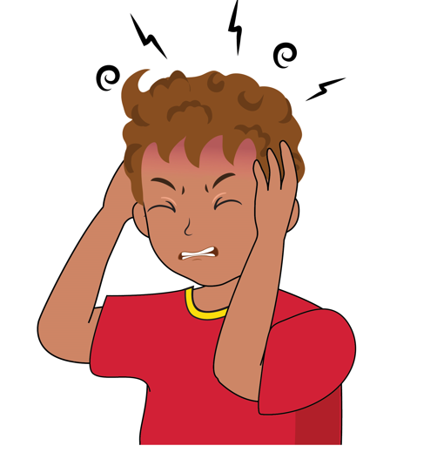
1
Listen and repeat.
headache
Unit 12– Lesson 2
Notes:
Ask students to listen and repeat word by cough, headache, earache, toothache, stomachache, temperature, hurt.

Slide 10
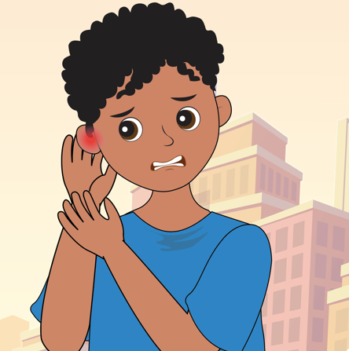
1
Listen and repeat.
earache
Unit 12– Lesson 2
Notes:
Ask students to listen and repeat word by cough, headache, earache, toothache, stomachache, temperature, hurt.

Slide 11
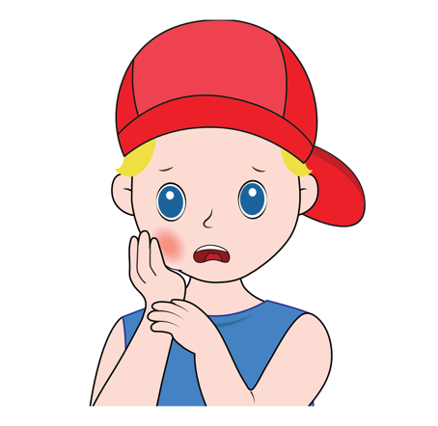
1
Listen and repeat.
toothache
Unit 12– Lesson 2
Notes:
Ask students to listen and repeat word by cough, headache, earache, toothache, stomachache, temperature, hurt.

Slide 12
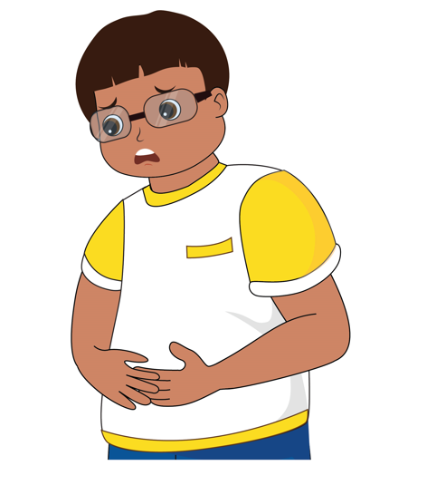
1
Listen and repeat.
stomachache
Unit 12– Lesson 2
Notes:
Ask students to listen and repeat word by cough, headache, earache, toothache, stomachache, temperature, hurt.

Slide 13
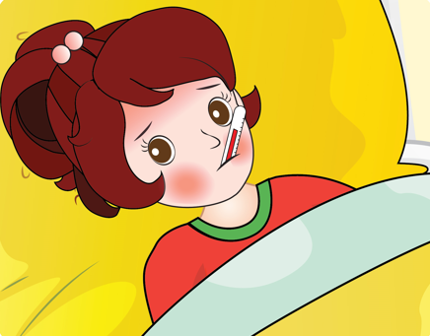
1
Listen and repeat.
temperature
Unit 12– Lesson 2
Notes:
Ask students to listen and repeat word by cough, headache, earache, toothache, stomachache, temperature, hurt.

Slide 14
1
Listen and repeat.
cough
headache
earache
toothache
temperature
stomachache
Unit 12– Lesson 2
Notes:
Ask students to listen and repeat word by cough, headache, earache, toothache, stomachache, temperature, hurt.

Slide 15

Game: Whispering.
Unit 12– Lesson 2
Notes:
Divide class into 3- 4 groups.
Invite six or seven students from each group to participate the game.
All the groups line up, teacher whispers any content to the first students’ ears in their lines.
The first students will whisper on ear of the second student in their groups, keep doing that to the end.
The last students run to the teacher and say out the word.
The fastest student who answers the question correctly, gets one point for his/her group. The group having the most points is the winner.

Slide 16
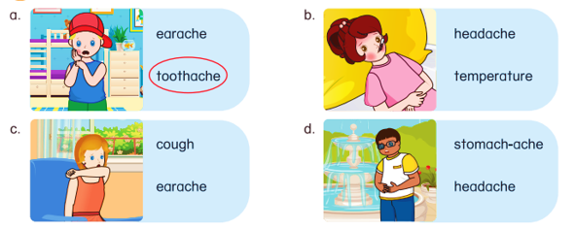
2
Circle the correct words.
Unit 12– Lesson 2
Notes:
Use the software/ PowerPoint/ Book and show the pictures in Activity 2. “Hi class, look at the pictures and guess what they are doing. Let students give answers.
Lead in: “Now, you look at the pictures and circle to the words or phrases with the correct pictures”.
Ask students to look at the screen match the words with the correct pictures.
Ask students to work in pairs and share their answers with their partners.
Ask some students to go to the board and write down their answers.
Check and give correct answers.

Slide 17
2
Circle the correct words.
Unit 12– Lesson 2
Notes:
Use the software/ PowerPoint/ Book and show the pictures in Activity 2. “Hi class, look at the pictures and guess what they are doing. Let students give answers.
Lead in: “Now, you look at the pictures and circle to the words or phrases with the correct pictures”.
Ask students to look at the screen match the words with the correct pictures.
Ask students to work in pairs and share their answers with their partners.
Ask some students to go to the board and write down their answers.
Check and give correct answers.

Slide 18


DUCK GAME
Unit 12– Lesson 2
Notes:
Students play individually. If student has a correct answer, he/ she will be given a sticker.
Explain that you are going to give instructions. Give a question with an illustration, students must choose the duck float with the correct answer.
Model the activity, e.g. feed the cat.
Play game until the last question.

Slide 19
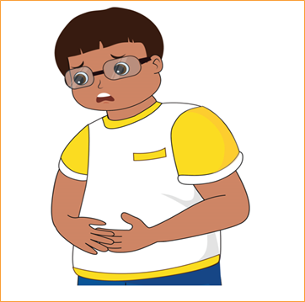

earache
hot
stomachache
Unit 12– Lesson 2
Notes:
Students play individually. If student has a correct answer, he/ she will be given a sticker.
Explain that you are going to give instructions. Give a question with an illustration, students must choose the duck float with the correct answer.
Model the activity, e.g. stomachache
Play game until the last question.

Slide 20

temperature
cold
cough
Unit 12– Lesson 2
Notes:
Students play individually. If student has a correct answer, he/ she will be given a sticker.
Explain that you are going to give instructions. Give a question with an illustration, students must choose the duck float with the correct answer.

Slide 21

toothache
earache
cough
Unit 12– Lesson 2
Notes:
Students play individually. If student has a correct answer, he/ she will be given a sticker.
Explain that you are going to give instructions. Give a question with an illustration, students must choose the duck float with the correct answer.

Slide 22

toothache
earache
dizzy
Unit 12– Lesson 2
Notes:
Students play individually. If student has a correct answer, he/ she will be given a sticker.
Explain that you are going to give instructions. Give a question with an illustration, students must choose the duck float with the correct answer.

Slide 23
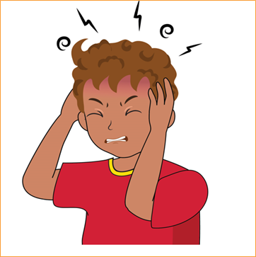
tired
headache
cold
Unit 12– Lesson 2
Notes:
Students play individually. If student has a correct answer, he/ she will be given a sticker.
Explain that you are going to give instructions. Give a question with an illustration, students must choose the duck float with the correct answer.

Slide 24
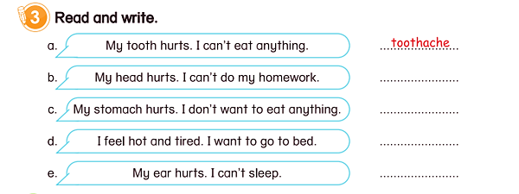
3
Read and write
Unit 12– Lesson 2
Notes:
Tell students that they are going to write the words about health problems next to the sentences.
Model the example with Sentence a. Ask students read aloud the sentence. Focus the students on the sample sentence and explain.
Give students 3 minutes to do the task
Let students check their answers in pairs before checking as a class.
Ask some students go to the board and write the answers.

Slide 25
3
Read and write
headache
stomachache
temperature
earache
Unit 12– Lesson 2
Notes:
Tell students that they are going to write the words about health problems next to the sentences.
Model the example with Sentence a. Ask students read aloud the sentence. Focus the students on the sample sentence and explain.
Give students 3 minutes to do the task
Let students check their answers in pairs before checking as a class.
Ask some students go to the board and write the answers.

Slide 26


… Day … Month …. Date … Year
Unit 12: Health
Lesson 2. Period 1
Vocabulary
earache
stomachache
temperature
headache
toothache
cough
Unit 12– Lesson 2
Notes:
Review all the words they have learned by using flashcards.
Count the stars.
Give compliments.

Slide 27

WRAP UP
Unit 12– Lesson 2

Slide 28


CÔNG TY CỔ PHẦN PHÁT TRIỂN GIÁO DỤC
VIỆT NAM VPBOX
Hà Nội
Tầng 2, Nhà A, Nhà Khách La Thành, số 226 Vạn Phúc, P.Liễu Giai,
Quận Ba Đình, Hà Nội.
ĐT: (024) 3 3793 2405
phonics.hanoi@vpbox.edu.vn
Thành Phố Hồ Chí Minh
Số 270A, Lý Thường Kiệt, P.14, Quận 10.
ĐT: (028) 3 820 5934
phonics.hcm@vpbox.edu.vn
www.vpbox.edu.vn
https://phonics-smart.edu.vn

