Slide 1


Slide 3

TEAM DIVISION
Team 1
Team 2
Team 3
Team 4
Notes:
Divide class into 4 teams

Slide 4




CLASSROOM RULES
1. Be quiet!
2. Listen!
3. Sit nicely!
4. Raise your hand to speak!
UNIT 14 – LESSON 1
Notes:
Set the classroom rules

Slide 5

WARM UP
Sing “Let's Go on a Trip” song
UNIT 5 – LESON 1
Notes:
Play a warm-up song: Let's Go on a Trip

Slide 6
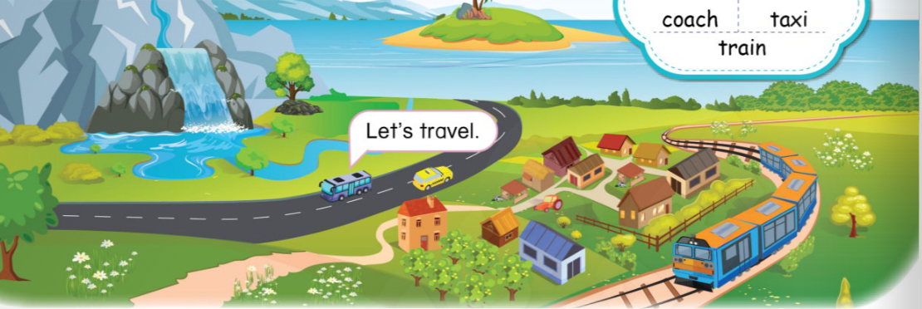
UNIT 14 – TRAVELLING
Lesson 1
Period 1

Slide 7



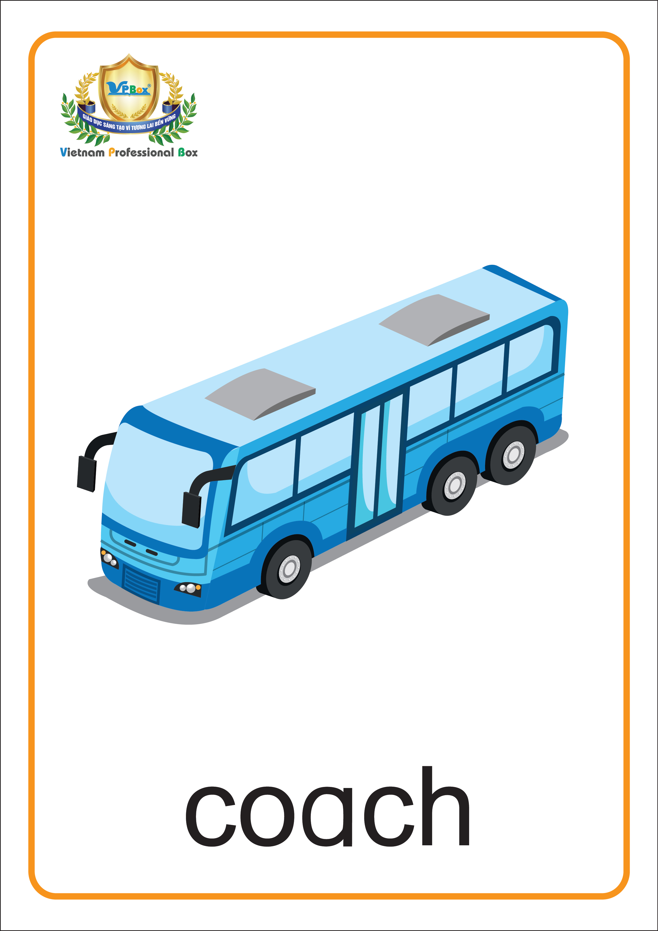




1
Listen and repeat.
Let’s travel.
UNIT 14 – LESSON 1
Notes:
-Focus students’ attention by asking some questions: “Class, where do you usually go on holidays or weekends? How do you go there?”
-Ask students to look at the picture in the book (or show it on the screen) and say: “There are a lot of beautiful places in the picture. People travel there by different means of transport.”.
-Ask students to look at the screen and listen to the audio CD (Track 84) twice.

Slide 8
1
Listen and repeat.
Let’s travel.
UNIT 14 – LESSON 1
Notes:
-Ask students to listen and repeat word by word.
-Do choral and individual repetition and check students' pronunciation.

Slide 9
1
Listen and repeat.
UNIT 14 – LESSON 1
Notes:
-Ask students to listen and repeat word by word.
-Do choral and individual repetition and check students' pronunciation.

Slide 10
1
Listen and repeat.
UNIT 14 – LESSON 1
Notes:
-Ask students to listen and repeat word by word.
-Do choral and individual repetition and check students' pronunciation.

Slide 11
1
Listen and repeat.
Let’s travel.
UNIT 14 – LESSON 1
Notes:
-Use flashcards to practice by raising high and low. If the teacher raises the flashcards high, students read aloud and if the teacher raises them low, students read softly.
-Correct students’ pronunciation mistakes and instructs students to say using proper intonation.

Slide 12

SLOW MOTION GAME
UNIT 14 – LESSON 1
Notes:
-Each turn, teacher reveals the flashcards slowly to the whole class.
-Which student guess it fast and correctly will gain 1 star for the whole team.
-Call that student to read the full word with the flashcard and have the class repeat.
-Teacher can make adaptations by showing the flashcards faster/ half of the flashcard.

Slide 13

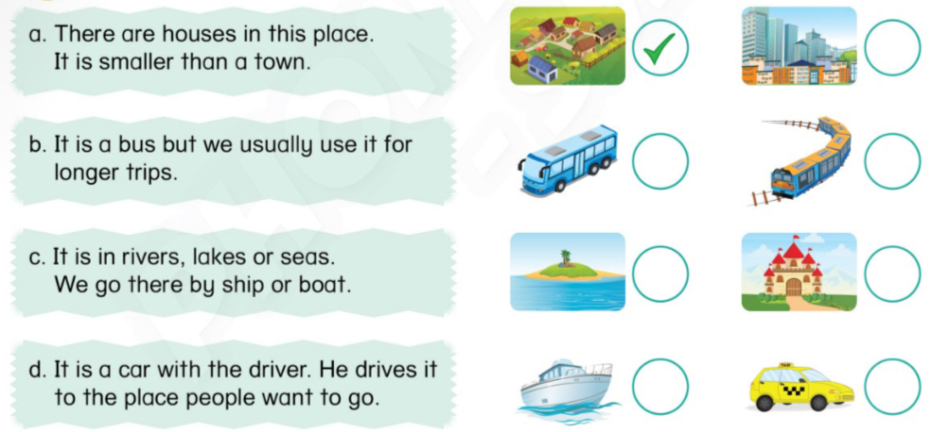

2
Tick ( )the correct picture. Say.
UNIT 14 – LESSON 1
Notes:
-Ask students to look at the picture and ask students “Who can say the names of the items in the picture?” and pick one students to answer.
-Tell students that they are going to read some sentences about places/ means of transport and tick the correct pictures.
-Model the example with Sentence a and explain.
-Give students time to read and tick.
-Remind students of doing the task with their pencils.
-Ask students to share their answers with their partners.
-Call some students to give their answers.
-Check and give correct answers.

Slide 14
2
Say.
a. There are houses in this place. It is smaller than a town.
b. It is a bus but we usually use it for longer trips.
c. It is in rivers, lakes or seas. We go there by ship or boat.
d. It is a car with the driver. He drives it to the place people want to go.
UNIT 14 – LESSON 1
Notes:
-Point at each sentence randomly and ask students to read aloud in chorus and individually
-Check students' pronunciation.

Slide 15
3
Write the sentences.
a.
I
live
small village
I live in a small village.
.......................................
b.
There
not
waterfalls
my hometown
.......................................
c.
A train
slower
a plane
.......................................
d.
I
like
climb
mountains
my father
.......................................
UNIT 14 – LESSON 1
Notes:
-Tell students that they are going to write the sentences using the given prompts.
-Model the example with the first sentence.

Slide 16
3
Write the sentences.
b.
There
not
waterfalls
my hometown
There are not/aren’t any waterfalls in my hometown.
......................................................................................
c.
A train
slower
a plane
A train is slower than a plane.
..................................................................................
d.
I
like
climb
mountains
my father
I like climbing the mountains with my father.
...................................................................................
UNIT 14 – LESSON 1
Notes:
-Let students guess the meaning of the sentences in pairs.
-Give students time to do the task invidually.
-Let students check their answers in pairs before checking as a class.
-Ask some students to read the answers aloud.

Slide 17


… Day … Month …. Date … Year
Unit 14: Travelling
Lesson 1. Period 1
Vocabulary
island
mountain
village
waterfall
coach
taxi
train
UNIT 14 – LESSON 1
Notes:
Review all the words they have learned by using flashcards.
Count the stars.
Give compliments.

Slide 18
WRAP UP
UNIT 14 – LESSON 1

Slide 19


CÔNG TY CỔ PHẦN PHÁT TRIỂN GIÁO DỤC
VIỆT NAM VPBOX
Hà Nội
Tầng 2, Nhà A, Nhà Khách La Thành, số 226 Vạn Phúc, P.Liễu Giai,
Quận Ba Đình, Hà Nội.
ĐT: (024) 3 3793 2405
phonics.hanoi@vpbox.edu.vn
Thành Phố Hồ Chí Minh
Số 270A, Lý Thường Kiệt, P.14, Quận 10.
ĐT: (028) 3 820 5934
phonics.hcm@vpbox.edu.vn
www.vpbox.edu.vn
https://phonics-smart.edu.vn

