Slide 1
WARMLY WELCOME ALL THE TEACHERS
AND STUDENTS ATTENDING
CLASS 4A
Teacher: Nguyen Thi Giang
School: Bach Dang Primary School

Slide 2
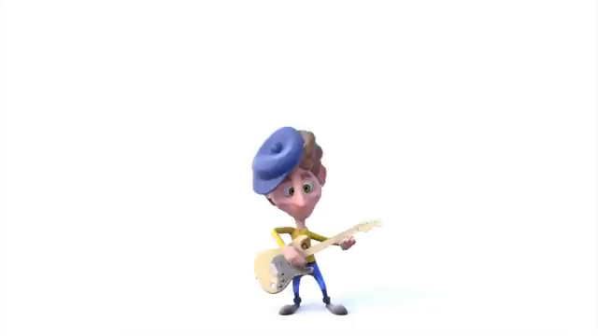

Slide 4


List your activities in the week

Slide 5
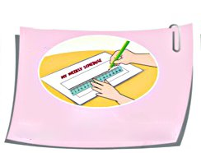
Draw a ‘My weekly schedule’ table

Slide 6
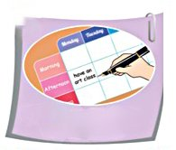
Fill the activities in the table

Slide 7
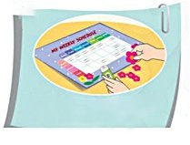
Make your schedule beautiful

Slide 8

Follow it

Slide 9

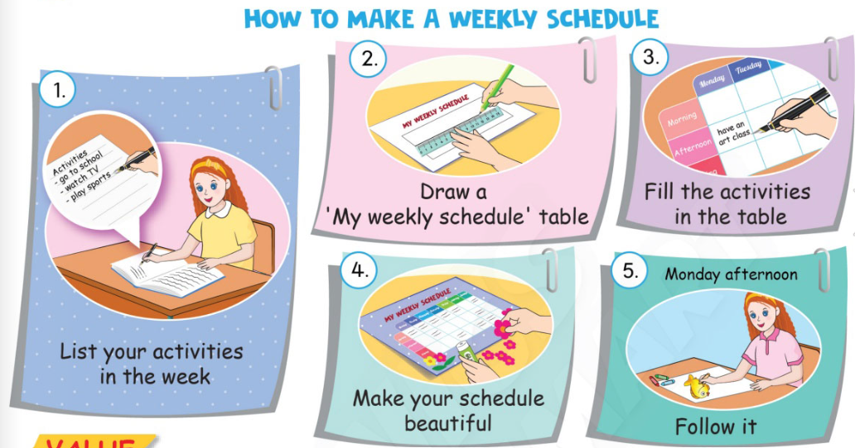
1
Listen and repeat.
Notes:
-Ask students to look at the picture and say: “These are some basic steps to make a weekly schedule. What you can see in each step?”, then let them elicit things or the actions.
-Play the audio CD (track 14) for students to listen and repeat to the five steps twice.
-Do choral and individual repetition.

Slide 11

VALUE
Making a weekly schedule helps you to have a good week.
Notes:
-Let the class to discuss why they should make a weekly schedule. (to have an effective week)
-Draw students’ attention to the Value box, then select some students to read them.

Slide 12
GAME
read an English book
WW
weekly activities

Slide 13
 | Monday | Tuesday | Wednesday | Thursday | Friday | Saturday | Sunday
Morning
Afternoon
Evening
watch TV

Slide 14
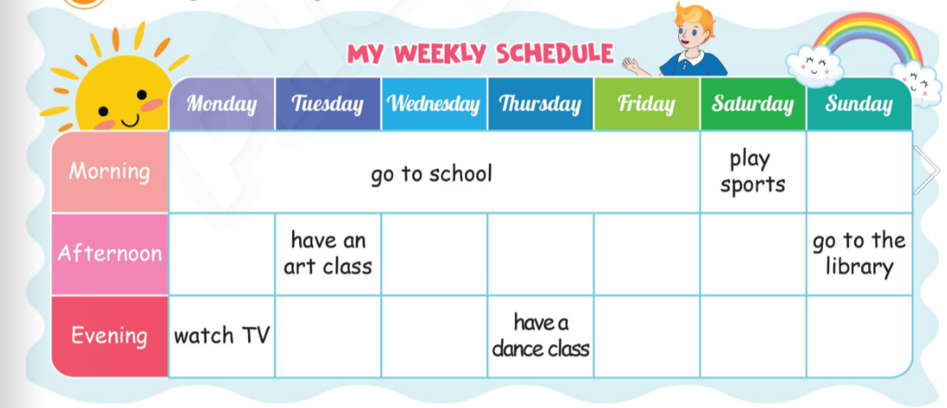
2
Ask and answer.
Notes:
-Focus students’ attention on the sample dialogue and explain.
Give students time to make dialogues, teachers ask students to move on to the speaking task after they finish step 3 and they can decorate their schedules at home.

Slide 15

2
Ask and answer.
Notes:
-Focus students’ attention on the sample dialogue and explain.
Give students time to make dialogues, teachers ask students to move on to the speaking task after they finish step 3 and they can decorate their schedules at home.

Slide 16
2
Ask and answer.
What do you do on _______?
I _______.
Notes:
-Ask pairs of students to make dialogues and change the roles.
-Invite some pairs of students to perform in front of the class. Give feedback.

Slide 17
Free talk:
- talk about your weekly schedule.

Slide 18


- 5 steps to make a weekly schedule.
- Structure:
What do you do on ...? – I --------------------- .
Notes:
Review all the words they have learnt by using flashcards.
Count the stars.
Give compliments.

Slide 19
WRAP UP
What do you do on _______?
I _______.

Slide 20


CÔNG TY CỔ PHẦN PHÁT TRIỂN GIÁO DỤC
VIỆT NAM VPBOX
Hà Nội
Tầng 2, Nhà A, Nhà Khách La Thành, số 226 Vạn Phúc, P.Liễu Giai,
Quận Ba Đình, Hà Nội.
ĐT: (024) 3 3793 2405
phonics.hanoi@vpbox.edu.vn
Thành Phố Hồ Chí Minh
Số 270A, Lý Thường Kiệt, P.14, Quận 10.
ĐT: (028) 3 820 5934
phonics.hcm@vpbox.edu.vn
www.vpbox.edu.vn
https://phonics-smart.edu.vn

