Slide 1



1
Hello
LESSON 2
Period 3

Slide 2
Contents
1
Warm-up
2
Look, listen and repeat.
3
Listen, point and say.
4
Let’s talk.
5
Fun corner and wrap-up

Slide 3
1
Warm-up and review
Game

Slide 4




Picking
Coconuts
Notes:
Step 1: Divide the class into 4 teams: A, B, C, D.
Step 2: Set the rules: Teacher says (or plays the recording of) a number and let the teams take turns to answer. Pupils have to click the correct number on the screen. If the answer is correct, 1 point is given to that team.
- Encourage pupils to join the game. Give points to the teams and encourage the students.

Slide 5







Listen and click the right coconut.
5
8
9
We did it!
eight

Slide 6

Listen and click the right coconut.
7
3
10
We did it!
ten

Slide 7

Listen and click the right coconut.
3
2
6
We did it!
three

Slide 8

Listen and click the right coconut.
4
2
9
We did it!
four

Slide 9
2
Look, listen and repeat.

Slide 10

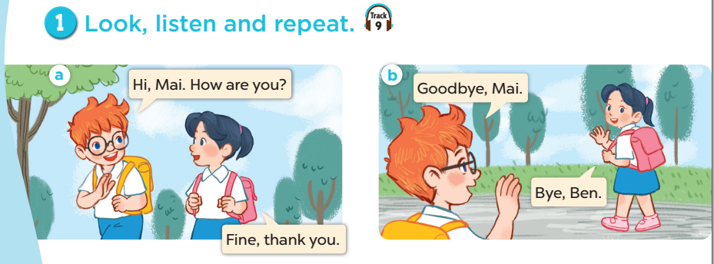

Slide 11
3
Listen, point and say.

Slide 12

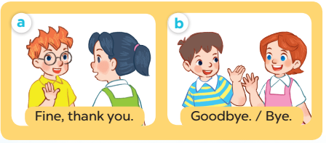
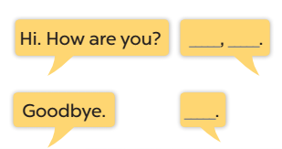

Slide 13

Role play

Slide 14
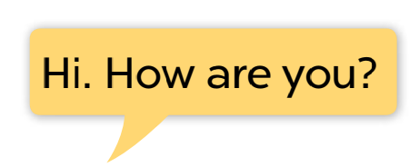
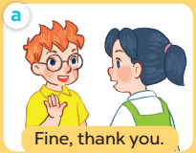

Slide 15

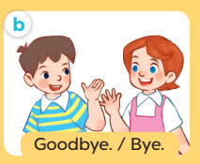

Slide 16
4
Let’s talk.

Slide 17
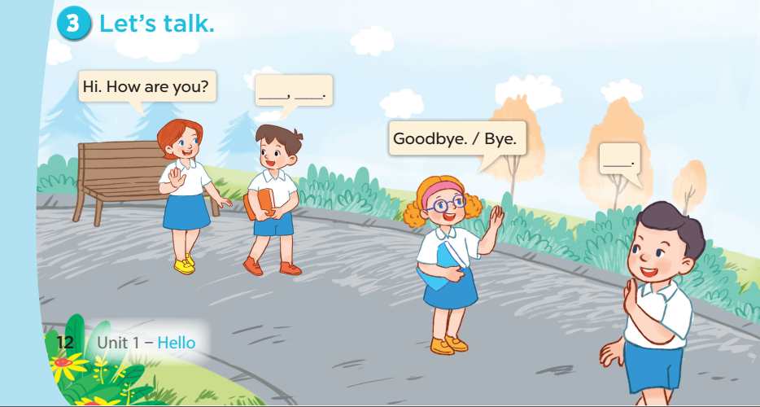

Slide 18
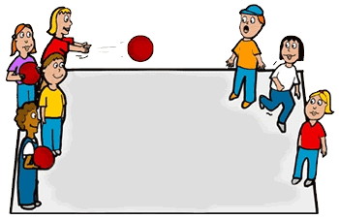
Pass the ball!
Game
Notes:
Step 1: Set the rules: Give 2 balls to pupils and turn on the music. Pupils pass the ball until the music stops. The one who is keeping the ball will talk with his/ her friends, asking “How are you?”, the others have to say the answer.
Step 2: Encourage pupils to practise speaking.
Step 3: Give point to the pupils.

Slide 19
5
Fun corner and wrap-up

Slide 20



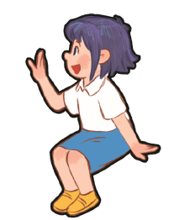
Hi, __. How are you?
Fine, thank you.
Goodbye, __!
Bye, __.

