Slide 1


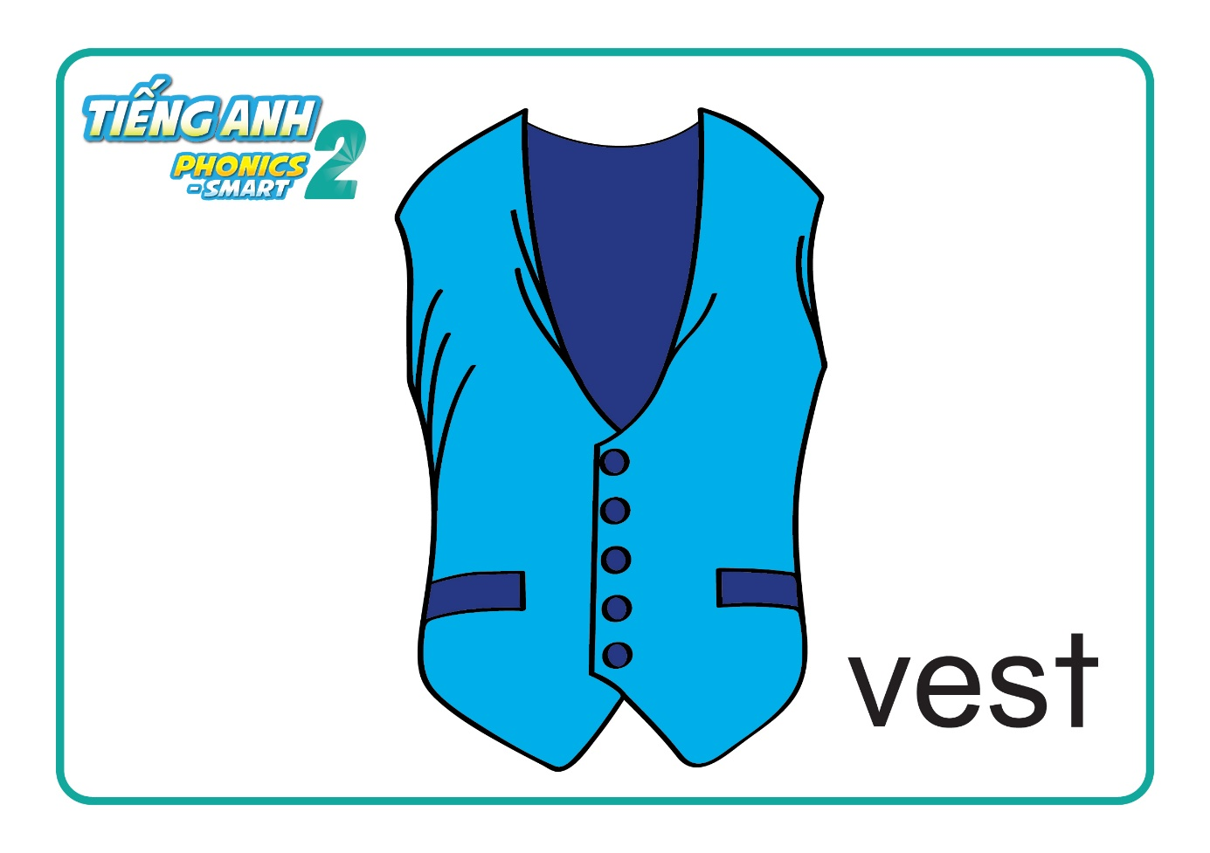

Unit 9
Let’s say
Notes:
T clicks to show the pictures.
The pictures will disappear in a few seconds.
T asks students to work in groups.
Students raise hands to answer.
T gives stars for the correct answers.

Slide 2



Unit 9
Let’s say
Notes:
Hello children!
Do you remember these cards?
Let’s say again.
Letter Vv,
Vest, violin. Good job.

Slide 3
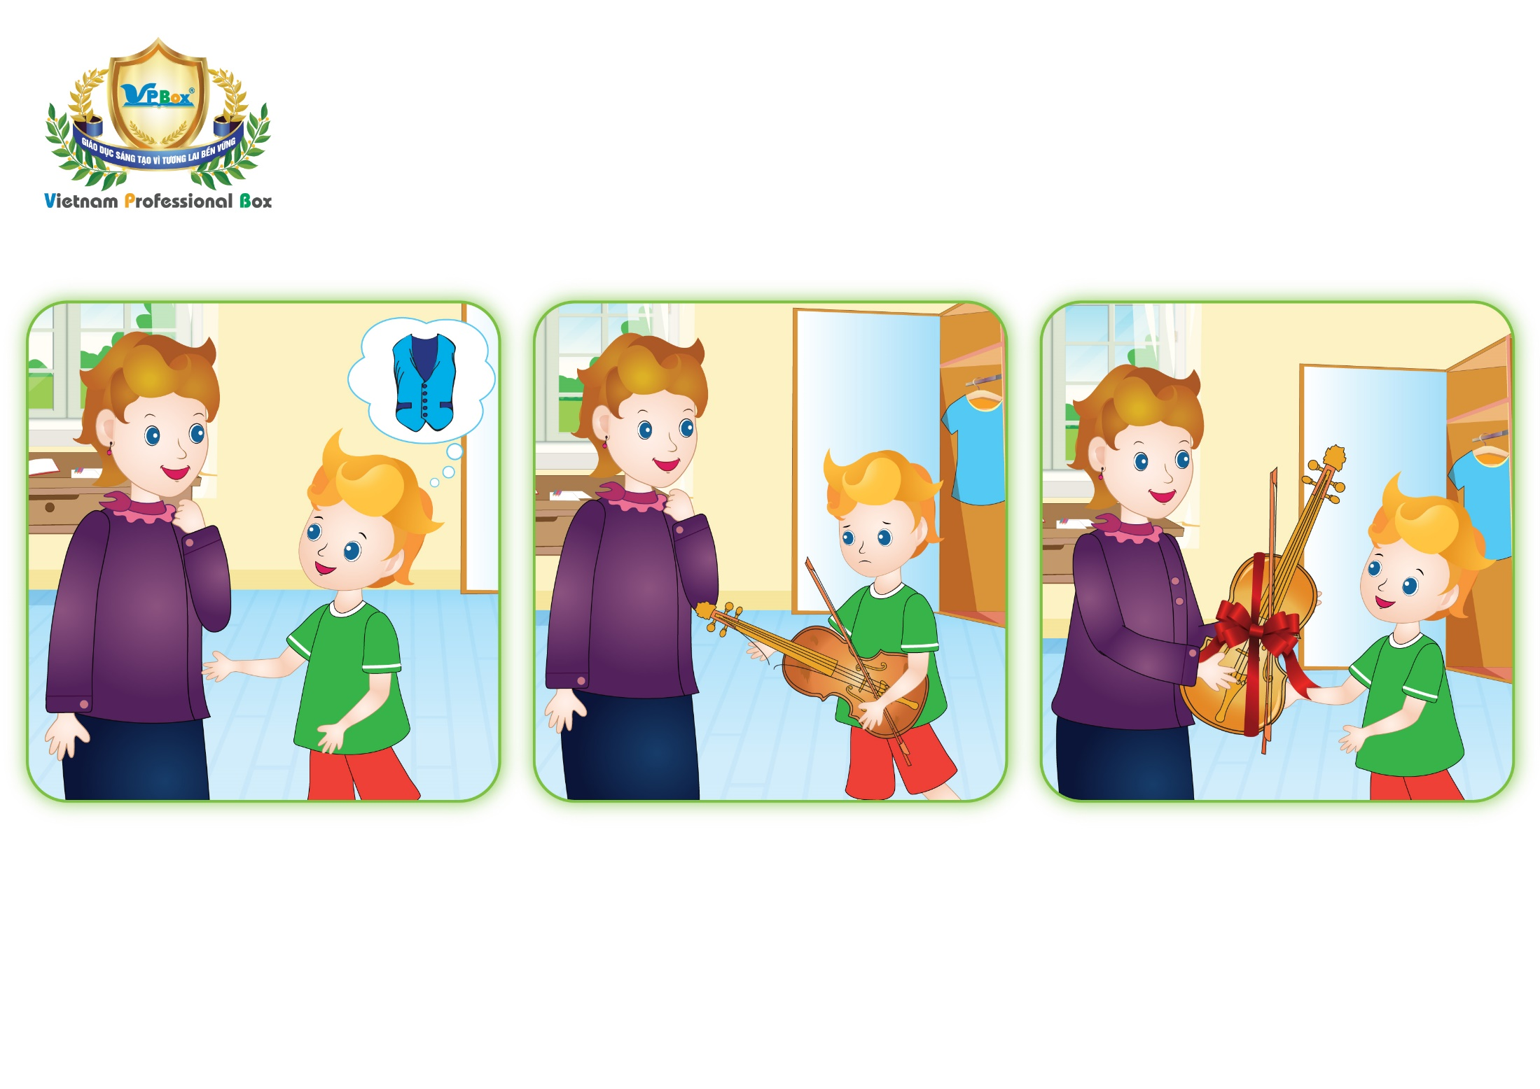
Unit 9: Lesson 2 Vv
Notes:
Welcome to Unit 9 – Lesson 2

Slide 4

Unit 9: Lesson 2 Vv
Mum, I’d like a blue vest.
I’d like a new violin.
Thank you!
Notes:
-Now, This is Part 1 – Listen and repeat.
You listen 2 times. Play the audio.

Slide 5
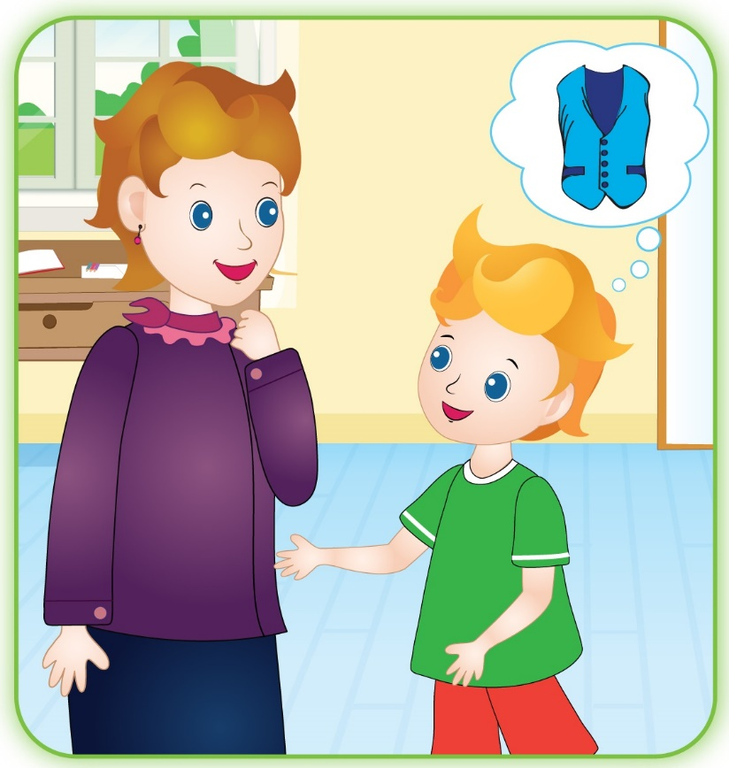
Unit 9: Lesson 2 Vv
1. Listen and repeat
Mum, I’d like a blue vest.
Notes:
Play the audio and ask students to listen and repeat.

Slide 6
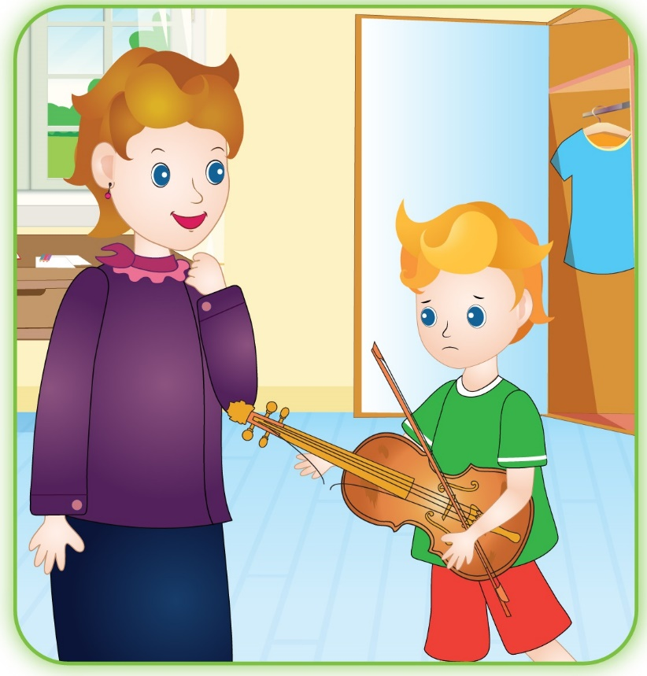
Unit 9: Lesson 2 Vv
1. Listen and repeat
I’d like a new violin.

Slide 7
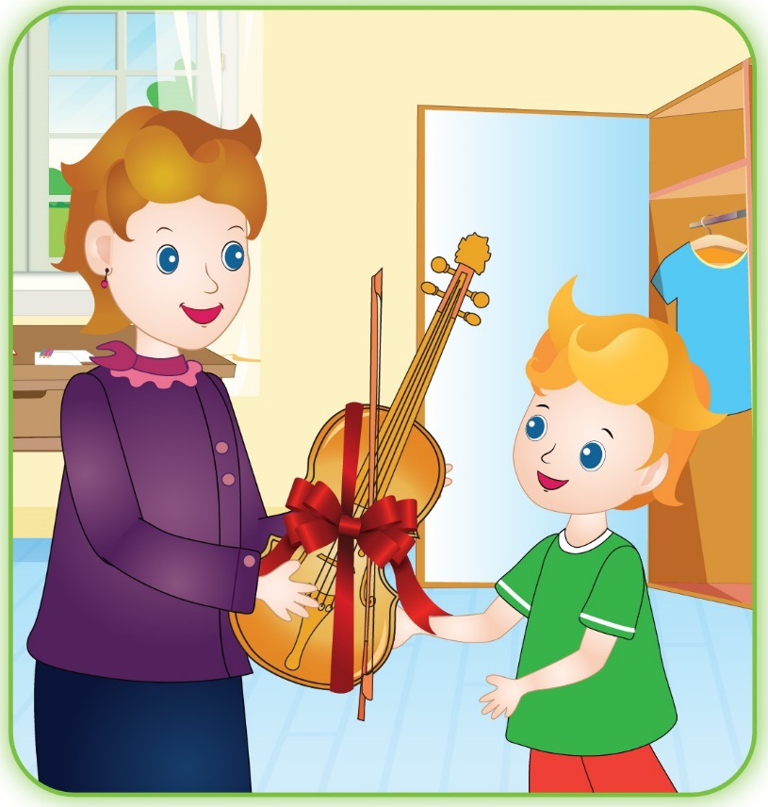
Unit 9: Lesson 2 Vv
1. Listen and repeat
Thank you!

Slide 8
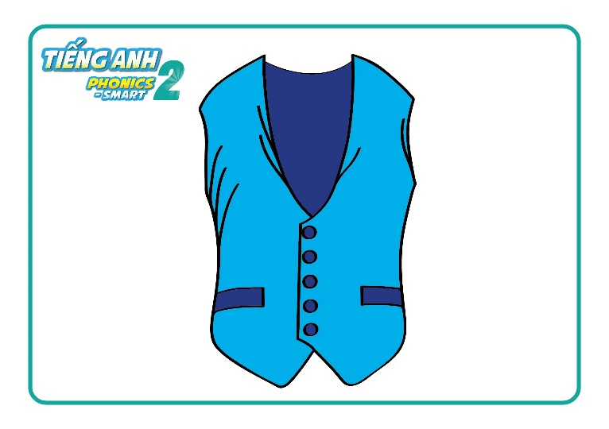
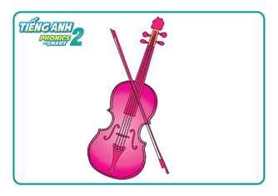
Unit 9: Lesson 2 Vv
1. Listen and repeat
I’d like a
I’d like a
Notes:
Let’s look and say.

Slide 9

Unit 9: Lesson 2 Vv
1. Listen and repeat
Mum, I’d like a blue vest.
I’d like a new violin.
Thank you!
Page 43
Notes:
Now, you look at your book Page 43.
- Work with your partner. Point and say.

Slide 10
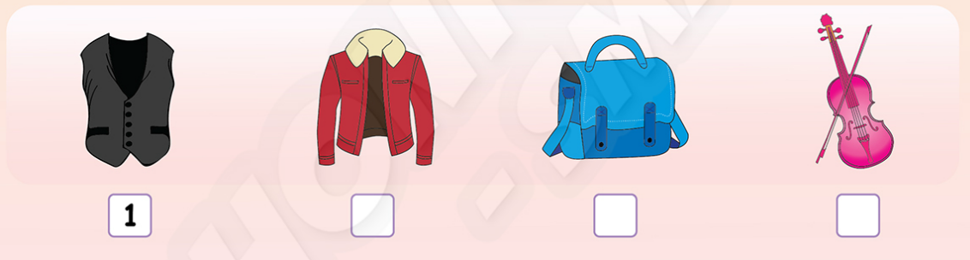
Unit 9: Lesson 2 Vv
1. Listen and repeat.
2. Listen and number.
Example
4
3
2
Notes:
Well, we move to Part 2 – Listen and number.
There is one example. Listen.
Now. Listen and number. You’ ll listen twice.
T clicks to “Example” to review the sentence number 1.
T clicks to each number to review each sentence.

Slide 11
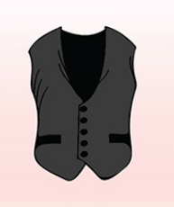
Unit 9: Lesson 2 Vv
I’d like a new vest.
Notes:
T clicks to the picture of the vest to go back slide 13.

Slide 12

Unit 9: Lesson 2 Vv
I’d like a pink violin.

Slide 13
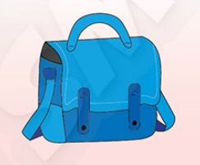
Unit 9: Lesson 2 Vv
I’d like a blue bag.

Slide 14
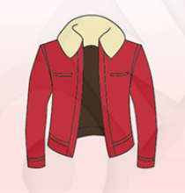
Unit 9: Lesson 2 Vv
I’d like a new jacket.

Slide 15

Unit 9: Lesson 2 Vv
1. Listen and repeat
2. Circle and say
3. Let’s talk.
Let’s go shopping!
Notes:
Now, let’s go shopping. What would you like?

Slide 16
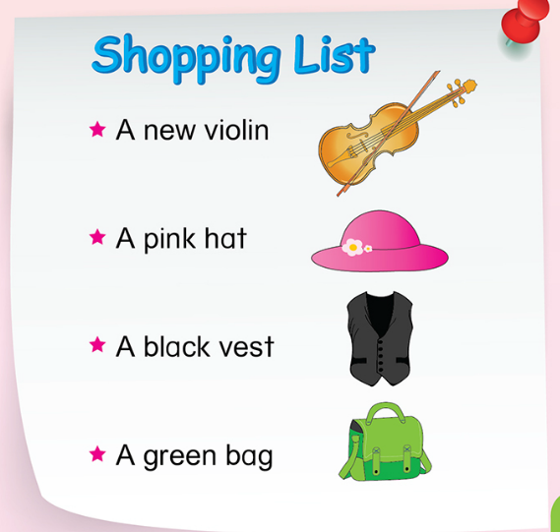
Unit 9: Lesson 2 Vv
3. Let’s talk.
I’d like a new violin.
Notes:
Now, look at the shopping list.
Can you name the items?
Good. Look and say.
Ok. Let’s go shopping.
First, I’d like a new violin.

Slide 17
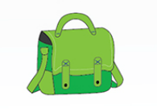


Unit 9: Lesson 2 Vv
2. Circle and say
I’d like a ….
Notes:
Now tell me “What would you like?”
Look at the pictures and say “I’d like …”

Slide 18
Unit 9: Lesson 2 Vv
GAME:
Let’s go shopping!
Notes:
Now, Let’s play game.
You are going to go shopping.

Slide 19

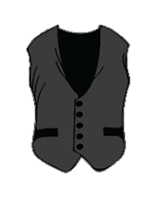
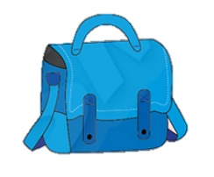


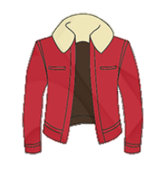
Unit 9: Lesson 2 Vv
2. Circle and say
I’d like a ….
Notes:
I show you the items you’d like.
Try to remember all of the items.
They are will disappear in a few minutes.
Each group will take turns to answer by saying “I’d like a …”
T gives the stars for group who get the most correct answers.

Slide 20
Unit 9: Lesson 2 Vv
2. Circle and say
I’d like a ….
Notes:
T asks students to review all the sentences with the items they have learnt.

Slide 21
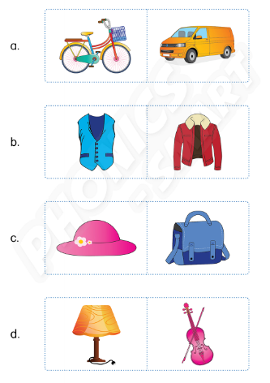
Unit 9: Lesson 2 Vv
Activity book
Listen and circle.
Notes:
T correct the activity in Activity Book.

Slide 22
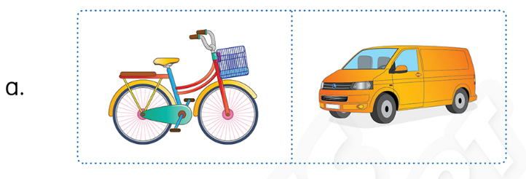
Unit 9: Lesson 2 Vv
Listen and circle.

Slide 23
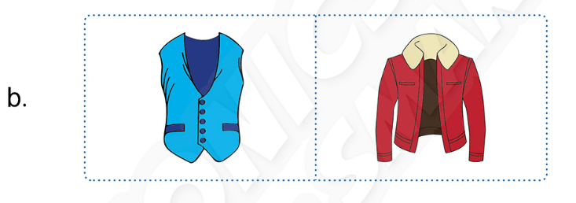
Unit 9: Lesson 2 Vv
Listen and circle.

Slide 24
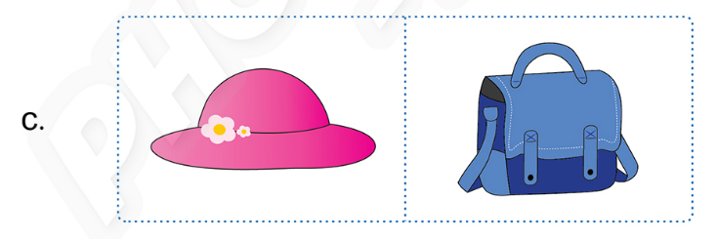
Unit 9: Lesson 2 Vv
Listen and circle.

Slide 25
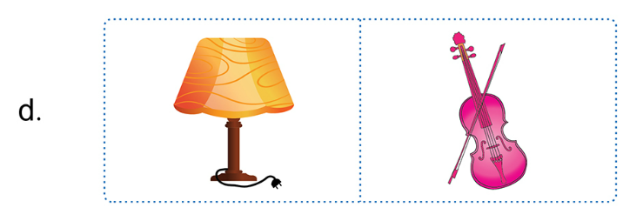
Unit 9: Lesson 2 Vv
Listen and circle.

