Slide 1









GAME: WHO IS THE FASTEST
Fast
Medium
Slow
Appear
Disappear

Slide 2






a
b
c
d

Slide 3



LUCKY DOOR

Slide 4


d

Slide 5

c

Slide 6

b

Slide 7
Lucky door

Slide 8

a
b
c
d

Slide 9
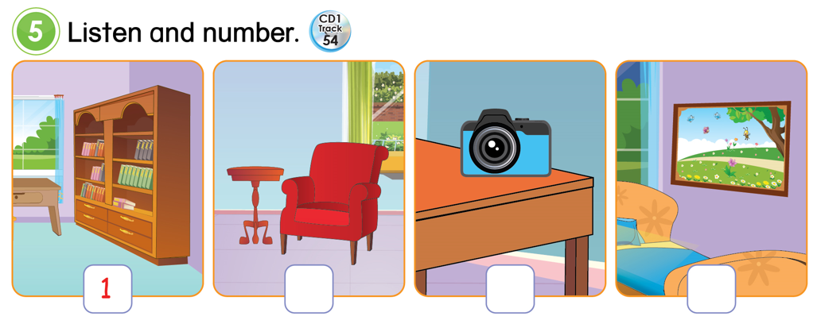





1
2
3
4
1
3
4
2

Slide 10


Consolidation
a camera
a picture
in my room
a bookcase
an armchair
a computer
- Is there a sofa in your room?
- Yes, there is.
- No, there isn’t.
Notes:
Tell students to open their notebook and write down

