Slide 1



Slide 2



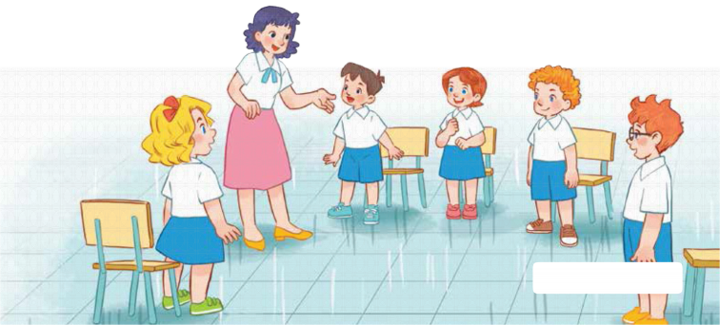
7
Classroom instructions
LESSON 3 – PERIOD 5

Slide 3
CONTENTS
Let’s chant.
Listen and repeat.
Listen and tick.
Fun corner and wrap- up
Warm-up and review

Slide 4

Jigsaw Puzzle
GUESS AND SAY
Warm up & Review
A
B
Notes:
- Divide the class into 2 teams.
- Each team chooses one jigsaw piece to go to the question.
- Have pupils open the jigsaw pieces, guess and say the right sentences.
- Pupils can choose to open the secret box or give it to the other team.
- Back to the menu for another question.
- Pupils take turns to play until they get all the jigsaw pieces.
- The team who gets more points is the winner.

Slide 5

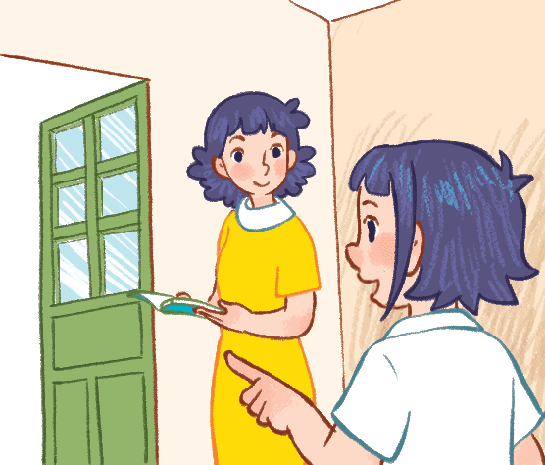


May I go out?
Home
50
Check
Take or give
Notes:
Click on “check” to check answer.
Click on the gift box to know how many point there are for this puzzle.
Click on “home” to go back.

Slide 6

May I open the book?
Home
30
Check
Take or give
Notes:
Click on “check” to check answer.
Click on the gift box to know how many point there are for this puzzle.
Click on “home” to go back.

Slide 7
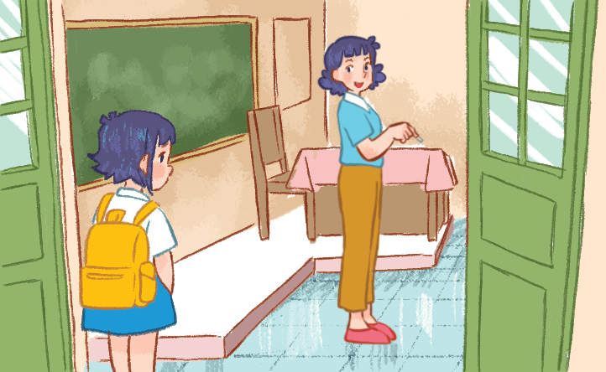
May I come in?
Home
20
Check
Take or give
Notes:
Click on “check” to check answer.
Click on the gift box to know how many point there are for this puzzle.
Click on “home” to go back.

Slide 8
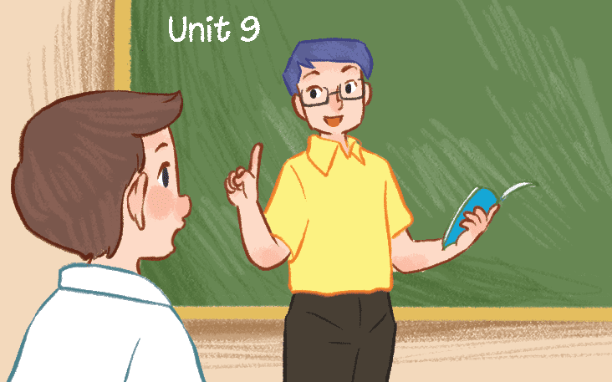
May I speak Vietnamese?
Home
-10
Check
Take or give
Notes:
Click on “check” to check answer.
Click on the gift box to know how many point there are for this puzzle.
Click on “home” to go back.

Slide 9
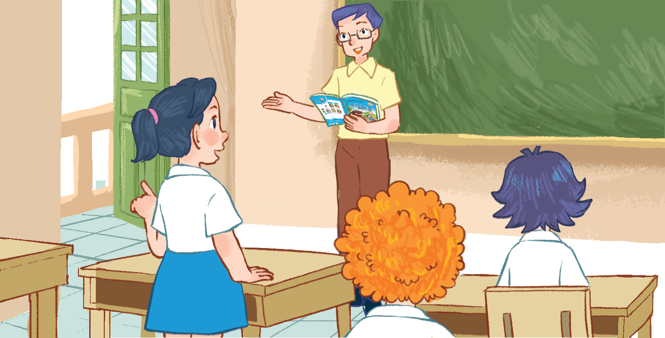
May I go out?
Home
40
Check
Take or give
Notes:
Click on “check” to check answer.
Click on the gift box to know how many point there are for this puzzle.
Click on “home” to go back.

Slide 10
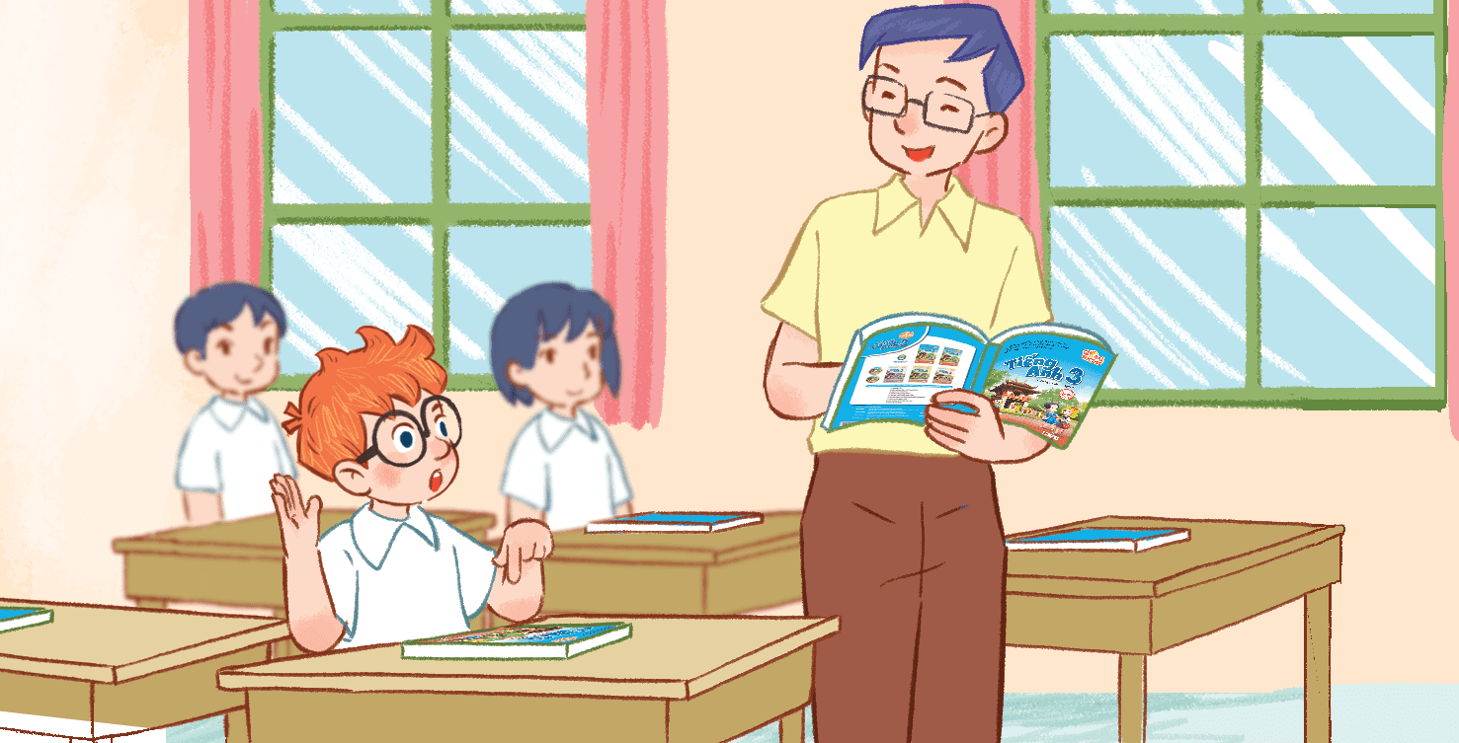
May I open the book?
Home
-30
Check
Take or give
Notes:
Click on “check” to check answer.
Click on the gift box to know how many point there are for this puzzle.
Click on “home” to go back.

Slide 11
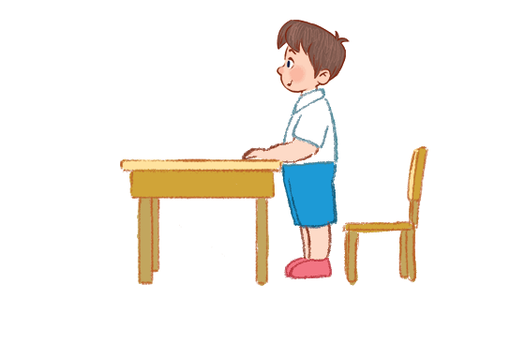
Sit down, please!
Home
25
Check
Take or give
Notes:
Click on “check” to check answer.
Click on the gift box to know how many point there are for this puzzle.
Click on “home” to go back.

Slide 12
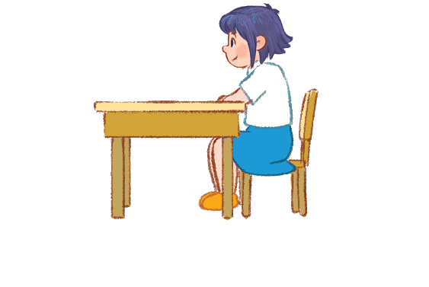
Stand up, please!
Home
25
Check
Take or give
Notes:
Click on “check” to check answer.
Click on the gift box to know how many point there are for this puzzle.
Click on “home” to go back.

Slide 13

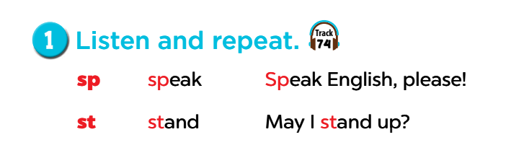


Slide 14
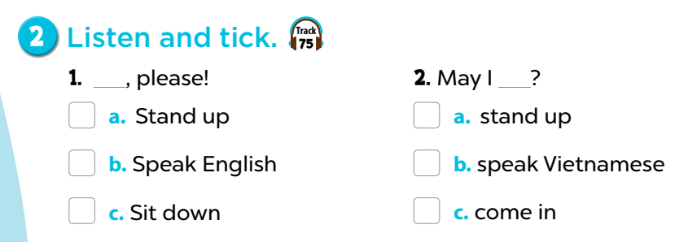


Slide 15
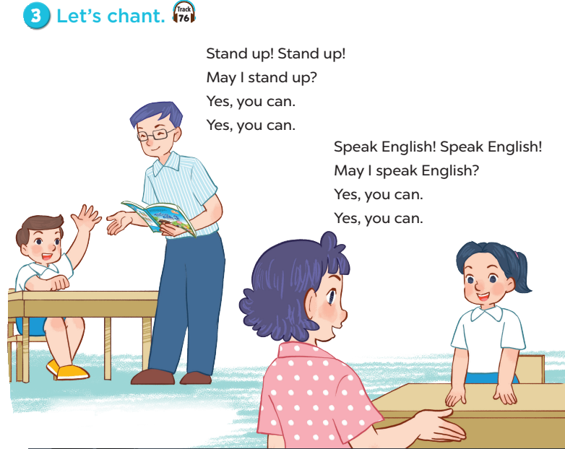

Slide 16

Fun corner and wrap-up
Find the correct sounds!
A
C
A
B
B
D
F
E
Notes:
Divide the class into 2 teams.
Each team chooses one letter to go to the question.
Teacher can write scores in box A and B.

Slide 17

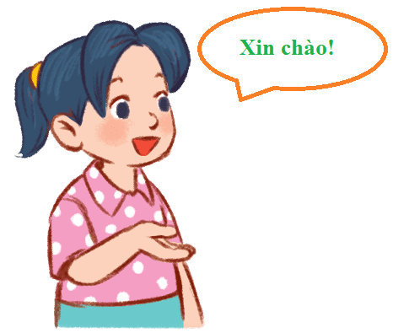

St
Sr
10
Sp
Sc
Sk
Sh
Sp
eak Vietnamese!
Notes:
- Click the “home” button to go back.

Slide 18

Sc
Sh
10
Sp
St
Sk
Sr
St
and up!
Notes:
Click the “home” button to go back.

Slide 19

St
Sc
10
Sr
Sh
Sk
Sp
Sp
eak English!
Notes:
- Click on “home” to go back.

Slide 20
st
sr
20
sp
sc
sk
sh
sp
May I
eak Vietnamese?
Notes:
Click the “home” button to go back.

Slide 21

sc
sh
20
sp
st
sk
sr
st
May I
and up?
Notes:
Click the “home” button to go back.

Slide 22

st
sc
20
sr
sh
sk
sp
sp
May I
eak English?
Notes:
Click the “home” button to go back.

Slide 23

Website: sachmem.vn
Fanpage: www.facebook.com/sachmem.vn

