Slide 1





8
2
Period 4

Slide 2


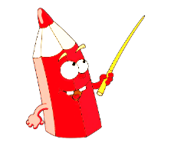
①
Warm-up and review
Contents
②
Listen and number.
③
Read and match.
④
Let’s play.
⑤
Fun corner and wrap-up

Slide 3


①
Warm-up and review

Slide 4
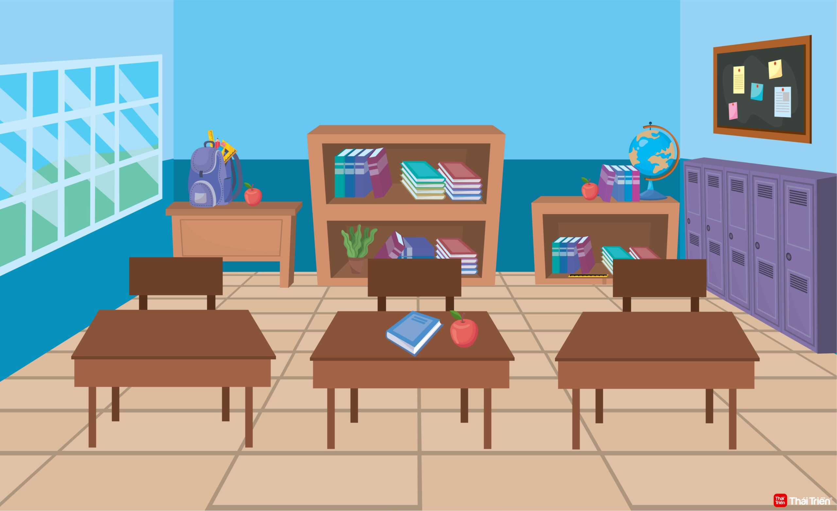
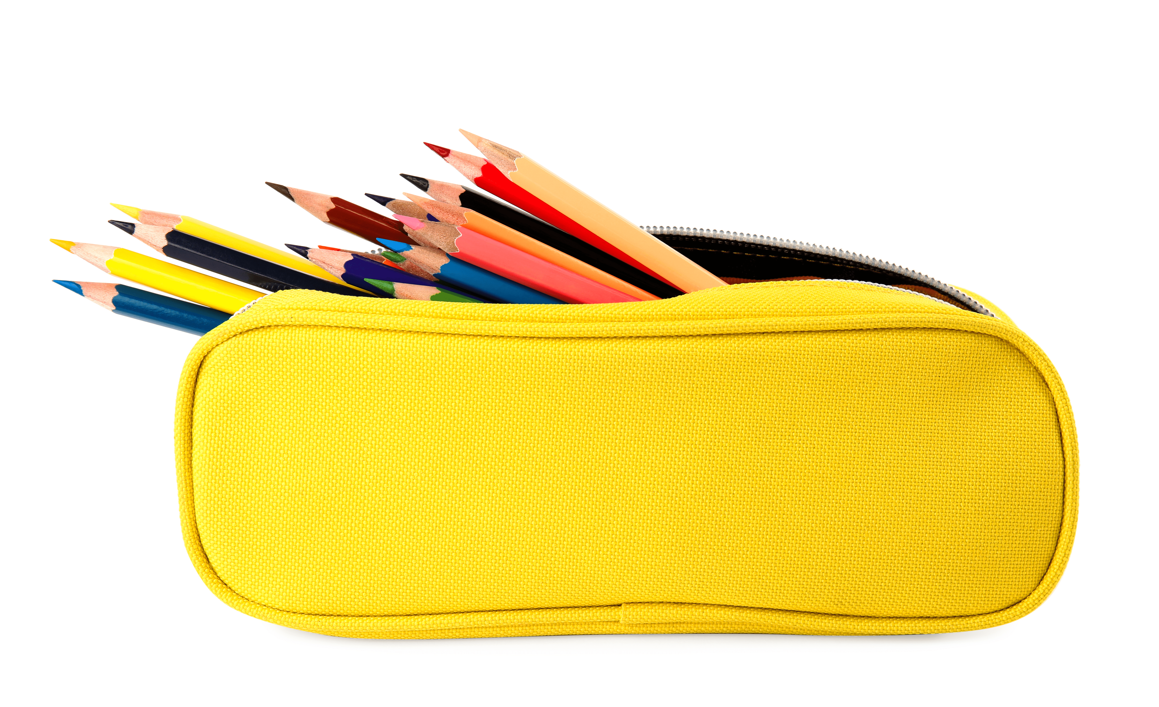






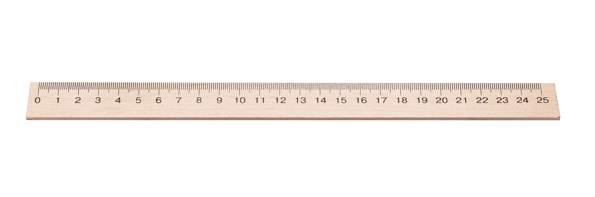


What school things do you see?
Notes:
There’s a classroom with school things everywhere. Ask pupils to look at the pictures carefully and find the school things. Let pupils count the items they find to make it more interesting.

Slide 5
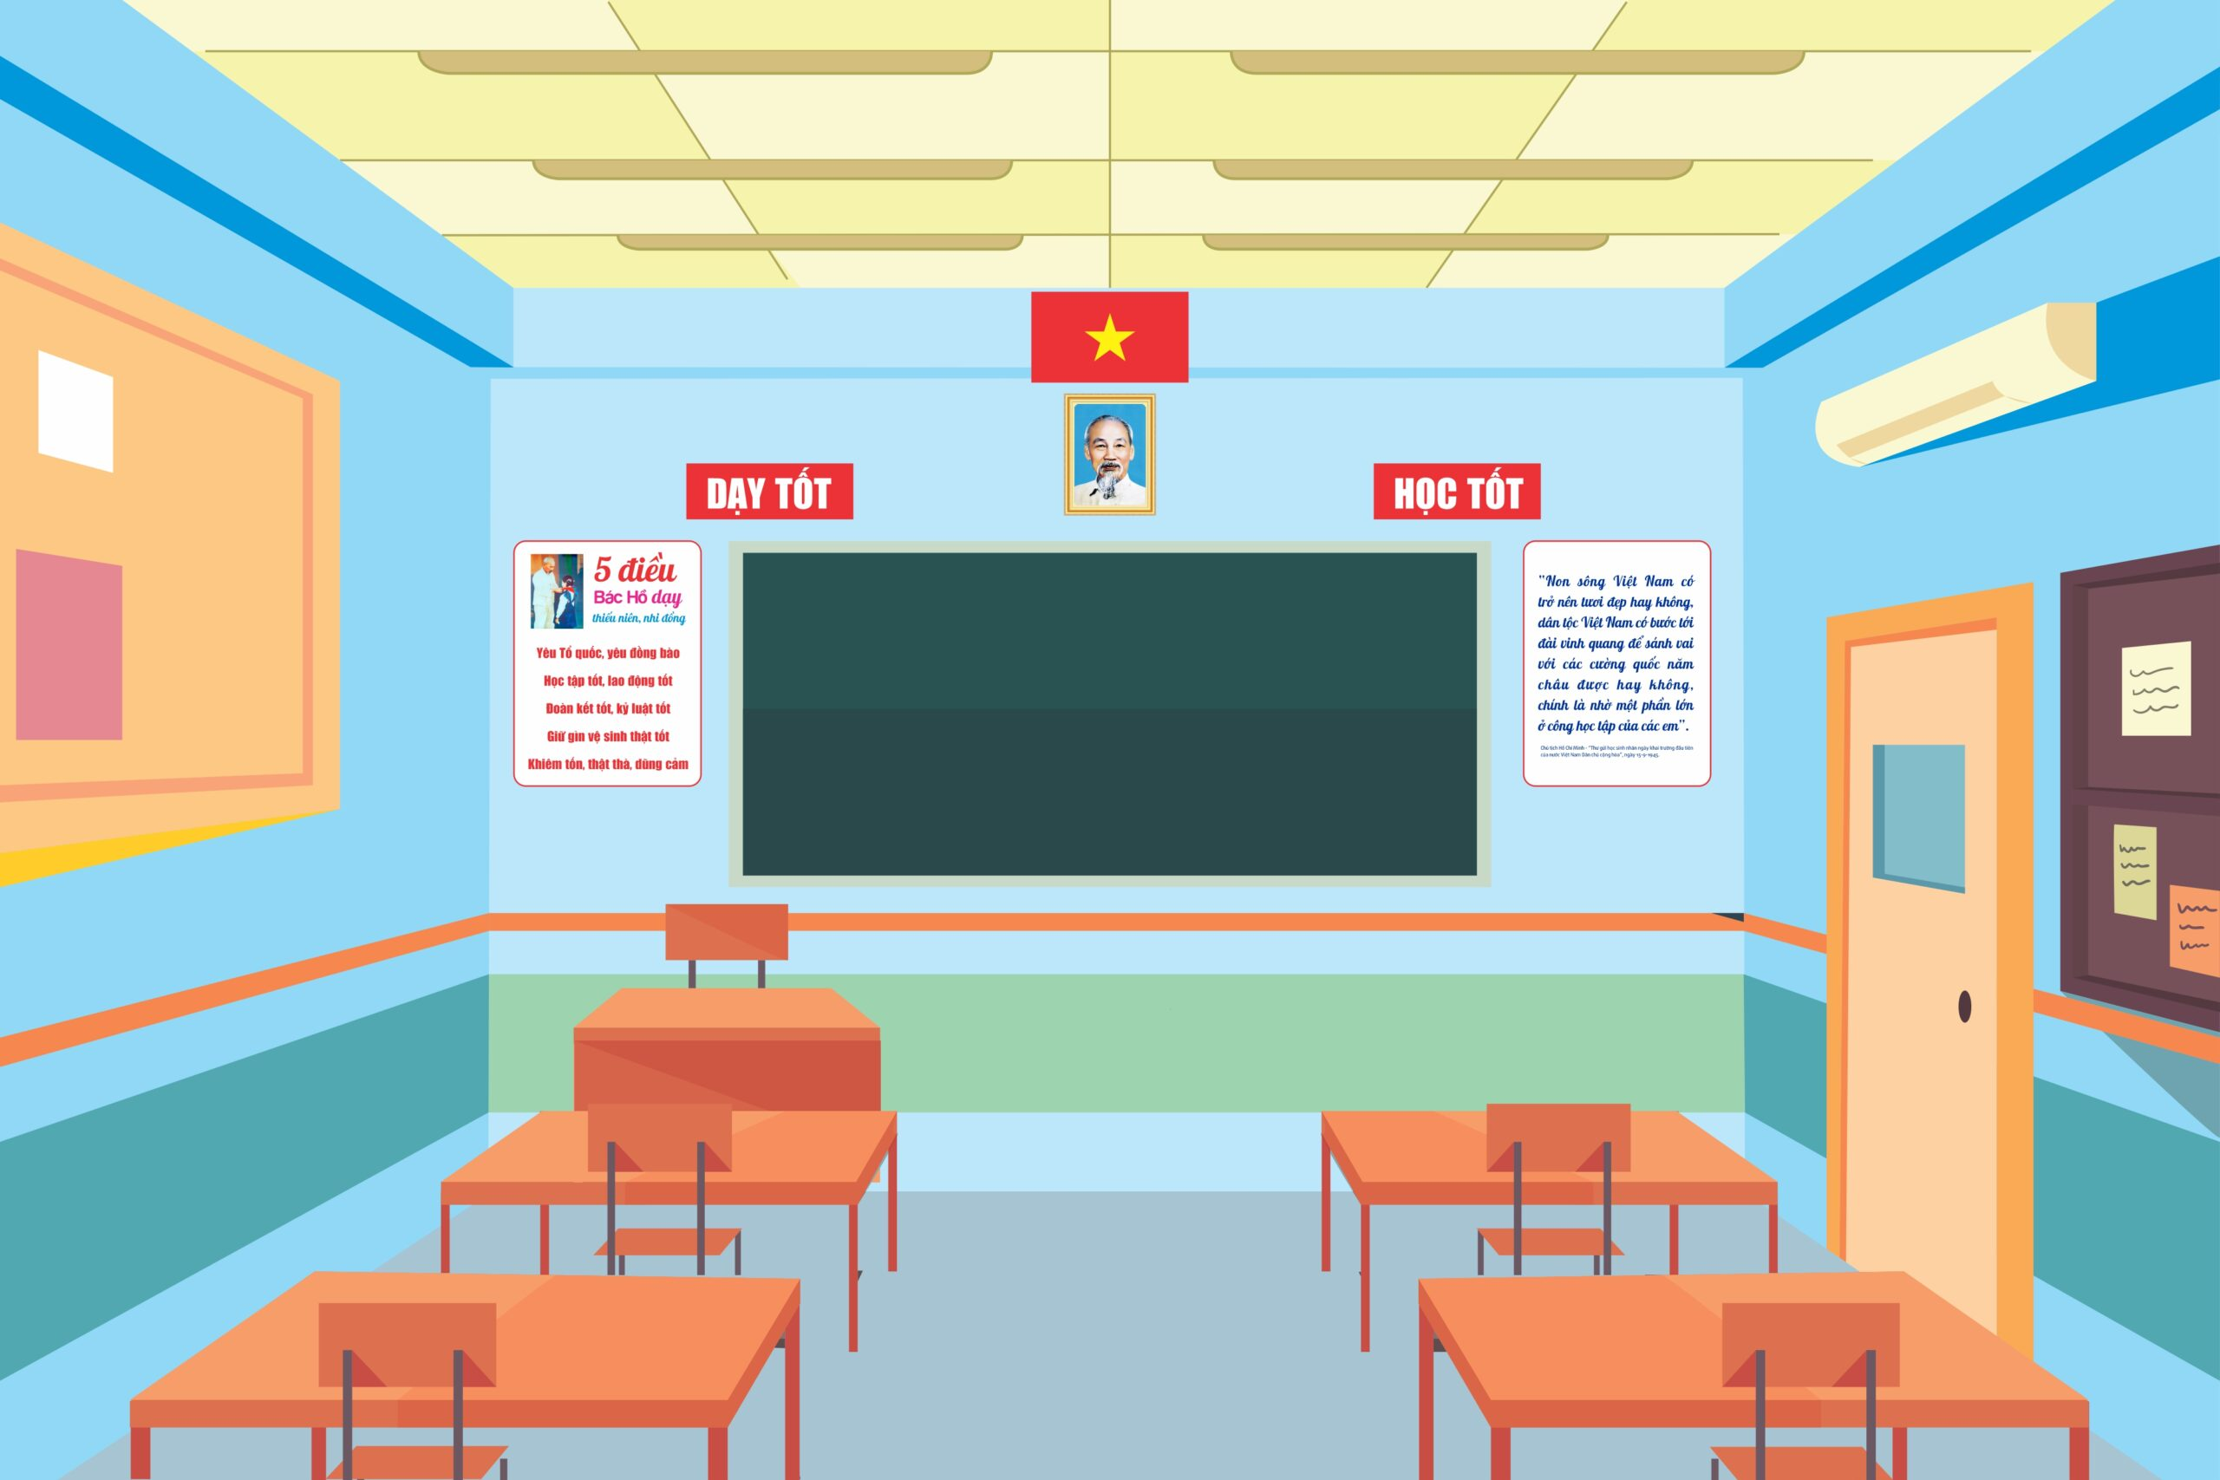
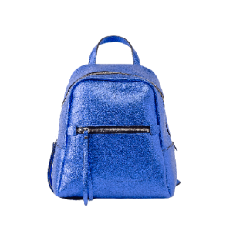

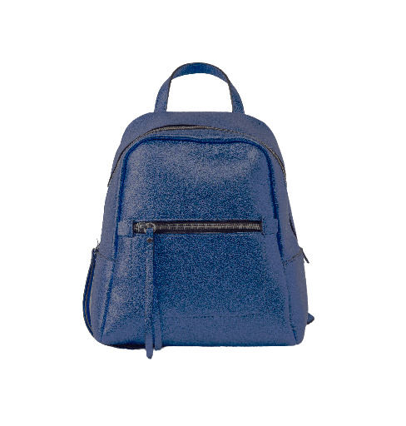
What school things do you see?
Notes:
There’s a classroom with school things everywhere. Ask pupils to look at the pictures carefully and find the school things. Let pupils count the number of items they find to make it more interesting.

Slide 6
②
Listen and number.

Slide 7
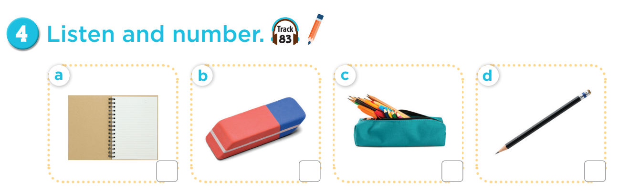
3
4
1
2

Slide 8
③
Read and match.

Slide 9
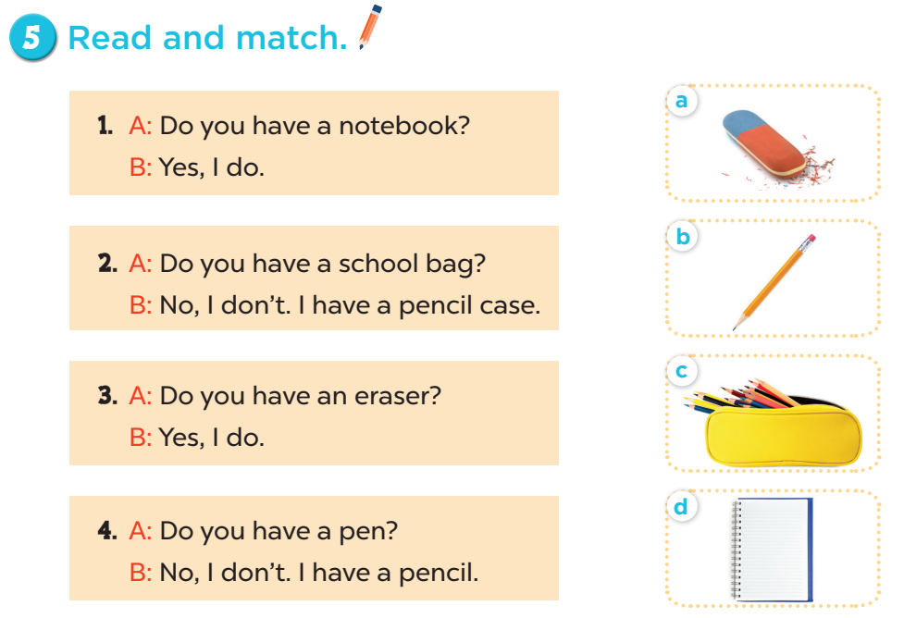

Slide 10


Let’s choose and say!
1
2
3
4
5
6
7
8
Next
Notes:
Let’s choose and say!
Pupils choose a number then choose the correct answer for the question. Who can say it correctly will get points for the team.

Slide 11
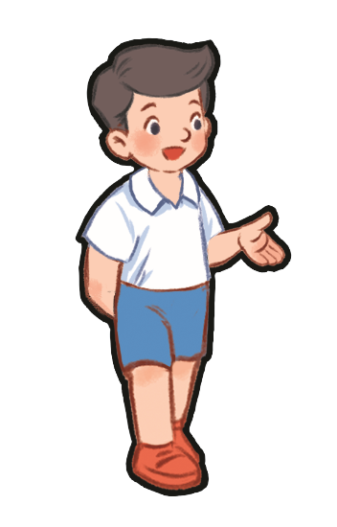


Do you have a pencil?
Yes, I do.
No, I don’t.
Notes:
- Click home to go back.

Slide 12

Do you have a ruler?
Yes, I do.
No, I don’t.
Notes:
- Click home to go back.

Slide 13
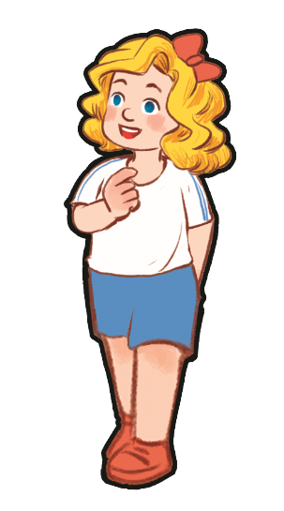
Do you have a book?
Yes, I do.
No, I don’t.
Notes:
- Click home to go back.

Slide 14
Do you have an eraser?
Yes, I do.
No, I don’t.
Notes:
- Click home to go back.

Slide 15
④
Let’s play.

Slide 16
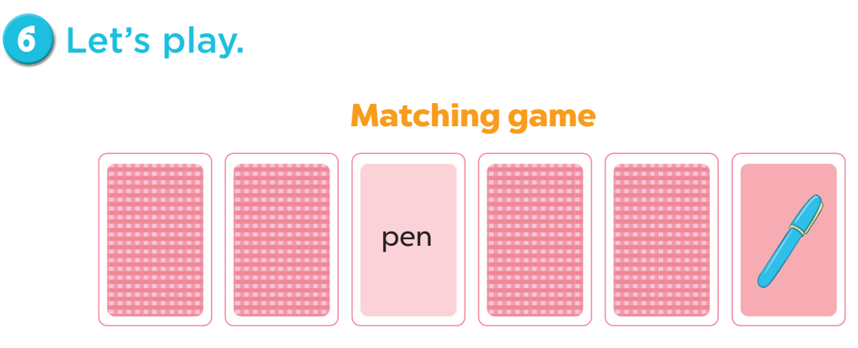

Slide 17

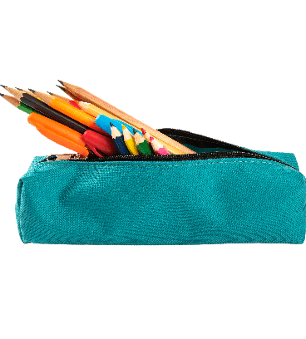
Let’s play.
pencil
pencil case
pen
Notes:
Click the card to show the words/picture. Click again to turn it face down.

Slide 18
Let’s play
pencil case
pencil
pen
Notes:
Click the card to show the words/picture. Click again to turn it face down.

Slide 19
⑤
Fun corner and
wrap-up

Slide 20
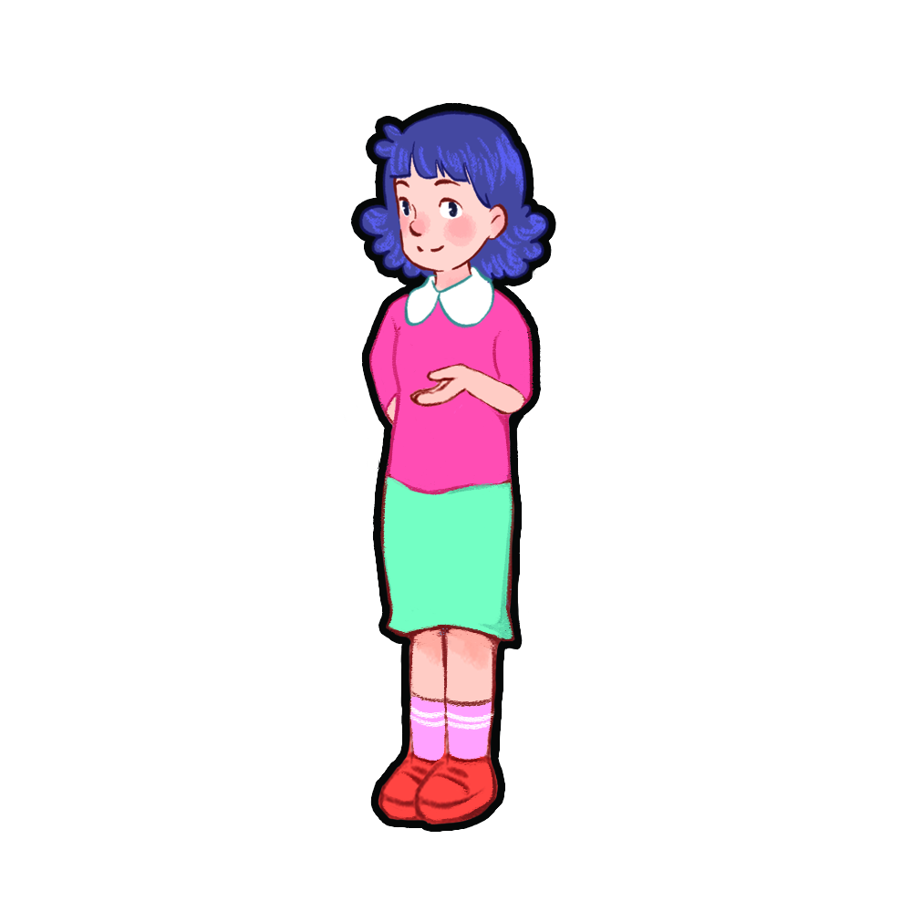
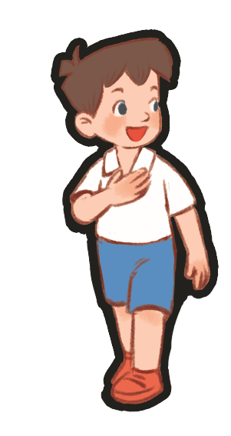
Show me: pencil, eraser, pen!
pencil, eraser, pen!
pencil, eraser, pen!
pencil, eraser, pen!
Notes:
- Teacher asks pupils to put their school things on the desk.
- Ask them to show the school things with the correct order. (example: Show me: pencil, eraser, pen).

