Slide 1







9
Colours
LESSON 1
Period 2

Slide 2



CLASSROOM RULES

Slide 3
Put your hands
On my desk.
Who’s the best?
It’s me!

Slide 4





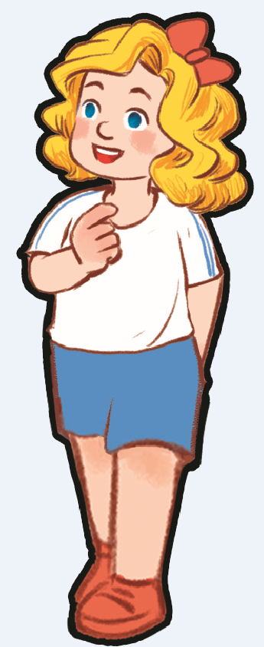


Let’s go to the top. There are 5 stops. Are you ready?

Slide 5

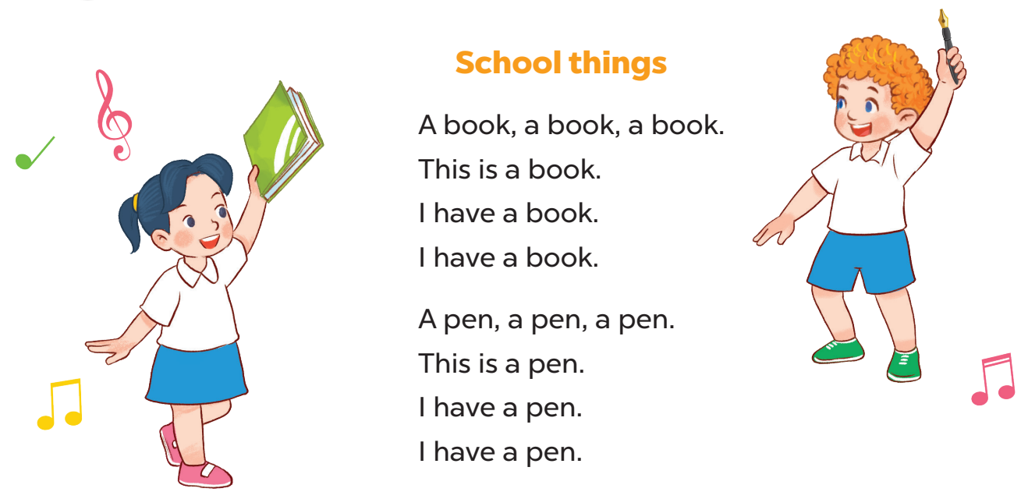
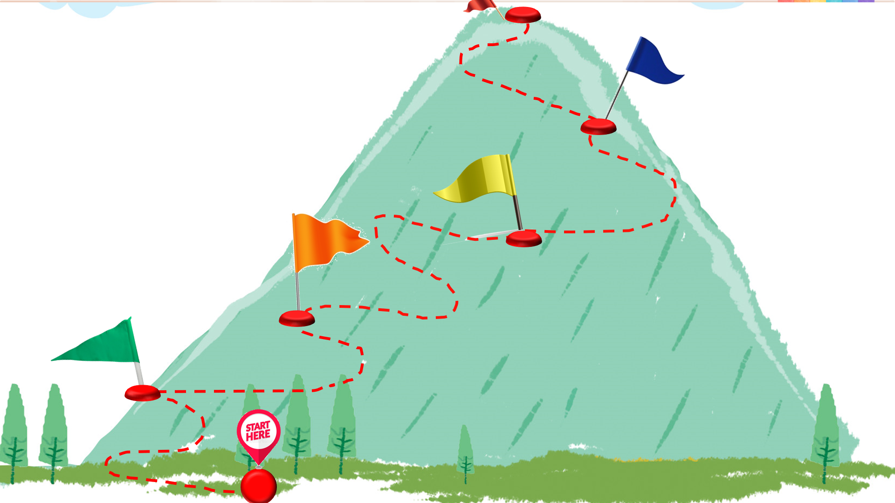
Sing a song
Ok! Now sing a song to the 1st stop! 1..2..3..Go!
Are you ready for the trip? We start from here.

Slide 6
Let’s play the guessing game to the next stop.

Slide 7


What colour is it?
blue

Slide 8

What colour is it ?
red

Slide 9


What colour is it?
yellow

Slide 10


Look and answer the question.
Notes:
Giáo viên làm mẫu với câu hỏi:
-What’s this?
What colour is it?
Gọi Hs trả lời
Mời 2 hs lên bảng làm mẫu: chỉ vào tranh hỏi và trả lời

Slide 11
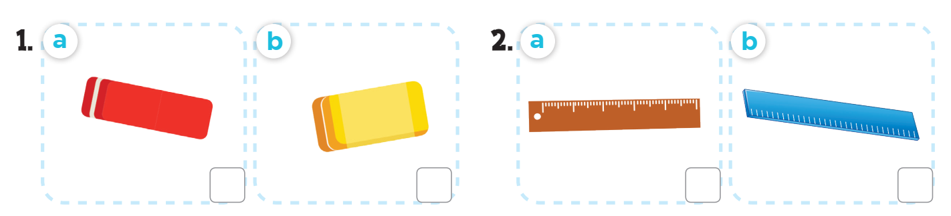
Listen and tick.

Slide 12

Let’s check!

Slide 13







Spin and choose a school thing
1 point
5 points
SPIN
3 points
2 points
10 points
End game
tekhnologic
Notes:
- Divide the class into groups of 2 (boys and girls). Each team takes turn to choose a school thing. They need to read the sentence and say the missing word(s) with the picture to get points.
- The group with more points at the end of the game will be the winner.

Slide 14

Read and complete.
What colour is ________?
it
It’s blue.

Slide 15


Read and complete.
colour
What ________ is it?
It’s red.

Slide 16

Read and complete.
What colour is it?
___________brown.
It’s

Slide 17

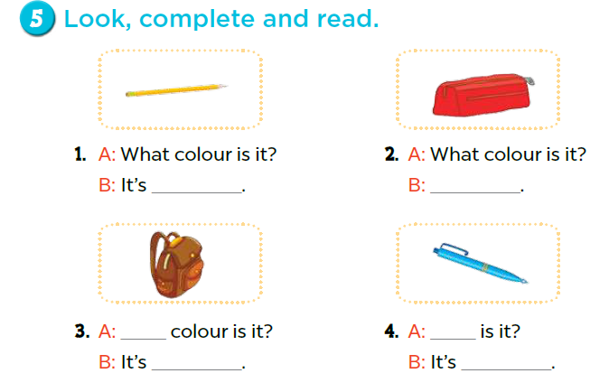
Good! Look at this activity. Let’s do it.

Slide 18
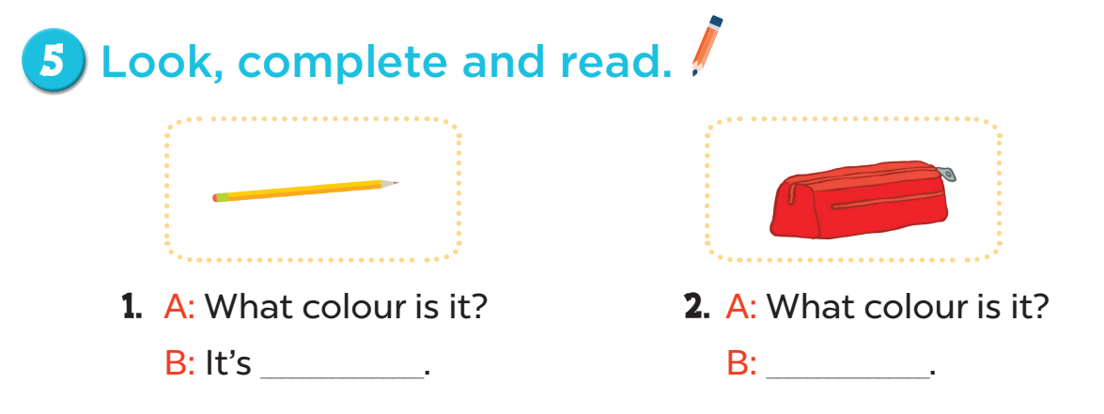
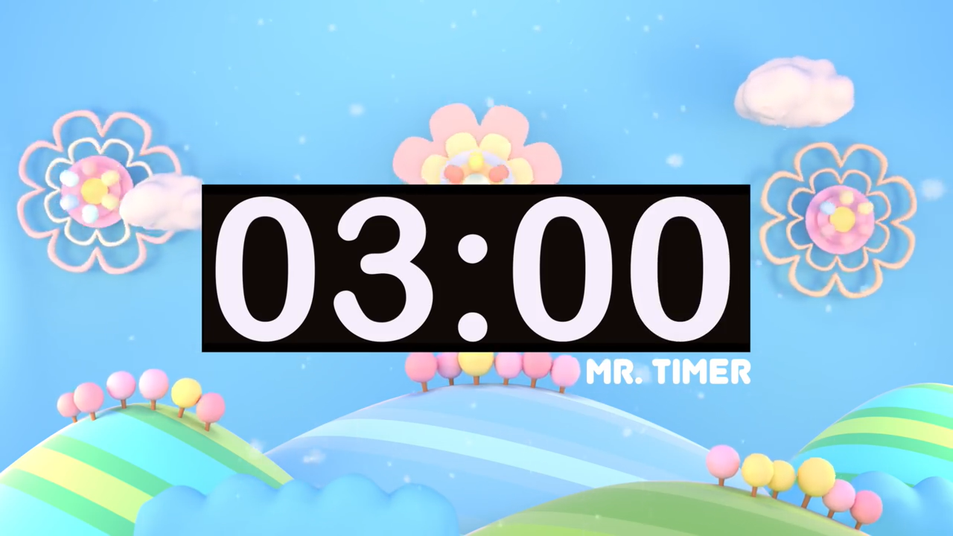
yellow
It’s red
63

Slide 19
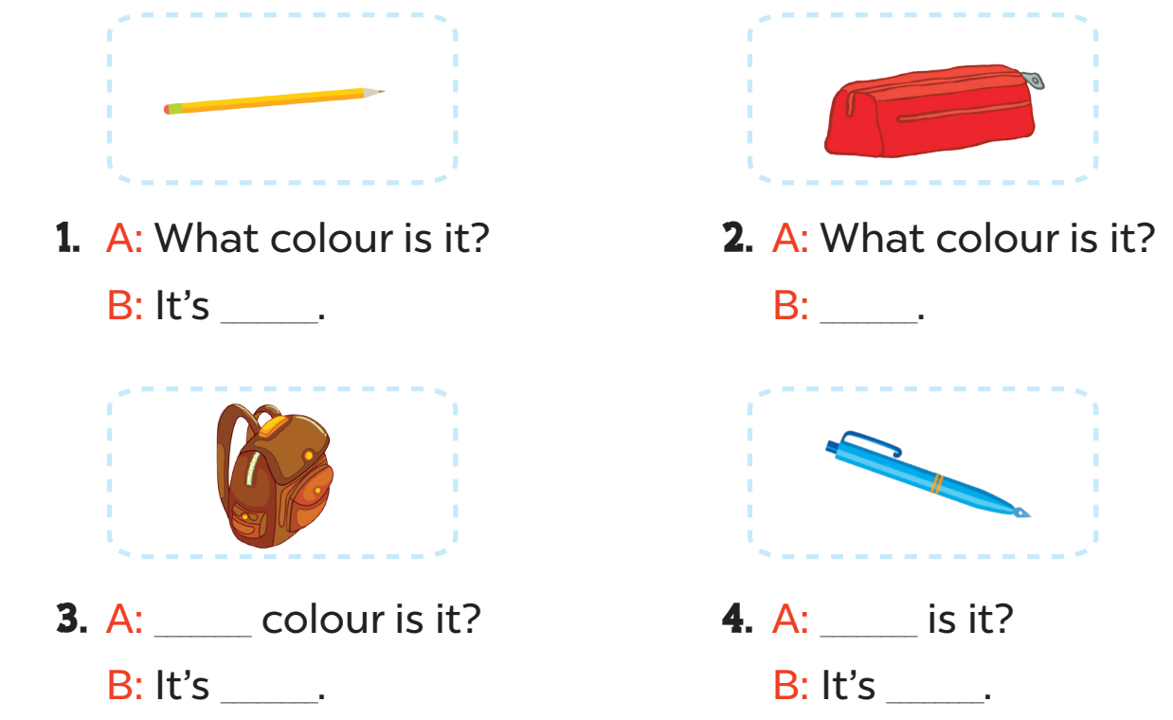
3. A: _______colour is it?
B: It’s __________.
4. A: ______________is it?
B: It’s __________.
What
What colour
brown
blue

Slide 20
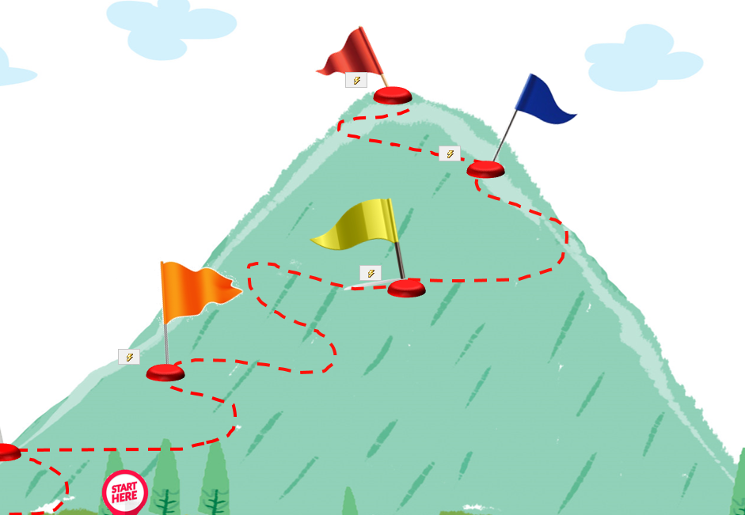
One more stop to go.
We can do it!

Slide 21
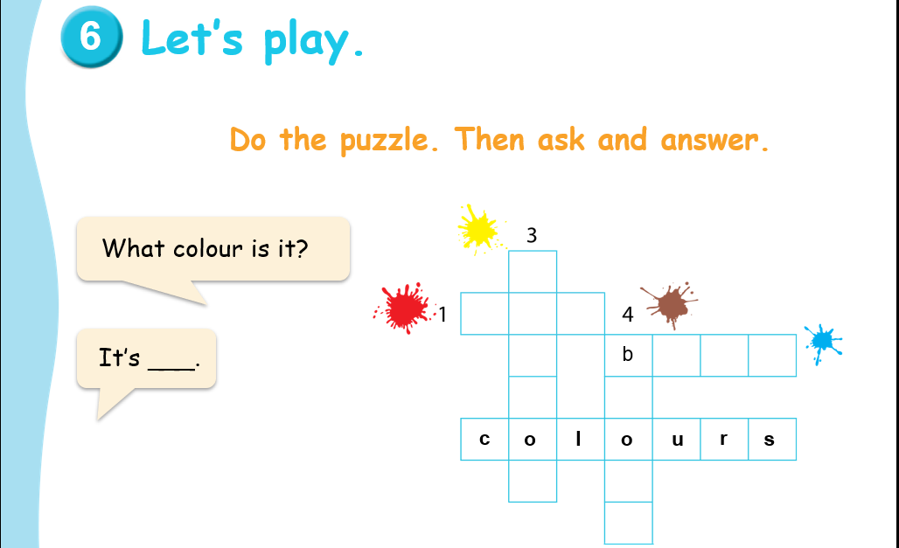
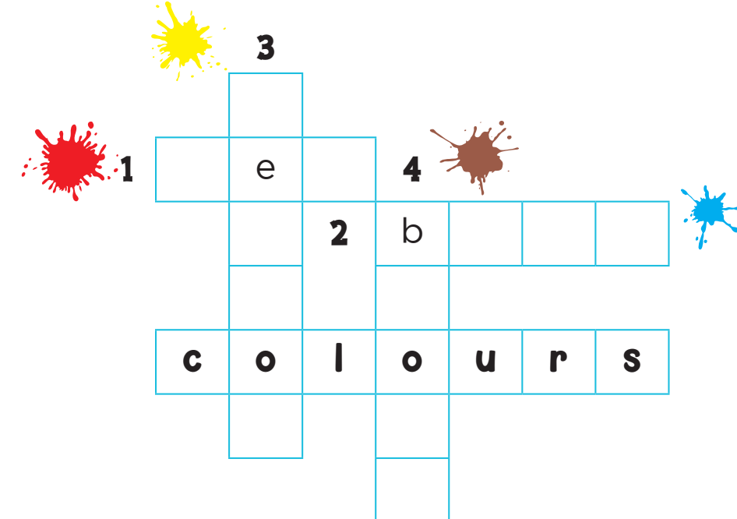
y
l
l
w
r d
l u e
r
w
n

Slide 22

Yeah! We are on the top of the mountain.

Slide 23
One – Stand up!
Two – Turn around!
Three – Clap your hands!
Four – Say Hurray!
It’s time to say goodbye.
Goodbye, children!
Goodbye, teacher!

