Slide 1


Our sports day
9
Lesson 2 - Period 4

Slide 2
01
Warm -up & Review

Slide 3
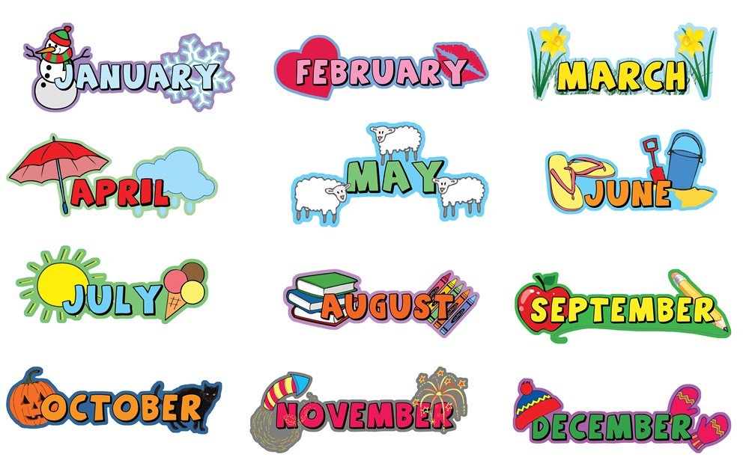
12 months of the year

Slide 4

Is your sports day in ___?
Yes, it is.
No, it isn't. It's in ____.

Slide 5
When's your sports day?
It's in _____.

Slide 6
02
Listen and tick.

Slide 7
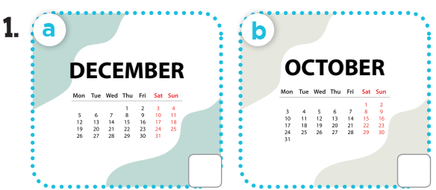
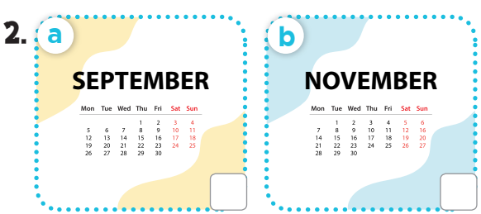
Look and say the months.

Slide 8
Listen and tick.



Slide 9
03
Look, complete and read.

Slide 10
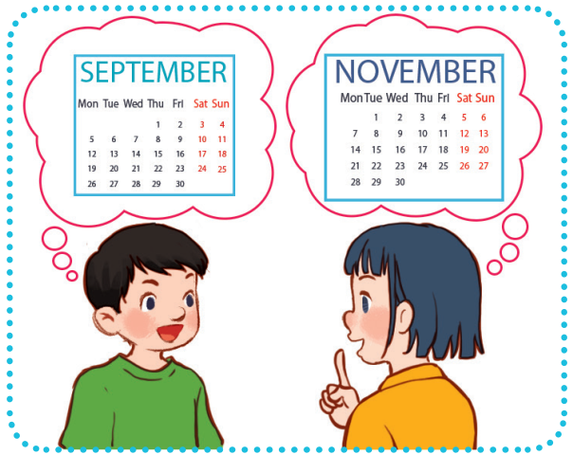
Look, complete and read.
5
1.
A: Is your sports day in September?
B: ______, it is. When’s your sports day?
A: It’s in __________.
Yes
November

Slide 11
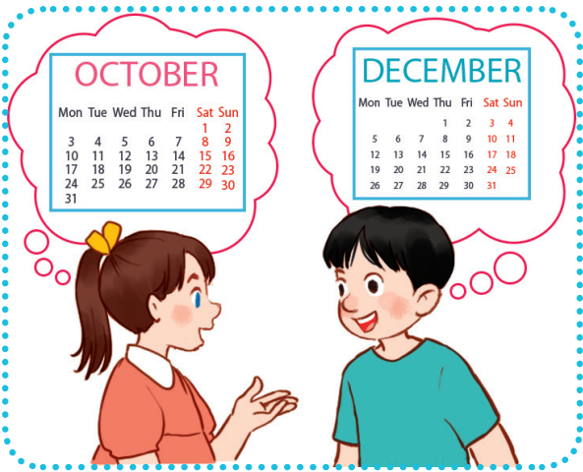
Look, complete and read.
5
2.
A: Our sports day is in October.
_____ your sports day in
October too?
B: No, it isn’t.
A: ________ your sports day?
B: It’s in __________.
Is
When’s
December

Slide 12
04
Let's play.

Slide 13
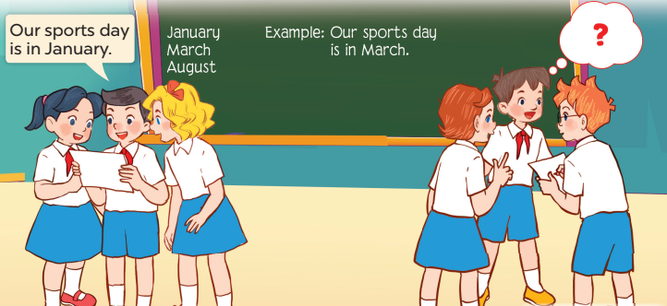
Let’s play.
6
Who’s faster?

Slide 14

1
2
3
THE
FOOTBALL GAME
4
5
6
7
8
9

Slide 15

_____ your sports day?
When's
A. When
B. Whens
C. When's

Slide 16
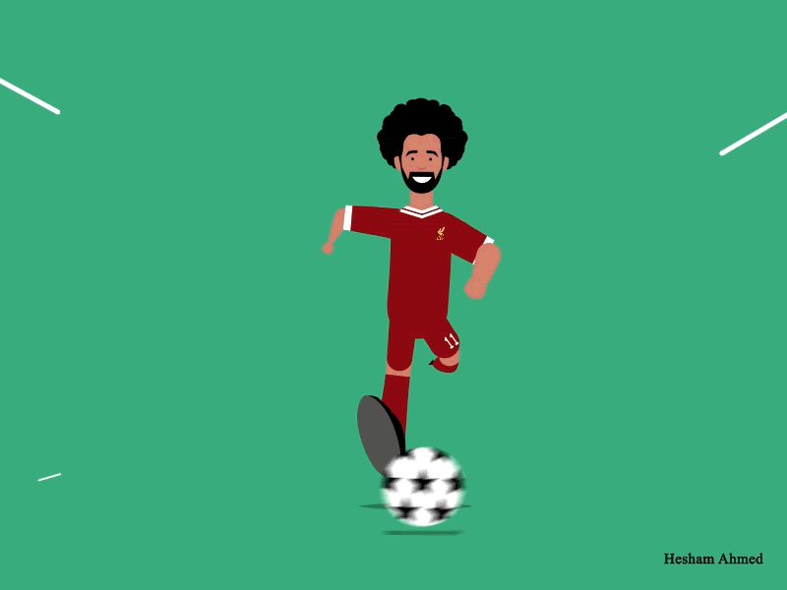
+ 3 points

Slide 17
Is
____ your sports day
in June?
A. Are
B. Is
C. It

Slide 18
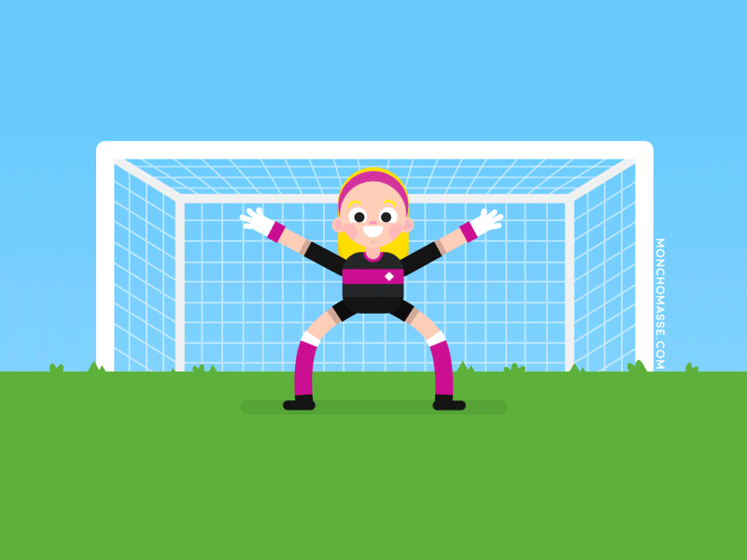
+ 5 points

Slide 19
When's your sports day?
A. It
B. It's
C. Is
___ in February.
It's

Slide 20
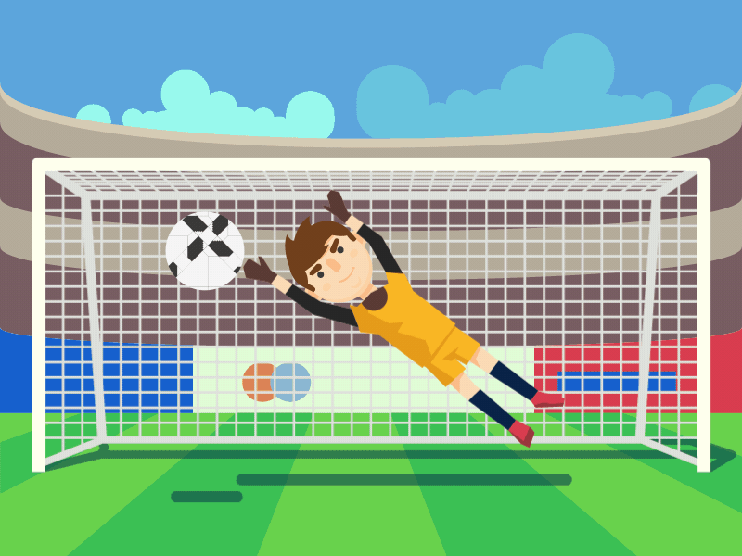
+ 2 points

Slide 21
Is your sports day
in May?
A. it is
B. it's
C. it isn't
Yes, _____.
it is

Slide 22
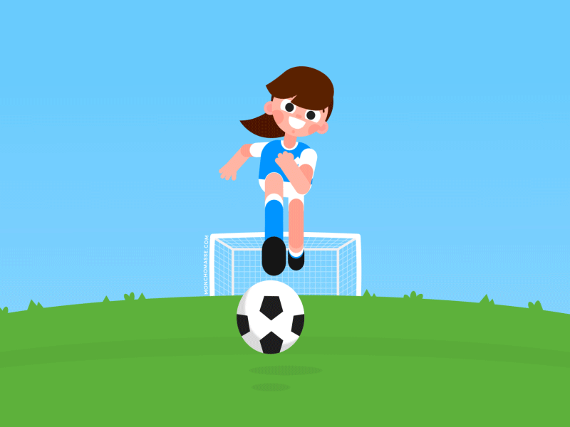
Take 2 points from another team

Slide 23
Is your sports day
in December?
A. it not
B. it's
C. it isn't
No, _______.
it isn't

Slide 24
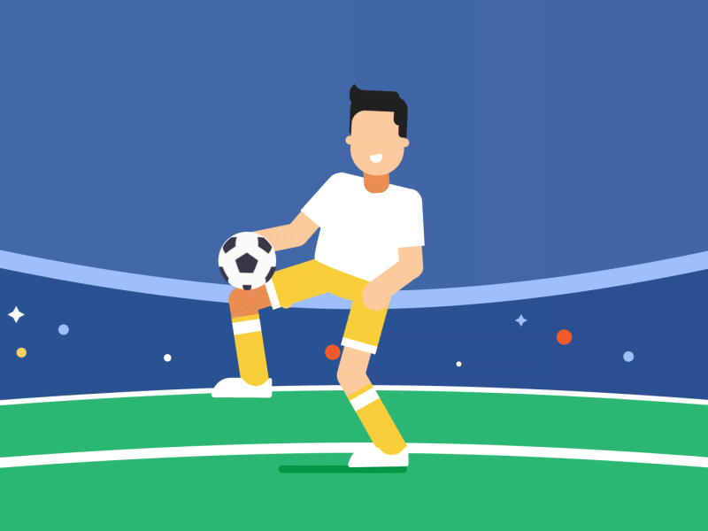
Change points with another team

Slide 25


When's your sports day?
It's in _________.
December

Slide 26
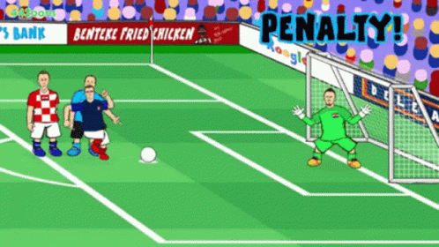
Oh no!
-3 points

Slide 27


When's your sports day?
Jun
It's in _______ .
June

