Slide 1


Our sports day
9
Lesson 3 - Period 6

Slide 2
01
Review

Slide 3


Let’s chant.
When’s your sports day?
In January, February or May?
In January, in January.
It’s in January.
When’s your sports day?
In May, June or July?
In July, in July.
It’s in July.

Slide 4
02
Read and tick True or False.

Slide 5
Read the passage.
Our sports day is in November. It is in the school playground. There are many pupils and teachers. We play different sports and games. The boys play badminton. The girls play football. The teachers play basketball. It is a lot of fun!

Slide 6

True or False.
 | True | False
1. The sports day is in November.
2. The sports day is in the school gym.
3. The boys play badminton.
4. The girls play basketball.

Slide 7
03
Let’s write.

Slide 8
5
Let’s write.
Our school sports day is in ________. We play sports and games in the school playground. The girls _________. The boys __________. The teachers _________. We all love our sports day.
October
play chess
play football
play volleyball

Slide 9
04
Project

Slide 10
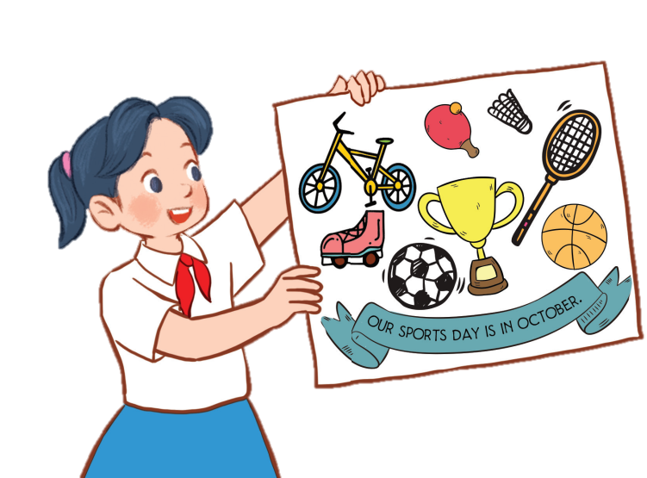
6
Project
Our sports day poster
Our sports day is in October. _______.

Slide 11
05
Fun time

Slide 12
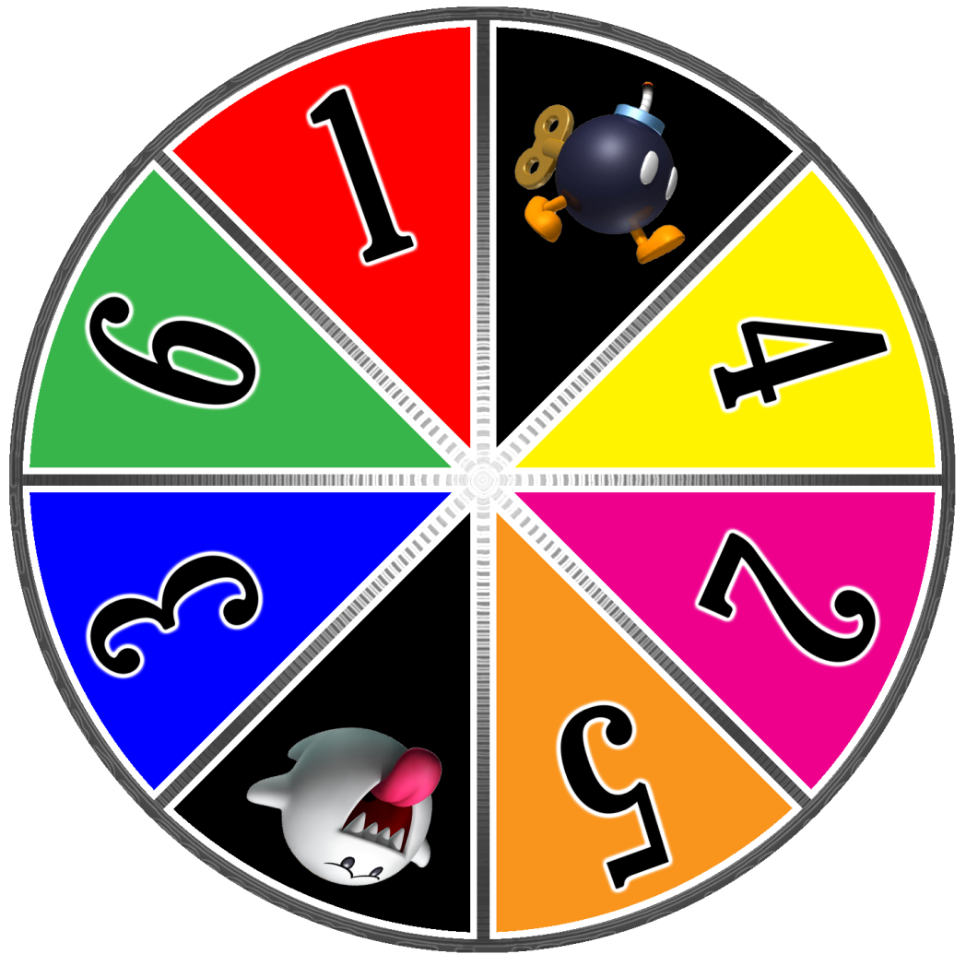




Slide 13

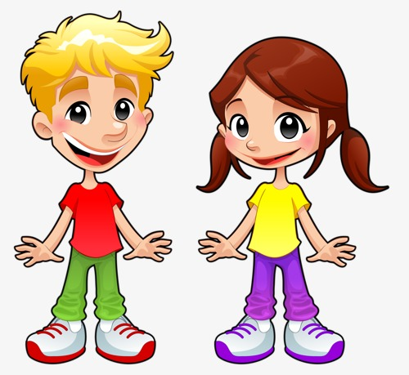

A
B
C
1
2
3
4
Notes:
24 Questions
Teacher says the first sentence. Student replies using the new structure. Click the rabbit to go back to question slide.

Slide 14
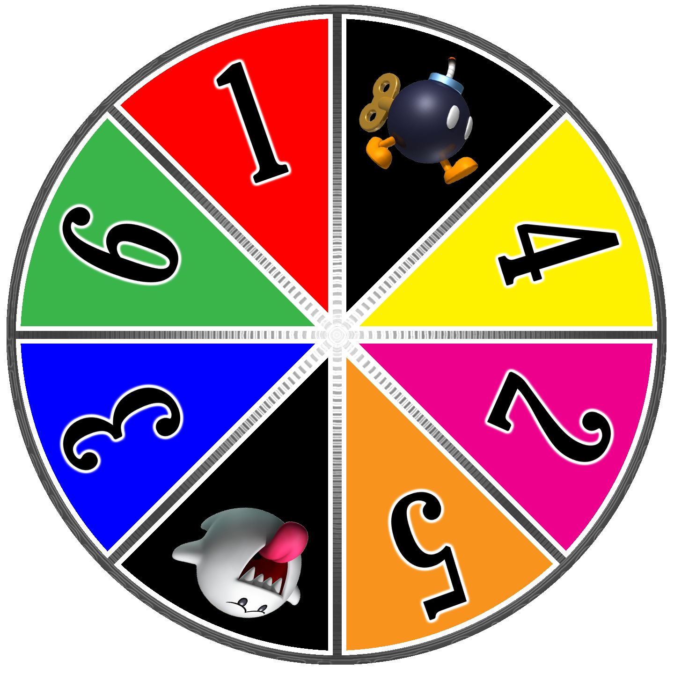

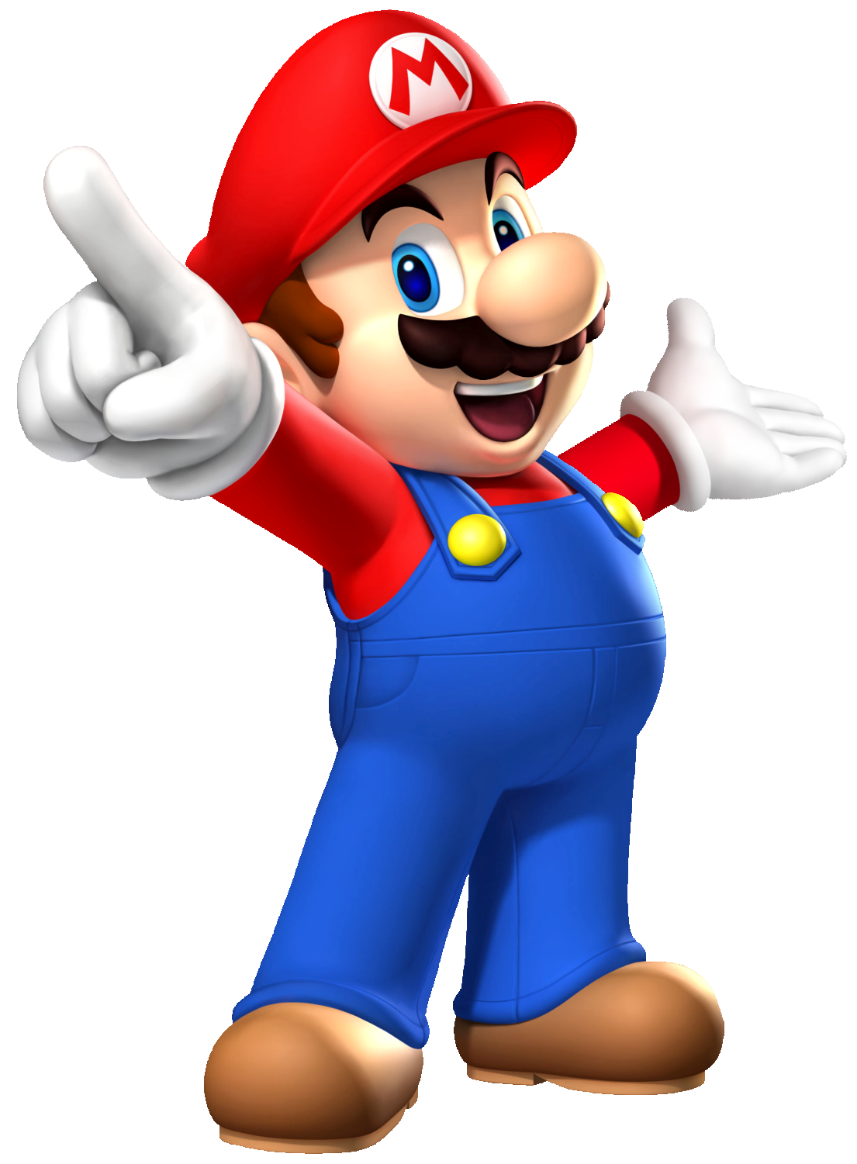


Slide 15
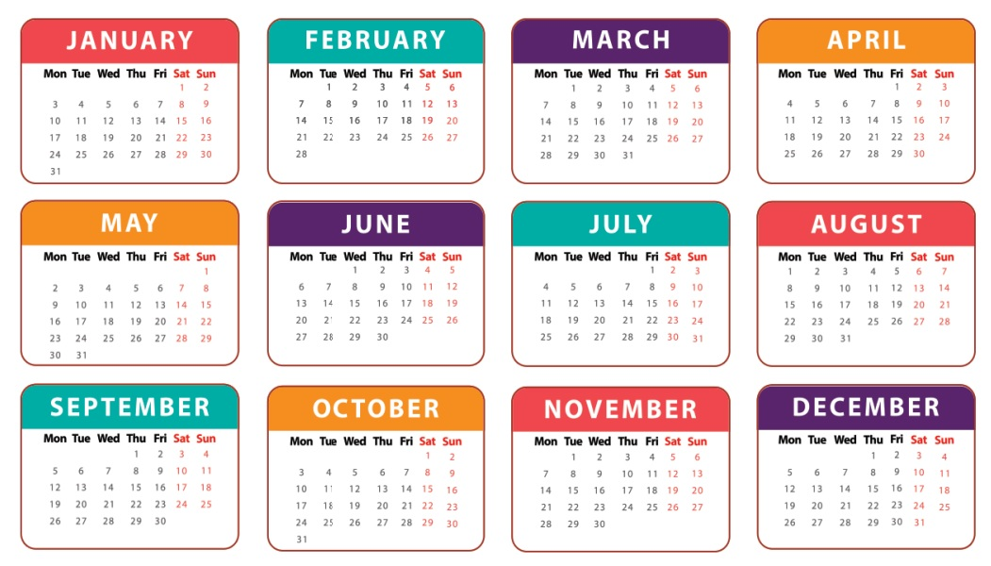

When’s your sports day?
It’s in August.

Slide 16
When’s your sports day?
It’s in September.

Slide 17
Is your sports day in June?
No, it isn’t. It’s in May.

