Slide 1
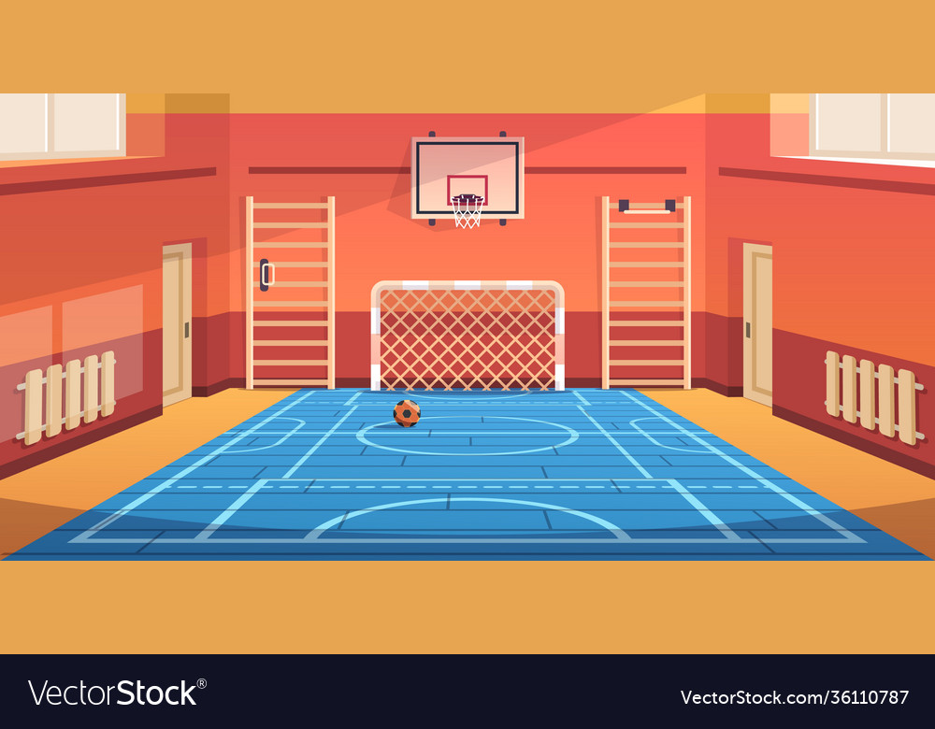




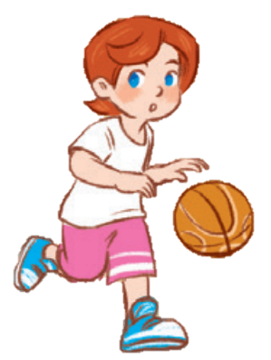
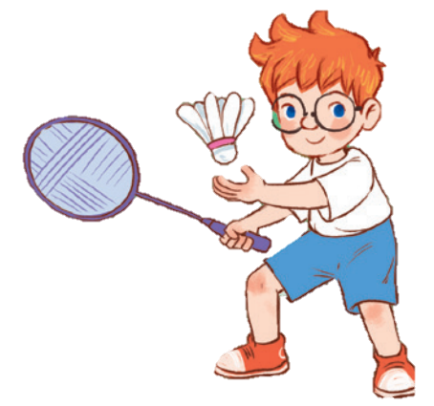
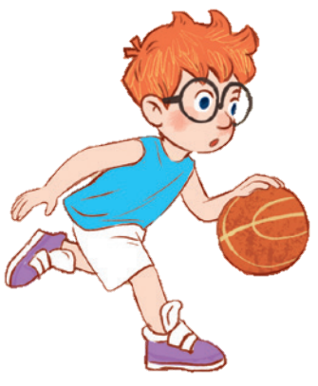
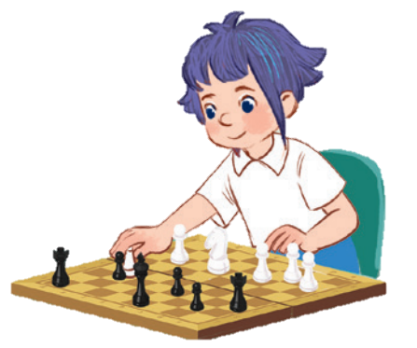
10
Period 6

Slide 2
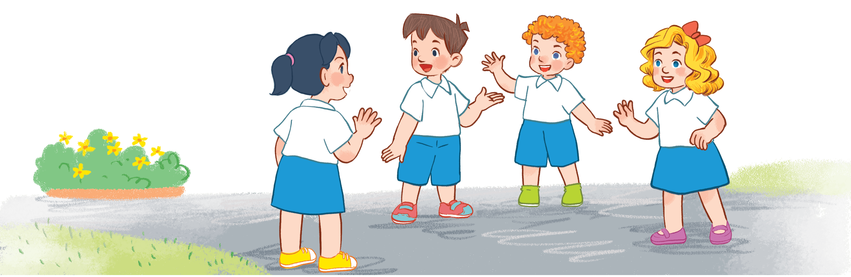
Warm-up and review
Notes:
Game: Picking flowers
- Teacher divides the class into groups of 4-5.
- Teacher lets the pupils choose the question numbers 1 - 8 (click to the flowers next to the numbers).
- When the members of groups answer correctly, they will get points by spinning the wheel (click to the big wheel) (points they can get: 1-4)
- Click on the 3-flower at the bottom to go back the WHEEL

Slide 3


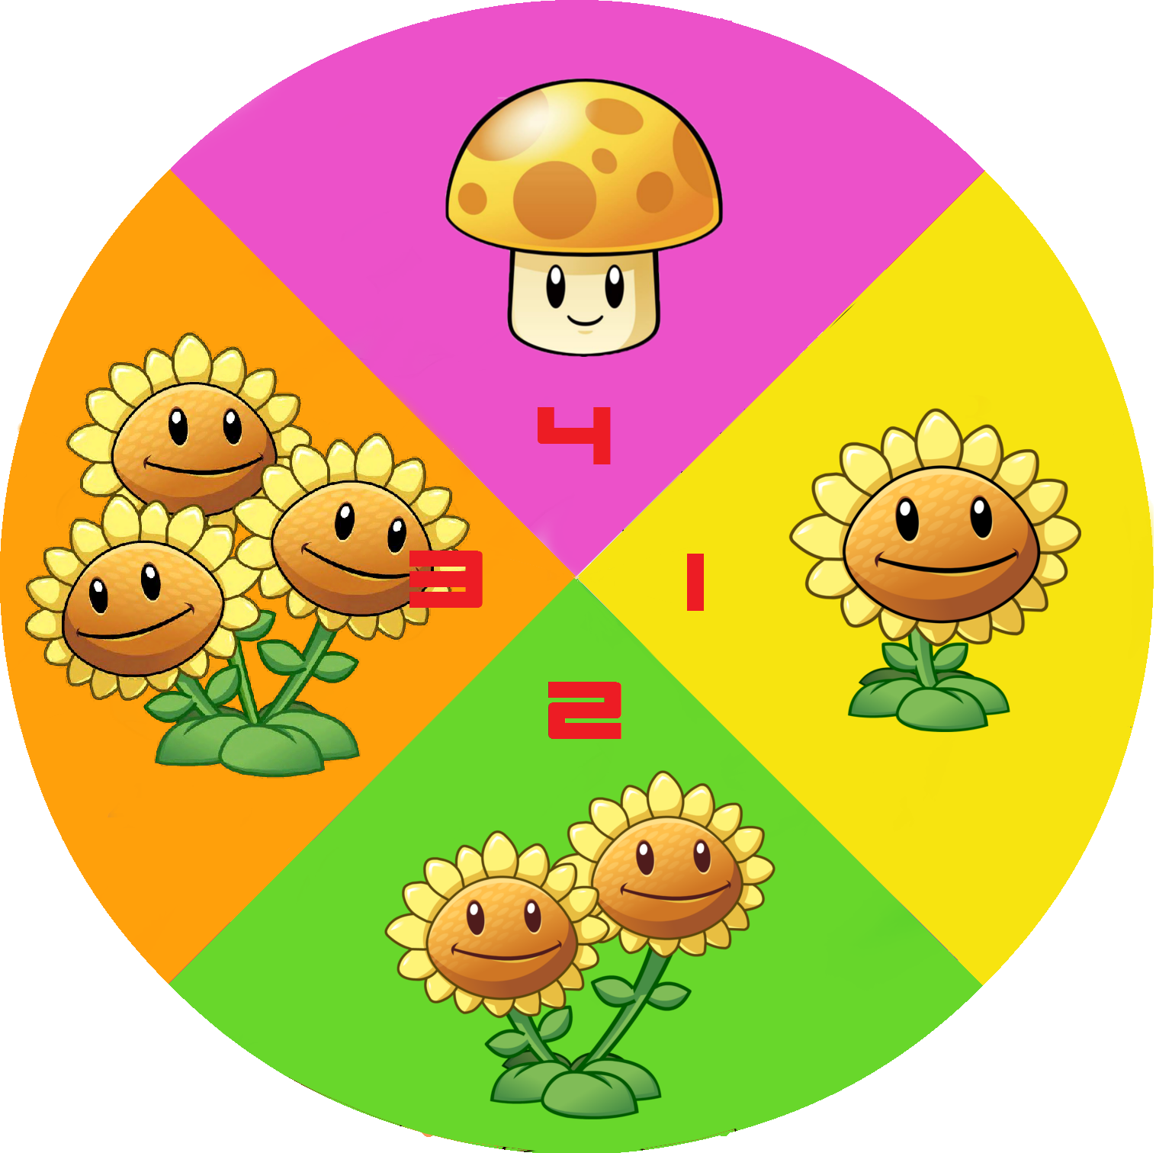
1
5
2
6
3
7
4
8
Notes:
Game: Picking flowers
- Teacher divides the class into groups of 4-5.
- Teacher lets the pupils choose the question numbers 1- 8 (click on the flowers next to the numbers).
- When the members of a group answer correctly, they will get points by spinning the wheel(click to the big wheel)(points they can get: 1-4).
- Click on the 3-flower to go back to the WHEEL.

Slide 4


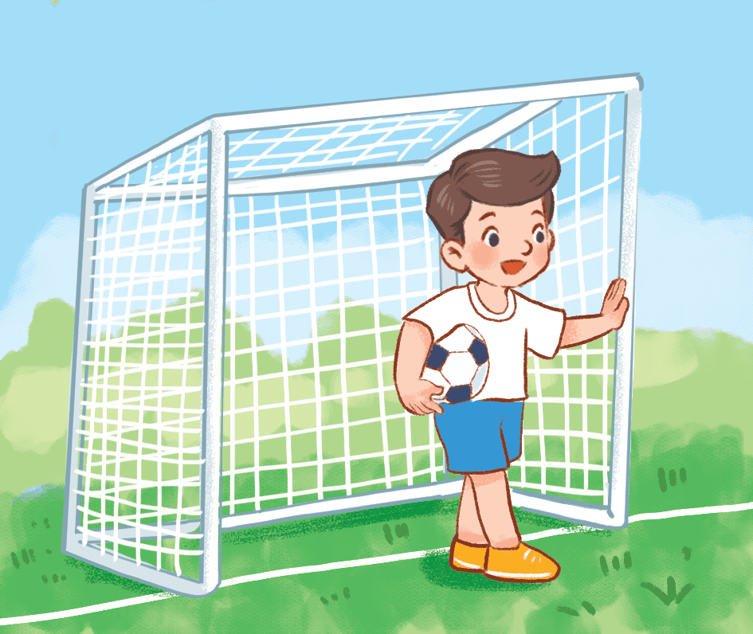
What do you do at break time?
I play football at break time.
Notes:
Click on the three flowers at the top right corner to go back to the WHEEL.

Slide 5
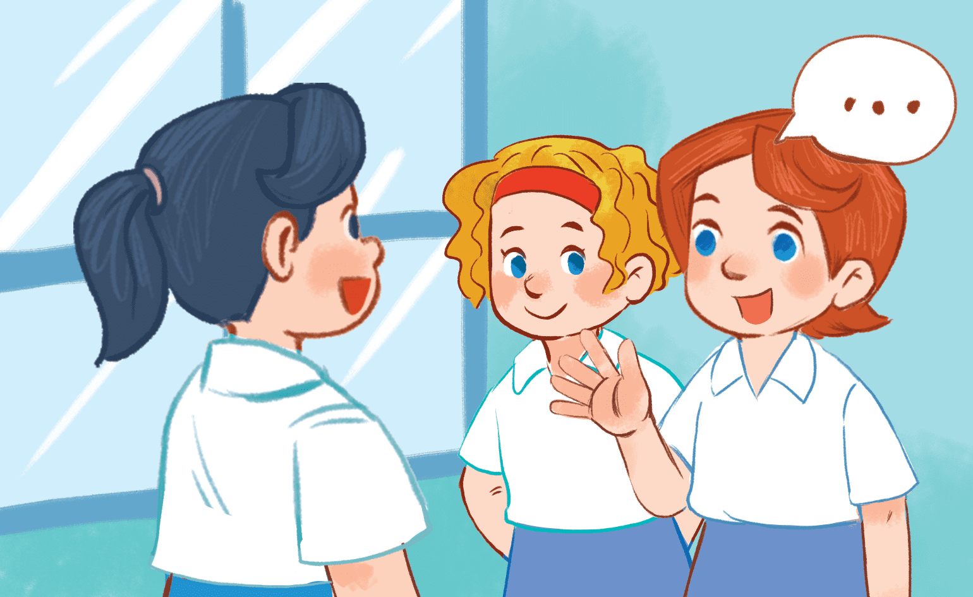
What do you do at break time?
I chat with my friends at break time.
Notes:
- Click on the three flowers at the top right corner to go back to the WHEEL.

Slide 6
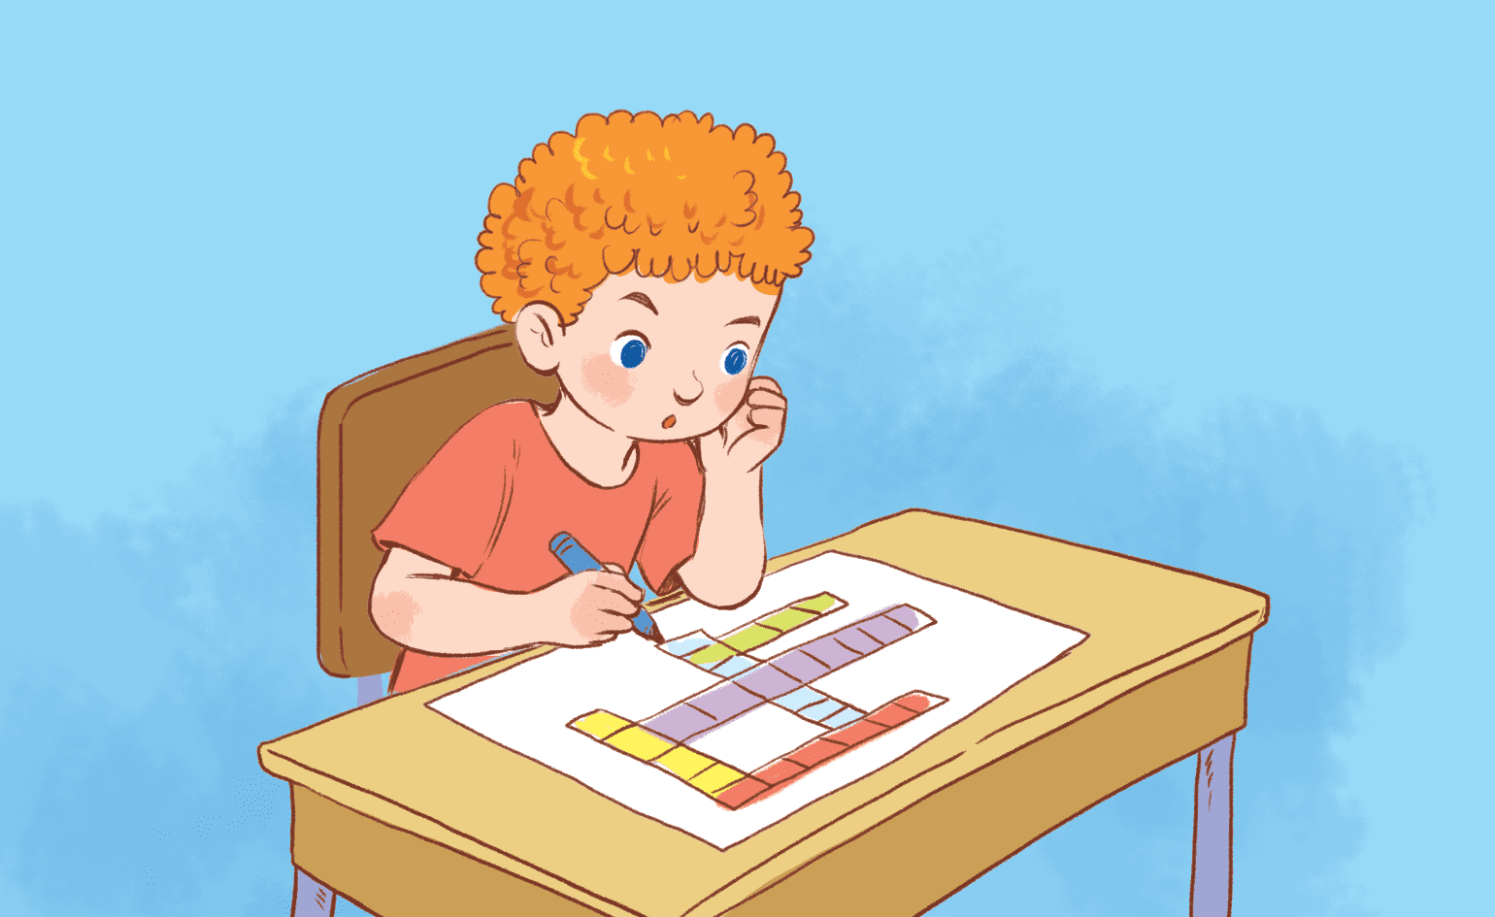
What do you do at break time?
I do word puzzles at break time.
Notes:
- Click on the 3-flower to go back to the WHEEL.

Slide 7
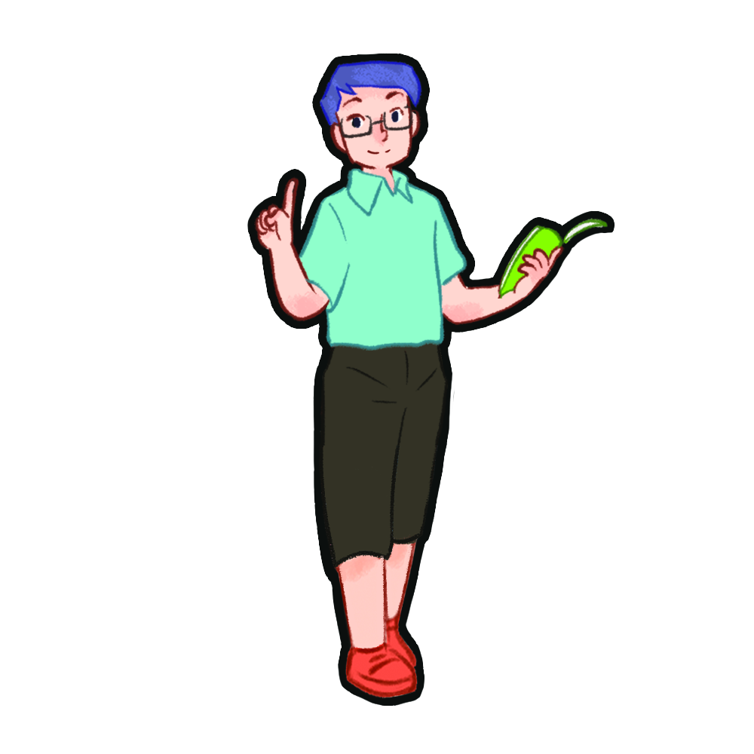
read and tick.

Slide 8
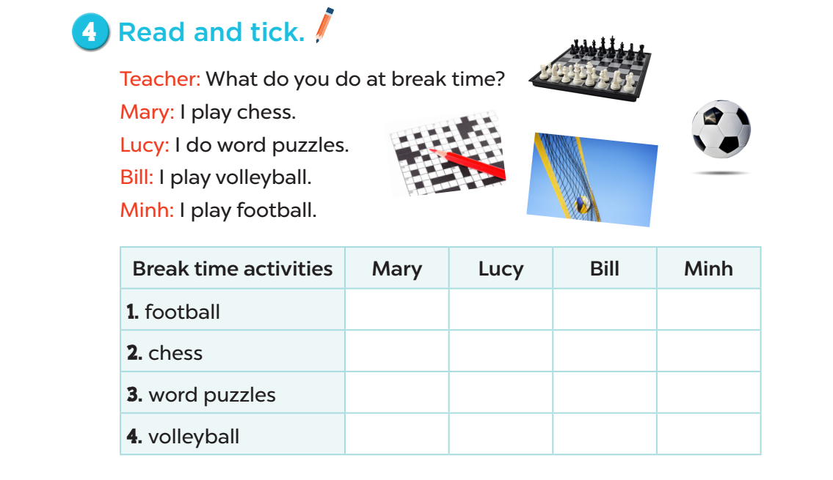


Slide 9
let’s write.

Slide 10

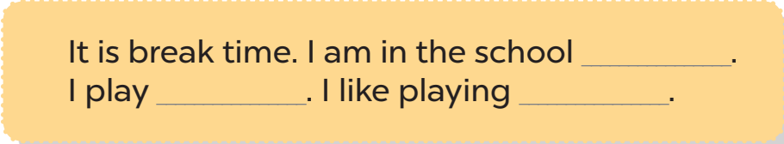
playground
chess
chess

Slide 11
project

Slide 12
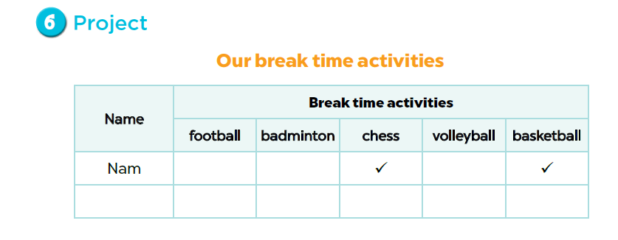

Slide 13
Fun corner and wrap-up

Slide 14












Who says fast?
Notes:
Game:
- Divide the class into 2 groups.
- Have pupils in each group take turns to stand up and say out loud their break time activities.
- Show the picture on the screen with 4 answers (there’s only one correct answer). Who can say the correct answer quickly will get points for his/her group.

Slide 15

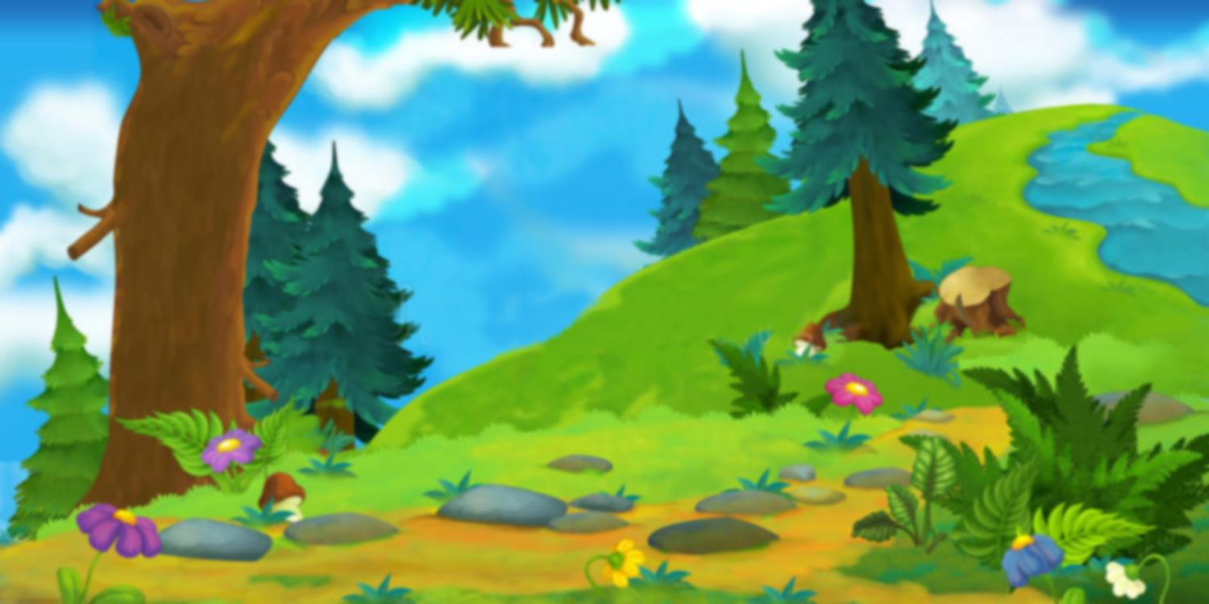

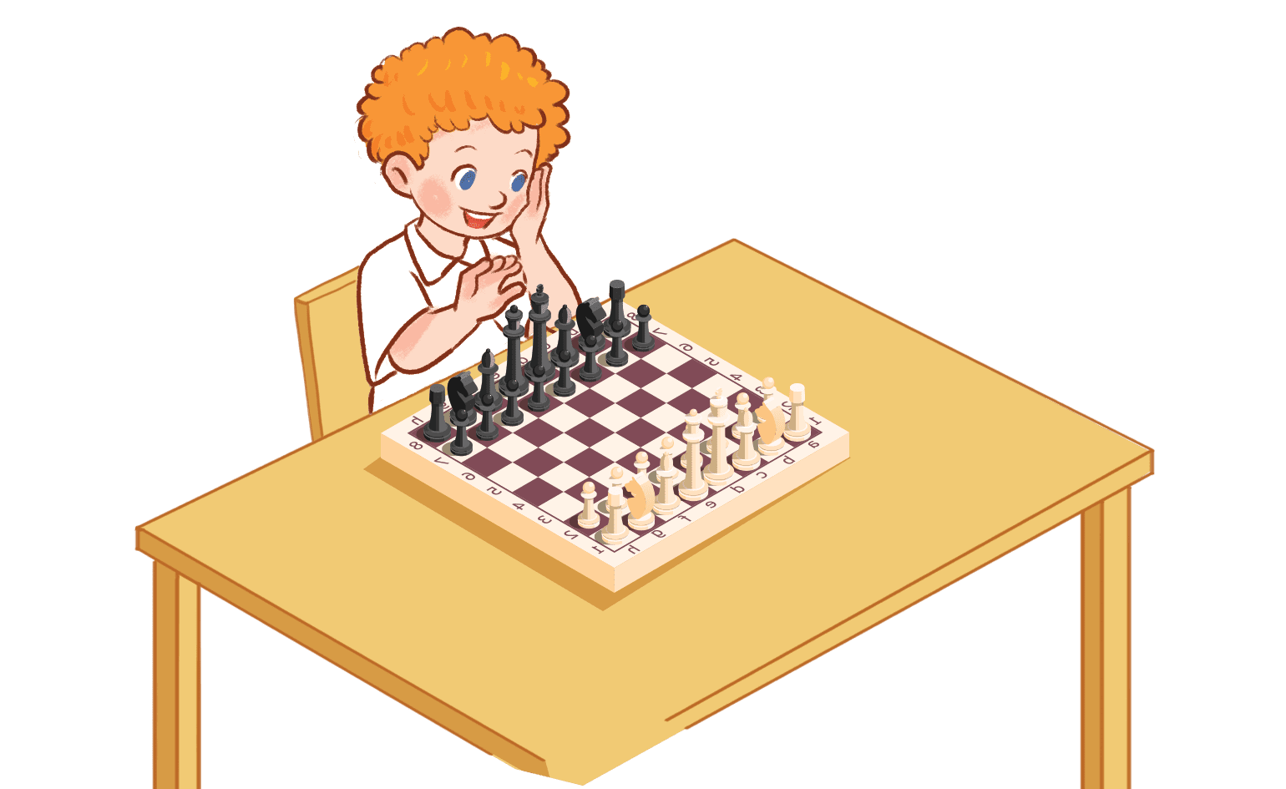





play volleyball
play basketball
play badminton
play chess
TIME OUT
YES

Slide 16
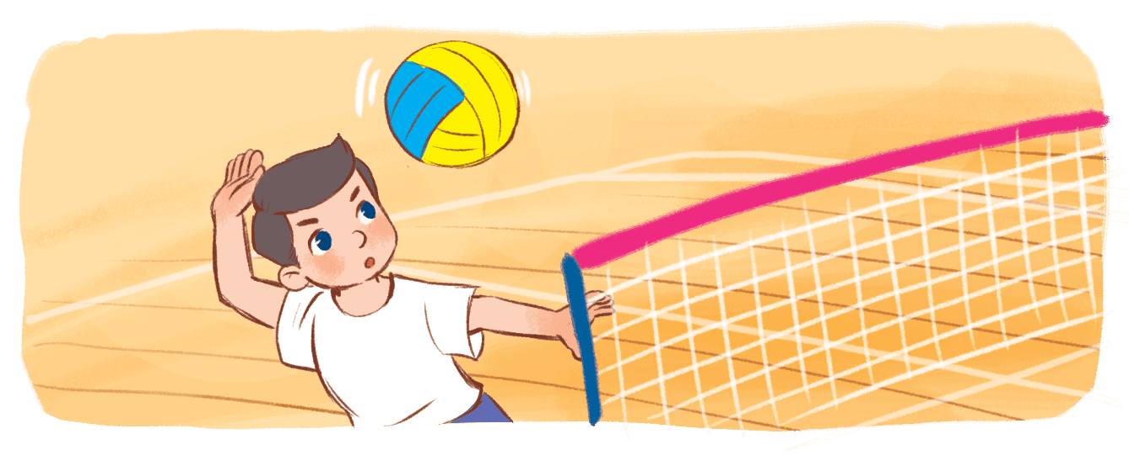



Play basketball
play volleyball
play chess
play badminton
TIME OUT
YES

Slide 17

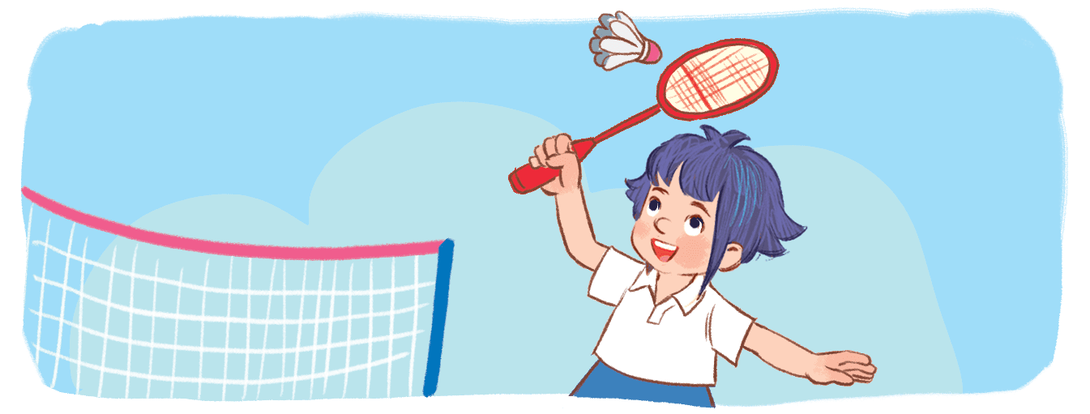


play badminton
play volleyball
play chess
play basketball
YES
TIME OUT

