Slide 1






Unit 8
IN OUR CLASSROOM
Lesson 1 – Period 2

Slide 2





/
TABLE OF CONTENTS
Warm-up & Review
Listen and tick or cross.
Read and complete.
Let’s sing.
Fun corner & Wrap-up

Slide 3




01
Warm-up & Review

Slide 4







Game
FLOWER BLOOMING

Slide 5








Game
FLOWER BLOOMING
Notes:
Click numbers to move to the Question slides.
Click the flower to disappear it.
Click the Red symbol to end the game (slide 20).

Slide 6







TEAM A
TEAM B
Notes:
Click Blue/Red/Green/Purple from each team in order to make their team’s flower bloom.
Click the Red symbol to end the game (slide 20).
Click the Blue symbol to back to the Number slide (slide 11).

Slide 7
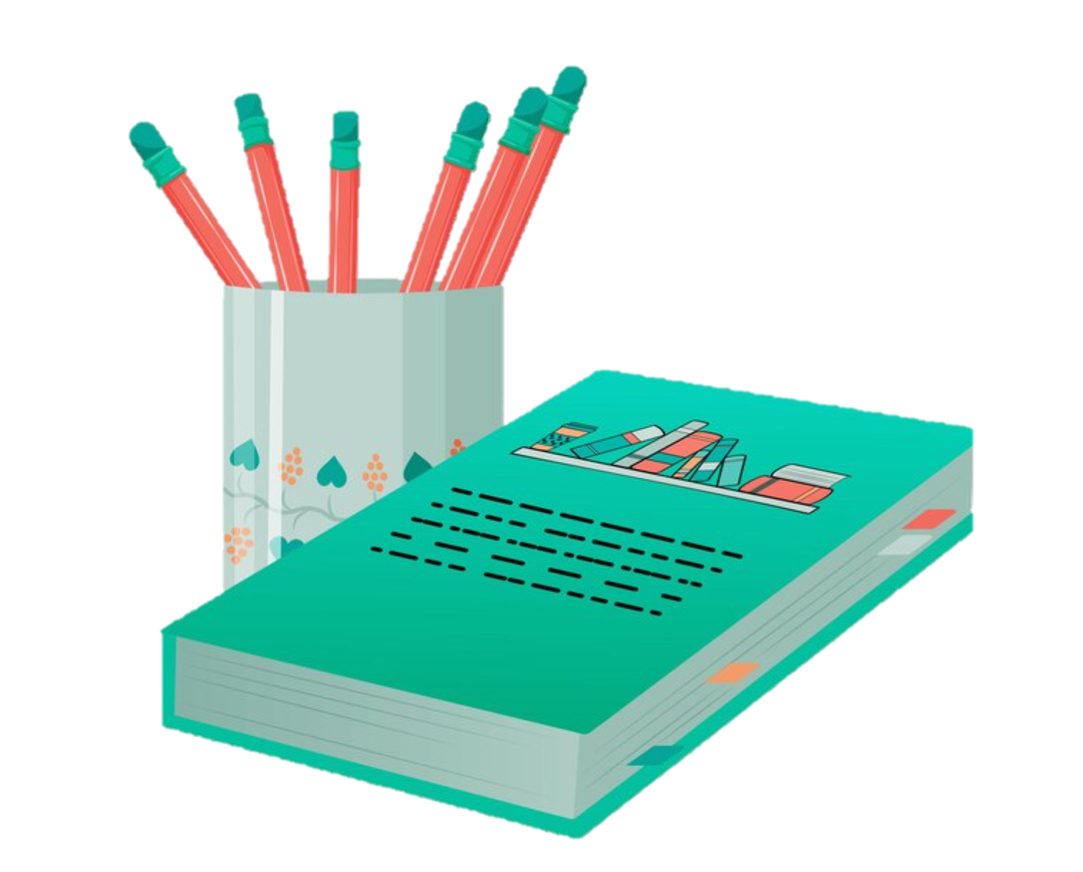


READ AND CHOOSE THE CORRECT ANSWERS.
under
above
A: Where are the pencils?
beside
B: They’re _____ the book.
Notes:
Click the instructions to back to the Score slide (slide 12).

Slide 8
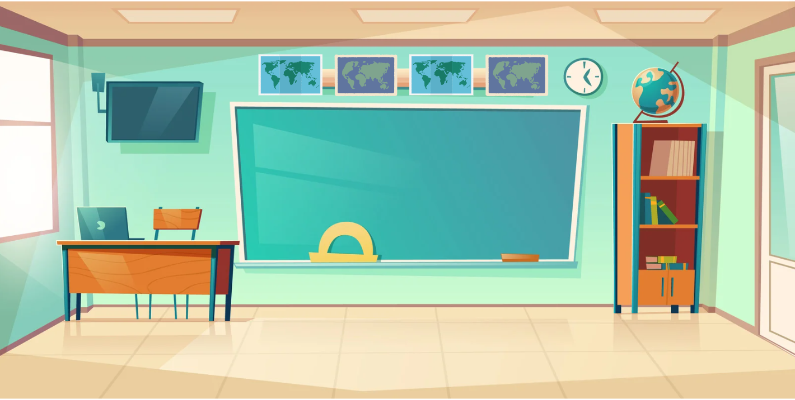
READ AND CHOOSE THE CORRECT ANSWERS.
under
above
A: Where are maps?
in front of
B: They’re _____ the board.
Notes:
Click the instructions to back to the Score slide (slide 12).

Slide 9
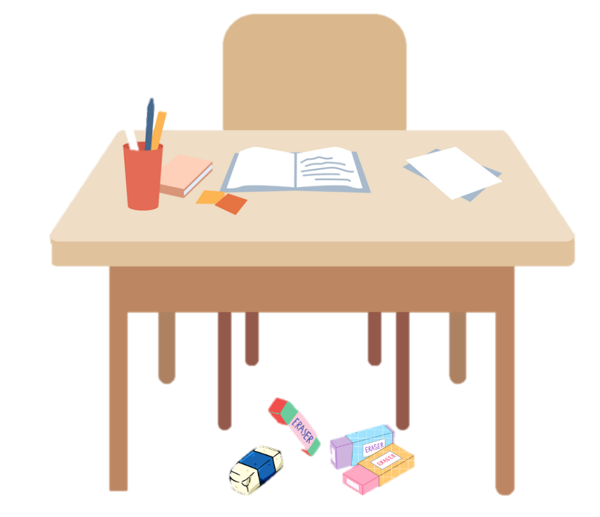
READ AND CHOOSE THE CORRECT ANSWERS.
under
beside
A: Where are erasers?
above
B:They’re ______ the desk.
Notes:
Click the instructions to back to the Score slide (slide 12).

Slide 10
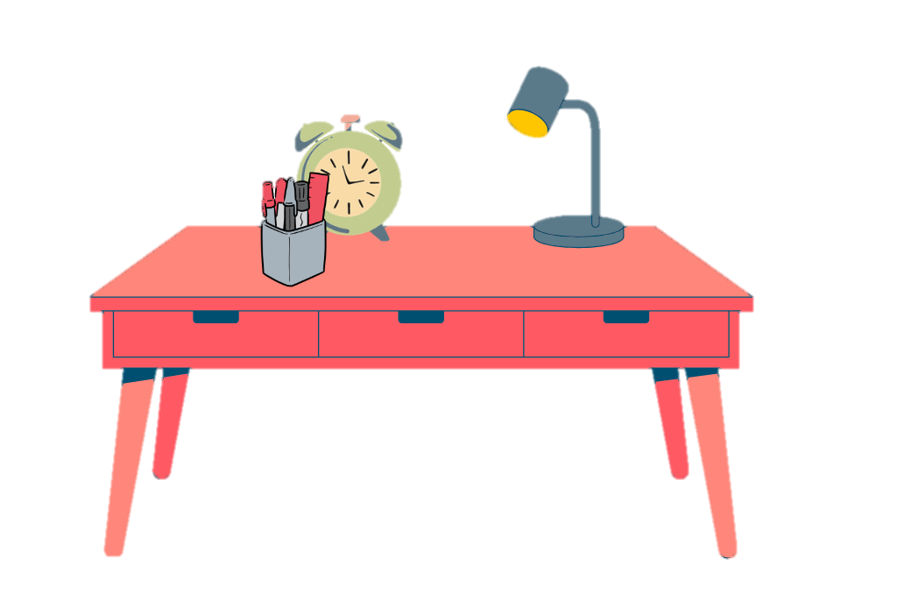
READ AND CHOOSE THE CORRECT ANSWERS.
under
in front of
A: Where are pens?
beside
B: They’re _____ the clock.
Notes:
Click the instructions to back to the Score slide (slide 12).

Slide 11

READ AND CHOOSE THE CORRECT ANSWERS.
under
above
A: Where are school bags?
on
B: They’re _____ the desk.
Notes:
Click the instructions to back to the Score slide (slide 12).

Slide 12
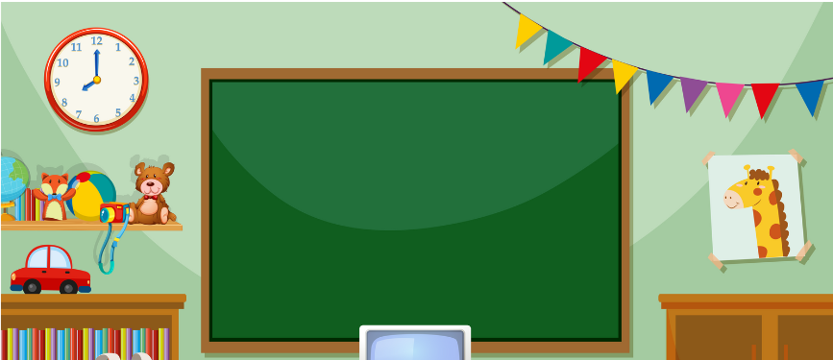
READ AND CHOOSE THE CORRECT ANSWERS.
beside
above
A: Where is the clock?
on
B: It’s _____ the bookcase.
Notes:
Click the instructions to back to the Score slide (slide 12).

Slide 13
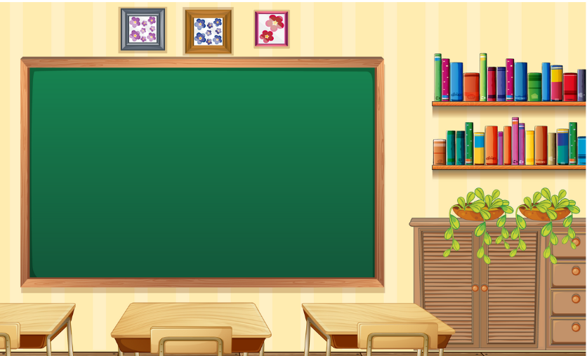
READ AND CHOOSE THE CORRECT ANSWERS.
above
in front of
A: Where is the bookcase?
beside
B: It’s _____ the board.
Notes:
Click the instructions to back to the Score slide (slide 12).

Slide 14
02
Listen and tick or cross.

Slide 15




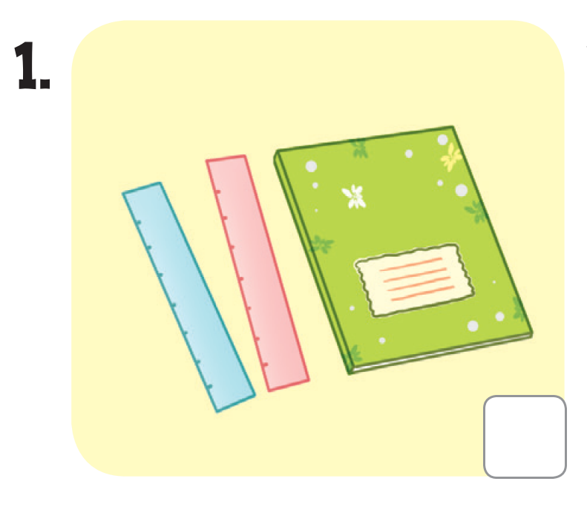
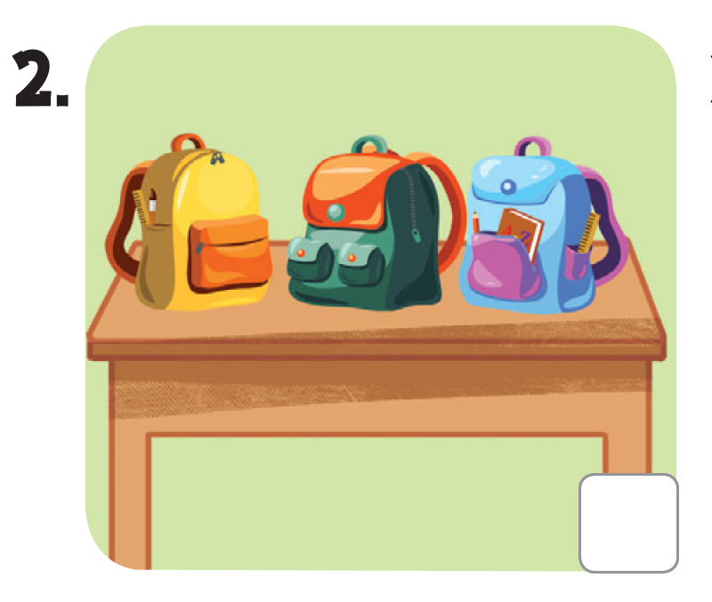
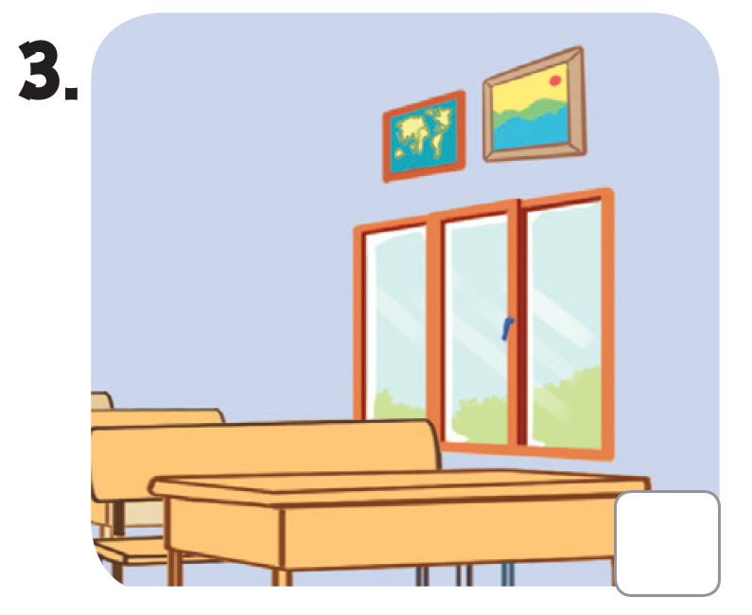
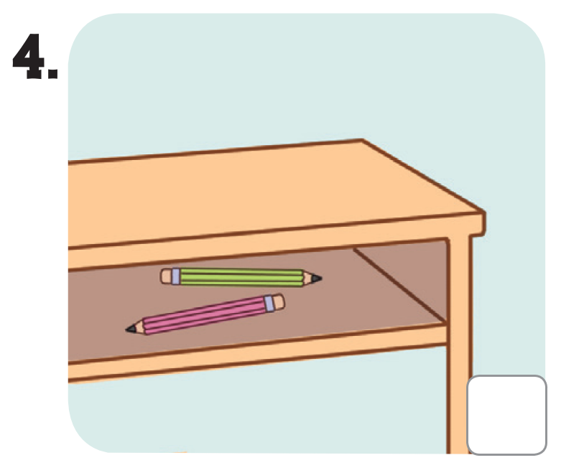

LOOK AND SAY.

Slide 16

LISTEN AND POINT.

Slide 17


LISTEN AND TICK OR CROSS.

Slide 18





SWAP YOUR BOOKS!
Notes:
Step 3: Get pupils to swap books with a partner to check their answers before checking as a class. Correct the answers if necessary.

Slide 19

LET’S CHECK!

Slide 20
03
Read and complete.

Slide 21





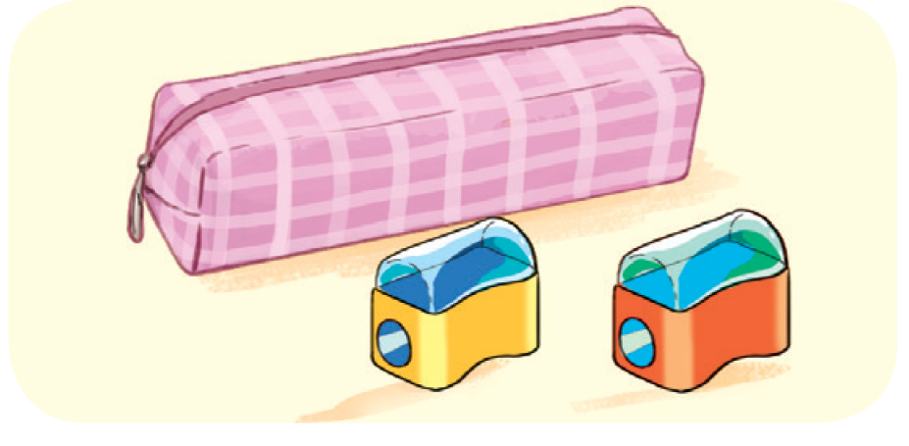
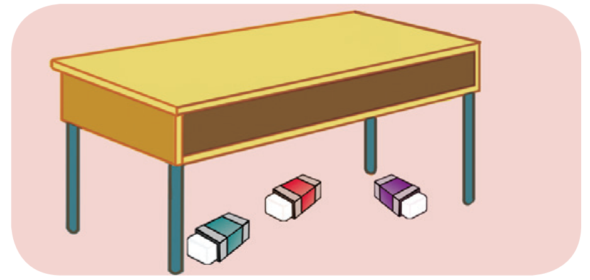
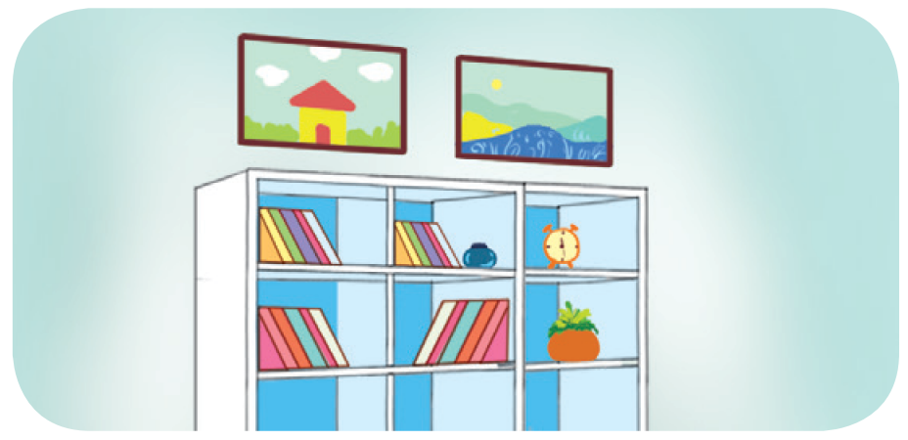
LOOK AND SAY

Slide 22




LOOK AND GUESS.
A: Where are the pens?
B: They’re _________ the notebook.

Slide 23

LOOK AND GUESS.
2. A: Where ___ the pencil sharpeners?
B: They’re in front of _____.

Slide 24
LOOK AND GUESS.
3. A: Are the ______ on the desk?
B: No, they aren’t.
A: Where are they?
B: They are __________ the desk.

Slide 25
LOOK AND GUESS.
4. A: ___________ are the pictures?
B: They’re _________ the bookcase.
A: Thank you.

Slide 26
READ AND COMPLETE.
A: Where are the pens?
B: They’re _______ the notebook.
beside

Slide 27

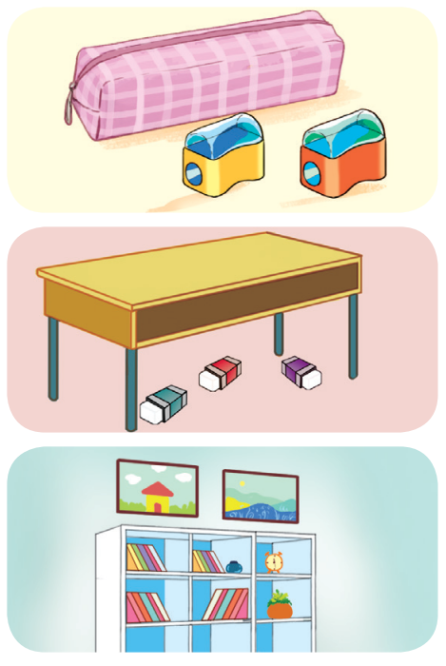
READ AND COMPLETE.
2. A: Where _____ the pencil sharpeners?
B: They’re in front of _________.
3. A: Are the __________ on the desk?
B: No, they aren’t.
A: Where are they?
B: They are __________ the desk.
4. A: ___________ are the pictures?
B: They’re _________ the bookcase.
A: Thank you.

Slide 28
SWAP YOUR BOOKS!

Slide 29
LET’S CHECK!
2. A: Where ____ the pencil sharpeners?
B: They’re in front of _______________.
are
the pencil case

Slide 30
LET’S CHECK!
3. A: Are the _______ on the desk?
B: No, they aren’t.
A: Where are they?
B: They are ______ the desk.
erasers
under

Slide 31
LOOK AND GUESS.
4. A: _______ are the pictures?
B: They’re _______ the bookcase.
A: Thank you.
Where
above

Slide 32




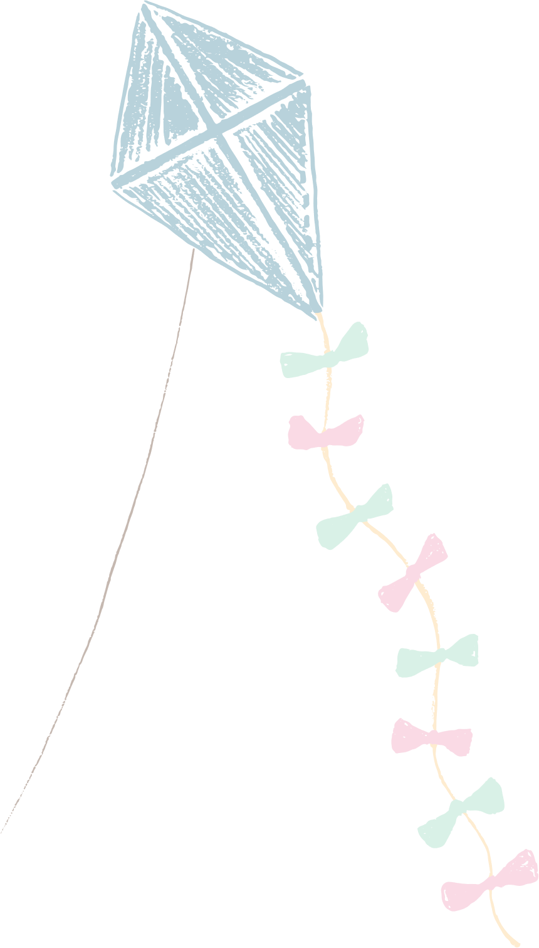






Slide 33
04
Let’s sing.

Slide 34



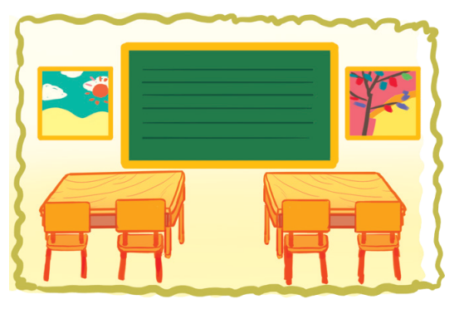
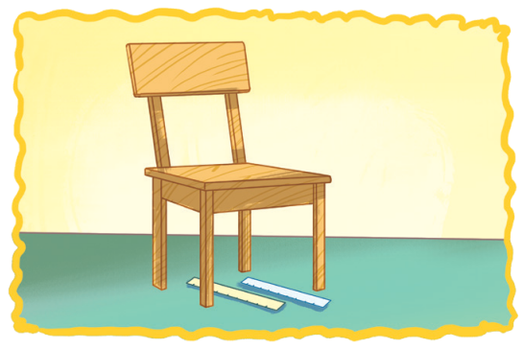

LOOK AND POINT.
WHERE ARE THEY?
Pictures, pictures, pictures.
Where are the pictures?
Beside the board.
Beside the board.
They’re beside the board.
Rulers, rulers, rulers.
Where are the rulers?
Under the chair.
Under the chair.
They’re under the chair.

Slide 35


LISTEN AND POINT.
WHERE ARE THEY?
Pictures, pictures, pictures.
Where are the pictures?
Beside the board.
Beside the board.
They’re beside the board.

Slide 36
LISTEN AND POINT.
WHERE ARE THEY?
Rulers, rulers, rulers.
Where are the rulers?
Under the chair.
Under the chair.
They’re under the chair.

Slide 37
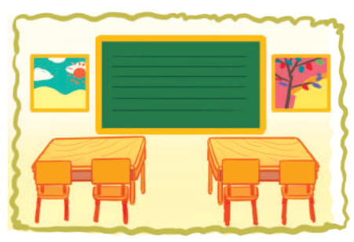
LISTEN AND REPEAT.
WHERE ARE THEY?
Pictures, pictures, pictures.
Where are the pictures?
Beside the board.
Beside the board.
They’re beside the board.

Slide 38
LISTEN AND REPEAT.
WHERE ARE THEY?
Rulers, rulers, rulers.
Where are the rulers?
Under the chair.
Under the chair.
They’re under the chair.

Slide 39
LISTEN AND SING.
WHERE ARE THEY?
Pictures, pictures, pictures.
Where are the pictures?
Beside the board.
Beside the board.
They’re beside the board.
Rulers, rulers, rulers.
Where are the rulers?
Under the chair.
Under the chair.
They’re under the chair.

Slide 40
SING AND CLAP.
WHERE ARE THEY?
Pictures, pictures, pictures.
Where are the pictures?
Beside the board.
Beside the board.
They’re beside the board.
Rulers, rulers, rulers.
Where are the rulers?
Under the chair.
Under the chair.
They’re under the chair.

Slide 41
05
Fun corner & Wrap-up

Slide 42














Game
ANGRY BIRDS
Let’s start!

Slide 43








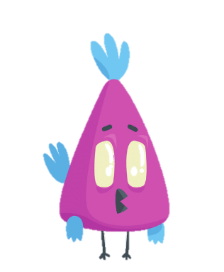


ANGRY BIRDS
Let’s choose a number.
Notes:
Click on the number to move to the Question slide.
Click on the red symbol at the right bottom to end the game.

Slide 44




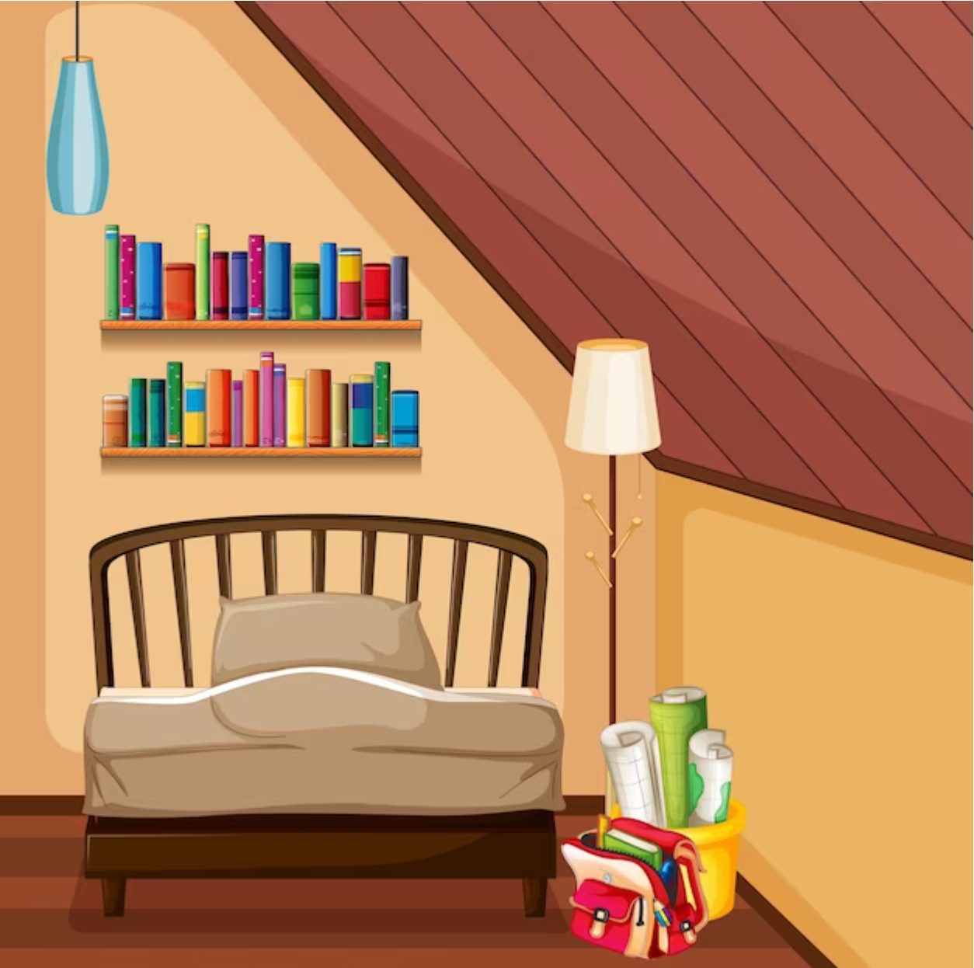




LOOK AND ANSWER.
A: Where are the books?
They’re on the bookcase.
B: ___________________
Notes:
Click on the Answer to back to the Number slide.

Slide 45



LOOK AND ANSWER.
A: Where are the pens?
They’re under the table.
B: _________________
Notes:
Click on the Answer to back to the Number slide.

Slide 46
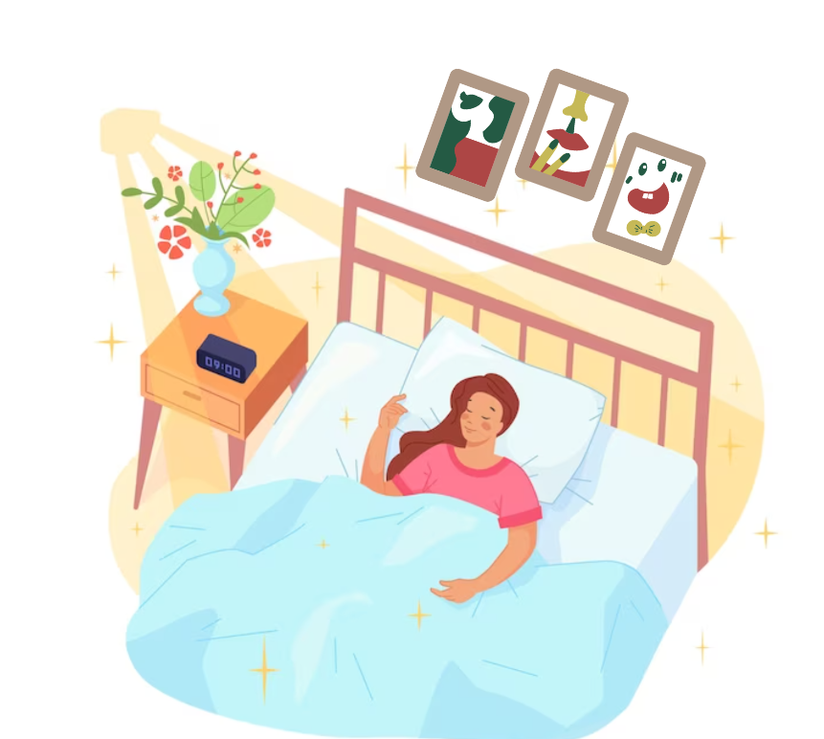
LOOK AND ANSWER.
A: Where are the pictures?
They’re above the bed.
B: _________________
Notes:
Click on the Answer to back to the Number slide.

Slide 47
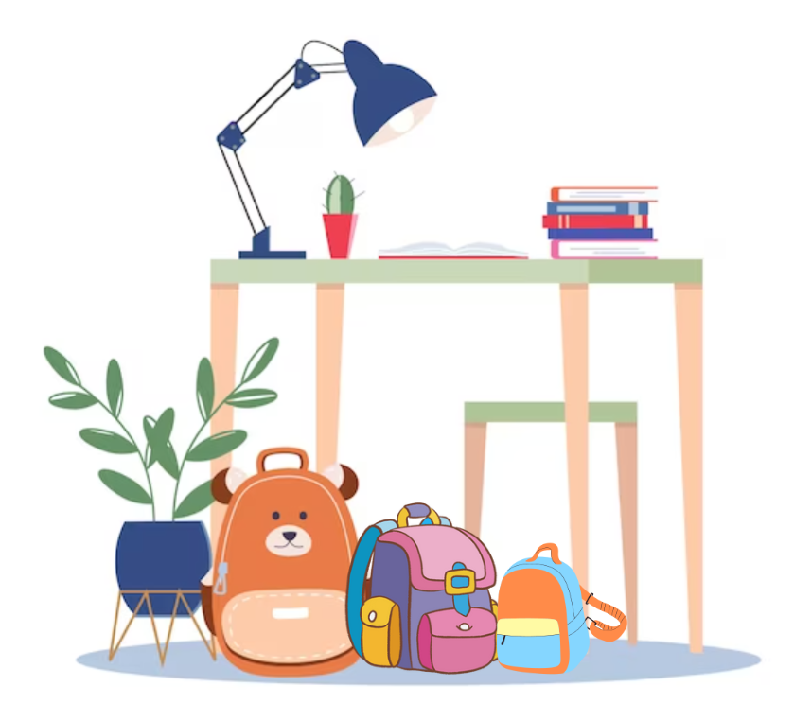
LOOK AND ANSWER.
A: Where are the bags?
They’re beside the plant.
B: __________________
Notes:
Click on the Answer to back to the Number slide.

Slide 48
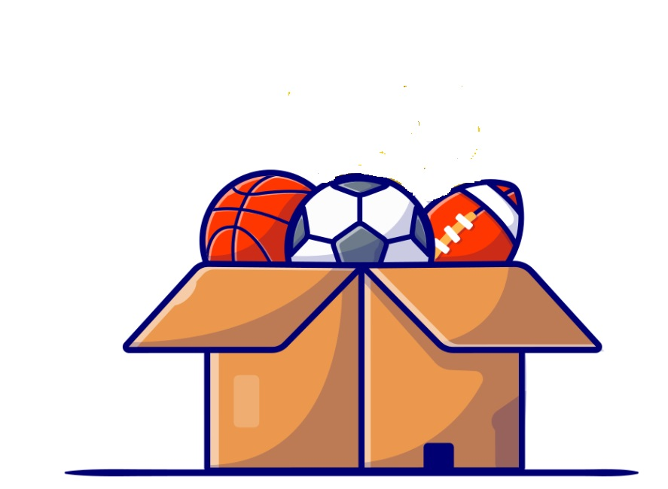
LOOK AND ANSWER.
A: Where are the balls?
They’re in the box.
B: ______________
Notes:
Click on the Answer to back to the Number slide.

Slide 49
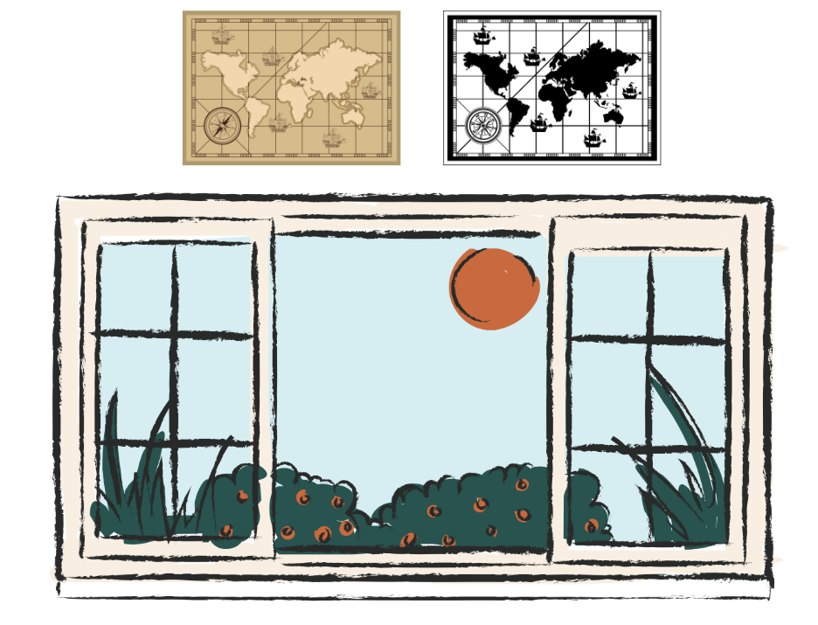
LOOK AND ANSWER.
A: Where are the maps?
They’re above the window.
B: ____________________
Notes:
Click on the Answer to back to the Number slide.

Slide 50
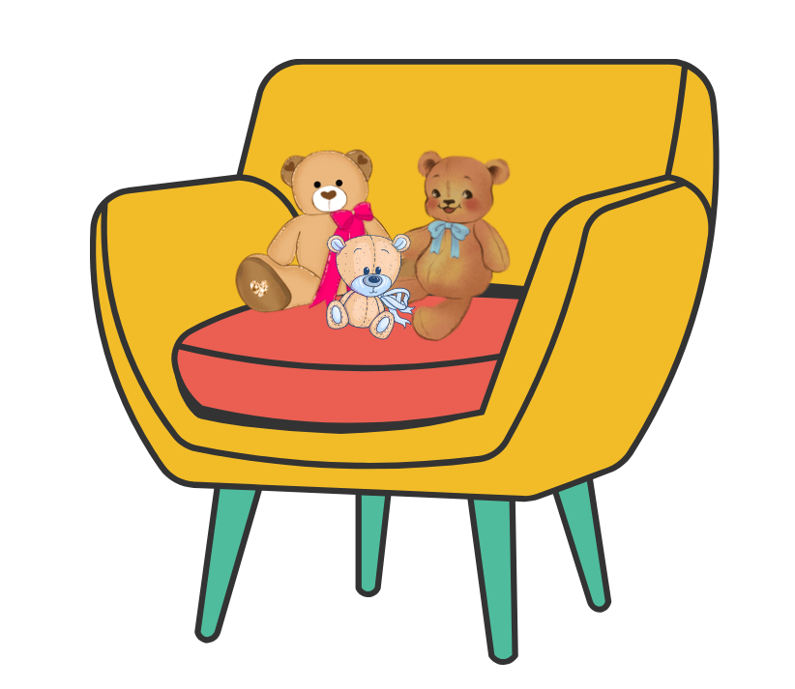
LOOK AND ANSWER.
A: Where are the teddy bears?
They’re on the chairs.
B: _________________
Notes:
Click on the Answer to back to the Number slide.

Slide 51
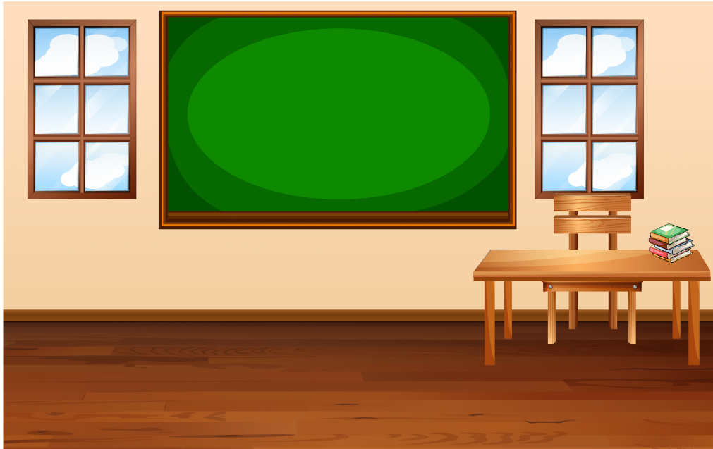
LOOK AND ANSWER.
A: Where are the windows?
They’re beside the board.
B: ___________________
Notes:
Click on the Answer to back to the Number slide.

Slide 52




Good Job!

