Slide 1


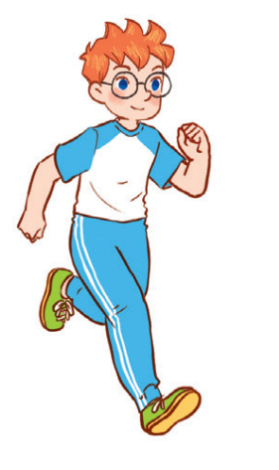
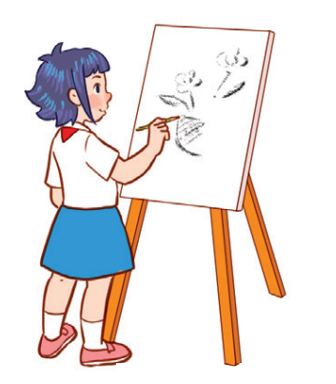

Unit 8
Period 2

Slide 2
Contents
1
Warm-up and review
2
3
4
Listen and tick or cross.
Look, complete and read.
Let’s play.
5
Fun corner and wrap-up

Slide 3
Warm-up and review
Warm-up and review
1
1
1
Game: Who’s faster?

Slide 4
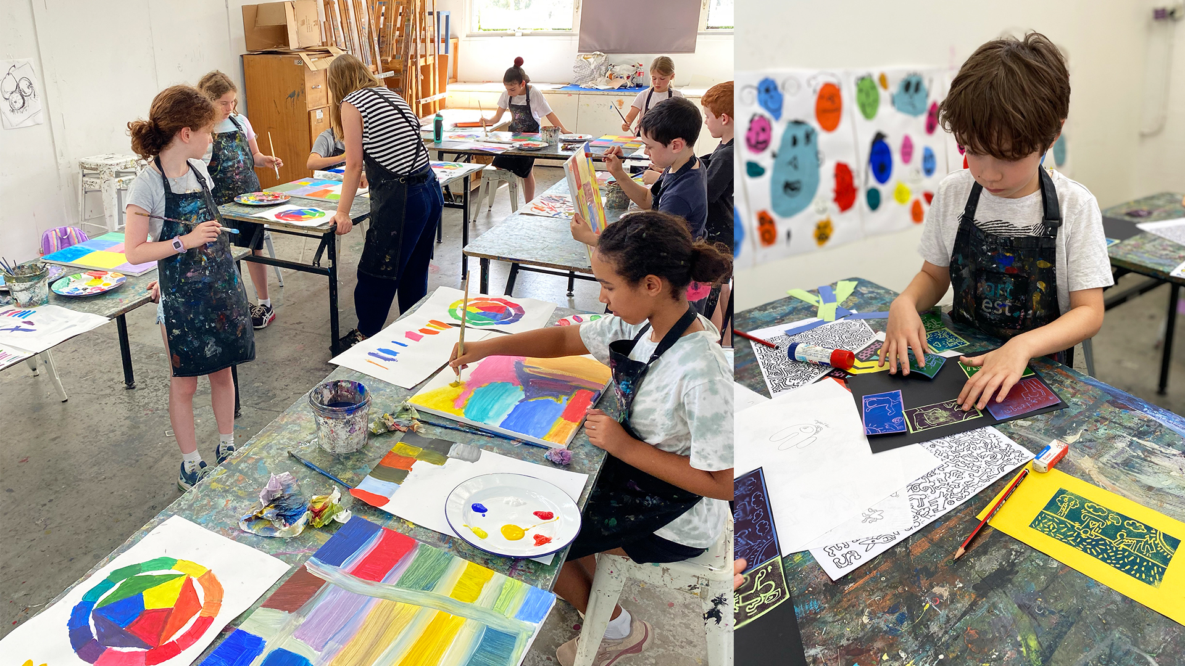
LOOK AT THE PICTURES, SAY THEN SPELL!
art

Slide 5

PE

Slide 6

music

Slide 7

IT

Slide 8

Listen and tick or cross.
2
2

Slide 9
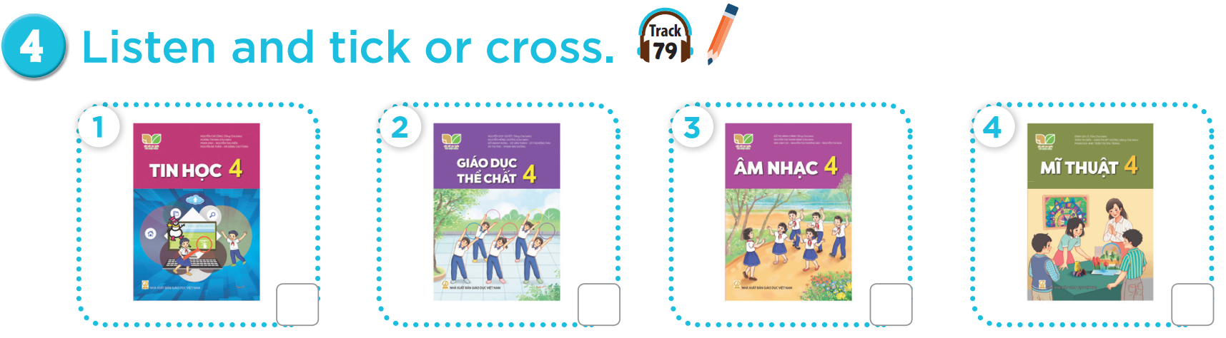


Slide 10
✓
✗
✓
✗

Slide 11
Look, complete and read.
3
3

Slide 12

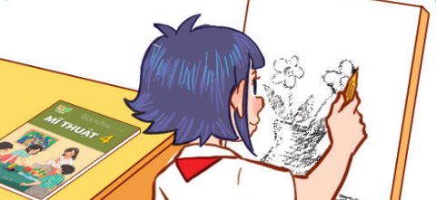



Slide 13
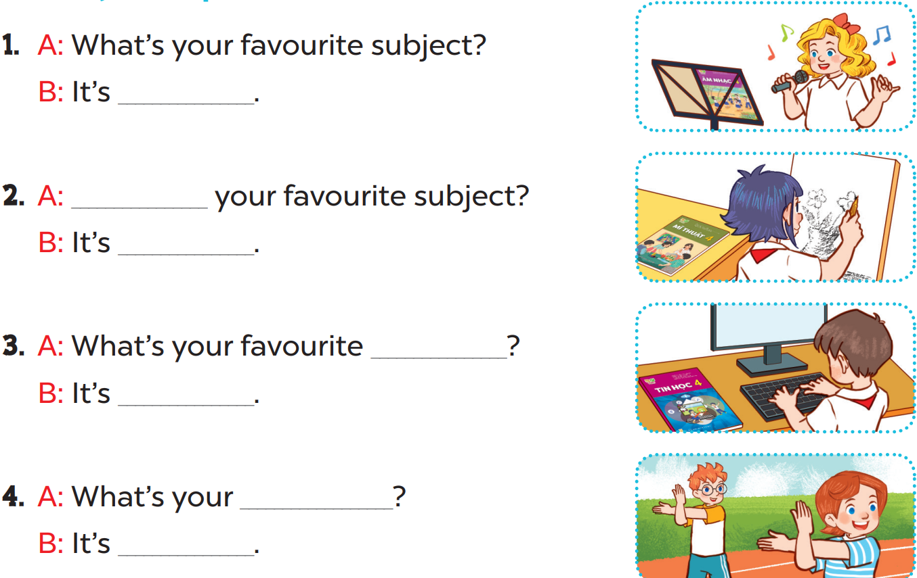

Slide 14
music
What’s
art
subject
IT
favourite subject
PE

Slide 15

Let’s sing.
4
4

Slide 16
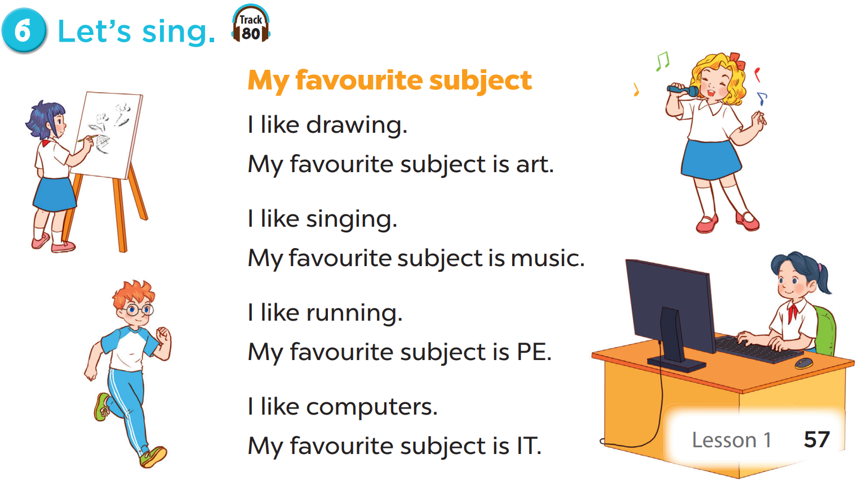

Slide 18
Fun corner and wrap-up
5
5
Game: Anagram

Slide 19
Make a sentence. What’s missing?
E
C
T
I
I
R
S
U
U
T
O
M
V
M
S
C
A
E
U
J
B
Y
F

