Slide 1




Welcome to English class!
English 5
Unit 4: Our free-time activities
Teacher: Ba Thi Quyen

Slide 2






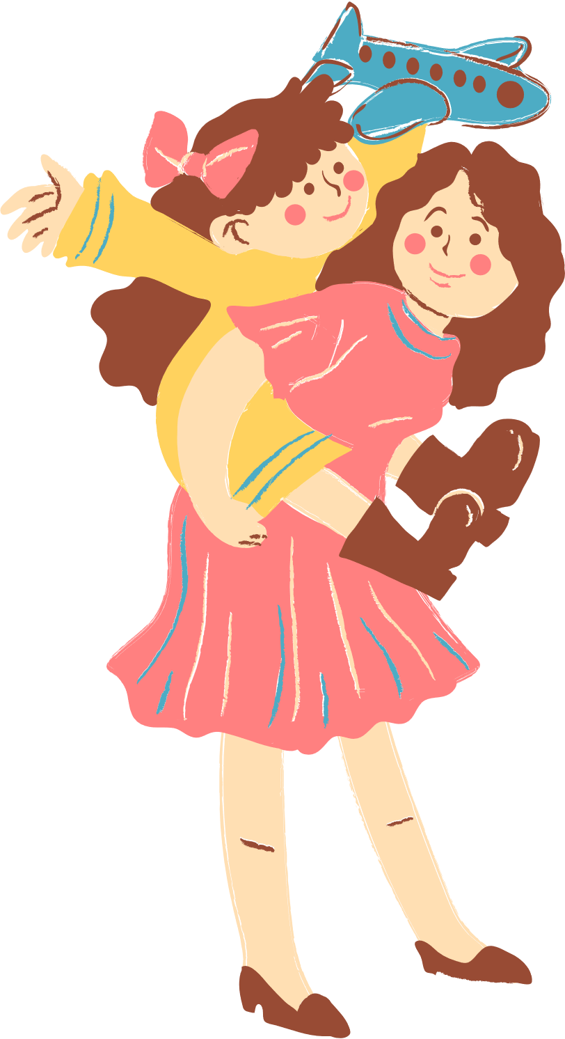
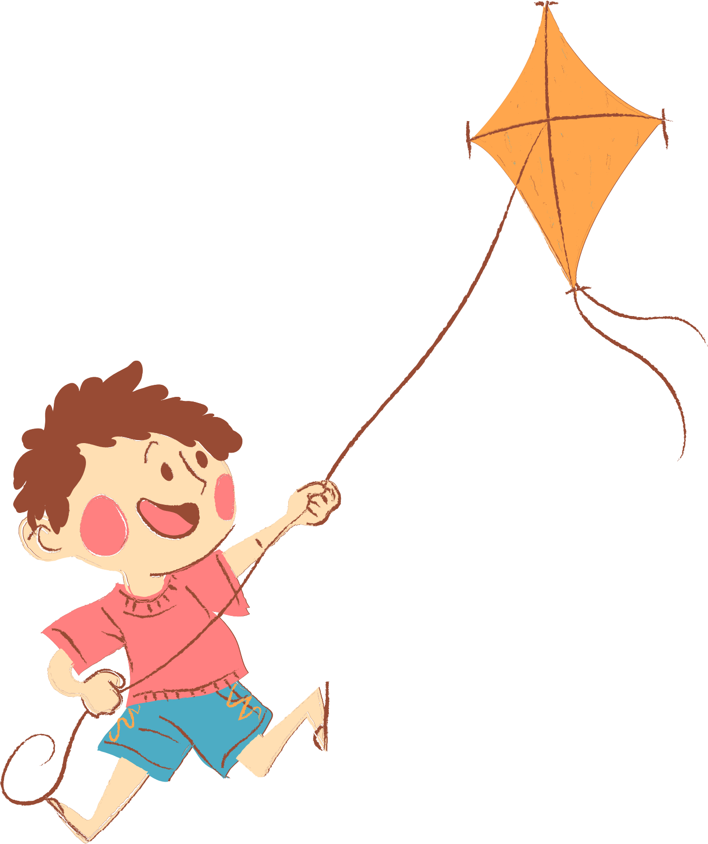
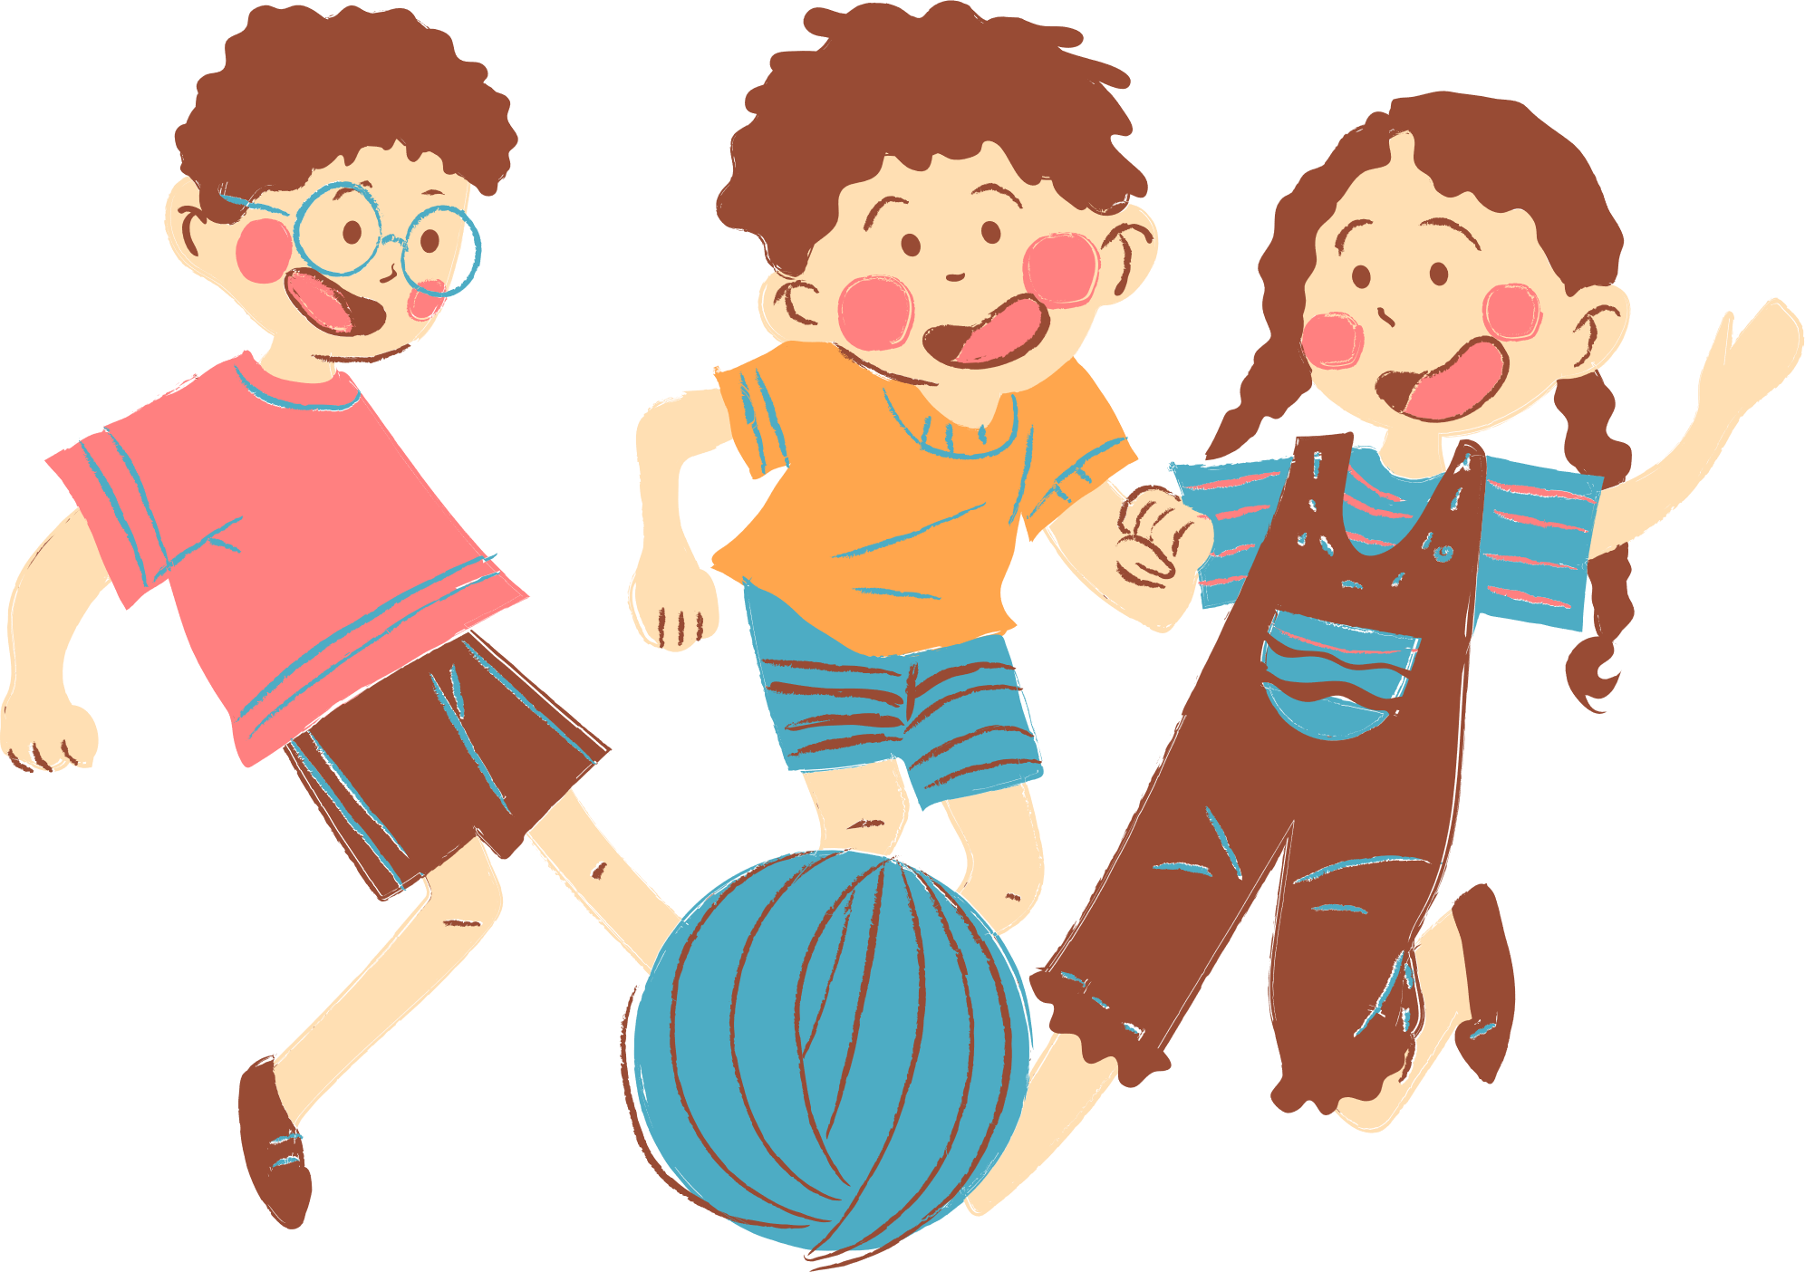
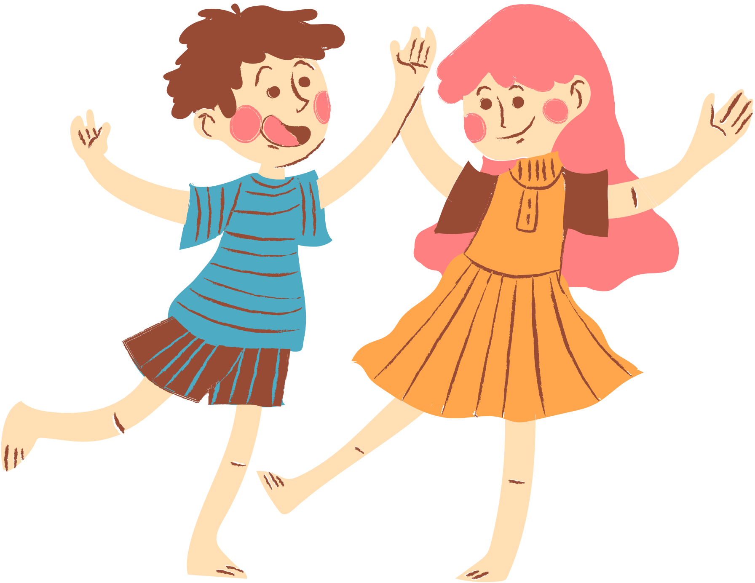
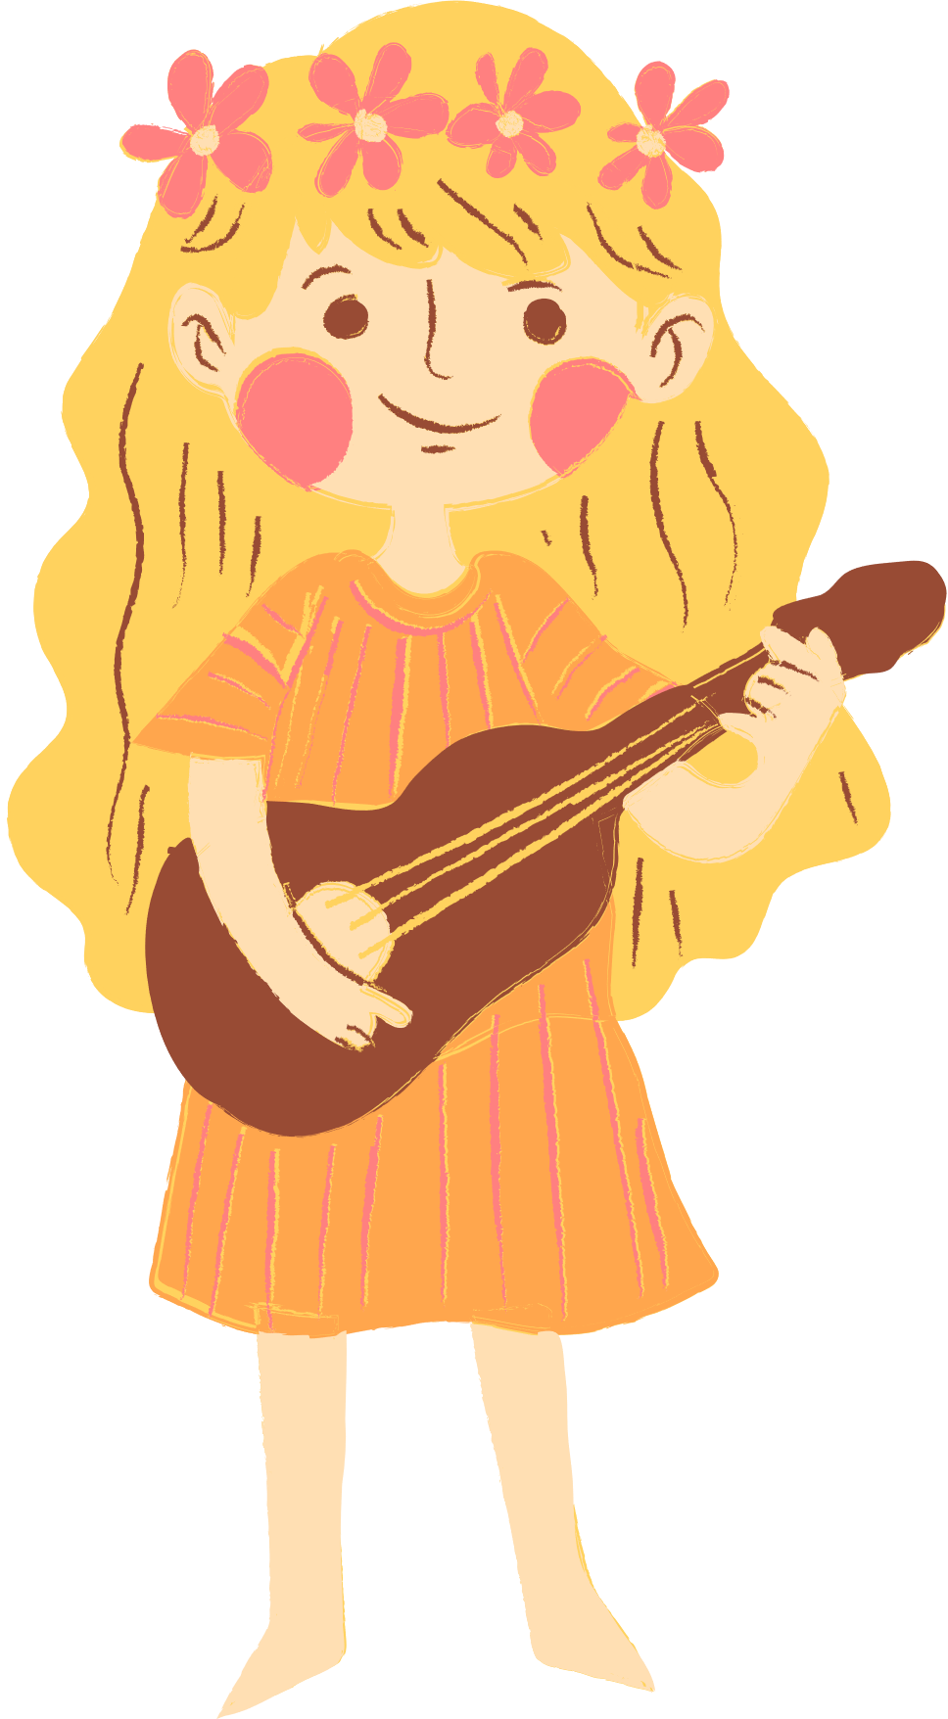
Warm-up:
Let’s chant.

Slide 3
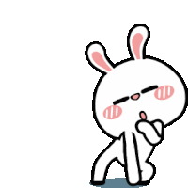


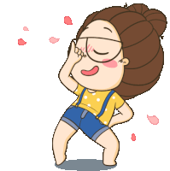
Cook Cook Cook I like cooking.
Sing Sing Sing I like singing.
Dance Dance Dance I like dancing.
Swim Swim Swim I like swimming.
Jump Jump Jump I like jumping.

Slide 4




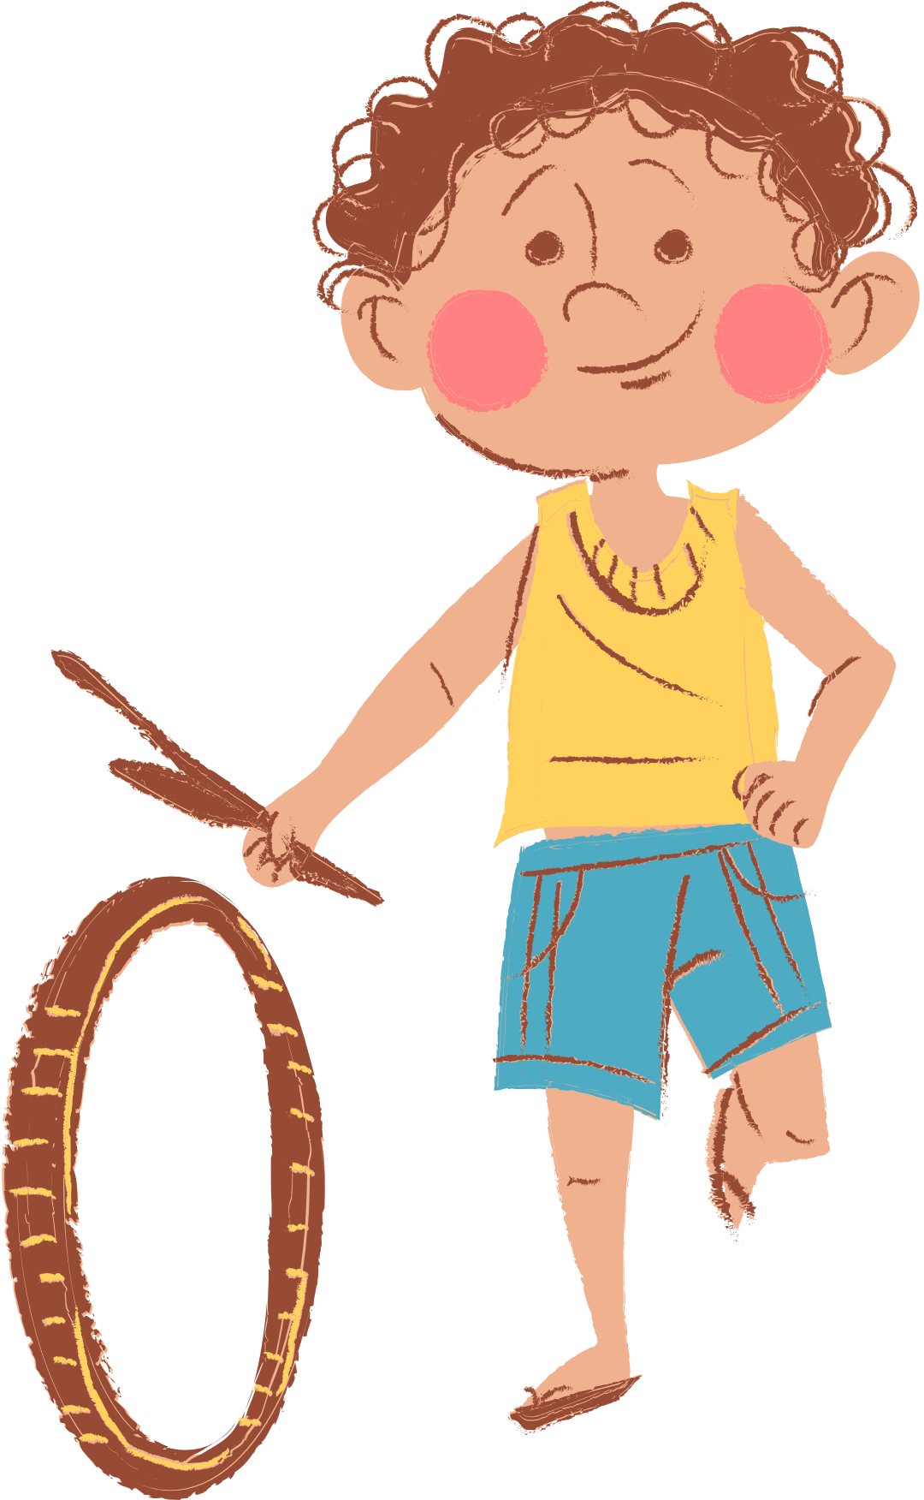
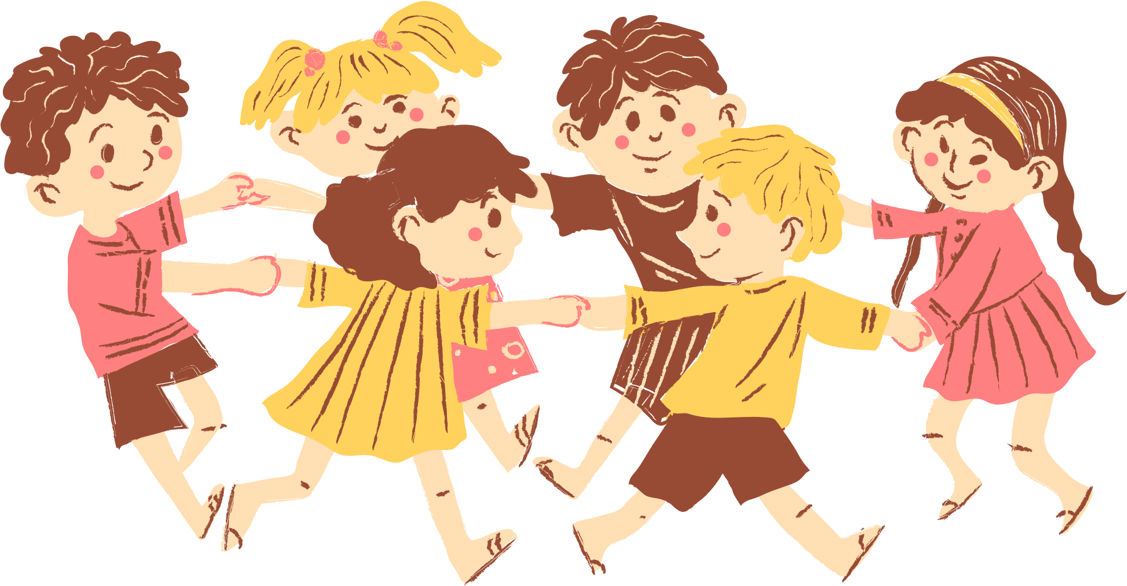
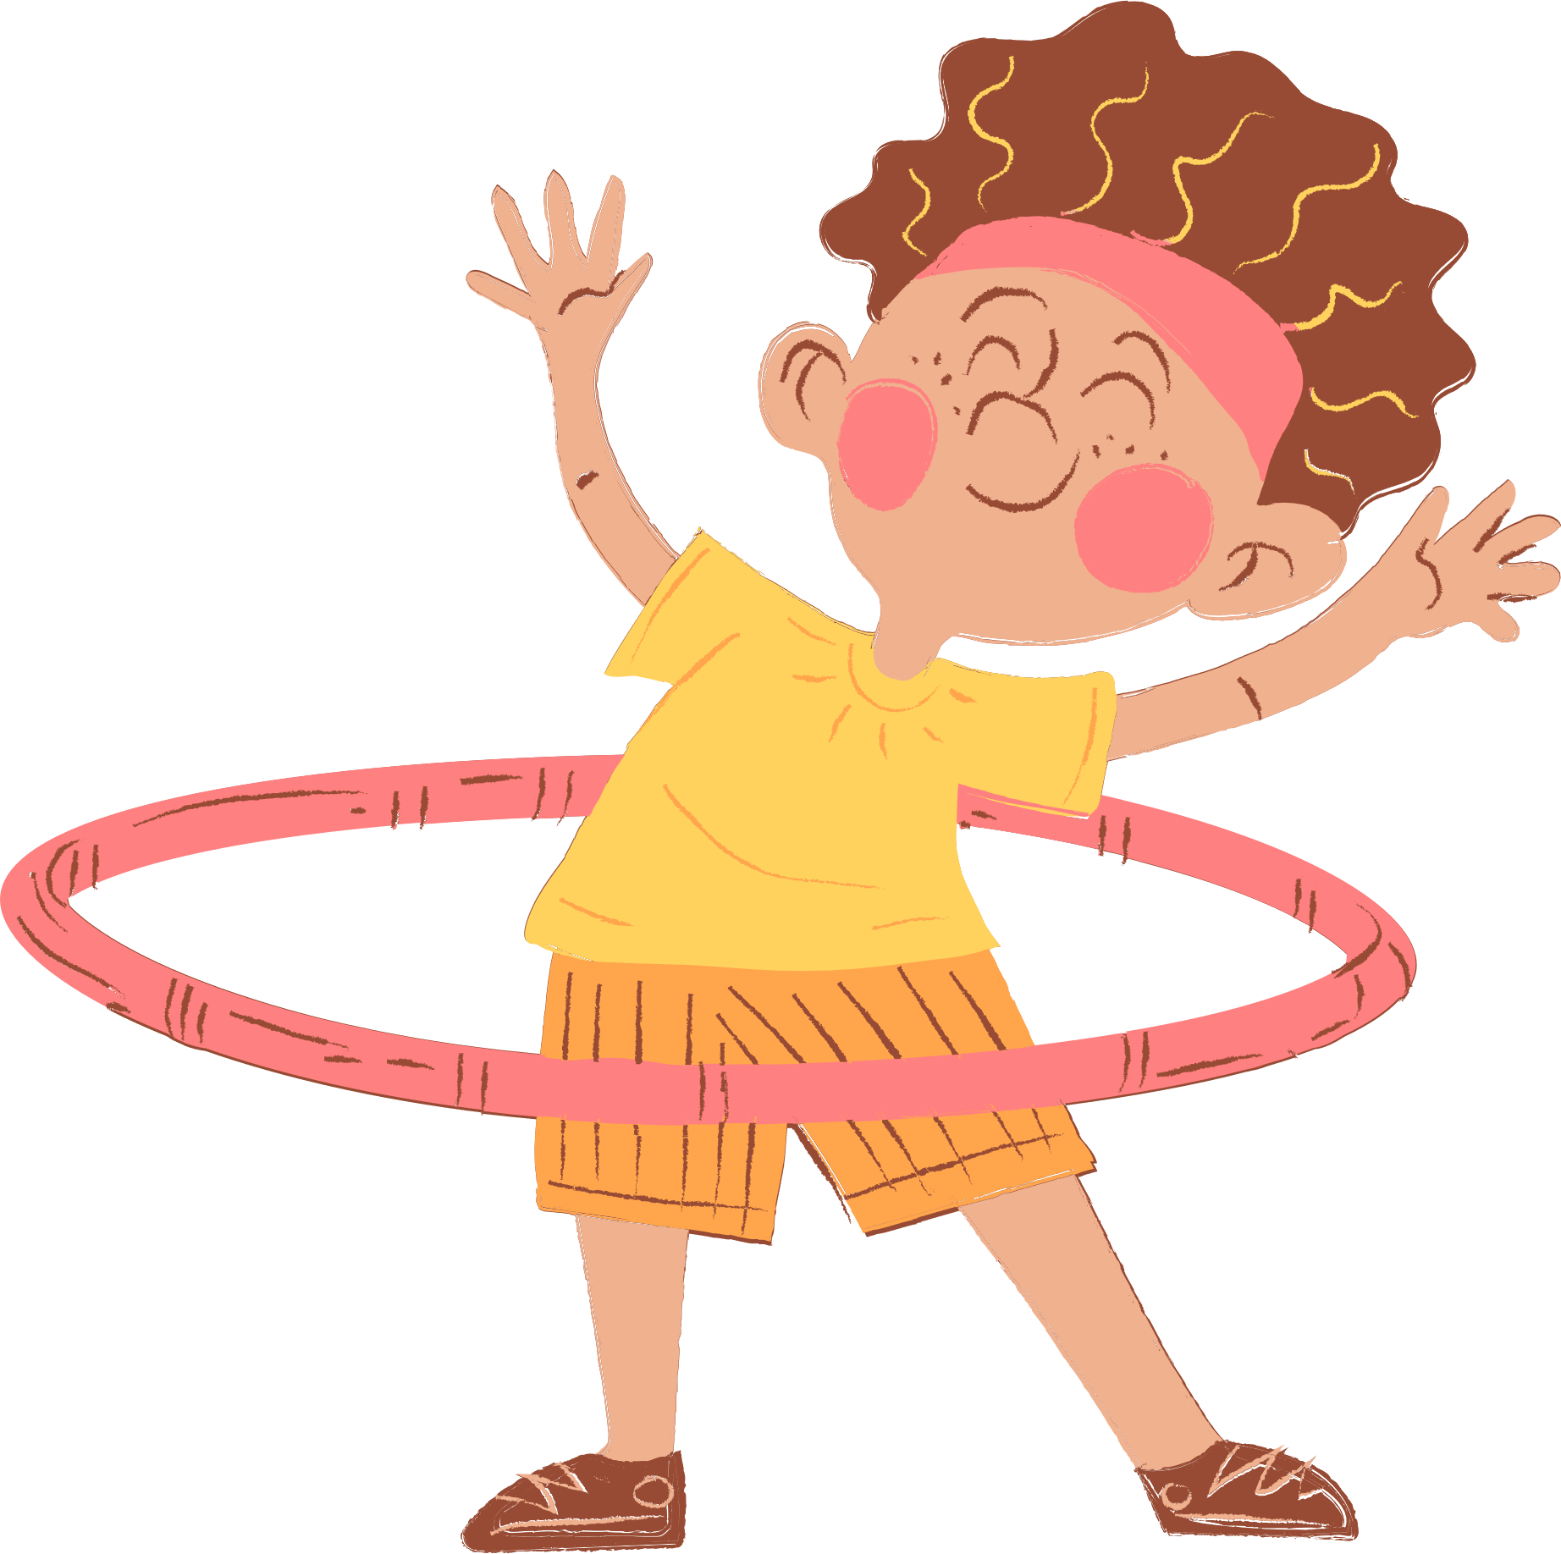
4
Our Free-time Activities
Lesson 1-Activity 1,2,3

Slide 5
play the violin playing the violin surf the Internet surfing the Internet go for a walk going for a walk water the flowers watering the flowers

Slide 6
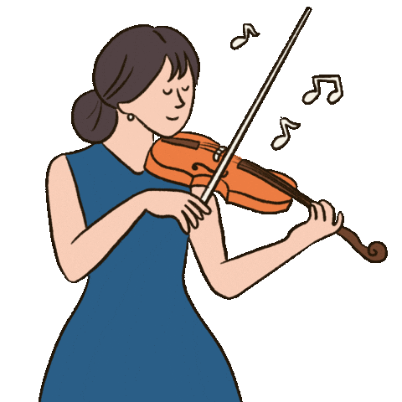
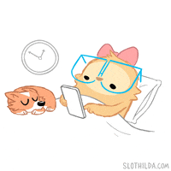
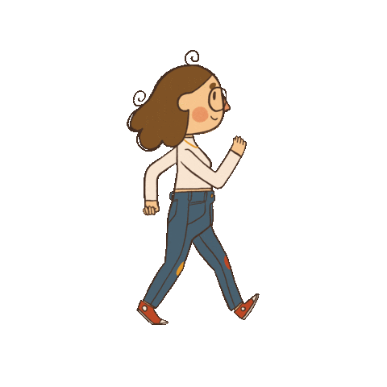
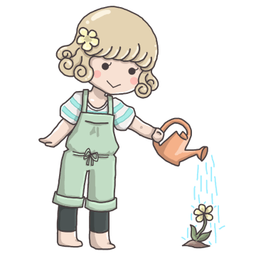
What do you like doing in your free time?
I like playing the violin.
What do you like doing in your free time?
I like surfing the Internet.
What do you like doing in your free time?
I like going for a walk.
What do you like doing in your free time?
I like watering the flowers.
Let’s sing!

Slide 7
What do you like doing in your free time?
I like playing the violin.
What do you like doing in your free time?
I like surfing the Internet.
What do you like doing in your free time?
I like going for a walk.
What do you like doing in your free time?
I like watering the flowers.
Let’s sing!

Slide 8
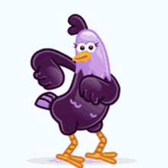
Game: Hot Chair

Slide 9
Game: Hot Chair

Slide 10
Game: Hot Chair

