Slide 1
GAME
GUESS THE FESTIVALS
T opens the boxes
Students write the names of festival
The quickest student gets 10 points for each

Slide 2
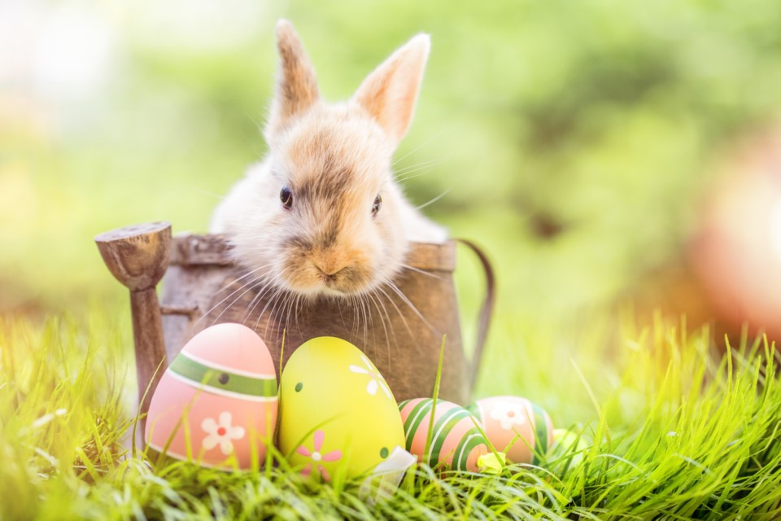
Easter
SHOW
KEY

Slide 3
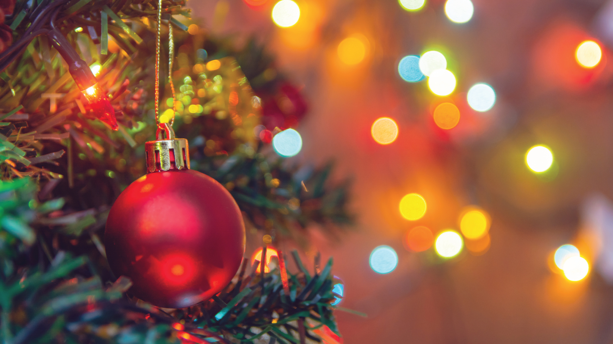
Christmas
SHOW
KEY

Slide 4
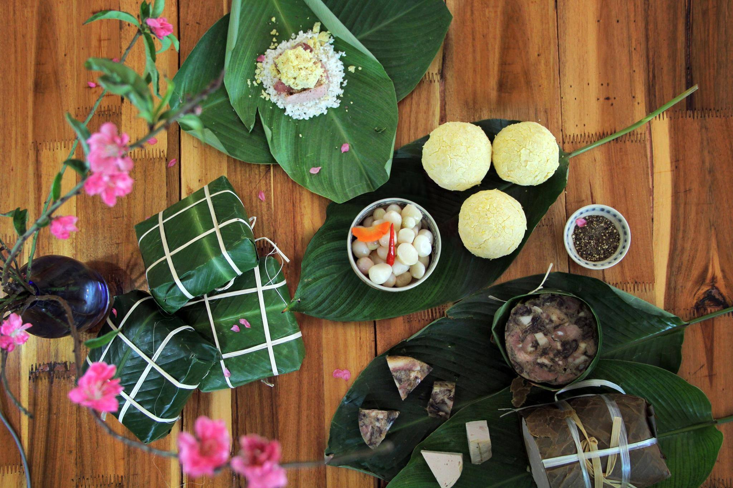
Tet
SHOW
KEY

Slide 5
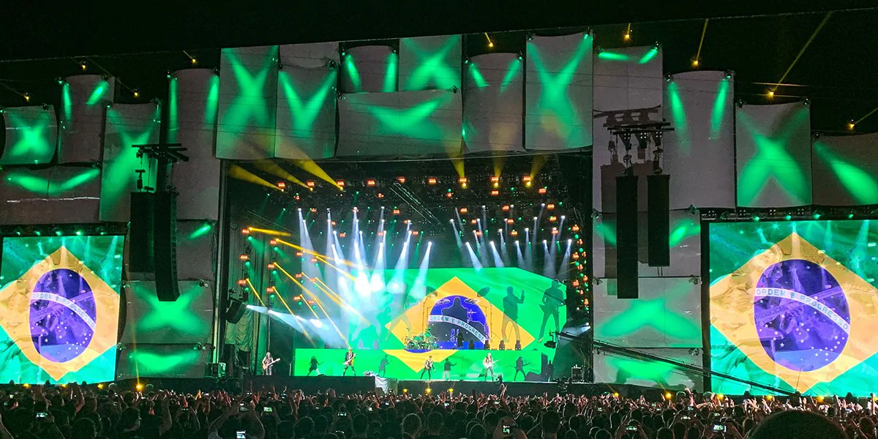
Rock in Rio
SHOW
KEY

Slide 6
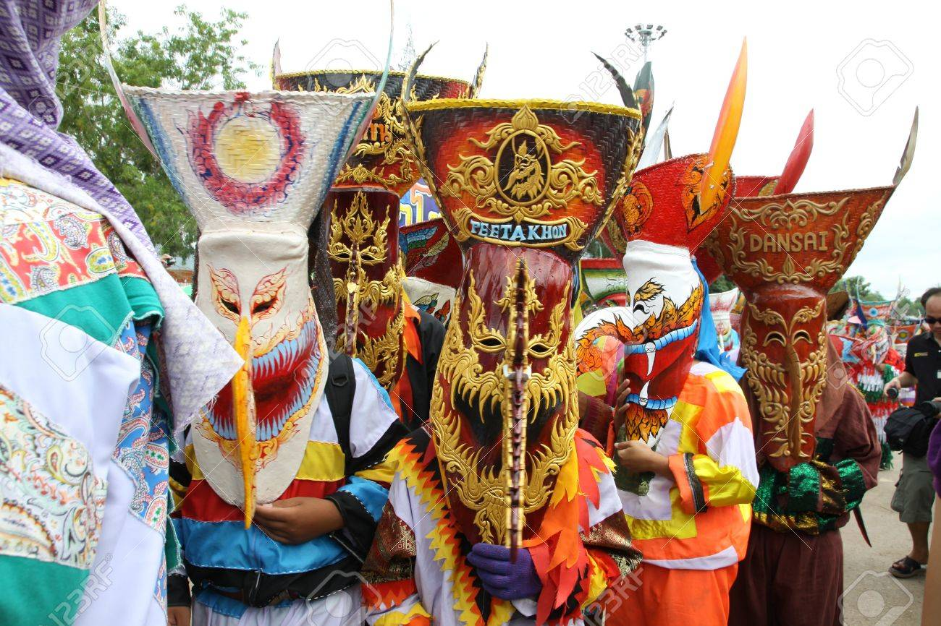
Ghost Day
SHOW
KEY

Slide 7

Cannes Film Festival
SHOW
KEY

Slide 8
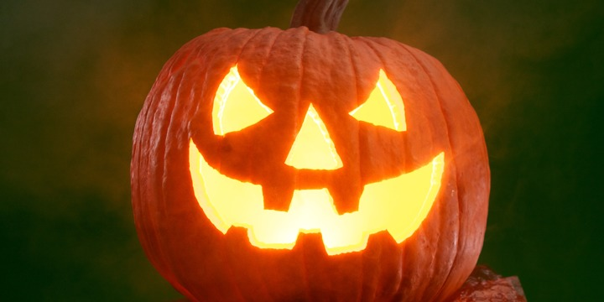
Halloween
SHOW
KEY

Slide 9
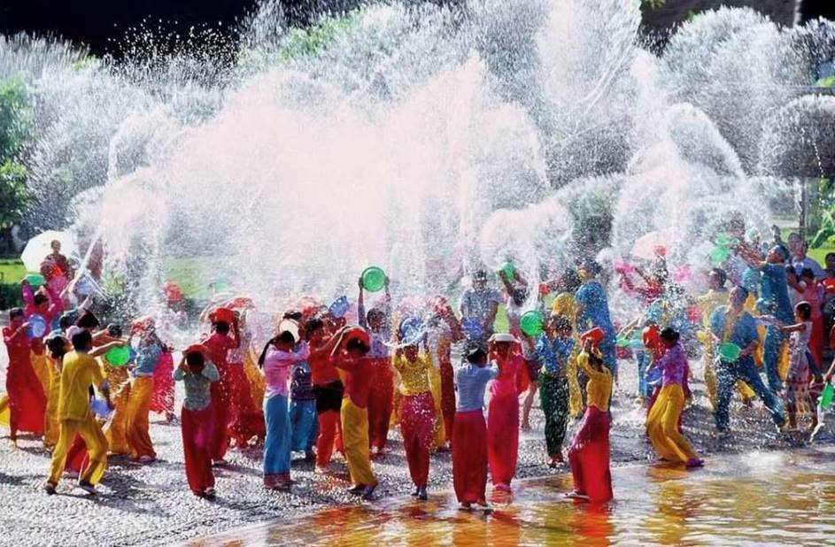
Water festival
SHOW
KEY

Slide 10
Unit 9
FESTIVALS
AROUND THE WORLD
LESSON 1 GETTING STARTED

Slide 11
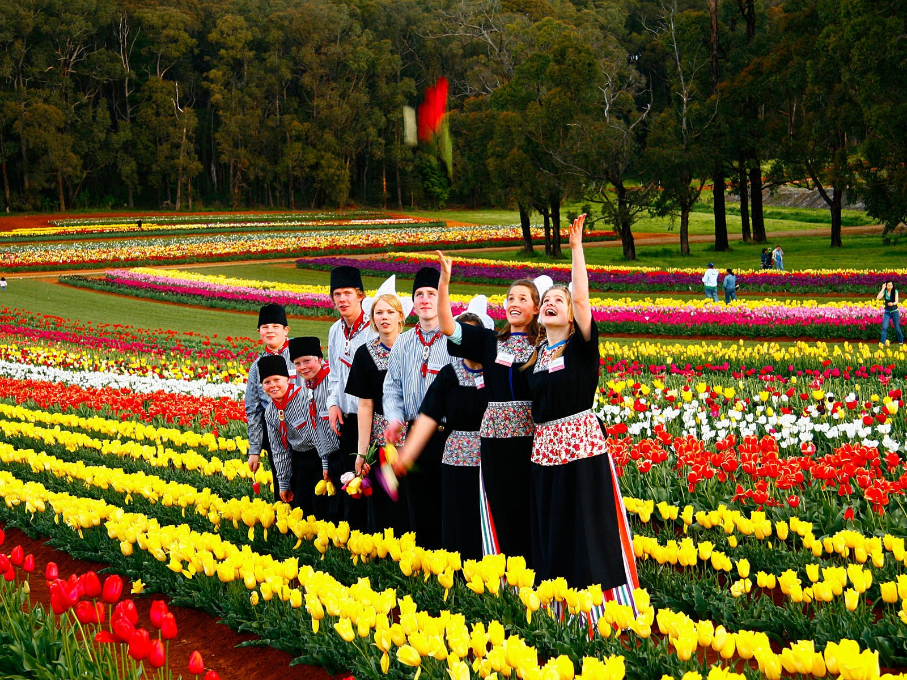
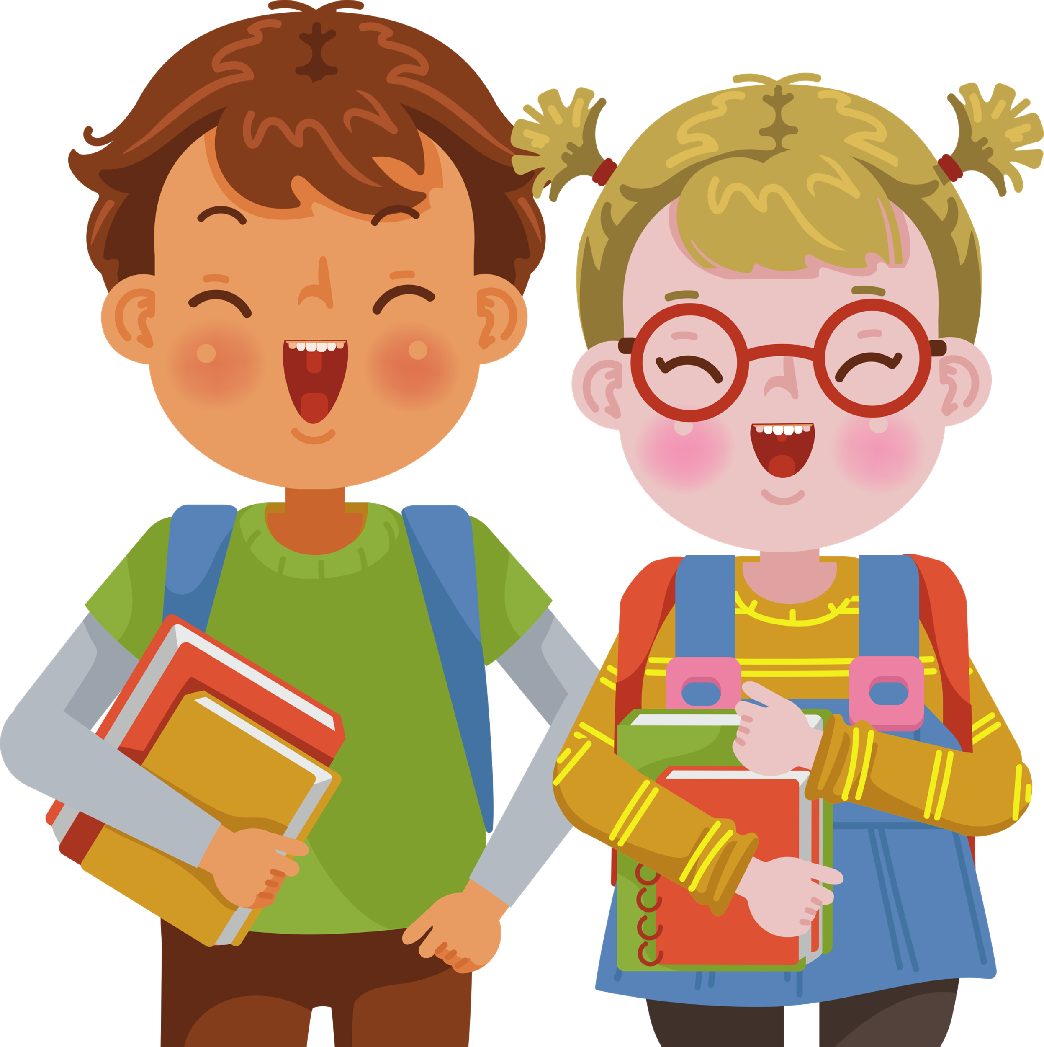
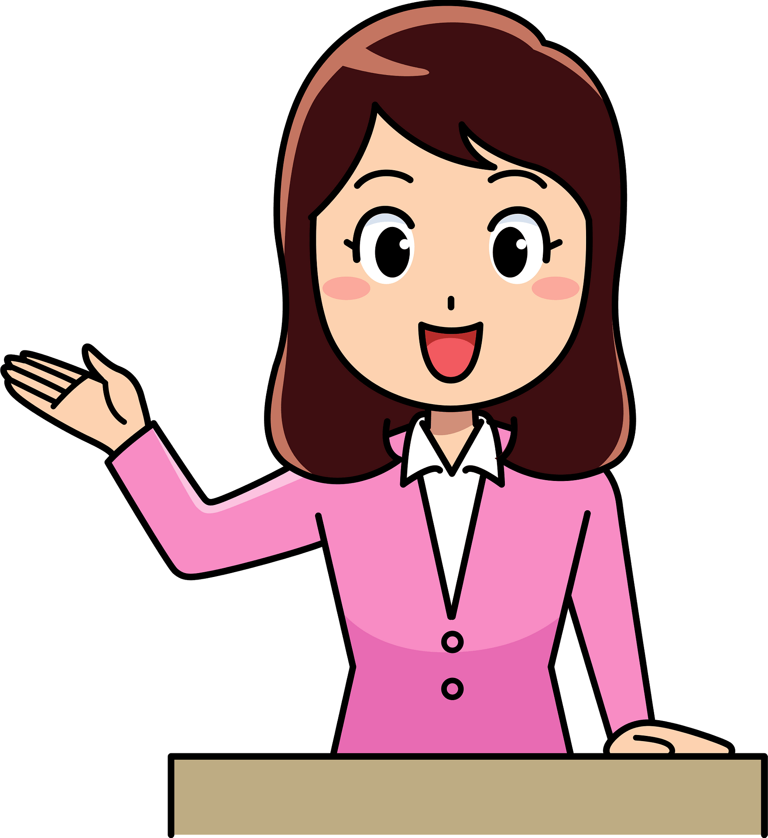
A tulip festival
Who are they?
What are they talking about?
Mark and Trang
Ms Hoa

Slide 12

Listen and read
Mark and Trang: Good afternoon, Ms Hoa.
Ms Hoa: Oh, hi. Come in.
Trang: Wow! This is a nice cozy room, Ms Hoa. I like the photos on the wall. I can see you among all those tulips. Where did you take the photos?
Ms Hoa: I took them at the Tulip Festival in Australia last September.
Mark: Really? I went to a tulip festival two years ago but it was in the Netherlands. It was the Dutch Tulip Festival.
Trang: What did you do at the festival, Ms Hoa?
Ms Hoa: I watched Dutch folk dances. The dancers wore traditional costumes. I also got a chance to try some delicious Dutch food and drinks. What about you, Mark?
Mark: I watched folk dances too, but there wasn't any food or drinks. I also saw beautiful tulip floats at a parade.
Trang: Do they hold the festival every year in Australia? Ms Hoa: Yes, they do.

Slide 13

Ex 2 (pg. 92) Guess who did the following activities?
 | Mark | Ms.Hoa
1. went to the Tulip Festival in Australia
2. went to the Tulip Festival in the Netherlands
3. tried Dutch food and drinks
4. watched traditional Dutch dancing
5. saw tulip floats

Slide 14

Ex 2 (pg. 92) Check your answer.
 | Mark | Ms.Hoa
1. went to the Tulip Festival in Australia
Ms Hoa:
I took them at the Tulip Festival in Australia last September.

Slide 15
Ex 2 (pg. 92) Check your answer.
 | Mark | Ms.Hoa
2. went to the Tulip Festival in the Netherlands
Mark:
Really? I went to a tulip festival two years ago but it was in the Netherlands. It was the Dutch Tulip Festival.

Slide 16
Ex 2 (pg. 92) Check your answer.
 | Mark | Ms.Hoa
3. tried Dutch food and drinks.
Ms Hoa:
I watched Dutch folk dances. The dancers wore traditional costumes. I also got a chance to try some delicious Dutch food and drinks.

Slide 17
Ex 2 (pg. 92) Check your answer.
 | Mark | Ms.Hoa
4. watched traditional Dutch dancing
Ms Hoa:
I watched Dutch folk dances. The dancers wore traditional costumes. I also got a chance to try some delicious Dutch food and drinks.
Mark: I watched folk dances too, but there wasn't any food or drinks. I also saw beautiful tulip floats at a parade.
*folk dances = traditional dances

Slide 18
Ex 2 (pg. 92) Check your answer.
 | Mark | Ms.Hoa
5. saw tulip floats.
Mark:
I watched folk dances too, but there wasn't any food or drinks. I also saw beautiful tulip floats at a parade.

Slide 19
Ex 2 (pg. 92) Check your answers
 | Mark | Ms.Hoa
1. went to the Tulip Festival in Australia
2. went to the Tulip Festival in the Netherlands
3. tried Dutch food and drinks
4. watched traditional Dutch dancing
5. saw tulip floats

Slide 20
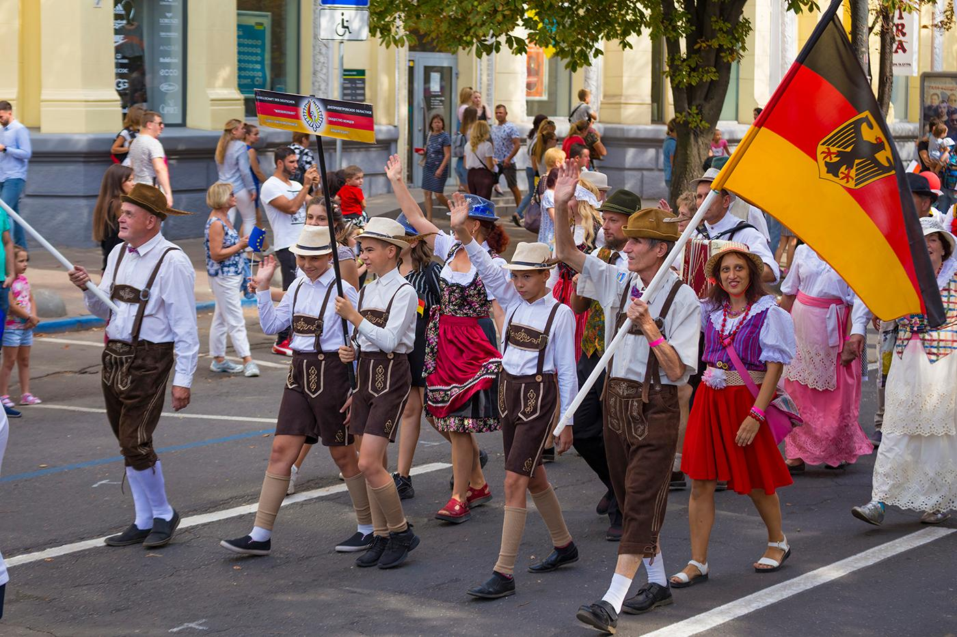
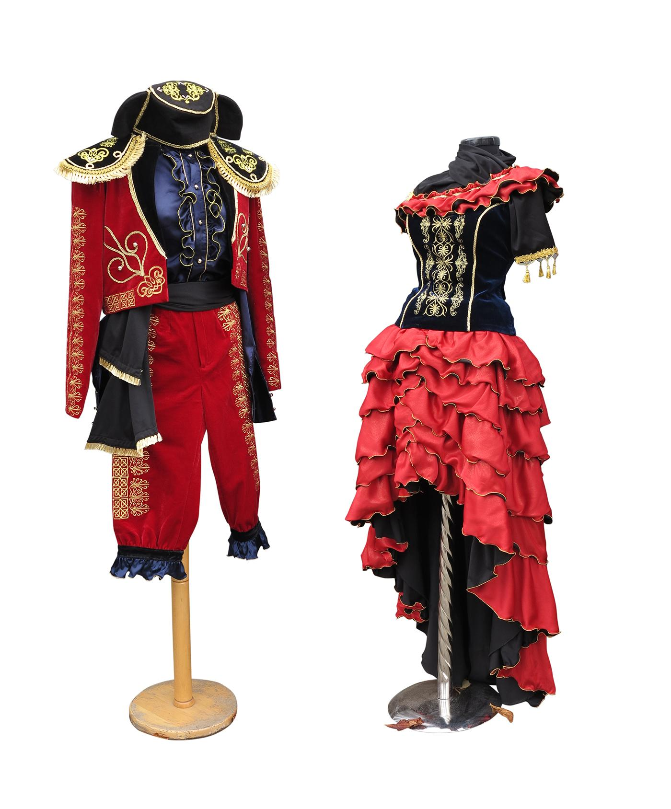
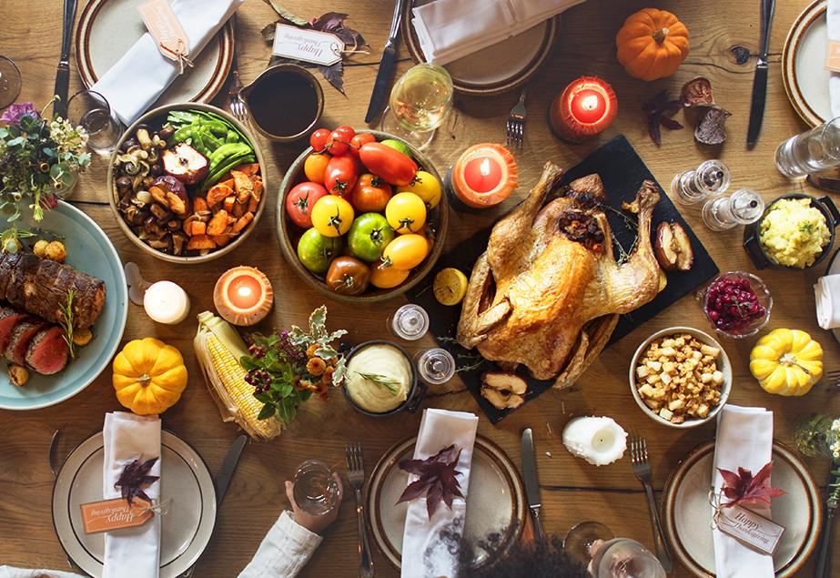
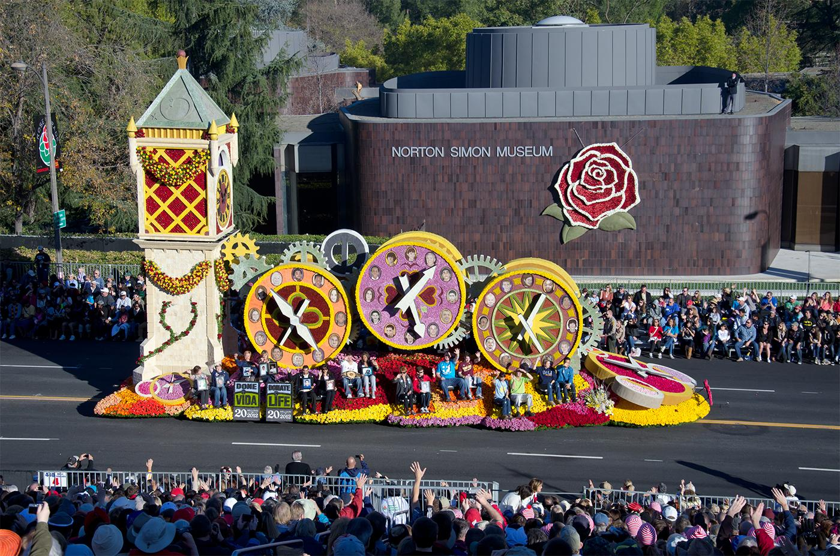
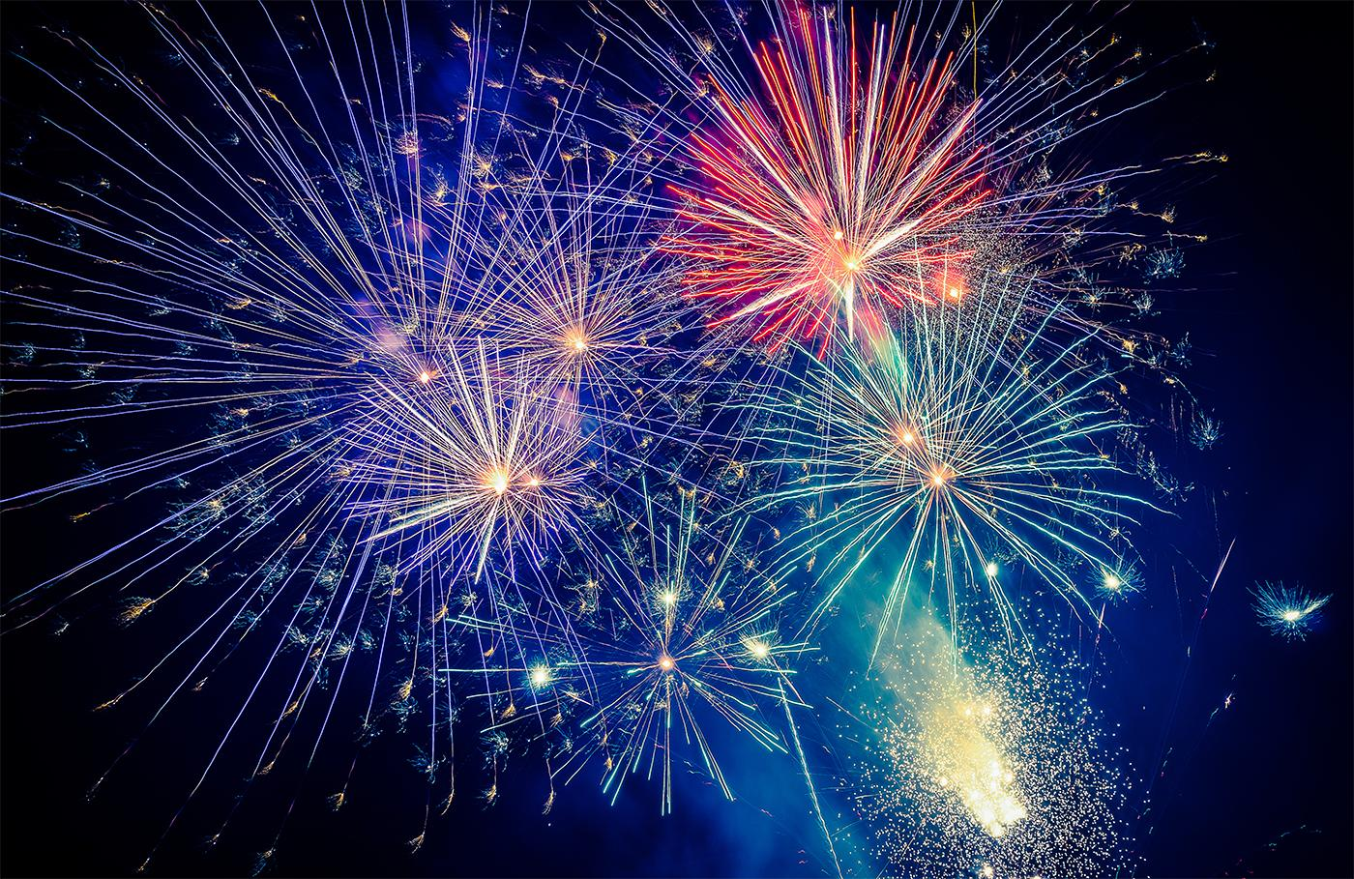
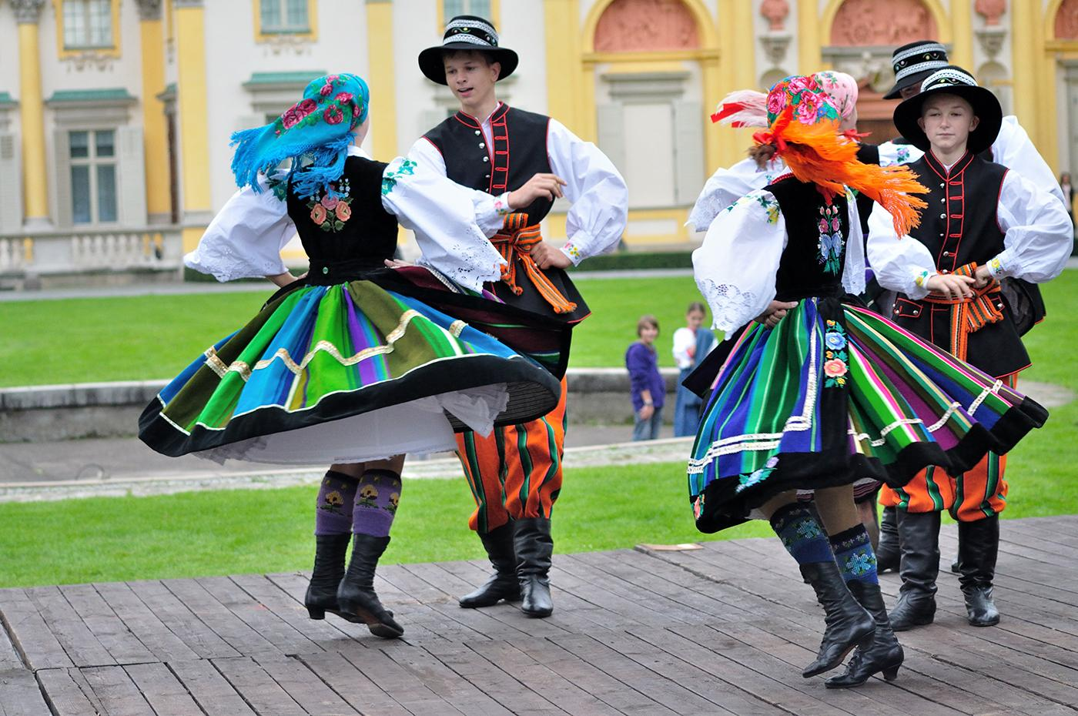
Ex 3 (pg. 93). Write a word or phrase from the box under each picture.
costumes
feast
fireworks
display
parade
float
folk dance

Slide 21
Ex 3 (pg. 93). Write a word or phrase from the box under each picture.
costumes
feast
fireworks
display
parade
float
folk dance
parade
/pəˈreɪd/

Slide 22
Ex 3 (pg. 93). Write a word or phrase from the box under each picture.
costumes
feast
fireworks
display
float
folk dance
costumes
/ ˈkɒstjʊmz/

Slide 23
Ex 3 (pg. 93). Write a word or phrase from the box under each picture.
feast
fireworks
display
float
folk dance
feast
/ fiːst /

Slide 24
Ex 3 (pg. 93). Write a word or phrase from the box under each picture.
fireworks
display
float
folk dance
float
/ fləʊt OR floʊt /

Slide 25
Ex 3 (pg. 93). Write a word or phrase from the box under each picture.
fireworks
displays
folk dance
fireworks display
/ ˈfaɪəwɜːks dɪˈspleɪ/

Slide 26
Ex 3 (pg. 93). Write a word or phrase from the box under each picture.
folk dance
folk dance
/ ˈfəʊk dɑːns/

Slide 27
Ex 4 (pg. 93) Check your answer.
costumes
feast
fireworks
display
parade
float
folk dance
folk dances
1. The dancers performed ________________ at the Tulip Festival.
2. On New Year's Eve, we went to Hoan Kiem Lake to watch the ___________________.
3. For Tet, we usually prepare a __________with special food.
4. People hold flower _______________ in several countries to welcome the new season.
5. The ___________ carried the dancers in special ____________.
fireworks display
feast
parades
costumes
floats

Slide 28

RECAP
1. What did we read about?
A. Rose festival B. Tet Holiday C. Tulip festival
2. Odd one out.
A
B
C
D

Slide 29


