Slide 1
SENTENCE PUZZLING
work in groups of 4-5 students
rearrange to make meaningful questions
try to write as fast as possible

Slide 2
SENTENCE PUZZLING
Did
yesterday
bed
you
go
late
to
?
early
get
Did
up
you
today
?
tired
Are
now
you
?

Slide 3
CHECK YOU ANSWER
1. Did you go to bed late yesterday?
2. Did you get up early today?
3. Are you tired now?
What are these called?
Yes/No Questions

Slide 4
UNIT 9
FESTIVALS AROUND
THE WORLD
Lesson 3: A closer look 2

Slide 5
QUESTION PATTERNS
1
2

Slide 6



QUESTION PATTERNS
Pattern 1
Did
you
go
to
bed
late
yesterday
?
Auxilary
+
subject
?
+
verb

Slide 7
QUESTION PATTERNS
Pattern 2
Are
you
tired
now
?
Be
+
subject
?
Note: We don’t use an auxiliary verb
when we use be as a main verb.

Slide 8
Ex 1 (pg. 95) Fill in each blank with a correct auxiliary verb or modal verb.
1. ______ they hold the festival in Ha Noi every year?
2. ______ he visit Hoi An last year?
3. ______ they performing folk dances?
4. A: ______ you make banh chung?
B: Yes, I can.
5. ______ your brother usually come back home at Tet?

Slide 9
Ex 1 (pg. 95) Fill in each blank with a correct auxiliary verb or modal verb.
1. ______ they hold the festival in Ha Noi every year?
2. ______ he visit Hoi An last year?
3. ______ they performing folk dances?
4. A: ______ you make banh chung?
B: Yes, I can.
5. ______ your brother usually come back home at Tet?
Present Simple
Do
Past Simple
Did
Present Continuous
Are
Modal verb: Can
Can
Present Simple
Does

Slide 10
Ex 2 (pg. 95) Change the sentences into Y/N questions.
1. My mother can make a costume for me.
2. She will bake a birthday cake for him.
3. The dragon dances are interesting.
4. The Rio Carnival takes place every year in Brazil.
5. They saw a fireworks display on New Year’s Eve

Slide 11
Ex 2 (pg. 95) Change the sentences into Y/N questions.
1. My mother can make a costume for me.
2. She will bake a birthday cake for him.
Aux + S + V?
→ Can your mother make a costume for you?
Aux + S + V?
→ Will she bake a birthday cake for him?

Slide 12
Ex 2 (pg. 95) Change the sentences into Y/N questions.
3. The dragon dances are interesting.
4. The Rio Carnival takes place every year in Brazil.
5. They saw a fireworks display on New Year’s Eve.
Be + S + adj?
→ Are the dragon dances interesting?
Aux + S + V?
→ Does The Rio Carnival take place every year in Brazil?
Aux + S + V?
→ Did they see a fireworks display on New Year’s Eve?

Slide 13
Exercise 3 (pg. 95)
Match the questions in column A with their answers in column B.
A
1. Will you help me take a photo?
2. Is he painting Easter eggs?
3. Do they eat candy apples on Halloween?
4. Are you excited about your holiday?
5. Can she perform Dutch folk dances?
B
a. Yes, he is.
b. No, I’m not.
c. Yes, I will
d. No, she can’t.
e. Yes, they do.

Slide 14
Ex 4 (pg. 96). Fill in the blanks with Trang’s answers below.
Mark: Do you celebrate the Mid-Autumn Festival in December?
Trang: (1) __________________________________________.
Mark: Do you eat moon cakes at the festival?
Trang: (2) __________________________________________.
Mark: Do you make lanterns at the festival?
Trang: (3) __________________________________________.
Mark: Do you like the festival?
Trang: (4) __________________________________________.
Mark: Can I join the festival with you next month?
Trang: (5) __________________________________________.
a. Yes, we do. We watch lion dances, too.
b. No, we celebrate it in the middle of the eighth lunar month
b. No, we celebrate it in the middle of the eighth lunar month.
e. Yes, we do. We also have some autumn fruits
c. Yes, I do. It’s one of my favourite festivals.
a. Yes, we do. We watch lion dances, too
d. Yes. Just come over to my house on the night of the festival.
c. Yes, I do. It’s one of my favourite festivals.
d. Yes, Just come over to my house on the night of the festival
e. Yes, we do. We also have some autumn fruits.

Slide 15
Mystery festivals
Work in groups
One student thinks of a festival he / she likes
Other students ask Yes / No questions

Slide 16
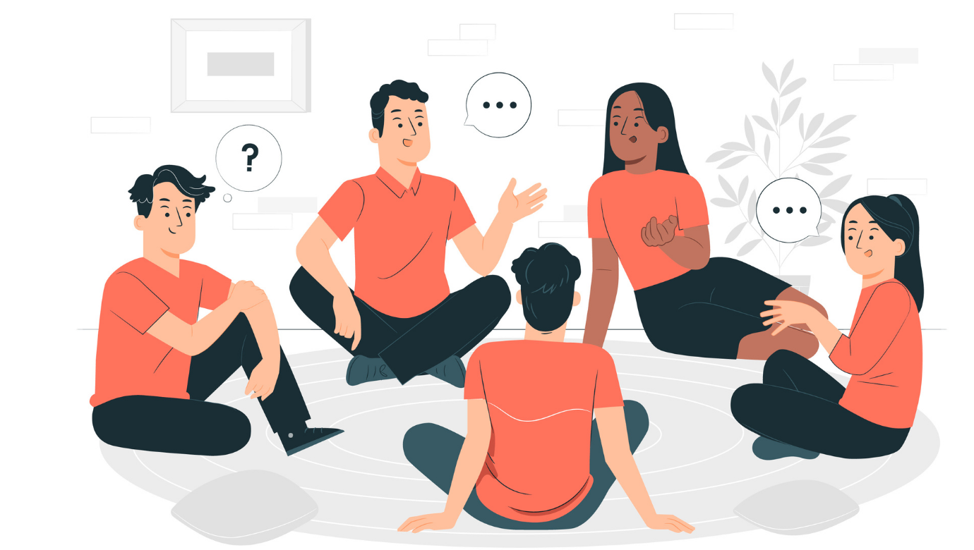
Do many countries celebrate the festival?
Do children like the festival?
Do they paint eggs?
Is it Easter?
Yes, they do.
Yes, they do.
Yes, they do.
Yes, it is.

Slide 17
RECAP
1. How many questions structure are there?
A. 1 B. 2 C. 3
2. Do we use add an auxiliary verb when we use ‘to be’ as a main verb?
A. Yes B. No

