Slide 2

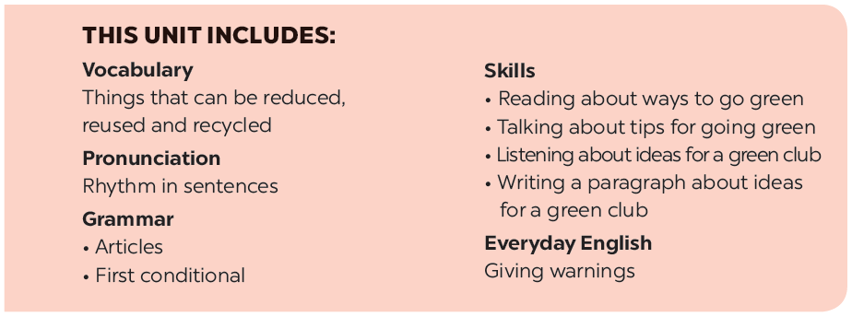
Teacher: Tran Thi Tam
Cap Tien-Bach Dang Secondary School

Slide 3








Let’s go green!
Listen and read.
Match the pictures with the ways to help the environment.
Read the conversation again. Complete the following sentences. Use no more than three words in each blank.
Find someone who ... Work in groups. Ask and answer to find someone who does the things in 4.
Based on the ideas in the conversation, match the first half of the sentence in column A with its second half in column B.

Slide 4



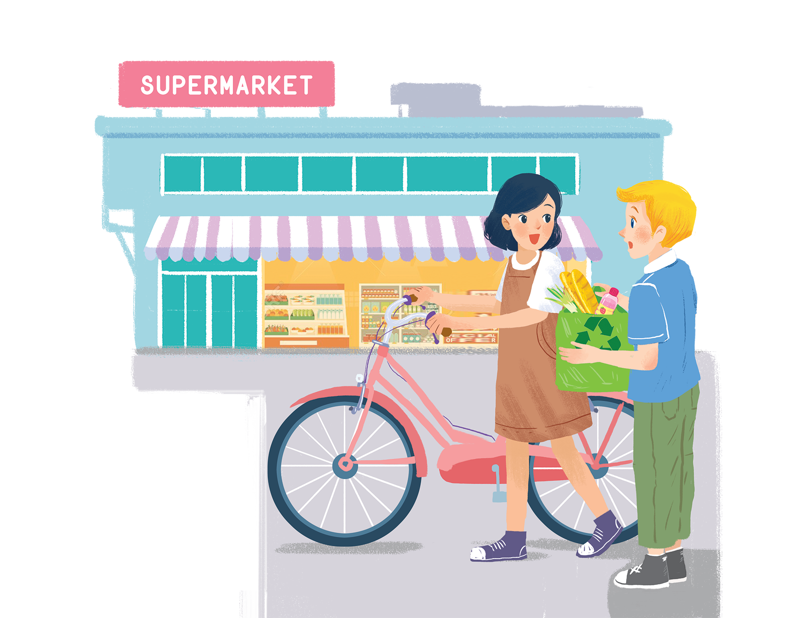
Listen and read.
Let’s go green!

Slide 5
Let’s go green!
Mi: Hi, Nick.
Nick: Hello, Mi.
Mi: You’ve bought a lot of things.
Nick: Yes. We’re going on a picnic tomorrow.What are you doing at the supermarket, Mi?
Mi: I’m buying some eggs. Hey, what’s this?
Nick: It’s a reusable shopping bag.
Mi: Do you always use it?
Nick: Yes. It’s better than a plastic one.If we all use this kind of bag, we will help the environment.
Mi: I see. I’ll buy one for my mum. Where can I buy one?
Nick: At the check-out. By the way, you’re also green. You’re cycling.
Mi: You’re right. If more people cycle, the air will be cleaner. Right?
Nick: Yes. Oh, it’s 5 o’clock already. I have to go now. See you later.
Mi: See you, Nick. Bye.

Slide 6

Read the conversation again. Complete the following sentences. Use no more than three words in each blank.
a picnic tomorrow.
1.
Nick is going on
_______ tomorrow.
2.
_______.
The green shopping bag is better than the
plastic one.
3.
People can buy green bags at
_______.
the check-out.
4.
Mi wants to buy
a reusable bag for her mum.
_______ bag for her mum.
5.
Nick thinks that Mi is green because
she’s cycling.
_______.
Teacher: Tran Thi Tam
Cap Tien-Bach Dang Secondary School

Slide 7

Based on the ideas in the conversation, match the first half of the sentence in column A with its second half in column B.
A
1. Green bags are better
2. The air will be cleaner
3. If people use reusable bags for shopping.
B
b. than plastic bags.
c. if more people cycle.
a. they will help the environment.
B
a. they will help the environment.
b. than plastic bags.
c. if more people cycle.

Slide 8

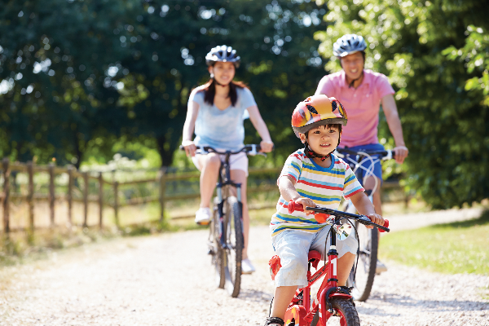
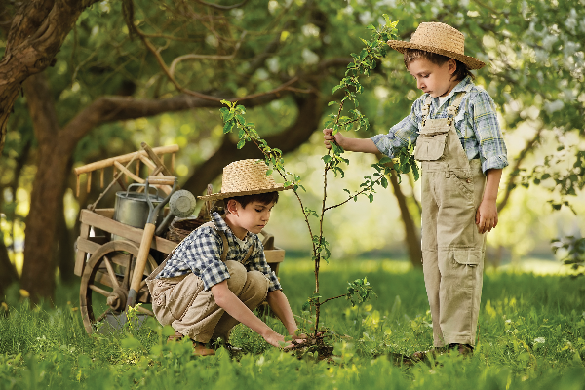
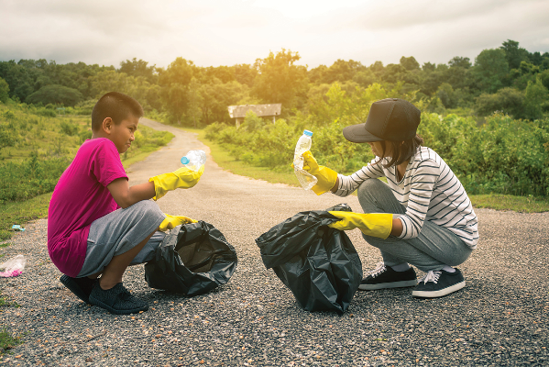
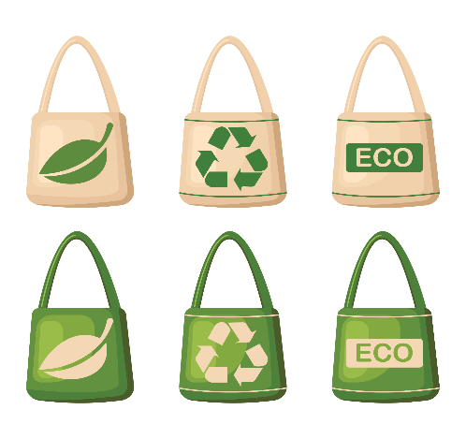
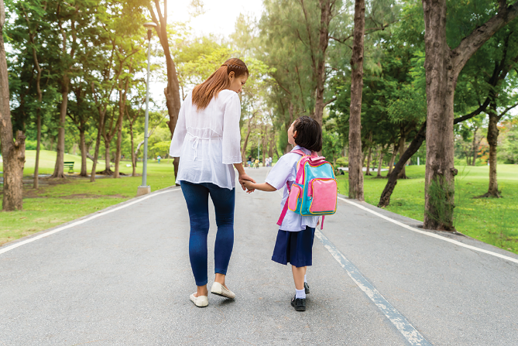
Match the pictures with the ways to help the environment.
1
2
3
4
5
Teacher: Tran Thi Tam
Cap Tien-Bach Dang Secondary School

Slide 9
walking to school
planting trees and flower
walking to school
planting trees and flower
picking up rubbish
picking up rubbish
d.
a.
d.
a.
b.
b.
using reusable bags when shopping
e.
using reusable bags when shopping
cycling
e.
c.
cycling
c.
1
2
3
b.
picking up rubbish
a.
planting trees and flower
c.
cycling
4
5
e.
using reusable bags when shopping
d.
walking to school

Slide 10

Find someone who ... Work in groups. Ask and answer to find someone who does the things in 4.
A: Do you plant trees?
B: No, I don’t.
A: Do you pick up rubbish?
B: Yes, I do.
Teacher: Tran Thi Tam
Cap Tien-Bach Dang Secondary School

Slide 11







