Slide 2

LET’S GO GREEN

Slide 3

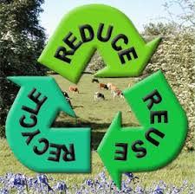

UNIT 11: OUR GREENER WORLD
Lesson 2: A closer look 1 (p. 50-51)
What do the three Rs stand for?
Teacher: Tran Thi Tam
Cap Tien-Bach Dang Secondary School

Slide 4





UNIT 11: OUR GREENER WORLD
Lesson 2: A closer look 1 (p. 50-51)
I- Vocabulary
1, The three Rs stand for Reduce – Reuse – Recycle. Draw a line
from a symbol in column A, to the matching word in column
B, and meaning in column C.
A | B | C
 | Reduce | using something again
 | Reuse | creating new products from used materials
 | Recycle | using something less
Teacher: Tran Thi Tam
Cap Tien-Bach Dang Secondary School

Slide 5





The three Rs stand for Reduce – Reuse – Recycle. Draw a line from a symbol in column A to its matching word in column B and its meaning in column C.
A | B | C
 | Reduce | using something again
 | Reuse | creating new products from used materials
 | Recycle | using less of something

Slide 6
The three Rs stand for Reduce – Reuse – Recycle. Draw a line from a symbol in column A to its matching word in column B and its meaning in column C.
A | B | C
 | Reuse | using something again
 | Reduce | using less of something
 | Recycle | creating new products from used materials

Slide 7

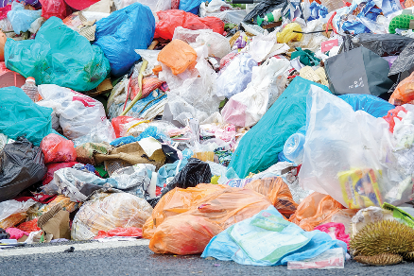
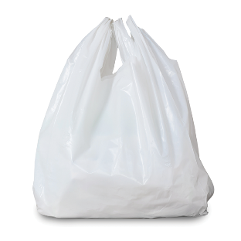
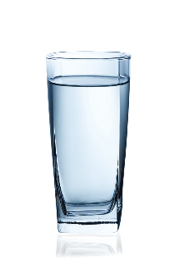
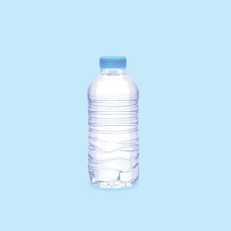

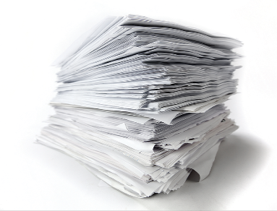

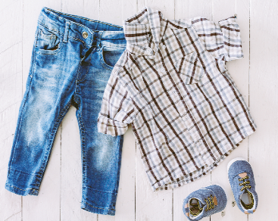
Write a word / phrase in the box under each picture.
rubbish
plastic bottle
glass
noise
plastic bag
paper
water
clothes

Slide 8

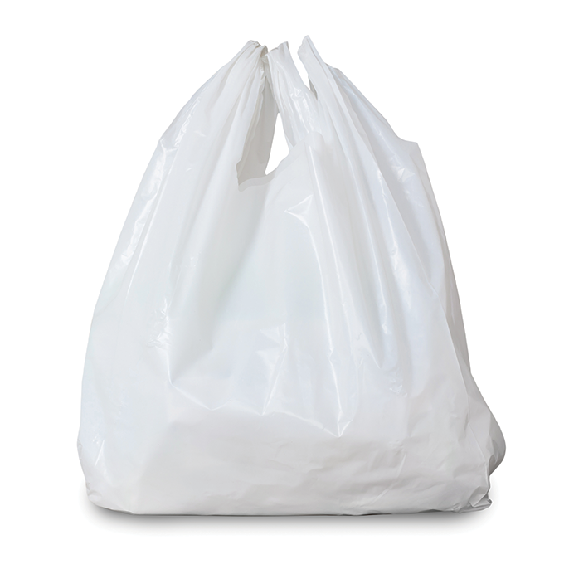
rubbish
plastic bottle
glass
noise
plastic bag
paper
water
clothes
1.
1. rubbish
2.
2. plastic bag
Teacher: Tran Thi Tam
Cap Tien-Bach Dang Secondary School

Slide 9
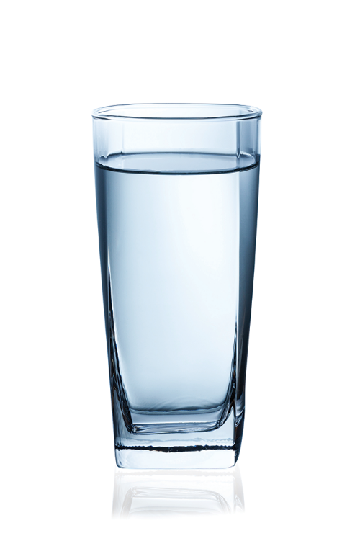
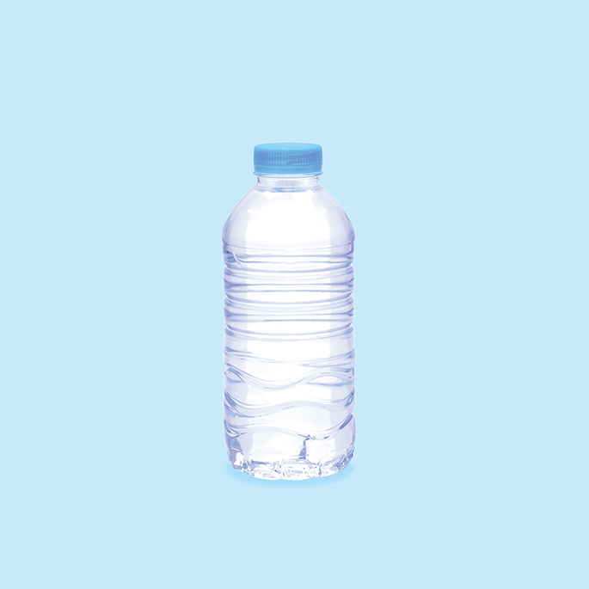
rubbish
plastic bottle
glass
noise
plastic bag
paper
water
clothes
3.
3. glass
4.
4. plastic bottle
Teacher: Tran Thi Tam
Cap Tien-Bach Dang Secondary School

Slide 10

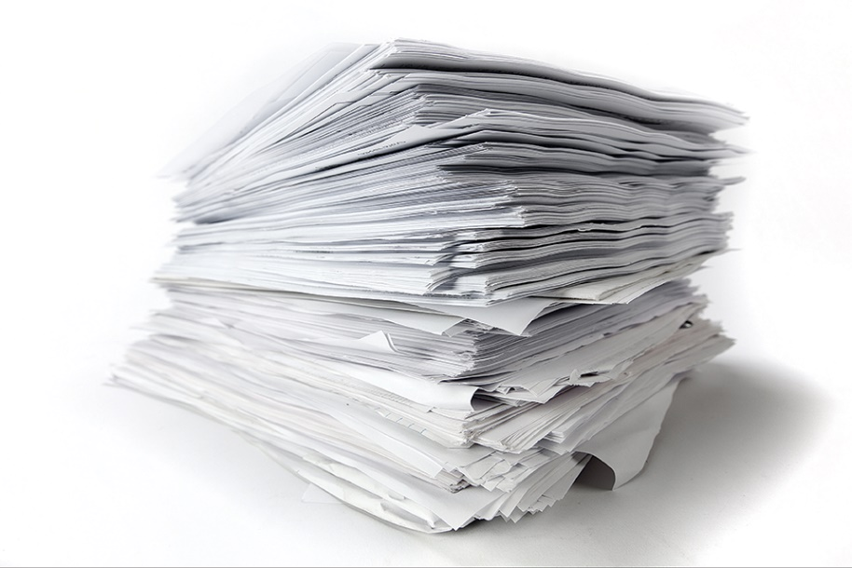
rubbish
plastic bottle
glass
noise
plastic bag
paper
water
clothes
5.
5. noise
6.
6. paper

Slide 11

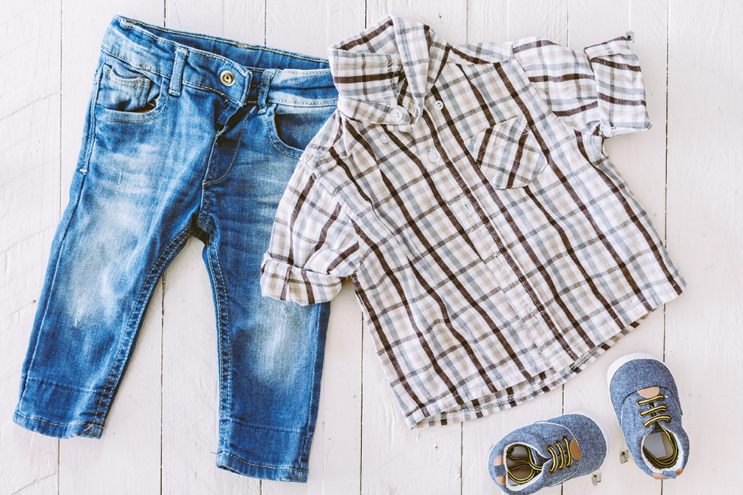
rubbish
plastic bottle
glass
noise
plastic bag
paper
water
clothes
7.
7. water
8.
8. clothes
Teacher: Tran Thi Tam
Cap Tien-Bach Dang Secondary School

Slide 12

Work in pairs. Put the words from 2 into groups. Some words can belong to more than one group.
Reduce | Reuse | Recycle
Teacher: Tran Thi Tam
Cap Tien-Bach Dang Secondary School

Slide 13
rubbish
plastic bottle
glass
noise
plastic bag
paper
water
clothes
Reduce | Reuse | Recycle
rubbish
plastic bag
rubbish
plastic bag
glass
plastic bag
noise
plastic bottle
glass
plastic bottle
paper
plastic bottle
paper
water
paper
water
clothes
Teacher: Tran Thi Tam
Cap Tien-Bach Dang Secondary School

Slide 14
Work in pairs. Put the words from 2 into groups. Some words can belong to more than one group.
Reduce | Reuse | Recycle
rubbish
plastic bag
rubbish
plastic bag
glass
plastic bag
noise
plastic bottle
glass
plastic bottle
paper
plastic bottle
paper
water
paper
water
clothes
Can you add more words to each group?

Slide 15


UNIT 11: OUR GREENER WORLD
Lesson 2: A closer look 1 (p. 50-51)
Listen to the ‘Three Rs’ song, and then sing along.
Reduce, reuse, recycle
Recycle, recycle
Reduce, reuse, recycle
It’s so so simple
Just reduce the noise
And reuse old bottles
Recycle broken glass
It’s so so simple

Slide 16


Pronunciation
Rhythm in sentences
In a sentence, the stressed and unstressed syllables combine to make rhythm.

Slide 17


Listen to these sentences, then repeat.
Pay attention to the bold syllables.
1.
If you cycle, it’ll help the Earth.
2.
Water is good for your body.
3.
The students are planting trees in the garden.
4.
Is it better to use paper bags?
5.
We are happy to walk to school.
Teacher: Tran Thi Tam
Cap Tien-Bach Dang Secondary School

Slide 18

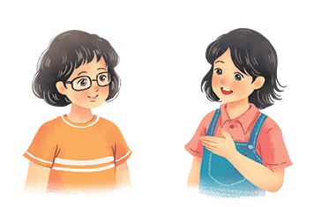
Listen to the conversation. Pay attention to the bold syllables. Then practise the conversation with a classmate.
Vy: What are you doing?
Mi: I’m writing an article about going green.
Vy: Great! I’m writing a poem about the 3Rs.
Mi: Let me read it.
Vy: I’m still writing. Wait for a minute.
Teacher: Tran Thi Tam
Cap Tien-Bach Dang Secondary School

Slide 19







