Slide 1
ANH 7 GLOBAL SUCCESS
UNIT 9
THCS Đại Thắng- Tiên Lãng – TP Hải Phòng

Slide 2
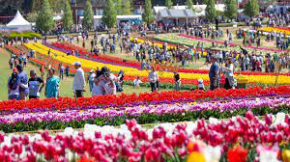
UNIT 9. FESTIVALS AROUND THE WORLD
Unit
LESSON 1: GETTING STARTED
A Tulip Festival
HOBBIES

Slide 3
OBJECTIVES
By the end of this lesson, Ss will be able to:
- have an overview about the topic Festivals around the world
- gain vocabulary to talk about festivals

Slide 4
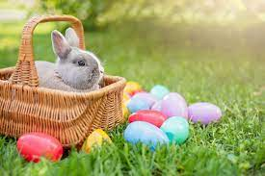
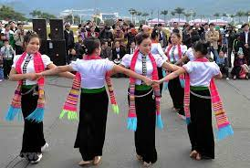
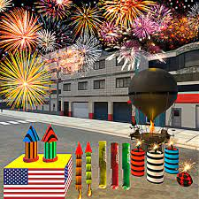

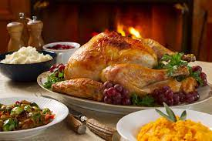
WARM-UP
easter
Folk dance
Firework play
- Mid – Autumn festival
Thanksgiving

Slide 5
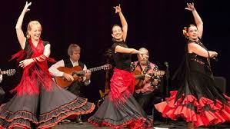
VOCABULARY
folk dance (n)
/ˈfəʊkdɑːns/
điệu nhảy/ múa dân gian

Slide 6
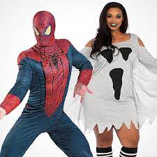
VOCABULARY
costume (n)
/ˈkɒstjuːm/
trang phục

Slide 7
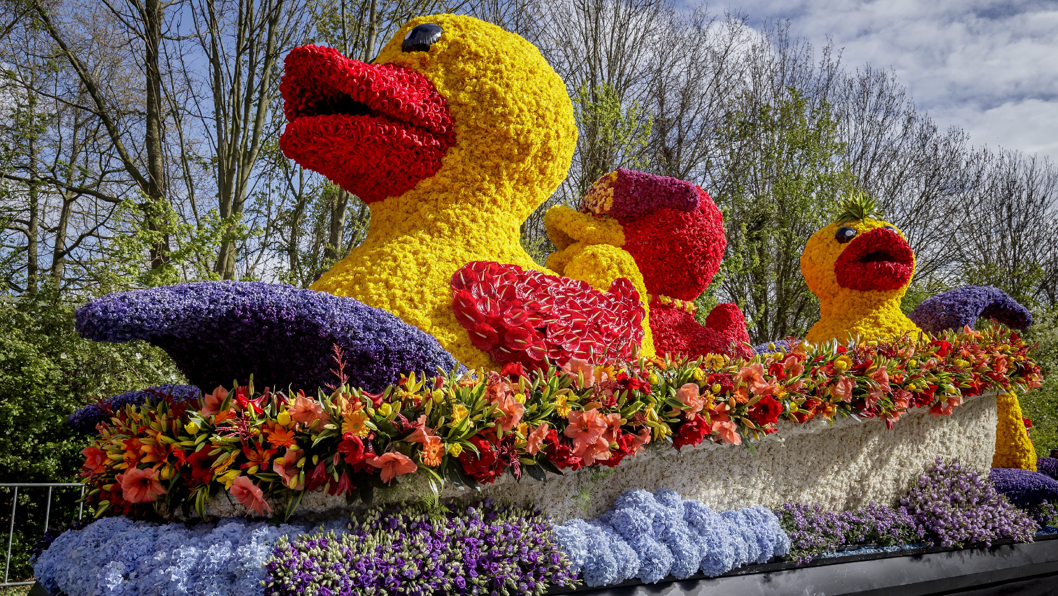
VOCABULARY
float (n)
/fləʊt/
xe diễu hành

Slide 8
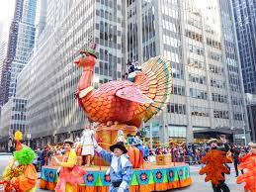
VOCABULARY
parade (n)
/pəˈreɪd/
diễu hành

Slide 9
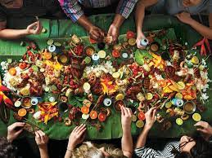
VOCABULARY
feast (n)
/fiːst/
bữa tiệc

Slide 10

VOCABULARY
fireworks display (n)
/ˈfɑɪəwɜ:rks dɪˈspleɪ/
màn bắn pháo hoa

Slide 11
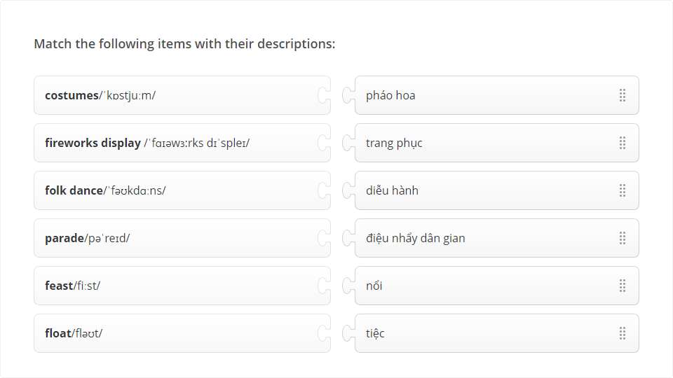
VOCABULARY

Slide 12

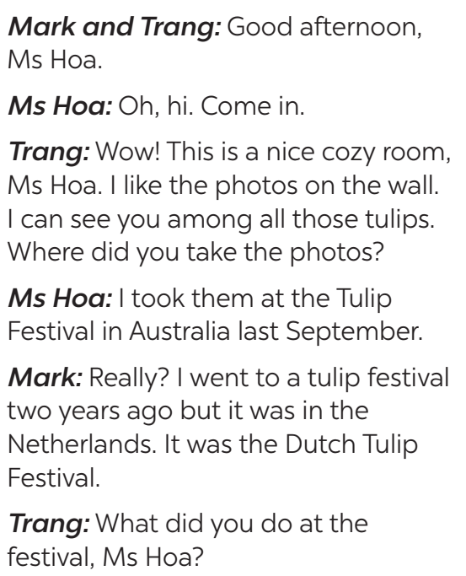
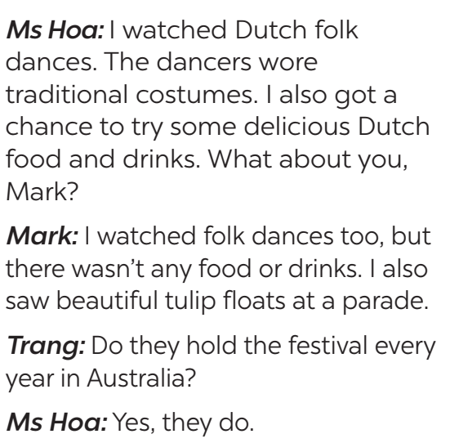
PRACTICE
1
Listen and read.

Slide 13
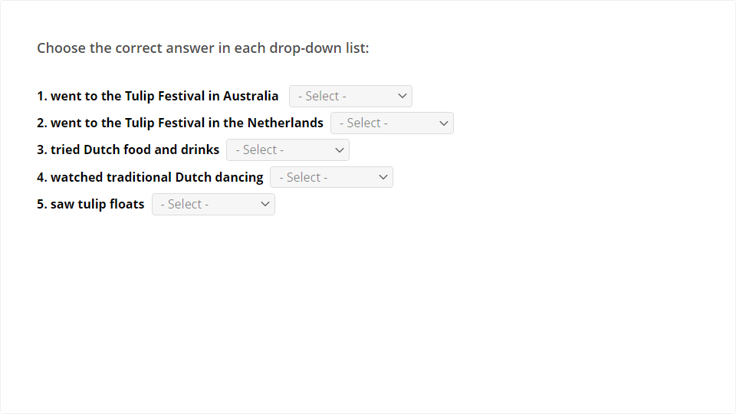
PRACTICE
PRACTICE
2
Read the conversation again. Who did the following activities? Tick (✓) the correct column. Sometimes you need to tick both.
2
Read the conversation again. Who did the following activities? Tick (✓) the correct column. Sometimes you need to tick both.

Slide 14

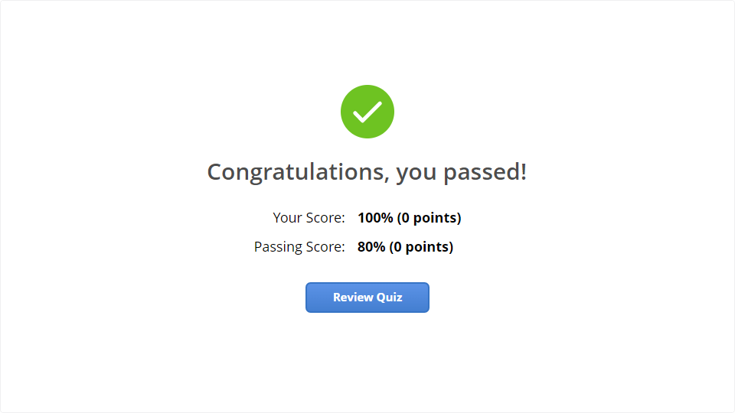
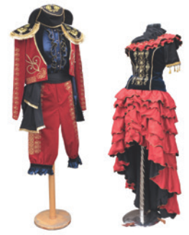
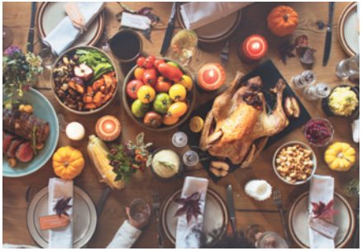
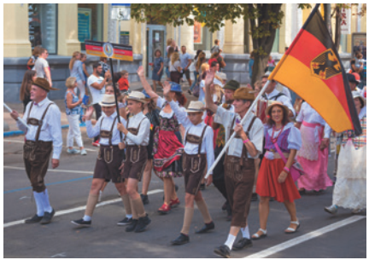
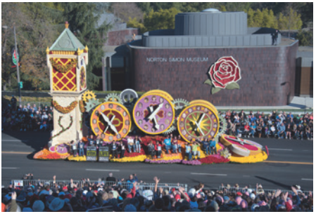

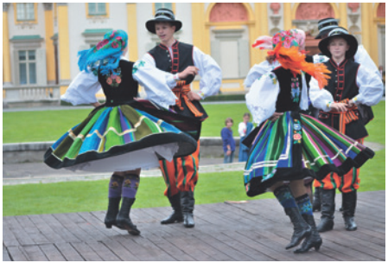
PRACTICE
Quiz
3
Write a word or phrase from the box under each picture.
Click the Quiz button to edit this object
costumes feast float fireworks display parade folk dance
1. ___________
2. ___________
3. ___________
parade
costumes
feast
4. ___________
5. _________________
6. ___________
float
fireworks display
folk dance

Slide 15
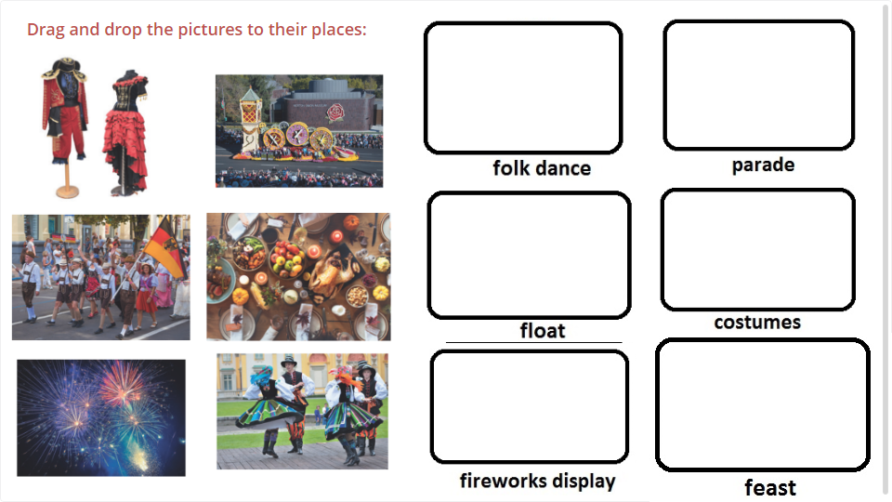
Quiz
Click the Quiz button to edit this object

Slide 16

PRACTICE
4
Fill in each blank with a word or phrase from 3. You may have to change the form of the word or phrase.
Aim of the task:
- to help Ss practise the words/phrases in 3.

Slide 17
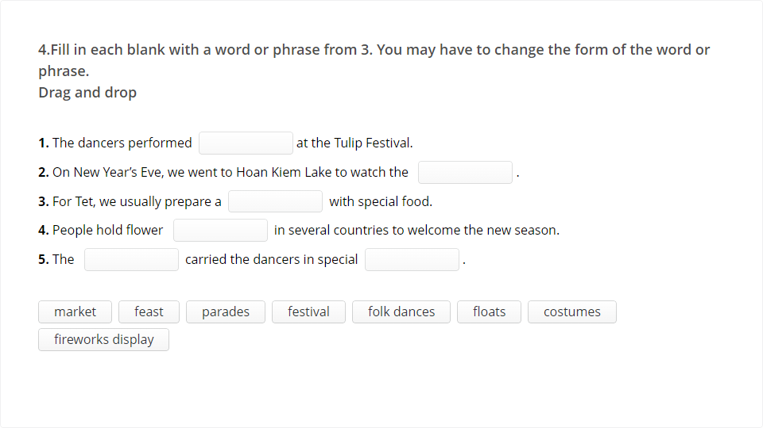
PRACTICE
4
Fill in each blank with a word or phrase from 3. You may have to change the form of the word or phrase.

Slide 18

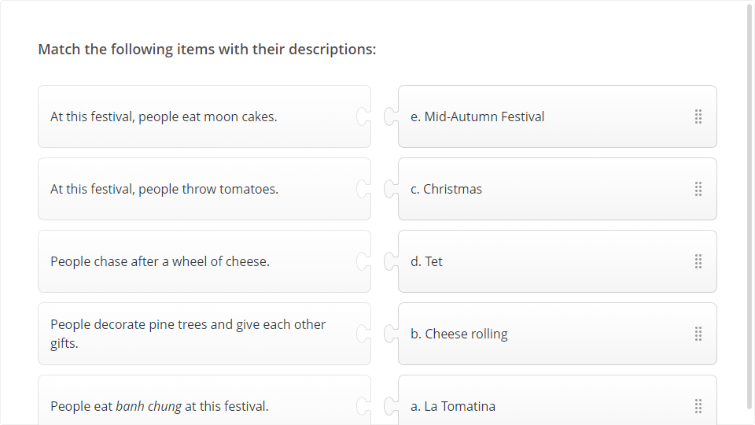
PRACTICE
5
5
What festival is it? Match each description with a festival.

Slide 19
1
WRAP-UP
Topic of the unit
Festivals around the world
Vocabulary
Festivals

Slide 20
CONSOLIDATION
2
HOMEWORK
- Learn by heart all the new words.
- Rewrite the sentences into notebooks.
- Do exercises in workbook.
- Prepare vocabulary for the next lesson: A closer look 1.

