Slide 1


Unit 2
MY HOUSE
Lesson 2: A closer look 1
_{Teacher: Bùi Quang Thái}
TRƯỜNG THCS ĐỒNG MINH – VĨNH BẢO – HẢI PHÒNG
_{Tel: 0906009575}

Slide 2
Matching game
Look at the picture.
Match the pictures with the correct words/phrases.
2 minutes

Slide 3
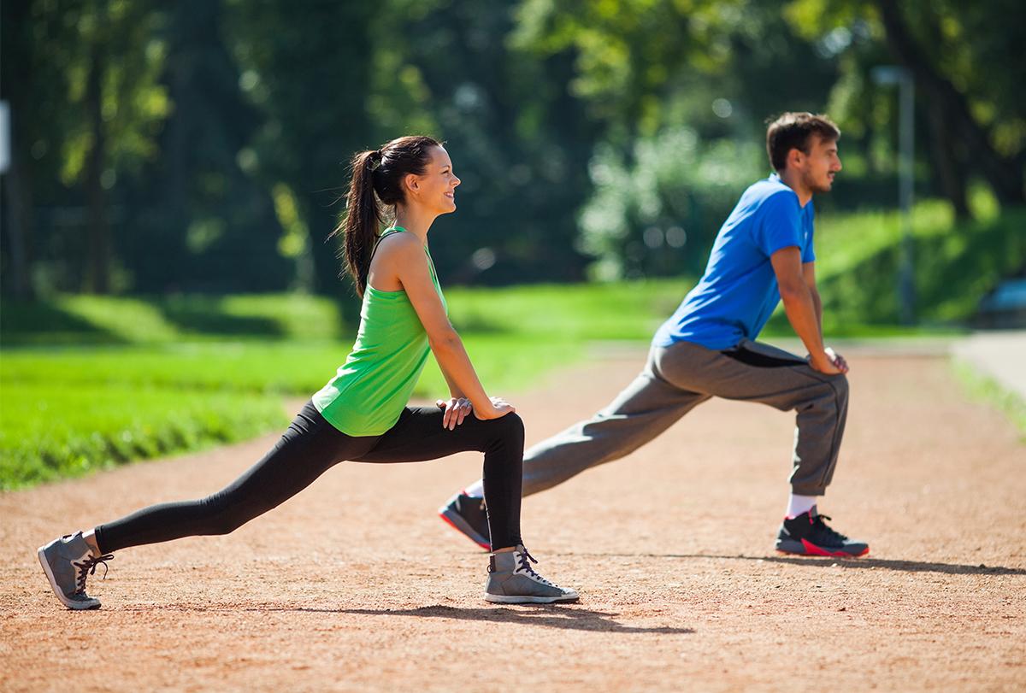
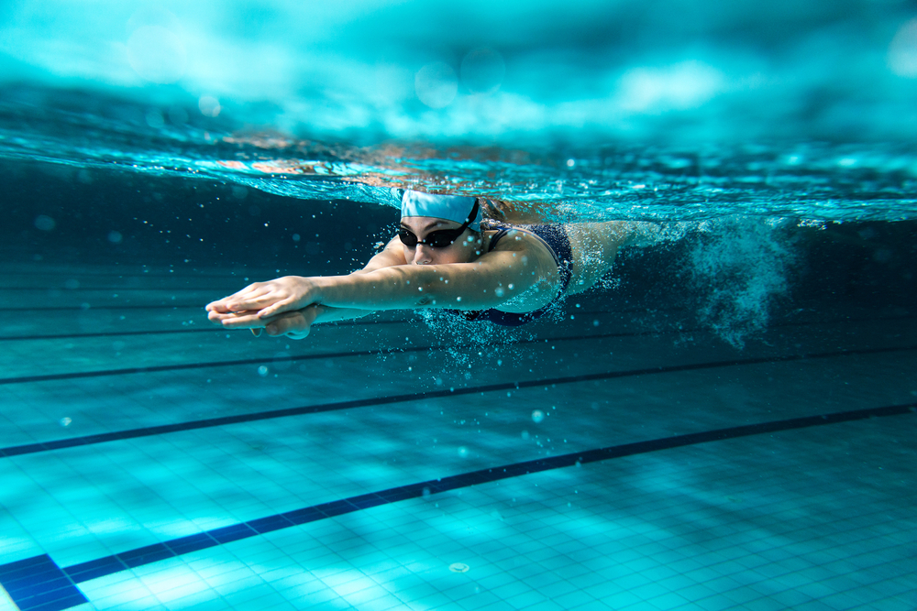
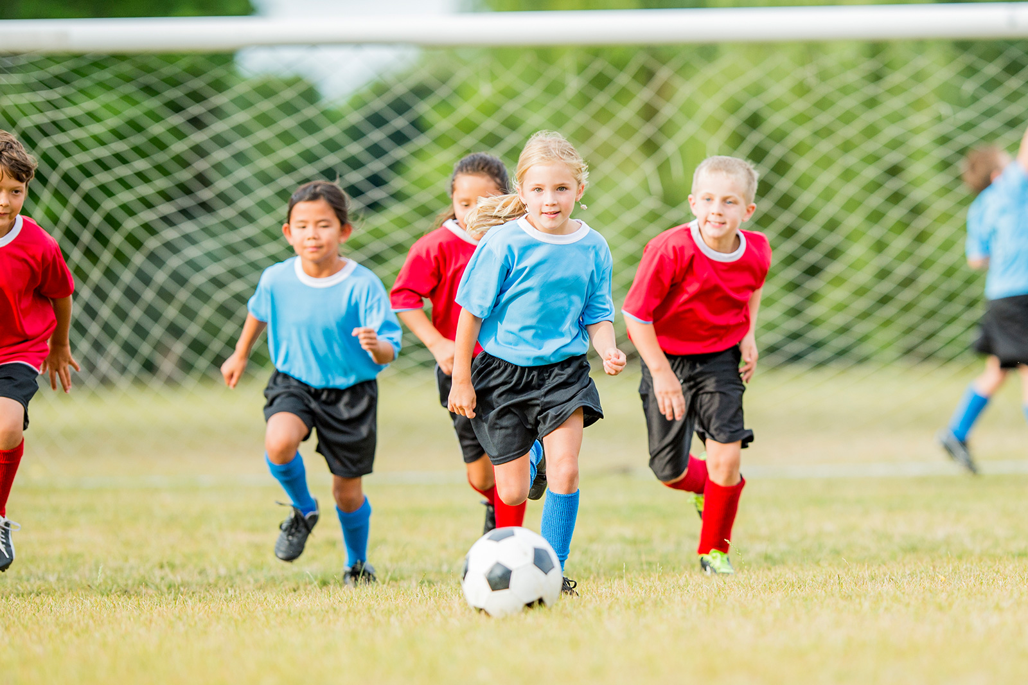
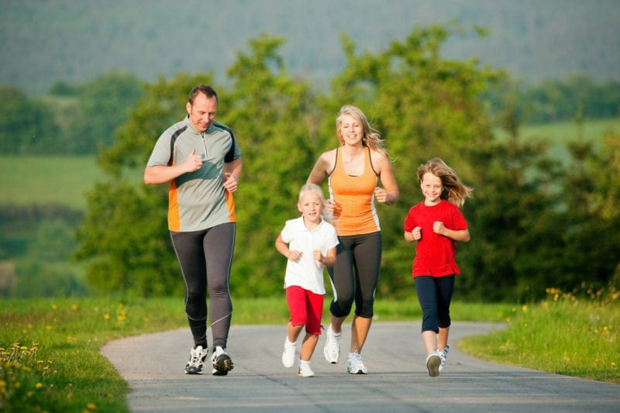
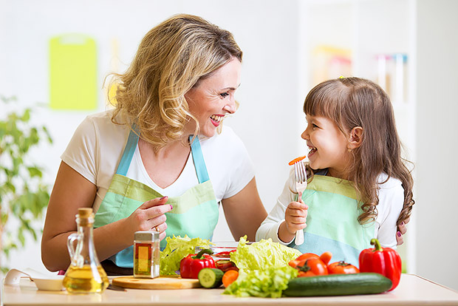
What is it?
1
2
3
4
5
jogging
swimming
eating fruits and vegetables
playing sports
doing exercise

Slide 4
Can you guess the topic?

Slide 5
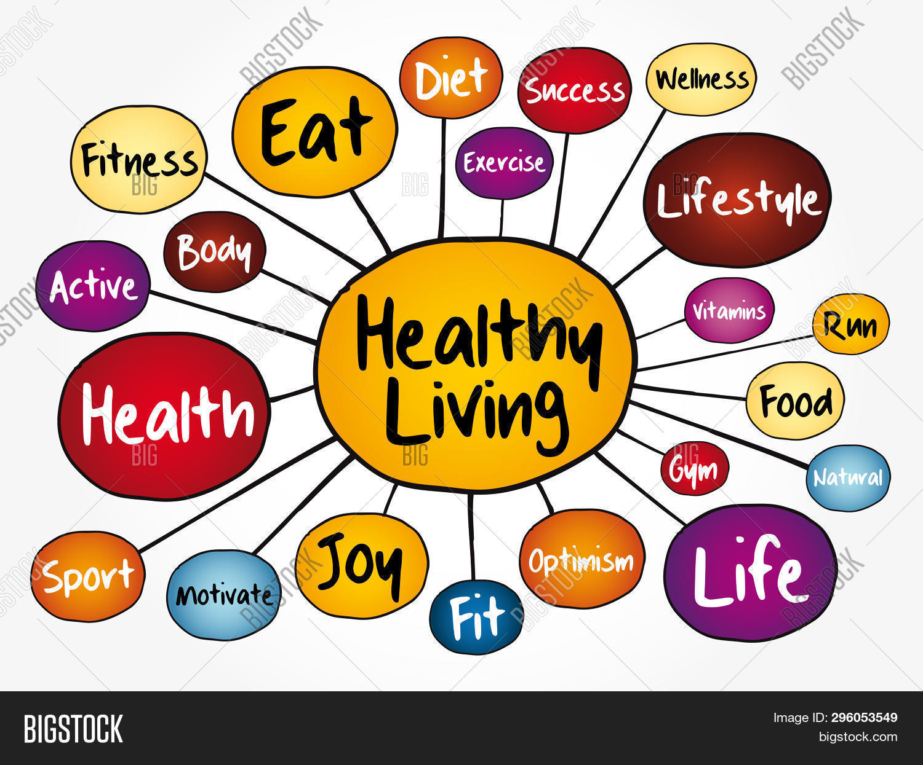
Unit 2:
Healthy living
Lesson 1: Getting started P₁₈₋₁₉
_{Teacher: Bùi Quang Thái}
TRƯỜNG THCS ĐỒNG MINH – VĨNH BẢO – HẢI PHÒNG
_{Tel: 0906009575}

Slide 6
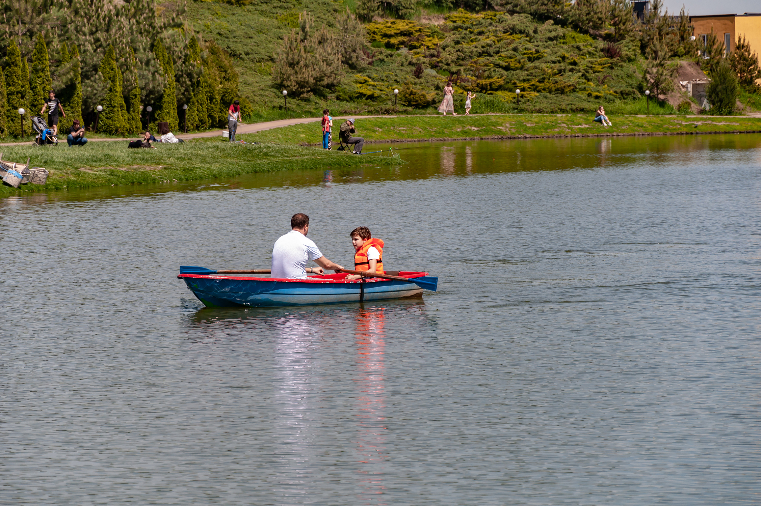

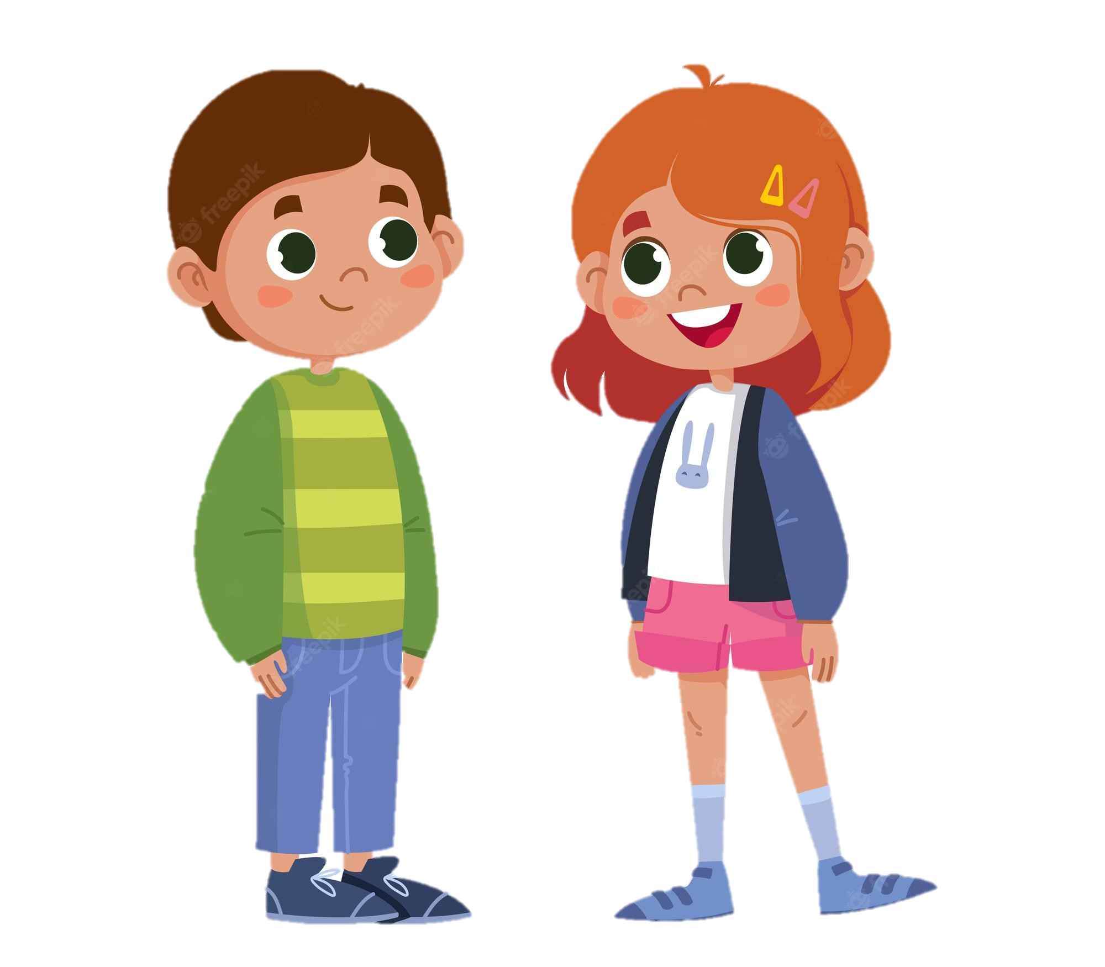
Look and answer.
1. Listen and check.
1. Who are in the picture ?
father
Mark
Mark and his father
2. What are they doing?
They are boating.

Slide 7
2. Read again and answer.
Mi: This is a nice picture, Mark.
Mark: That’s my dad and I boating at Yen So Park.
Mi: I also see a lot of people exercise there.
Mark: Yes, it’s a popular place for people in my neighbourhood.
Mi: Outdoor activities are good for our health. My family often goes cycling in the countryside. It’s quiet and there’s a lot of fresh air.
Mark: It sounds interesting.
Mi: Yes, it’s lots of fun. We also bring fruit, water, and a lunch box with us.
Mark: I’d love to join you next time.
Mi: Sure. Bring along a hat and suncream.
Mark: Why suncream?
Mi: It’s really hot and sunny at noon so you might get sunburn.
Mark: I see.
What are Mark and Mi talking about?
A. Health problems
B. Healthy activities
C. Sports and games

Slide 8

Read again and find the words
Mi: This is a nice picture, Mark.
Mark: That’s my dad and I boating at Yen So Park.
Mi: I also see a lot of people exercise there.
Mark: Yes, it’s a popular place for people in my neighbourhood.
Mi: Outdoor activities are good for our health. My family often goes cycling in the countryside. It’s quiet and there’s a lot of fresh air.
Mark: It sounds interesting.
Mi: Yes, it’s lots of fun. We also bring fruit, water, and a lunch box with us.
Mark: I’d love to join you next time.
Mi: Sure. Bring along a hat and suncream.
Mark: Why suncream?
Mi: It’s really hot and sunny at noon so you might get sunburn.
Mark: I see.
boating
suncream
lunch box
sunburn
cycling

Slide 9
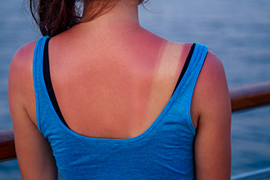
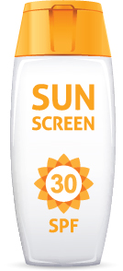
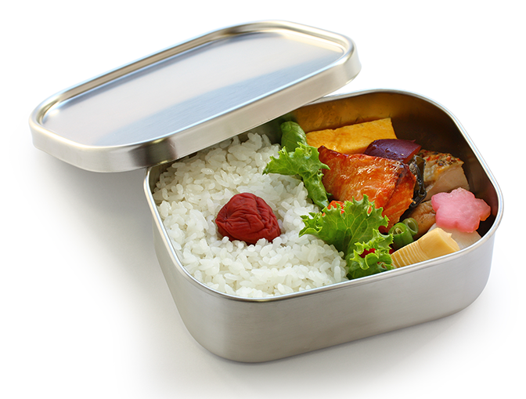
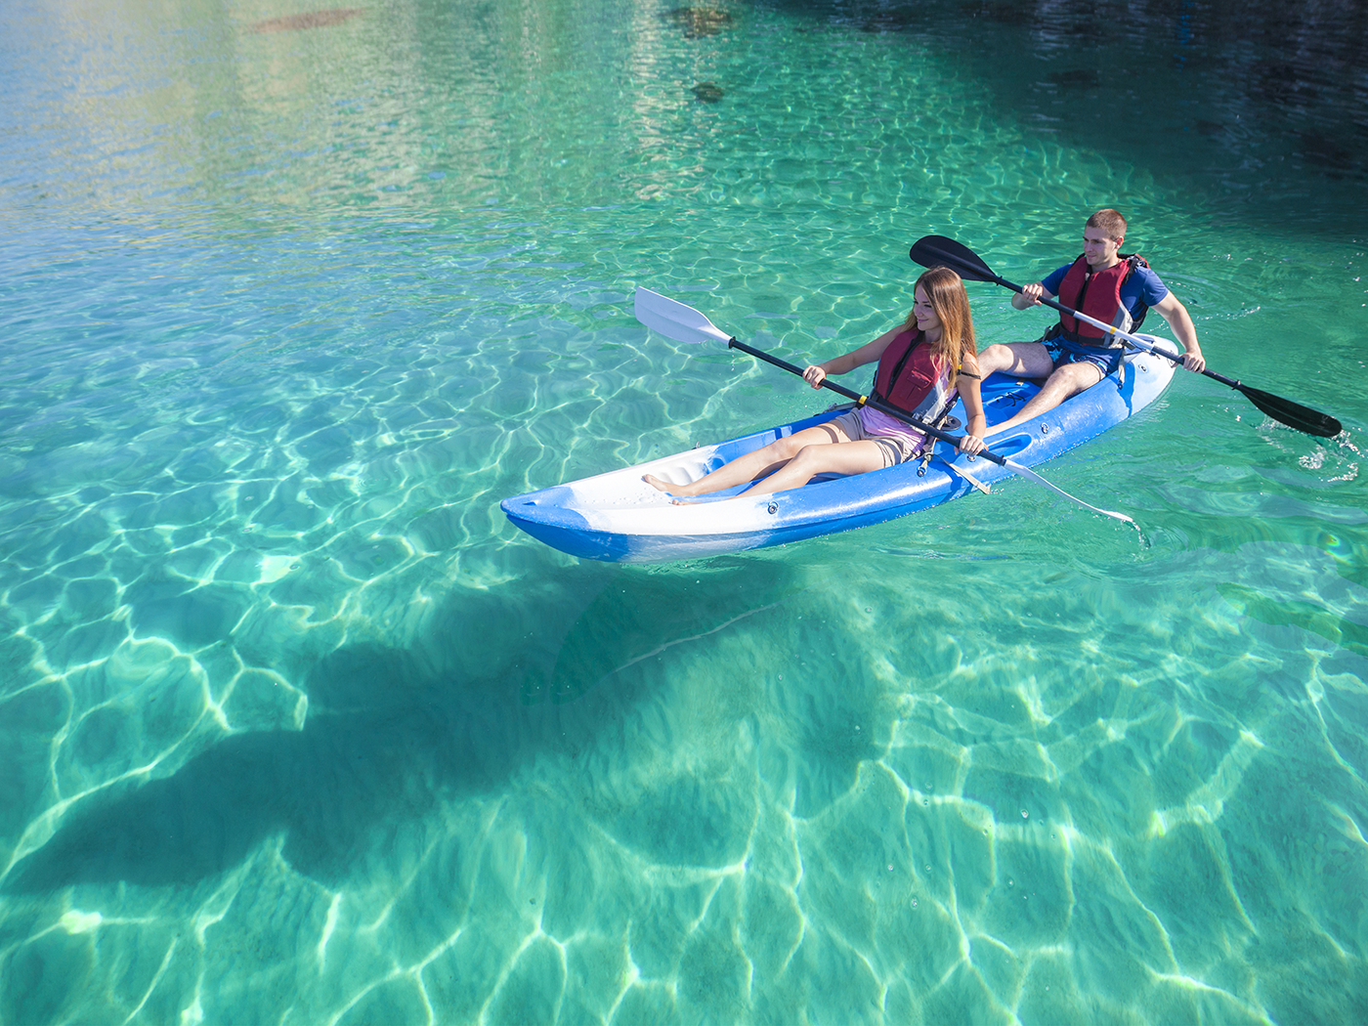
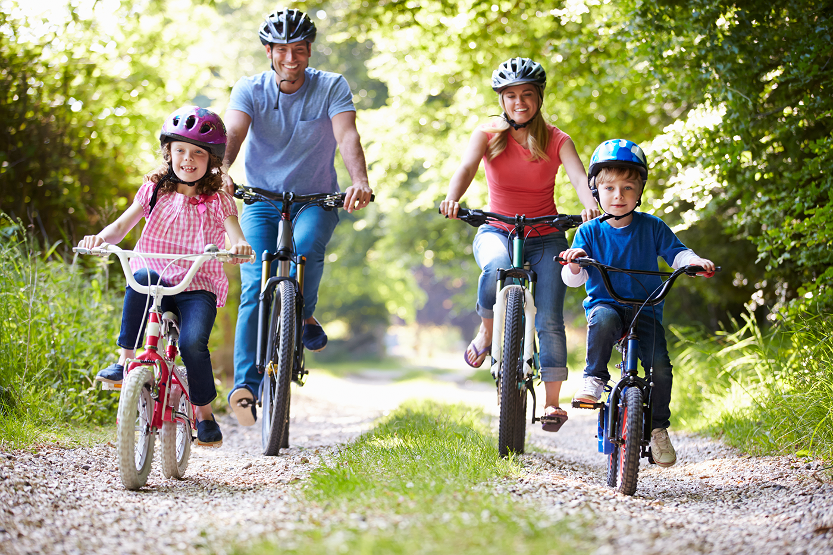
3. Write a word or phrase from the box under its picture.
boating
suncream
lunch box
sunburn
cycling

Slide 10

4. Complete each sentence with a word from the conversation.
1. In the picture, Mark and his father are…………………….
2. The people in Mark’s neighbourhood love to go to the ……………………...
3. Mi’s family often goes cycling in the……………………….
4. - I don’t want to get sunburn.
- Wear a hat and use ……………………
5. Fruit and water are good for our………………………..

Slide 11
4. Complete each sentence with a word from the conversation.
1. In the picture, Mark and his father are ……………
boating
Mi: This is a nice picture, Mark.
Mark: That’s my dad and I boating at Yen So Park.
2. The people in Mark’s neighbourhood love to go to the………..
park
Mark: That’s my dad and I boating at Yen So Park.
Mi: It also see a lot of people exercise there.
Mark: Yes, it’s a popular place for people in my neighbourhood.

Slide 12
4. Complete each sentence with a word from the conversation.
3. Mi’s family often goes cycling in the ………………….
countryside
Mi: Outdoor activities are good for our health. My family often goes cycling in the countryside. It’s quiet and there’s a lot of fresh air.
4. - I don’t want to get sunburn.
- Wear a hat and use………………
suncream
Mi: Sure. Bring along a hat and suncream.
Mark: Why suncream?
Mi: It’s really hot and sunny at noon so you might get sunburn.

Slide 13
4. Complete each sentence with a word from the conversation.
5. Activities like running and cycling are good for our…………
health
Mi: Outdoor activities are good for our health. My family often goes cycling in the countryside. It’s quiet and there’s a lot of fresh air.
Mark: It sounds interesting.
Mi: Yes, it’s lots of fun. We also bring fruit, water, and a lunch box with us.

Slide 14
Let’s present!

Slide 15
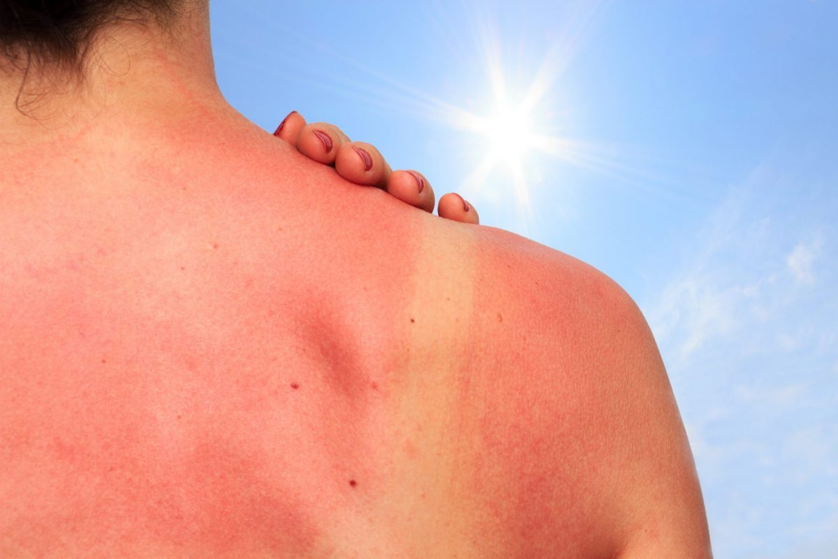
RECAP
1
What activities are good for your health?
A. cycling
B. boating
C. rarely eating breakfast
2
What health problem is it?
A. sunny
B. sunburn
C. suncream

Slide 16
Thanks
Do you have any questions?
Please keep this slide for attribution

